Slide 1
Impression of Mary
By Darren

Slide 2
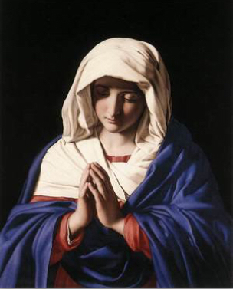
The Virgin in Prayer
The Virgin In Prayer , is an iconic painting, done by Artist Francesco de'Rossi, it was made between 1640 – 50. The painting consisted of Real Oil Paints, Real Brushes, Real Artists. And was a primate example of Real Art. Each oil painting was created by hand using only the finest canvas and oil paints available. And makes it’s an extremely realistic and nice to look at.

Slide 3
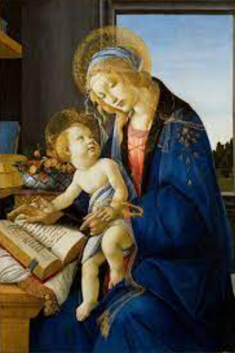
The Madonna of the book
The Madonna of the book, (or the Madonna del Libro was painted by Italian Renaissance artist Sandro Botticelli. It was a small painting which was painted between 1480 and 1481and is preserved in the Poldi Pezzoli Museum in Milan. The painting show shows a very elegant energy and shows Mary sharing a moment with her son Jesus

Slide 4
Comparison
In both these paintings Mary is shown wearing a blue garment and wearing a red shirt underneath. It symbolises the virgins purity and Symbolises the sky.
In the Madonna of the book painting, Mary is seen with a Halo on her head aswell as having Jesus in her arms.
Mary is depicted as a very calm and and peaceful person in both paintings. She is seen as a kindhearted women.
The art styles between both these paintings are very different. The virgin in prayer painting is done in oil paints, while the Madonna of the book is done in more generalised methods

Slide 5
Bible scripture
Matthew 1:18-25
Jesus is shown as very young in the painting so the birth of Jesus is the closest reference to such a painting. There aren’t many stores of Jesus as a young long so this is the closest reference

