Slide 1

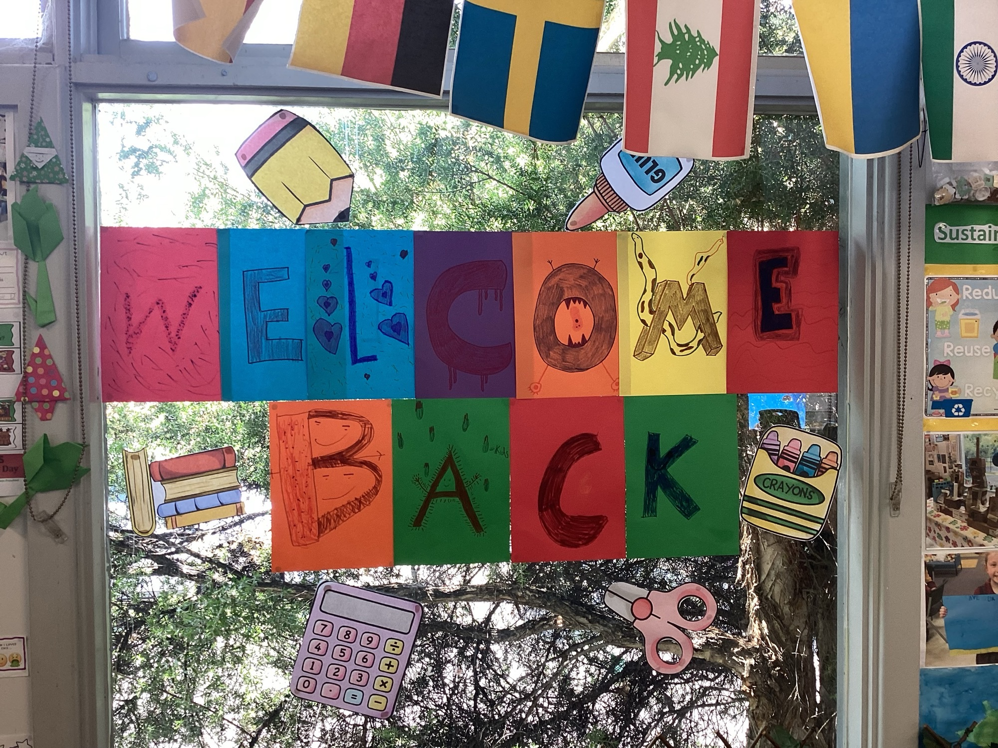
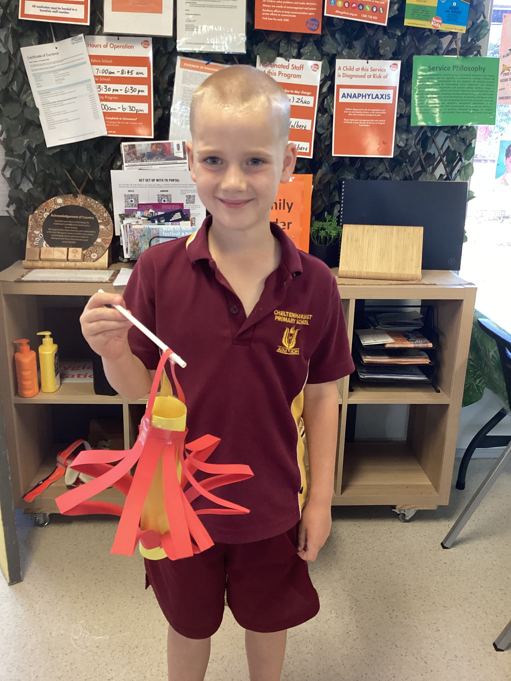
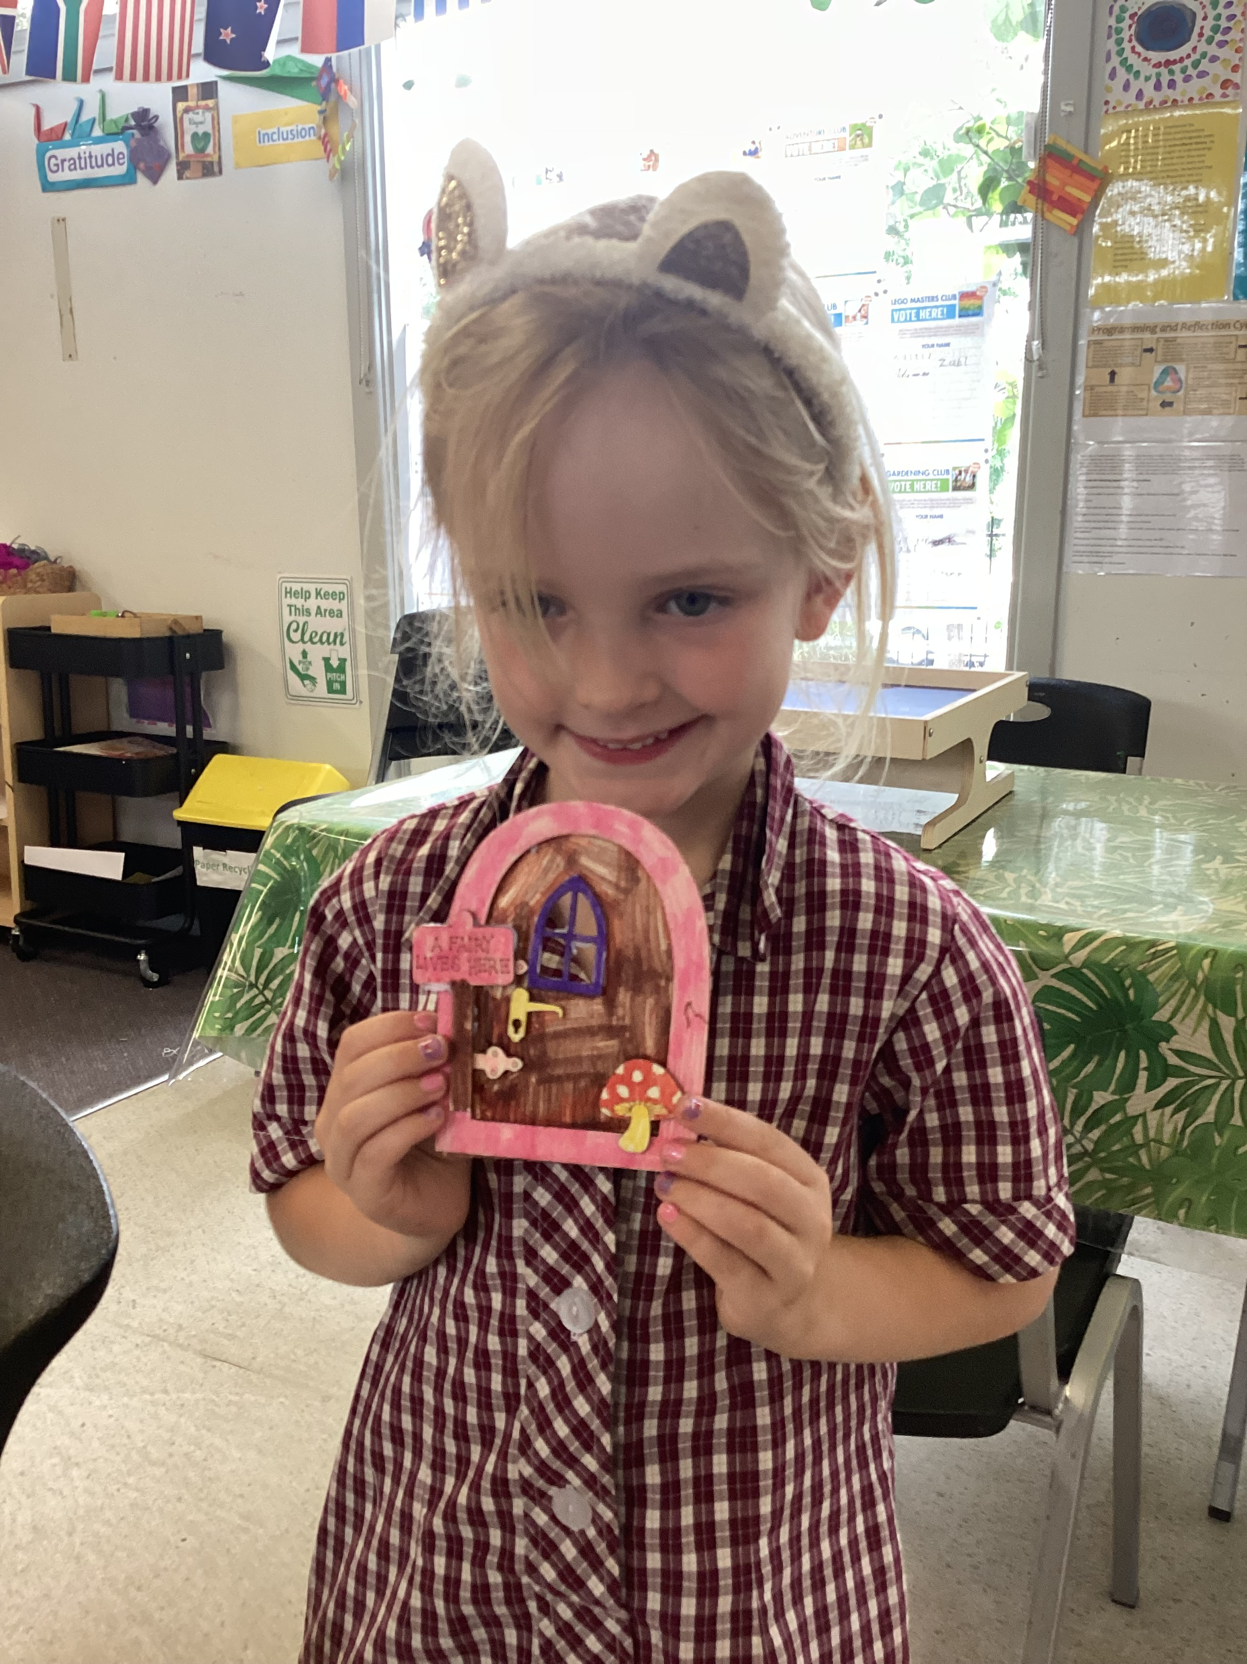

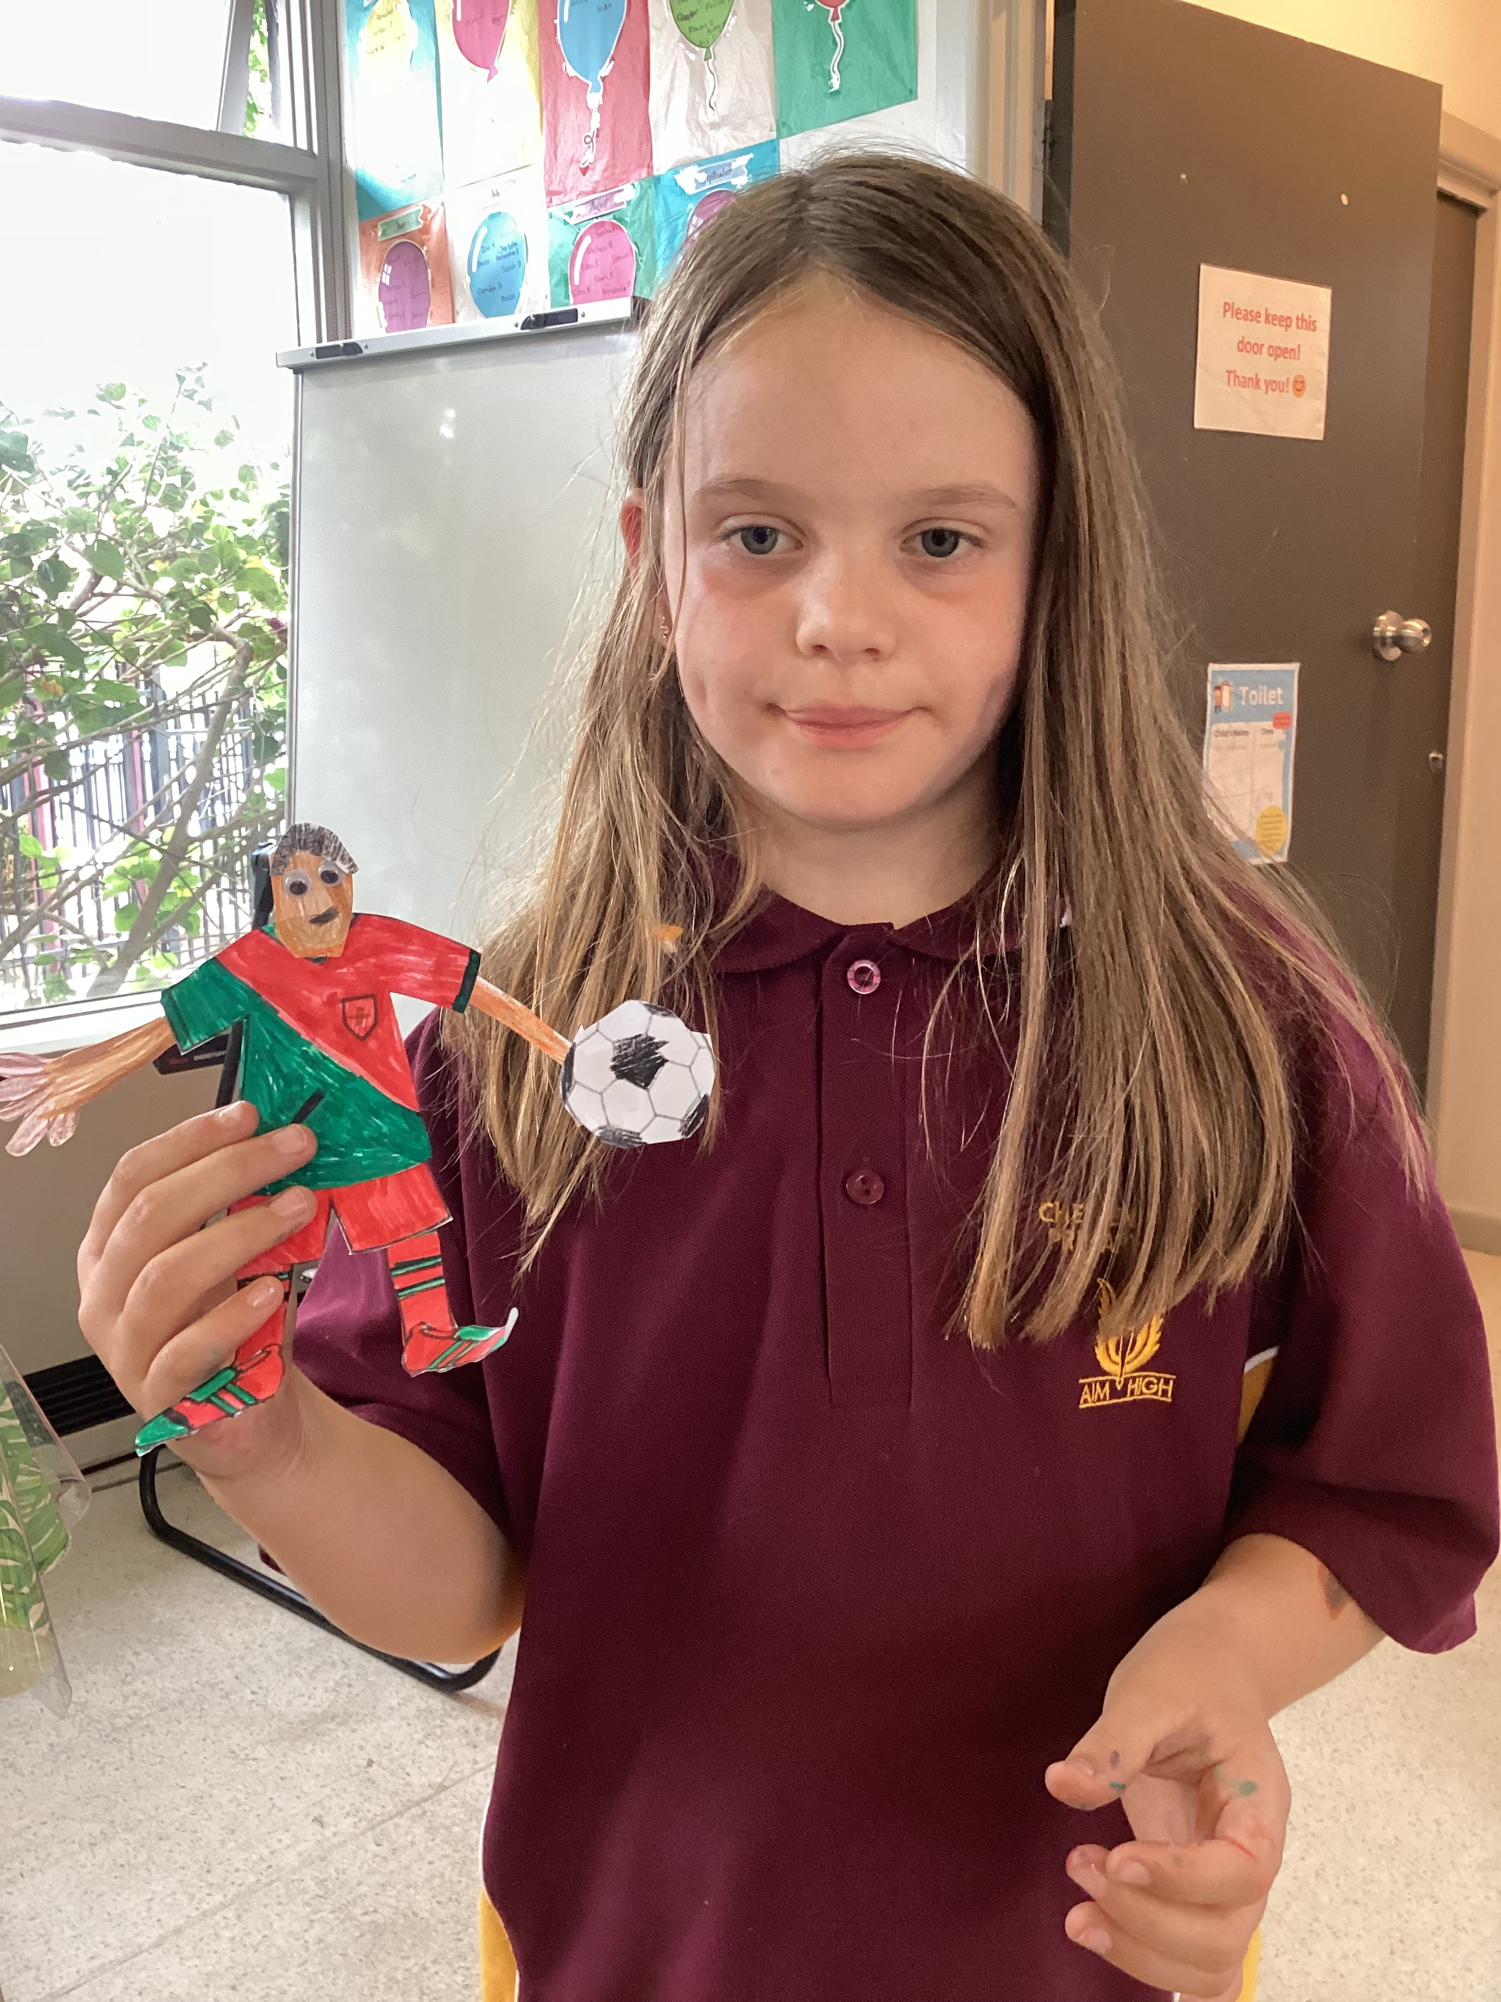

Cheltenham East Team Kids
Dear families,
Our new Preps had a fantastic time at Team Kids this week! They settled in beautifully and enjoyed making new friends. To help them feel even more welcome, our children created a special Welcome Back to School banner, which was a wonderful way to celebrate the start of their school journey.
Lunchtime Legends & Teddy Bears Picnic – Thursday
This Thursday, we have two exciting events planned:
•Lunchtime Legends (1:00 PM - 1:30 PM): Children will have an unforgettable indoor and outdoor play and learning experience, helping them relax and enjoy their break.
•Teddy Bears Picnic (After School Care): Preps are invited to bring their favorite teddies or fluffy animals for a fun-filled afternoon with delicious treats and great company.
Valentine’s Day Celebration – Friday
Love is in the air! This Friday, we will celebrate Valentine’s Day with a creative paper craft activity. The children will make special crafts for their loved ones.
We are looking forward to another exciting week at Team Kids!
Warm regards,
Eric
Director of Team Kid Before and After School Care
3
Art Attack Club
Lego Masters Club
Sustainability Club
Art Attack Club
Lego Masters Club
13rd February
Teddy Bear’s Picnic
14th February
Valentines Day
17th February
Random Acts of Kindness Day
0432 299 468
CheltenhamEastPS@teamkids.com.au
1300 035 000
info@teamkids.com.au

