Slide 3
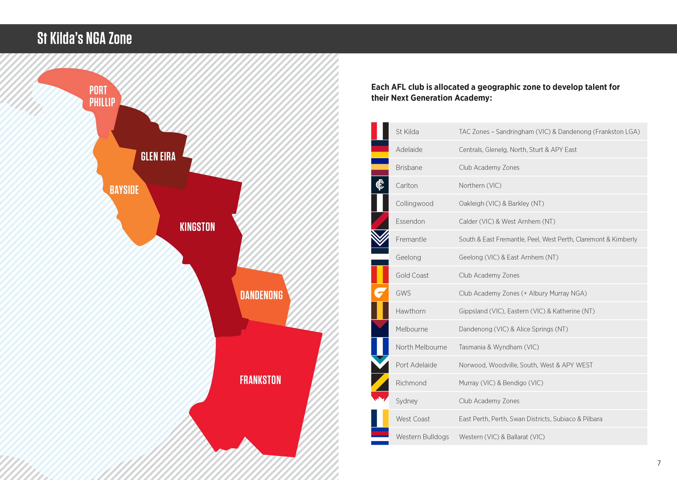

Slide 6
SAINTS NGA
DEVELOPMENT PLAN
13s
14s
15s
TRAINING TO TRAIN
Elite Habits
Reinforcing
TRAINING TO TRAIN
Executing
TRAINING TO TRAIN
Intro - Pathway
Reinforcing
Elite Habits HP
Executing
Elite Habits HP
Off Field
Intro - Modern Coaching
Reinforcing
Skill Technics
Executing
Skill Technics
Transition TAC/Local Leagues

Slide 7
SAINTS NGA
DEVELOPMENT FOCUS AREAS TRANSFORMED INTO
INCREMENT LEARNING CHART
13s e.g. Year 7s
14s e.g. Year 8s
15s e.g. Year 9s
Kicking
High/Low ball
Handball/First Give/Give one the up
Shape
Create Split
Contested Football
Defence
D1 CFD
Decision Making
Ball Movement
Line Craft Specifics
Defensive Fan
Transition Back to Forward
Entries Inside 50
Decision Making Under pressure
Forward Line Structure
Transition Back to Forward
Entries Inside 50
Decision Making Under extreme pressure
Introduction Dragons/Stingrays football

Slide 8
SAINTS NGA
DEVELOPMENT FOCUS AREAS
Fundamentals 70%
Fundamentals Skills craft
Line Craft
Ball Movement
Game Sense
Fundamental Skill drills
Line drills
Systems & Structures
(scenarios)
Game style Fundamentals 30%

Slide 9
PROGRAM:
7 x sessions (Term 3) -All sessions are tailored to the age and abilities but primarily focused around fundamental skill development. -All drills and activities are designed and filtered down from the Saints Next Generation Academy official curriculum. 1 x session at RSEA Park (Train, Tour, Theory Session) -Students will have access to tour the inner sanctum at STKFC, players gym, changerooms, theatre & saints admin. -Students will also have access to train on the ground.
Off Field Sessions: -Saints will provide industry experts to deliver session throughout the program such as High Performance & Nutrition.
1 x player appearance (subject to availability) -Depending on the players schedule we schedule a player to come visit the students at training.
1 x Matchday experience: -All students and teachers will receive free tickets to a Saints home game where they will the opportunity to observe a Saints player for the match and review their match progress for development purposes.
3 x Complimentary tickets to any Saints home game.
1 x Matchplay @ RSEA Park (AFL 9s tournament) against other schools. (subject to availability) -At the completion of the program your school will be invited to participate the annual NGA Secondary Schools AFL 9s tournament where schools can put into the practice the skills they have learnt over the duration of the program.
Note- Current Saints NGA Academy schools are passing on a cost for participation in the program to students

Slide 10
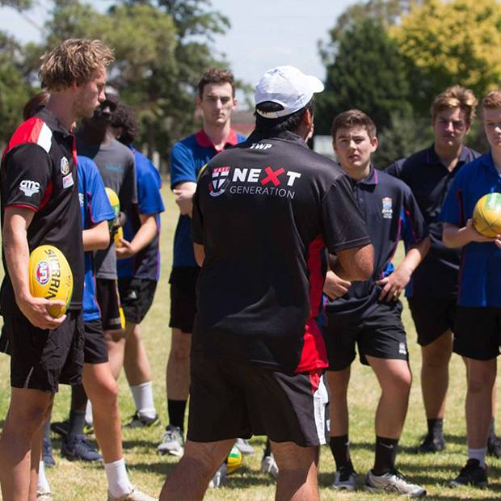
FACILITATION:
Delivery:
-1 x Head Coach to manage program (depending on student numbers)
-1 x Development Coach to assist. -NGA Equipment including footy’s

