Slide 1

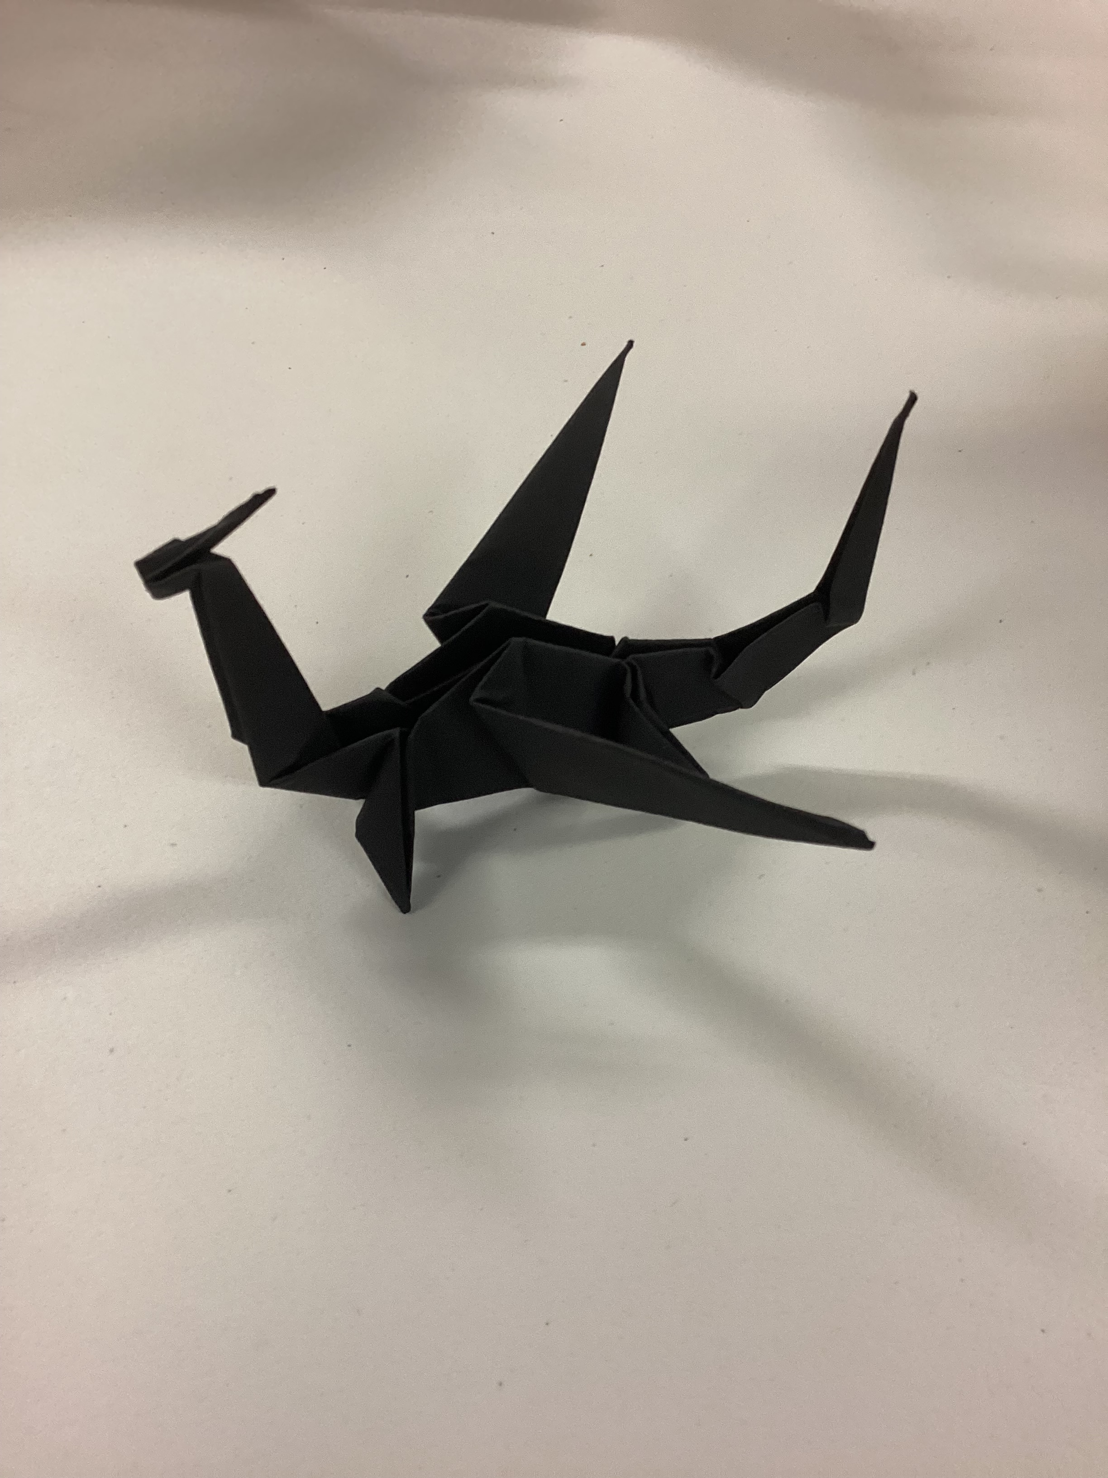
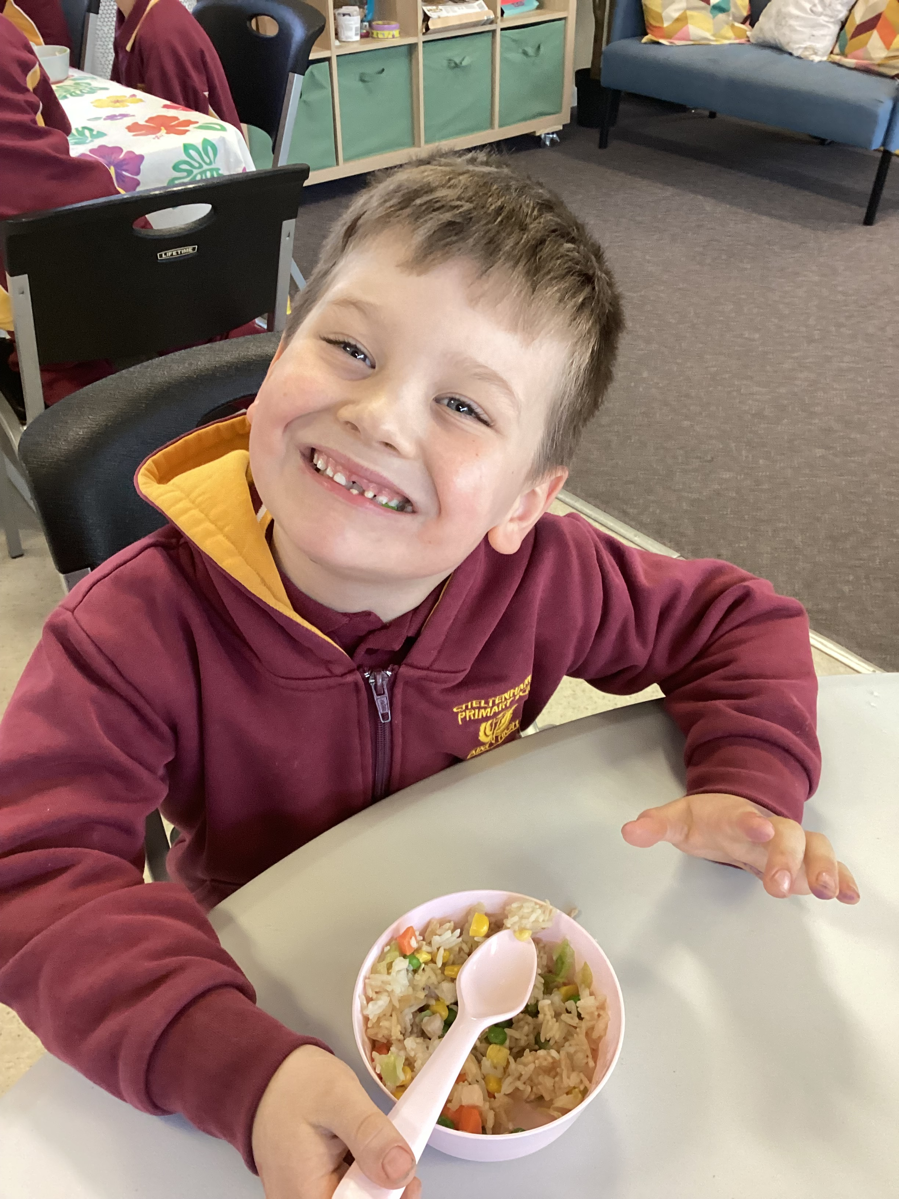
Cheltenham East Team Kids
Dear Parents and Guardians,
We are thrilled to share the excitement and joy that our Origami Club has brought to the children at our Before and After School Care program. The Origami Club has been warmly welcomed by the children, and they have thoroughly enjoyed their time exploring the art of paper folding. From creating magnificent origami dragons, graceful cranes, adorable foxes, to fun chatterboxes, the children's creativity knows no bounds! Our Origami Club is a place where imaginations take flight and new skills are crafted with each fold.
Our culinary journey has taken a delightful turn with our new and popular menu items. The children have been loving about our mouthwatering Tacos, delectable Fried Rice, and the fun and interactive DIY Wraps. We believe that a well-nourished child is a happy child, and our talented educators have put their heart and soul into preparing nutritious and scrumptious meals that our children absolutely love.
On OSHC Educator Day, the children expressed their gratitude to our dedicated educators by sending heartwarming Thank You cards. We were touched by their kindness and thoughtfulness, and it reaffirmed our passion for creating a nurturing and caring environment for our students. We take great pride in being a part of their growth and development journey, and their appreciation means the world to us.
As always, please feel free to reach out to us if you have any questions, suggestions, or concerns. Together, we can continue to make the Before and After School Care program an exceptional place for our children to learn, grow, and thrive.. Thank you! ☺
Warmest regards,
Eric
4
Cooking Club
Origami Club
Game Club
Cooking Club
Origami Club
Thu 3rd August
World Watermelon Day
Fri 4th August
Principal Appreciation Day
Wed 09th August
Keep Australia Beautiful Week
0432 299 468
CheltenhamEastPS@teamholiday.com.au
1300 035 000
info@teamkids.com.au

