Slide 1
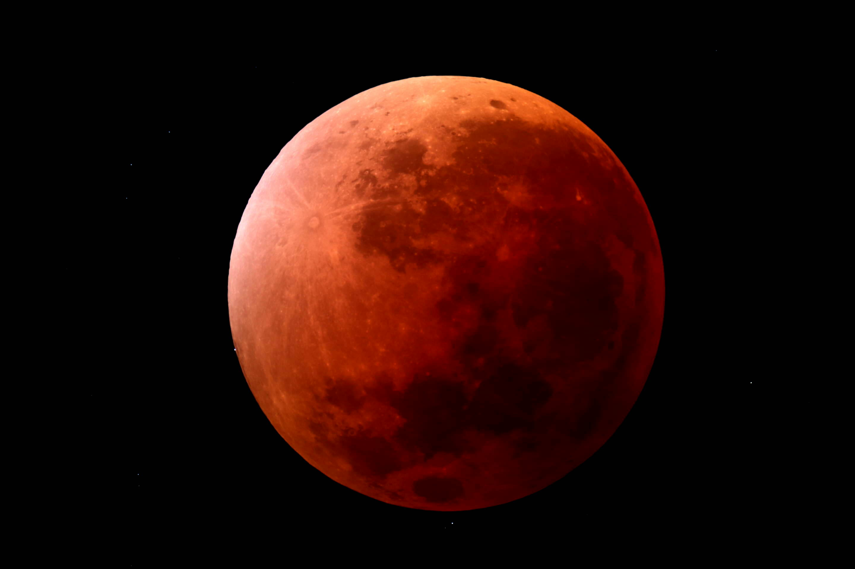
Our last Total Lunar Eclipse on 8th September 2025
All eclipse images from 8th Sep 2025 eclipse. Peter Anderson

Slide 2
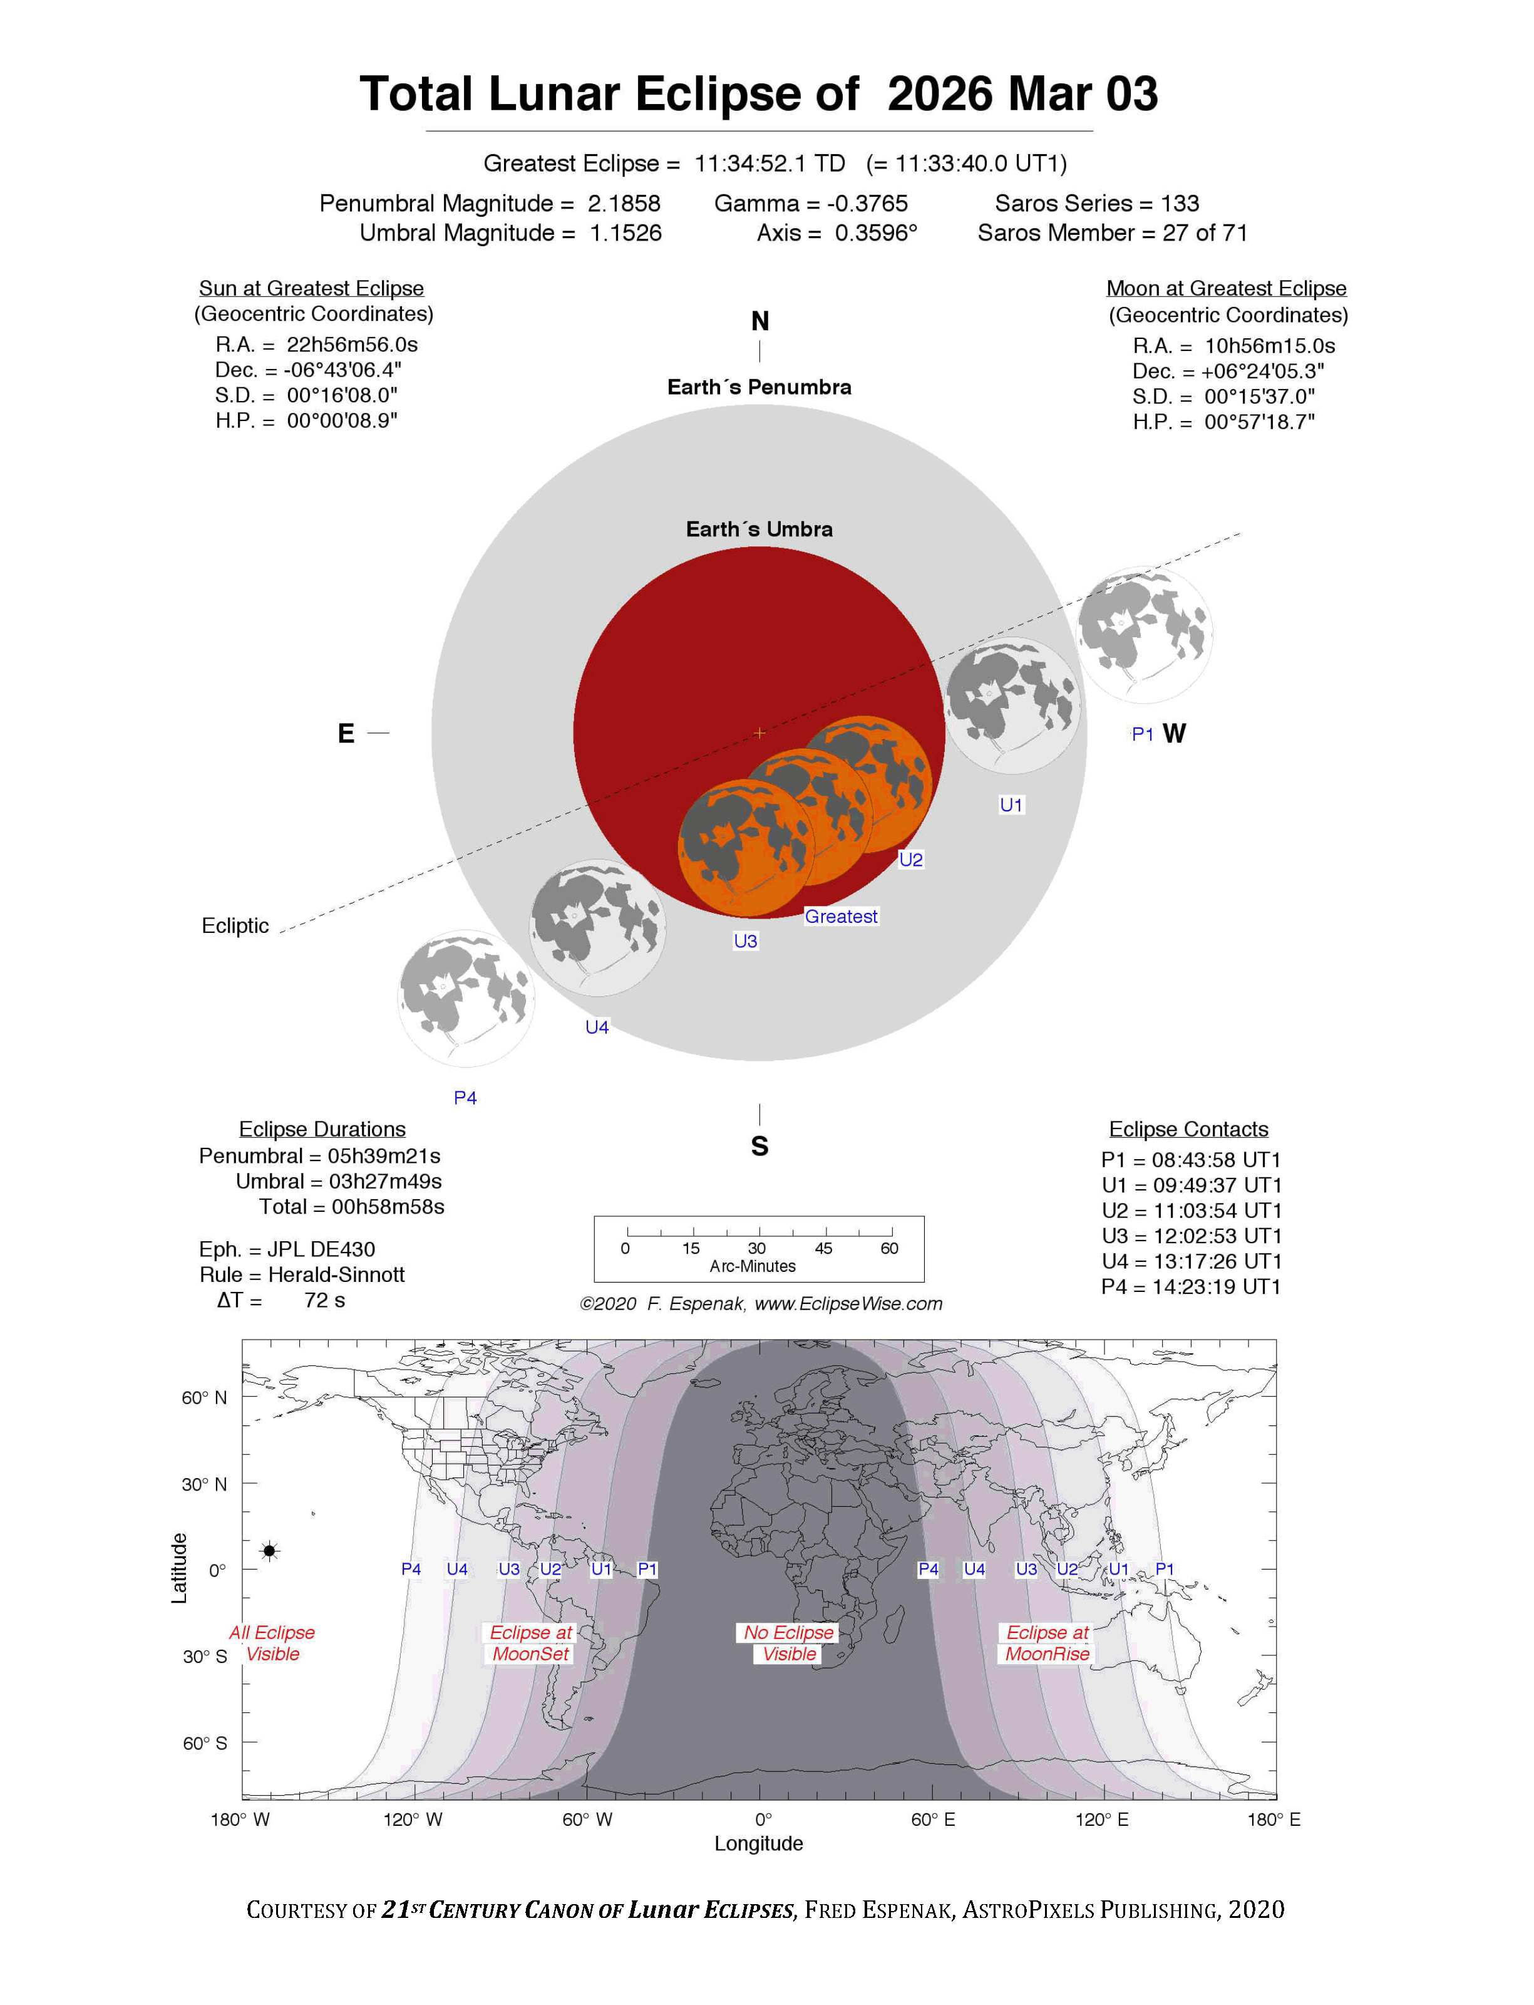
The Next Total Lunar Eclipse
3rd March 2026
Moon Enters total shadow 7.50pm
Eclipse becomes total 9.04pm
Total Eclipse ends 10.03pm
Moon leaves total shadow 11.17pm
Eastern Australian (Qld) Time not DST

Slide 3
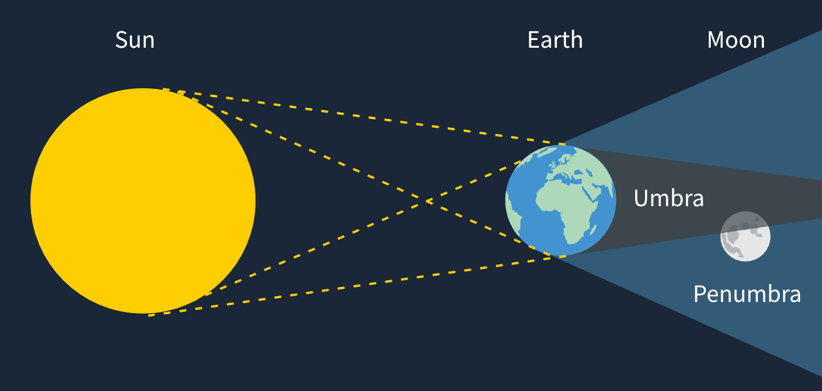
In the early partial (penumbral) stage, the eastern side of the Moon will be increasingly shaded. However after 7.50pm when the Moon begins entering the total shadow the direct shadow of the earth will be visible as the Moon moves into it.
The Earth is nearly four times the diameter of the Moon and this shadow is reduced to three times the diameter at the lunar distance. Its curving nature will be very plain.

Slide 4
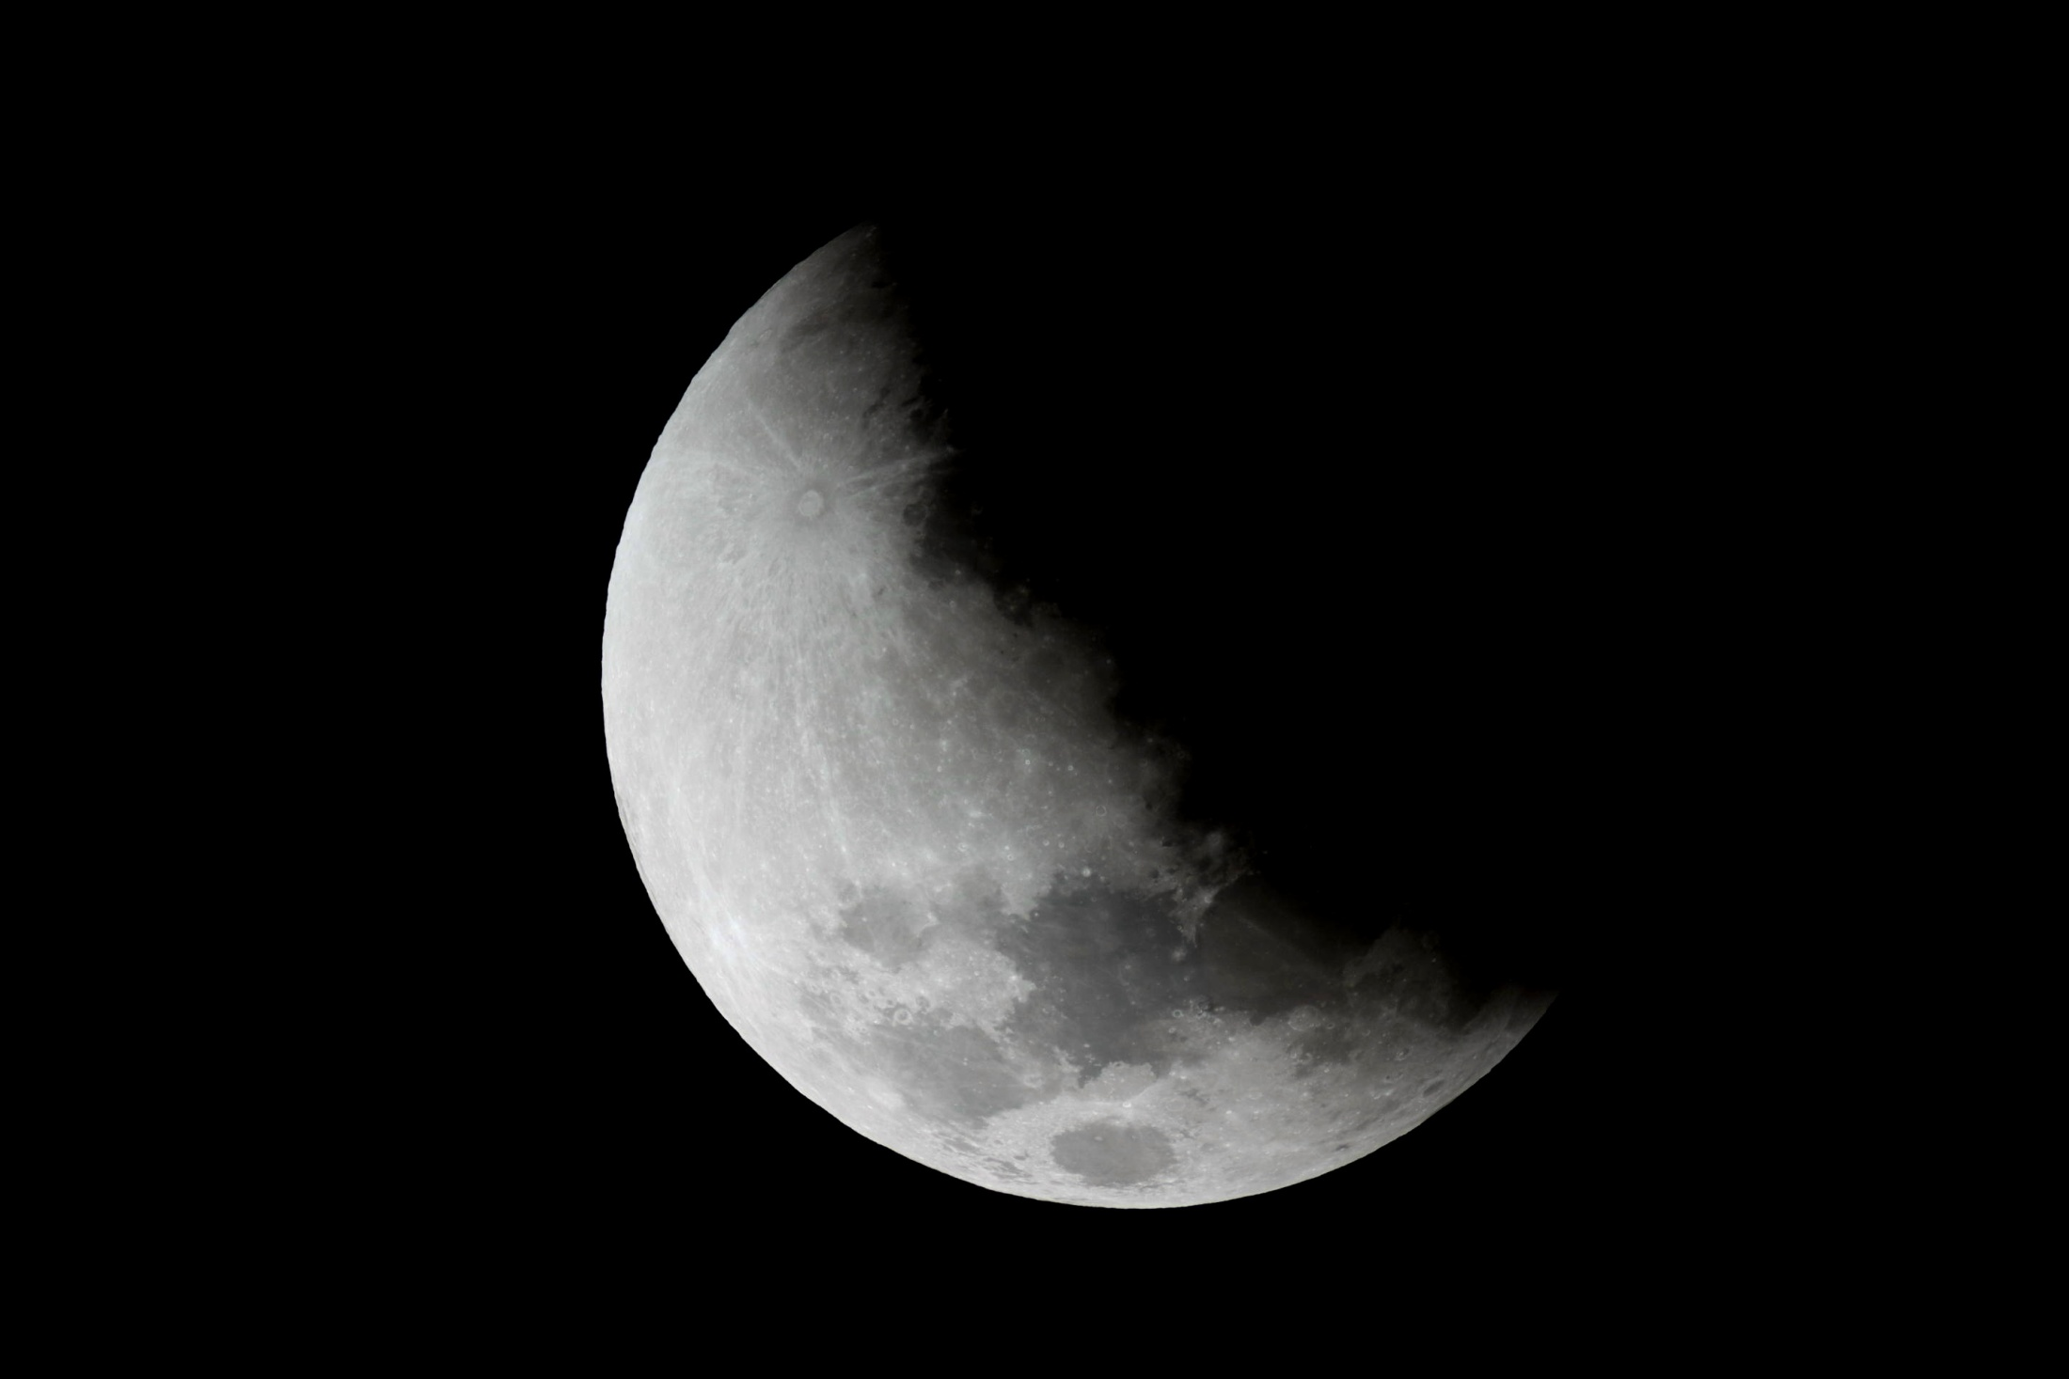

Slide 5
When the Moon is fully within the shadow, namely fully eclipsed, it will still be faintly illuminated by the light being bent or refracted through the sunrise/sunset regions of Earth’s atmosphere. It is like a double sunset effect – golden to coppery colour and fainter towards the centre of the shadow:

Slide 6
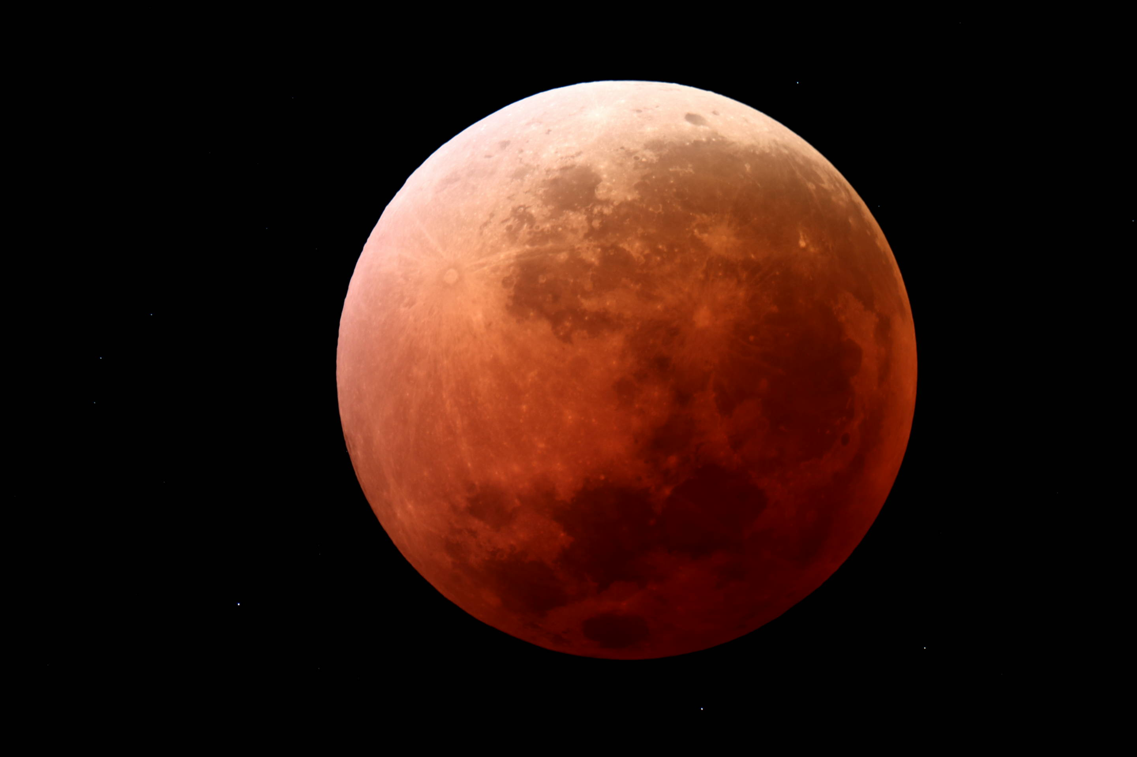
Then the reverse occurs as the moon leaves the shadow:

Slide 7
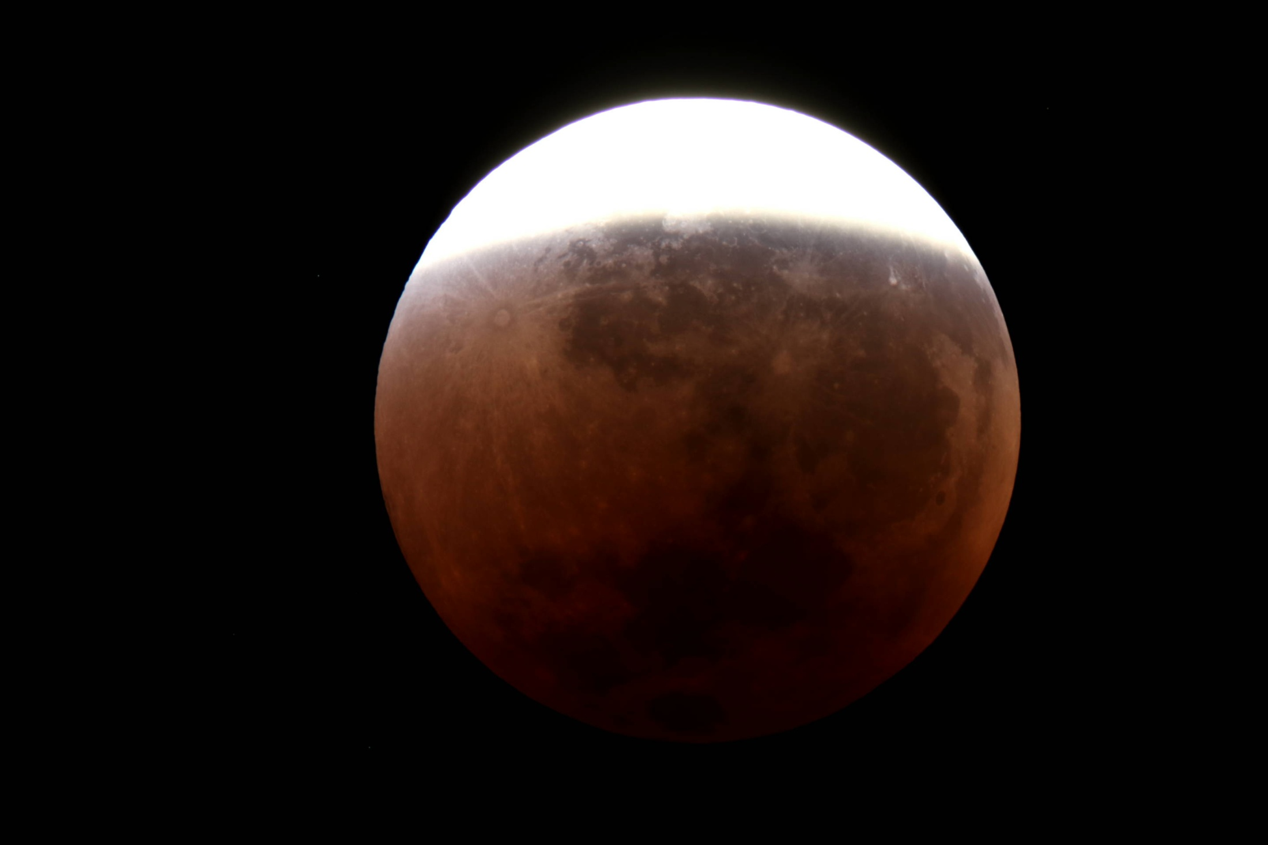

Slide 8

Parallax Demonstrated
Holding your extended finger stationary and then blinking from one eye to the other will cause the background to appear to shift. This parallax effect enables us to judge the distance when we reach out to grasp an object.

Slide 9
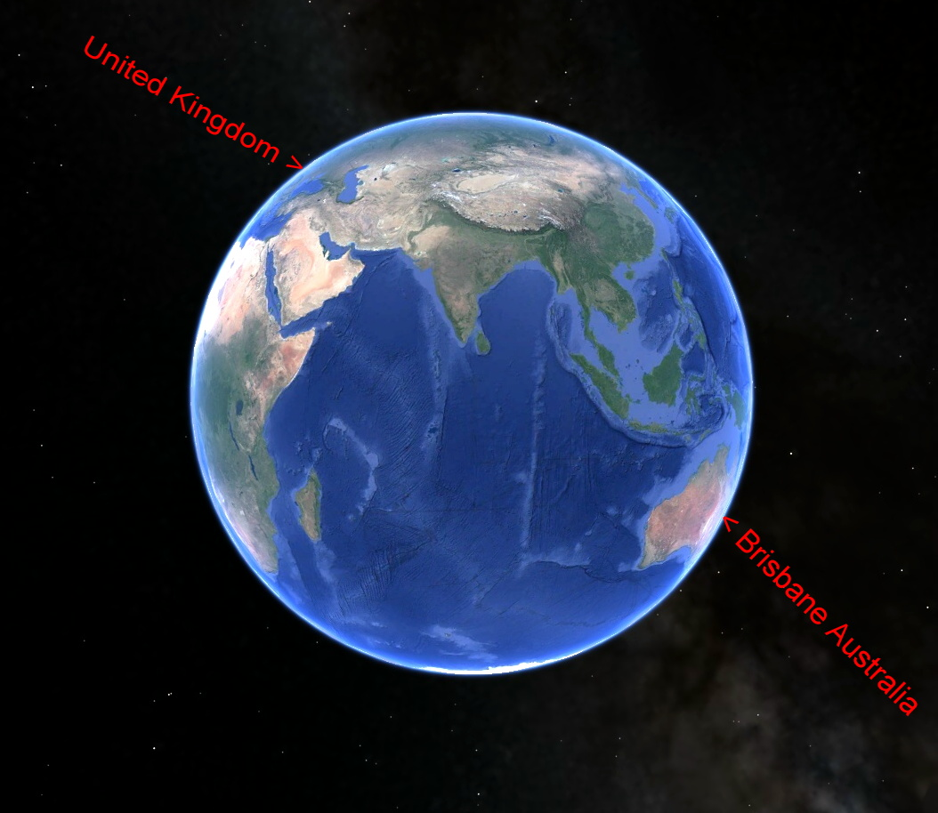
Parallax is demonstrated on the features of the Moon viewed from a slightly different angle by observers in England and Australia when imaged at exactly the same time during the last eclipse. The Moon had just risen in England and was setting here in Brisbane.
Please toggle back and forth between slides 10 and 11, and 12 and 13 to appreciate the change in viewpoint. (Two sets of images taken ten minutes apart.)
Google Earth image

Slide 10
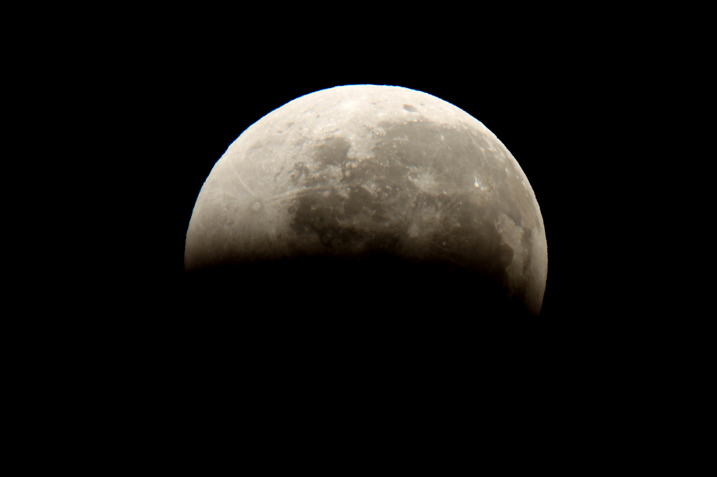

Slide 11
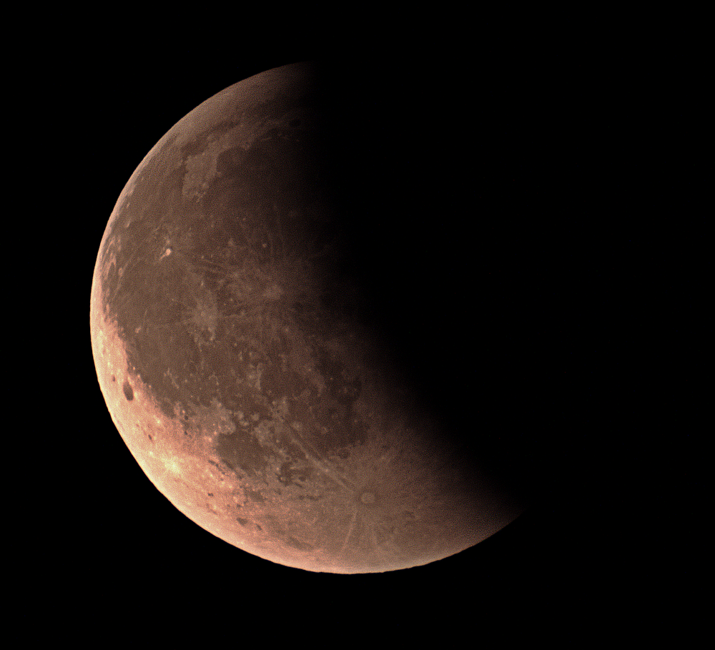

Slide 12
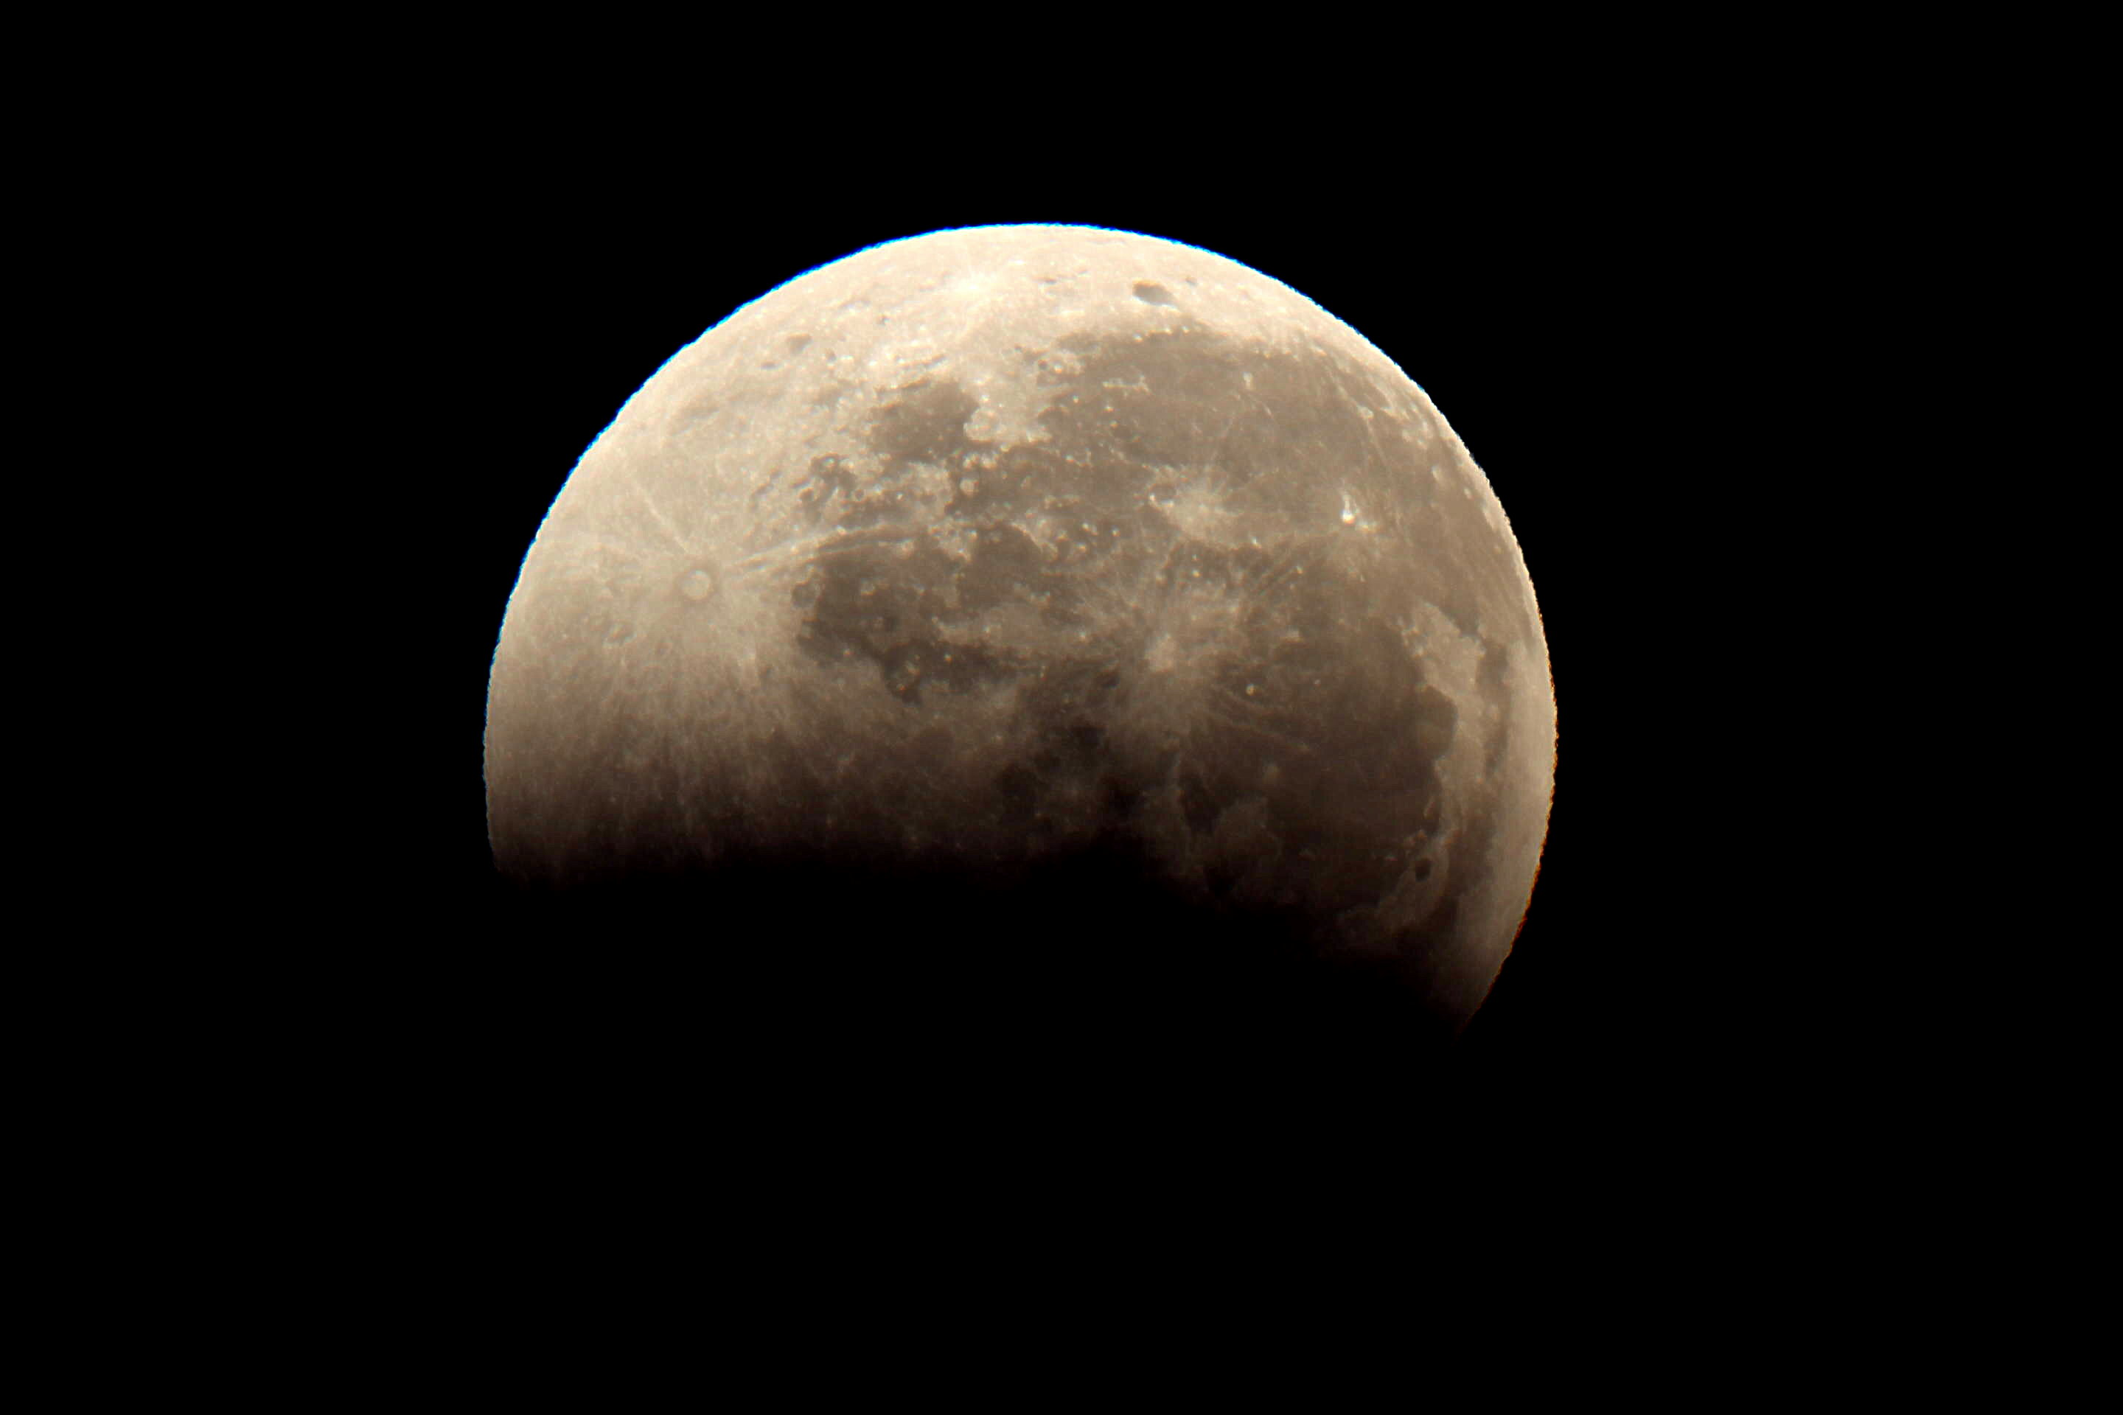

Slide 13
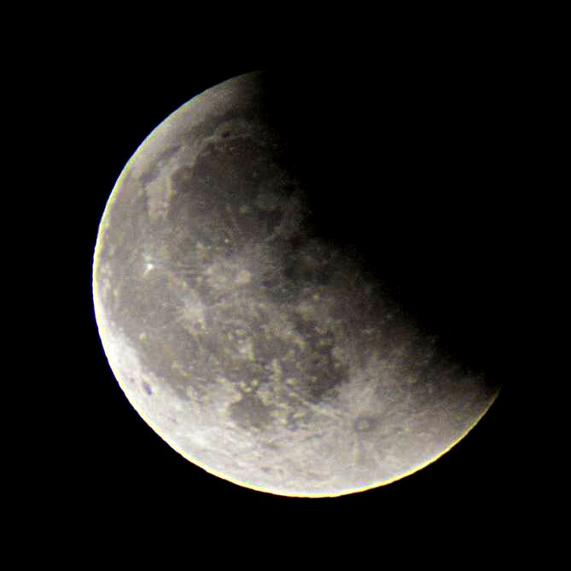

Slide 14
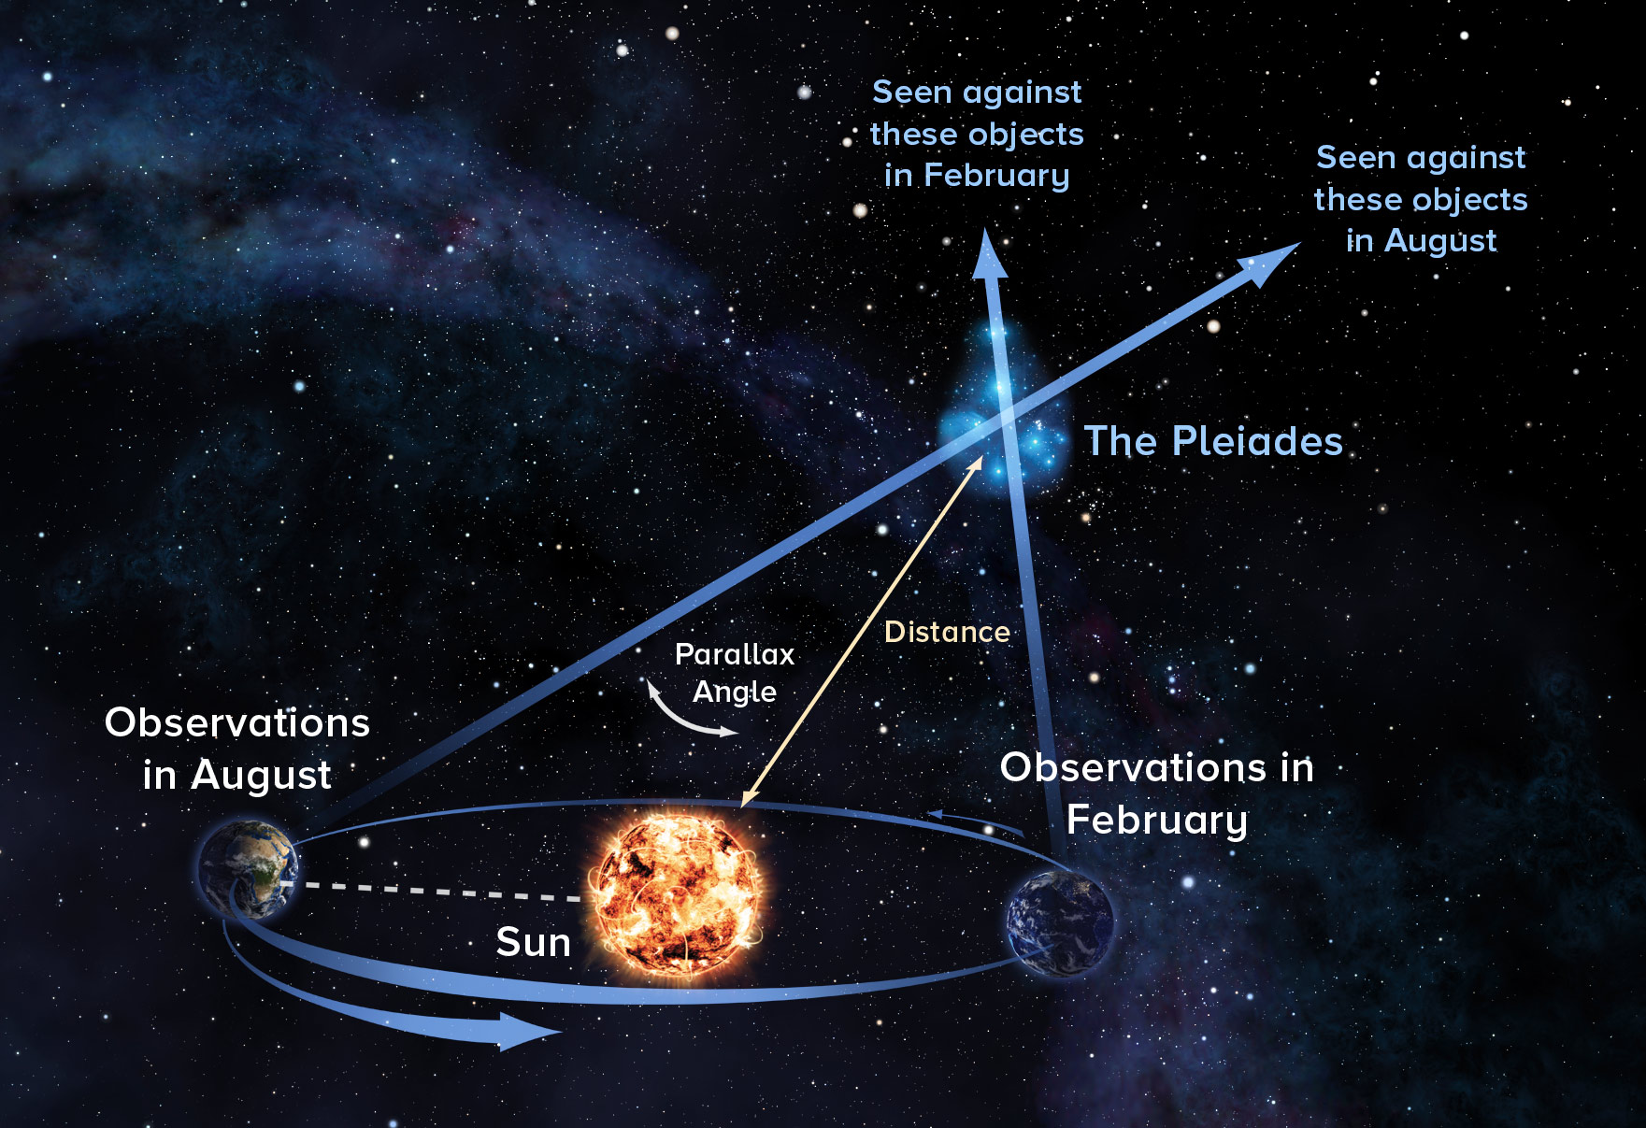
Parallax effects can have many practical uses. In astronomy, the width of the orbit of the Earth as it travels around the Sun is used in determining the distances of the nearer stars. (The below diagram is grossly exaggerated for demonstration purposes.)
END

