Slide 1
MELTON SECONDARY COLLEGE
Year 10 2021
Work Experience
Information Night
Welcome
2021 Work Experience Dates
3 – 7 May

Slide 2
MELTON SECONDARY COLLEGE
Year 10 2021
Work Experience
Information Night
Acknowledgement of Country
We begin tonight’s presentation by acknowledging the Traditional Owners of the land on which we meet today, and pay our respects to Elders past, present and emerging.

Slide 3
MELTON SECONDARY COLLEGE
Year 10 2021 Information Night
Summary
Welcome
Ms Danielle James (Head of Year 10)
Mrs Joanne Galea (VET/Careers Coordinator)
Ms Maria Hassan (Careers Coordinator)
Ms Kim Younger (Careers Team Support)
Ms Karamjeet Kaur (Careers Team Support)
Mr Robert Aduer (Community Liaison Officer)
Notes:
Good evening ladies and gentlemen
Thanks for coming along to the Information Evening for students going into Year 11 in 2011
My name is Daniel Crosbie and I’m the Sub-school Leader for Years 9 & 10
This evening will run for about an hour, and in this time our speakers will talk about:
*the school, its focus and the importance of academic achievement
*the VCE and the VCAL, their structure and their suitability for your student
*the learning experiences of current VCAL students
*the course counselling process and the next steps to take in preparing your student for 2011
After our speakers, you are invited to ask questions to our speakers.
Additionally a number of staff have made themselves available for your questions, should you prefer to ask them personally.
Firstly, our Principal – Mr Eric Sealey...

Slide 4
What is Work Experience?
MELTON SECONDARY COLLEGE
It is a program available to Year 10 students
It provides students with the opportunity to experience and explore the world of work
Classes will continue as normal for students who are unable to secure work experience
Should not be undertaken where student currently undertakes casual employment

Slide 5
Why is Work Experience important?
MELTON SECONDARY COLLEGE
allows students to explore a career area of interest
assists students with senior subject selection in Term 3
assists students to successfully gain part time employment or an apprenticeship
assists with applications into TAFE and University courses
assists with scholarship applications

Slide 6
Employer Responsibilities
MELTON SECONDARY COLLEGE
Employers have a Duty of Care to work experience students
Ensure they adhere to OH&S requirements in the work place
Provide supervision and support to the students
Complete an Evaluation Report to give feedback to the student, parents and Melton SC

Slide 7
MELTON SECONDARY COLLEGE
DET Guidelines
All students are to be 15 years and over
Work experience arrangement forms must be signed by Student, Parent, Employer and Principal before work experience can commence
All students must complete safe @ work online OHS modules/tests (General and Industry Specific) prior to work experience during STUCARR classes.

Slide 8
MELTON SECONDARY COLLEGE
Student Responsibilities
Complete all forms and OHS requirements prior to work experience
Follow all protocols for COVID 19
Be Punctual/Dress in an appropriate manner
Phone Melton SC and Employer if unable to attend due to illness
Phone Melton SC immediately if there are any concerns
Disclose any relevant medical information to Employer

Slide 9
MELTON SECONDARY COLLEGE
Student Responsibilities
Maintain a Portfolio which includes:
Resume
Safe@Work certificates
Evaluation form from Work Experience employer
STARR Award Certificates
References
Reminders: Subject Selection Interviews (Course Counselling) - Early Term 3

Slide 10
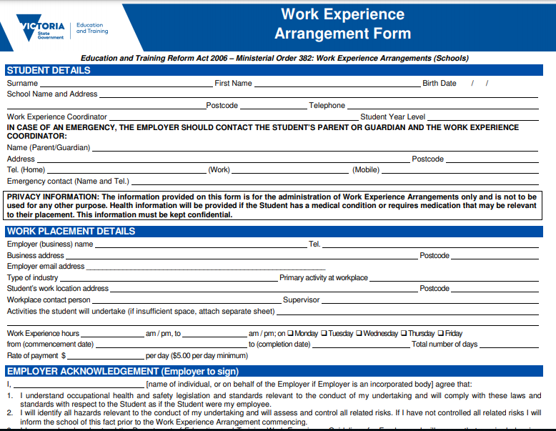
MELTON SECONDARY COLLEGE

Slide 11
MELTON SECONDARY COLLEGE
Examples of previous Work Experience opportunities:
RACV Club Melbourne
The Langham Hotel
Victoria Police Mounted Branch
Melton City Council
Melton Veterinary Clinic
Bundy’s Engineering - Melton
Bowens Hardware – Taylor’s Lakes
Djerriwarrh Health Services
Alan Mance Holden (Melton & Footscray)
Member of Parliament - Melton

Slide 12
MELTON SECONDARY COLLEGE
Year 10 2021
Work Experience
Information Night
Questions?
All work experience arrangements need to be finalised
by 31 March, 2021.

Slide 13
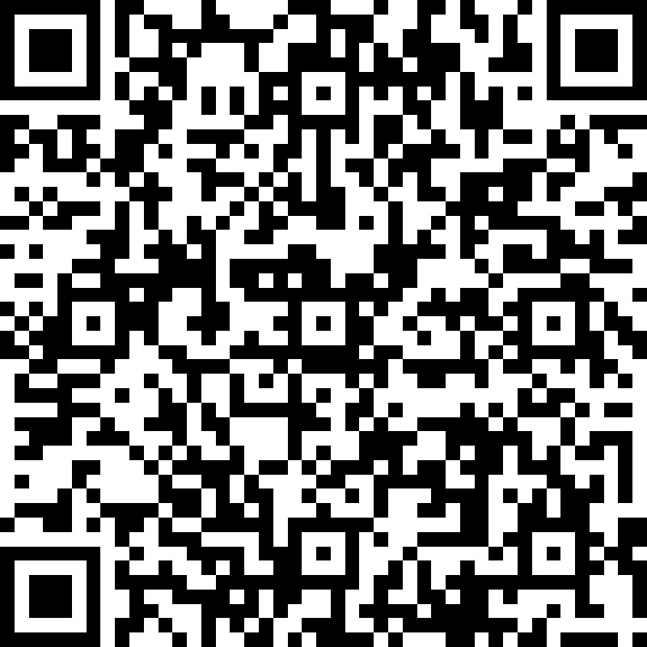
Survey link - bit.ly/2OlFGft
While we’ve got you – Complete our short survey to provide parent/carer feedback on your experience at MSC
Survey QR code -

Slide 14
MELTON SECONDARY COLLEGE
Year 10 2021
Work Experience
Information Night
Thank You
Please contact the Careers Room on 9743 3322
if you can assist with finding work experience for your student.

