Slide 1
The School for Student Leadership 2023

Slide 2
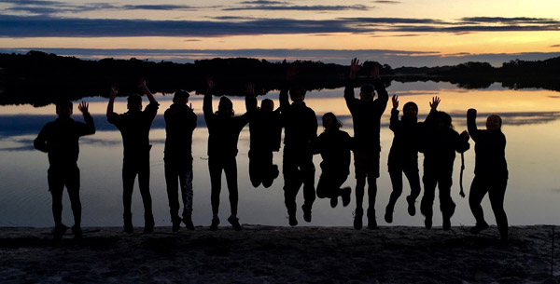
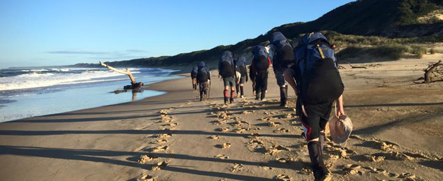
The School for Student Leadership is a Victorian Department of Education and Training (DET) initiative offering a unique residential education experience for year nine students. The curriculum focuses on personal development and team learning projects sourced from students' home regions. There are FOUR campuses in iconic locations across Victoria:
Alpine School
Snowy River
Gnurad-Gundidj
Don Valley (Yarra Ranges)
MELBOURNE GIRLS’ COLLEGE HAS BEEN OFFERED 6 PLACES AT DON VALLEY IN
TERM 4, 2023

Slide 4
Daisy, Immy, Eti and Eadie (2022) Scarlett, Leanne, Emily and Lily (2021)
What’s it like to be a student at the SSL?
https://www.facebook.com/SSLDonValleyCampus
http://www.alpineschool.vic.edu.au/alpine-lessons/

Slide 5
Other FAQ
Does it cost money to go to the SSL?
YES – there is an additional cost of approximately $1100 to attend the SSL. This needs to be paid BEFORE you go and MGC can sort out these details with your parents. There IS funding available for any student who is eligible for financial assistance via the Student Equity fun, so please don’t let this be a barrier to applying. More information here: https://www.sslstudentequityfund.vic.edu.au/about
Any other Questions?

Slide 6
Key Dates for the SSL
Once the team is selected you will be notified by the end of Week 3, Term 3. The remainder of the term will involve some meetings with your Liaison Teacher who will help you develop some ideas for your Community Learning Project (CLP)
Term 4
Students start school at Don Valley October 8
Parent visiting weekend Nov 11/12
CLP Day Dec 1st
Students leave Dec 9th

Slide 7
School for Student Leadership Application Process 2023
MGC has been allocated six places at the Don Valley campus in the Yarra Ranges in Term 4. The program runs for nine weeks.
If you wish to apply:
Complete the SSL Application Form (including Parent Approval form and Teacher Referee) and return via email to Ms. Carre - these will be available via a compass newsfeed tomorrow and will also be emailed to all Year 9 students. There will also be a link in the final newsletter for the Term this Friday.
2. The closing date for applications is Tuesday July 11th at 4pm – no applications will be accepted after this date
3. Written applications will be shortlisted and 8-10 students will be asked to interview for the positions.
4. Successful applicants will be notified by the end of Week 3 Term 3.

Slide 8
School for Student Leadership 2023
If you have any questions about the program:
Explore the School for Student Leadership website http://www.alpineschool.vic.edu.au
Contact Ms Carre or your Year Level Leaders Mr. McCracken and Ms. Marcuccio
Speak to the 2022 or 2021 SSL teams

