Slide 1
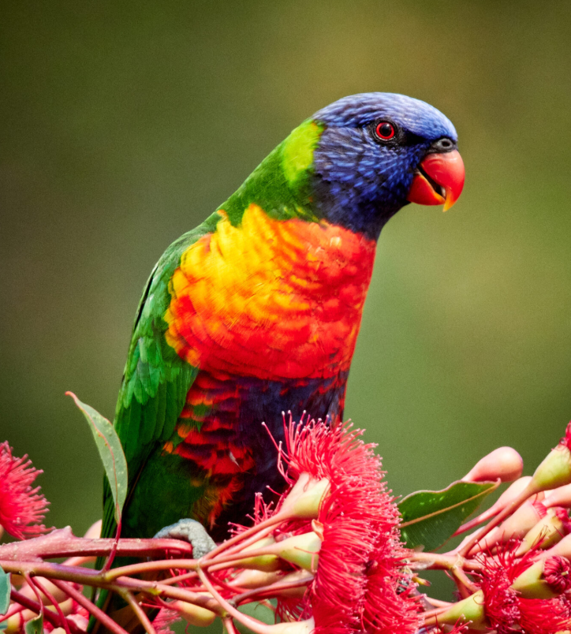

We choose the
Rainbow lorikeet because it has beautiful colours.
Rainbow lorikeet

Slide 2
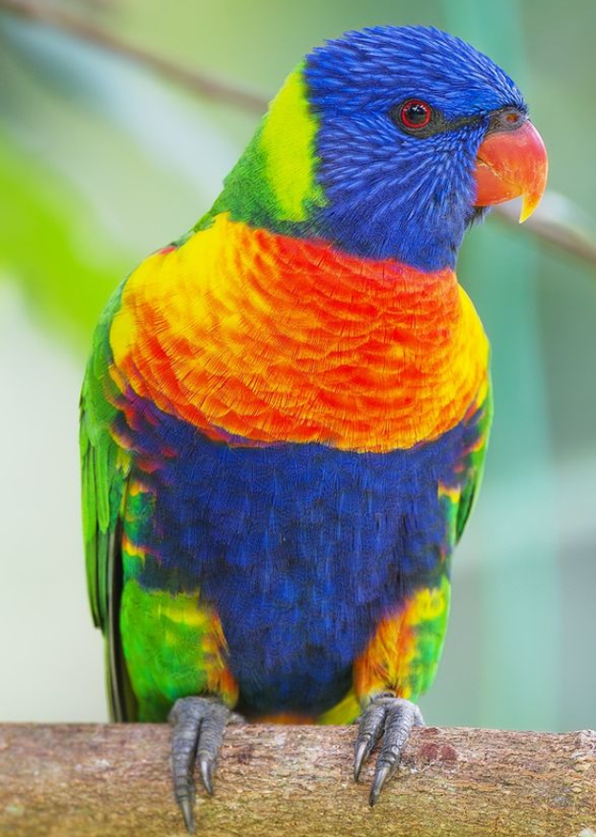
What is looks like
Rainbow lorikeets have:
blue head and belly
green wings, back, and tail
orange and yellow chest,
orange beak
brush-like tongues to drink nectar

Slide 3
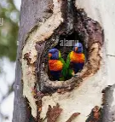
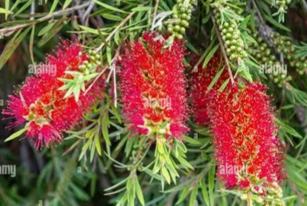
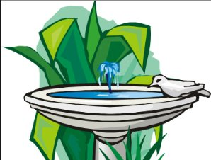
What it needs to thrive
Rainbow lorikeets thrive in environments with:
Nectar from flowers to eat all year round
Clean water to drink
Tree hollows for nesting

Slide 4
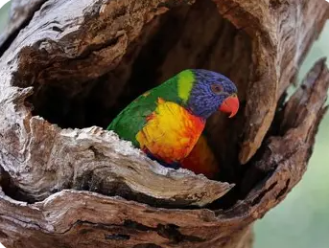
What is missing in our school
Things missing in our school for the Rainbow lorikeet include
Tree hollows for nesting

Slide 5
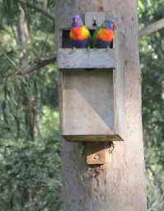
Our solution
We will build and place nest boxes around the school grounds.

Slide 6
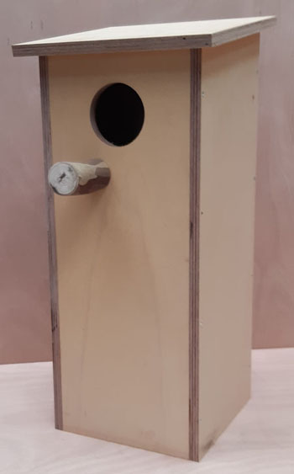
Our solution
Nest boxes should be
3 meters above the ground
Facing away from the afternoon sun
Have a clear entrance
Woodchips in the bottom
Drain holes in the bottom
Put in a quiet place near flowering shrubs

Slide 7
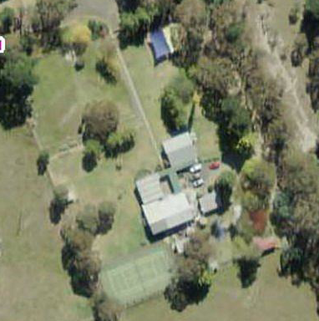
Our solution
Proposed location of nest boxes

Slide 8
Resources and references
Birdlife Australia
Australian Natural Museum
Backyard Buddies
Building a lorikeet nesting box

