Slide 1
GREASE
2023

Slide 2
Welcome!
Congratulations on being involved in this year’s production of GREASE!
We look forward to working with you on our journey.
Sometimes it may feel like hard work and you may not feel like attending rehearsal, but remember, we, and especially your choreographers, are counting on you!
Sometimes it will feel like it is never going to come together but it always does- that’s the magic of theatre!
You will be rewarded for all your hard work and remember these things:
You only get out of something what you put into it.
There is no such thing as a small part, only a small actor.
Enjoy every minute of your time on stage!
Chookas!

Slide 3
TERM 2 REHEARSALS
Mondays Before school: Band
Mondays afterschool: Leads
Thursdays Afterschool: Leads & Chorus
Tuesday Lunchtime: Specialist Dancers
Lunchtimes: Soloists

Slide 4
Introduction of Production Team
2023

Slide 5
Producer and Co-Director: Anne Corry

Slide 6
Co-Director: Lindy Mumme

Slide 7
Choreography: Georgia Culvenor

Slide 8
Music Director: Tony Hicks (Band rehearse Mondays before school)

Slide 9
Vocal Coach: Ellyce Calder

Slide 10
Andy Clarke Rhythm Section

Slide 11
Technical Director: TBC

Slide 12
Student Choreographers Sophie Quereshi Raphi Bevernage

Slide 13
Student Choreographers Sophie Quereshi Charlotte Wong

Slide 14
Student Choreographers Sophie Quereshi Asrin Sastradipradja

Slide 15
Student Choreographers Sophie Quereshi Brooke Marsland

Slide 16
Student Choreographers Sophie Quereshi Immy Martin

Slide 17
Student Choreographers Sophie Quereshi Olivia Johns

Slide 18
Student Choreographers Sophie Quereshi Elodie Mumme

Slide 19
Student Choreographers Sophie Quereshi Abi Grigg

Slide 20
Other Jobs
Student Crew:
Lights
Sound
Props
Video
Backstage
FOH- Student Executive
(Please note Front of House is out of bounds before and during the show)

Slide 21
Stage Manager Sophie Quereshi Sophia Quershi

Slide 22
Important Dates Reminders-please put these in your family calendar : EVENING PERFORMANCE DATES: Week 5 of Term 3 Tuesday 8th AUGUST & Thursday 10th August (Cast 1) Wednesday 9th August & Friday 11th August (Cast 2) NB: Chorus, Crew and Orchestra are required all 4 evenings. VENUE: MGC Theatre, 7.30PM.

Slide 23
Bump In- Term 3 Week 4 This is when all the equipment arrives. We get to work with our live orchestra, lights and sound and get used to the stage space.

Slide 24
Friday 4th August Term 3, Week 4 Technical Rehearsal (Curriculum Day)

Slide 25
Monday 7th August Term 3, Week 4 Full Dress Rehearsal (All Day)

Slide 26
Hair and Makeup
Unless directed otherwise, you will be responsible for organizing your own hair and make up. You will be given a detailed brief and time to organise this.

Slide 27
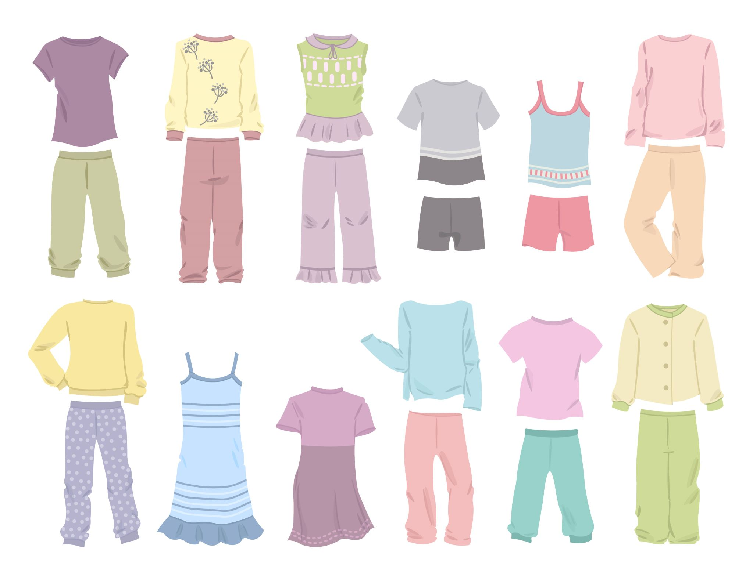
Costumes You will be responsible for organizing your own costume. Costume levy to cover hire for leads.

Slide 28
Souvenir T-shirt
You are welcome to buy a souvenir t-shirt.
MGC 2023

Slide 29
Souvenir Program
All students will receive a complimentary souvenir program.
This Photo by Unknown Author is licensed under CC BY-NC-ND

Slide 30
Production Week Procedure Week 5 Term 3
6.30pm: Compulsory preshow meeting @ in the Auditorium for everybody
7pm: Go to your dressing room and sign in with your staff supervisor.
7.15pm: Doors open
7.30pm: Show Starts!
8.40: (approx) Interval
Show Ends 10pm approx. (Final night will end a little later due to Presentations.)
Please make sure you have a lift home- organize a carpool. Please don’t travel alone.

Slide 31
After school Supervision
MDS Students have the option of being supervised after school for some quiet time/homework catch up if you live too far away to go home and return in time for 6.30pm call.

Slide 32
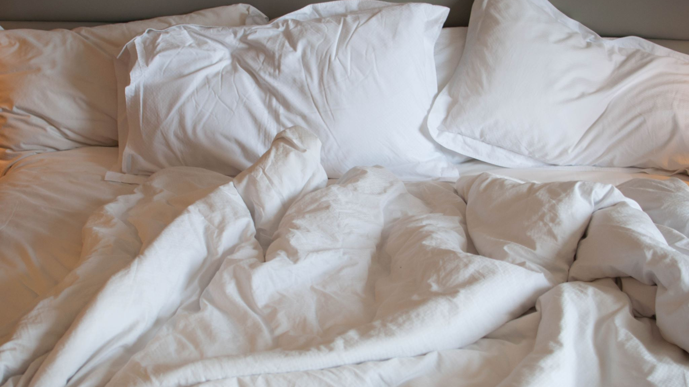
Sleep In!
Middle school students have permission to sleep in on the mornings after the production. This will appear on your Compass as an approved late for Period 1 only.

Slide 33
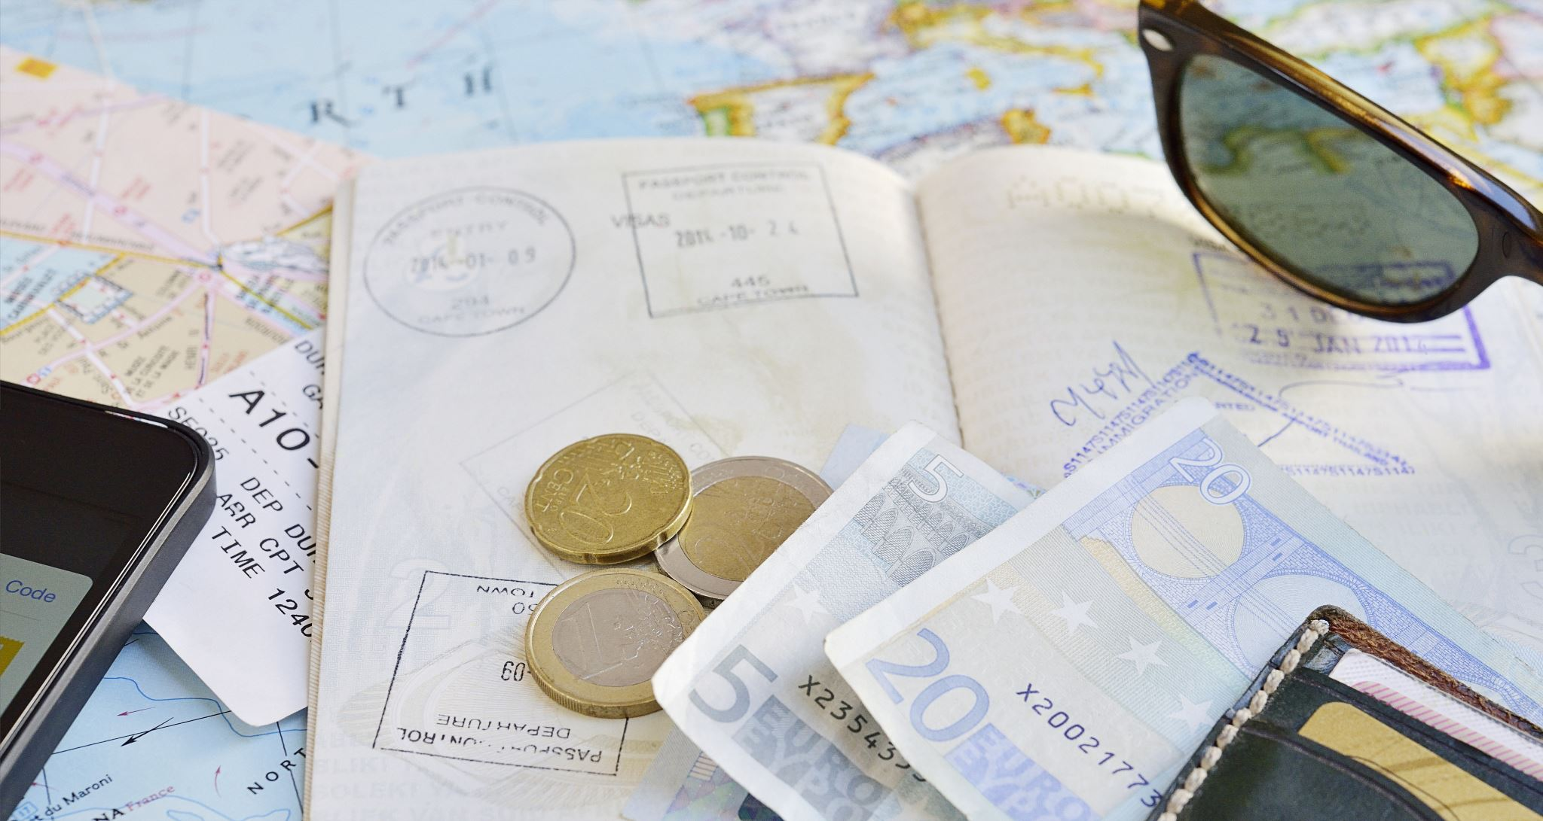
Ticket Sales
Tickets will go on sale, via our MGC website. Please ensure you have already organized what nights your family and friends are able to attend.

Slide 34
What to bring on the night:
Water bottle
Makeup
Costume
Healthy Snacks (no nuts)
A quiet activity such as a book or pack of cards for when you are not on stage.
Also bring a quiet activity such as a book or deck of cards for when you are not on st

Slide 35
What NOT to bring on the night:
VALUABLES
Please give your phone/wallet to your supervising teacher for safety.
NUTS

Slide 36
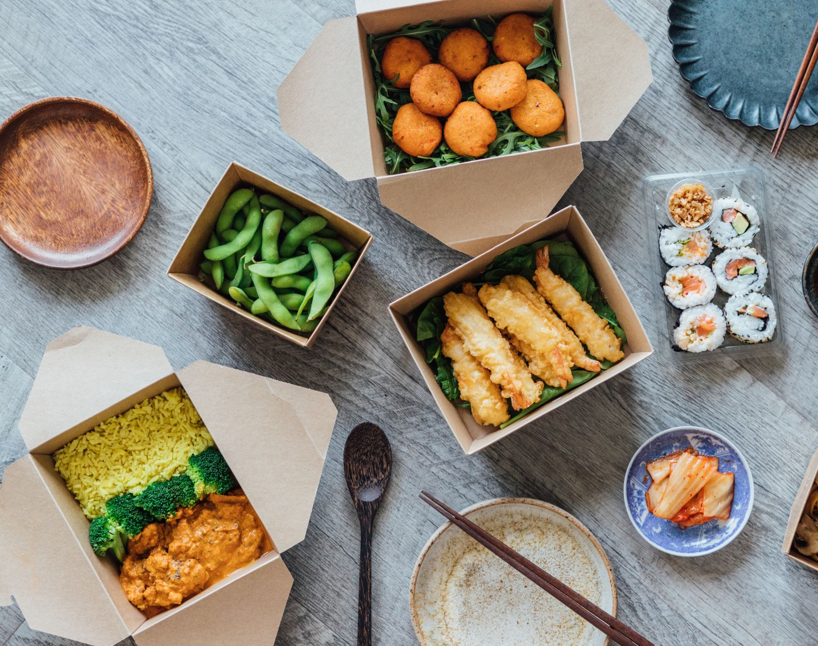
MEALS
Meals are available from the Café -just complete a lunch order at recess.
Alternatively, BYO dinner and heat it up in the microwave.

Slide 37
Act 1-please highlight which scenes you are in
Scene | Set | Musical Number | Required
1 | First Day of School | School Song & Parody | Miss Lynch, Blanche, Patty & Eugene T-Birds, Pinks, Sandy All chorus’
2 | Cafeteria & Bleachers | Summer Lovin’ | Sandy, T-Birds, Pinks, Patty , Eugene & Senior School Chorus
3 | School | Those Magic Changes | Pinks, T-birds, Patty & Eugene & Year 8 Chorus
4 | Sleepover | Freddy My Love Hopelessly Devoted | Sandy & Pinks
5 | Street | Greased Lightning’ | T-Birds & Specialist Dancers
6 | Cheerleading Practice | Rydell Fight Song | Sandy, Danny, Patty & Year 7 Chorus
7 | Park | Look At Me I’m Sandra Dee We Go Together | Pinks, T-birds, Eugene, Patty Sandy Senior School Chorus

Slide 38
Act 2- Please highlight which scenes you are in
Scene | Set | Musical Number | Required
1 | Sandy’s Bedroom | It’s Raining on Prom Night | Sandy and Radio Star
2 | Dance Competition | Tears on My Pillow Hand Jive | Everyone except Sandy!
3 |  | Beauty School Dropout | Year 7 Chorus
4 | Drive In | Sandy | Danny & Sandy & Year 8 Chorus
5 | Jans Party | Rock & Roll Party Queen There Are Worse Things I Could Do Sandra Dee Reprise | T-birds, Pinks, Patty, Sandy
6 | Muck Up Day | You’re the One that I Want We Go Together Reprise CURTAIN CALL | Everyone

Slide 39
CHOOKAS!
☺

