Slide 1






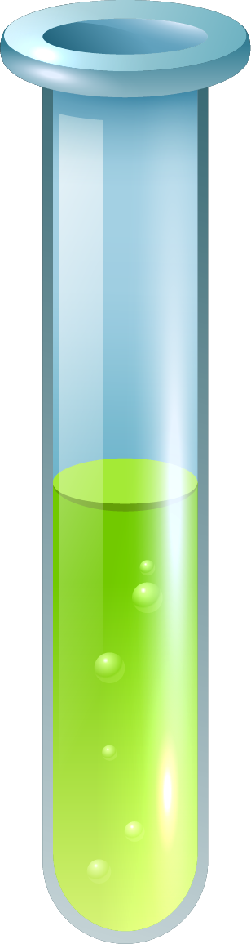
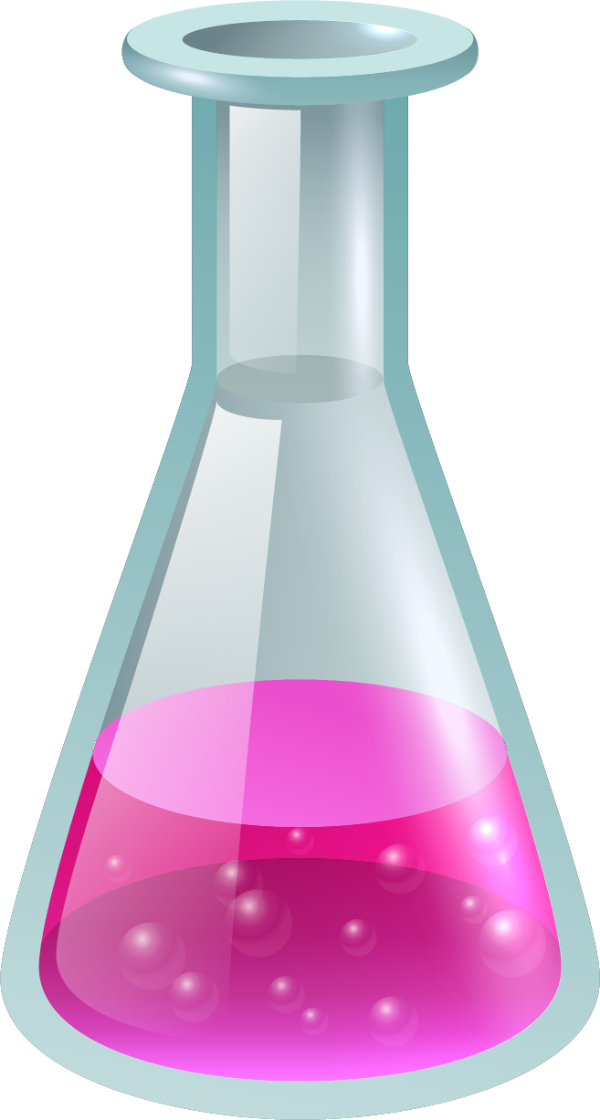
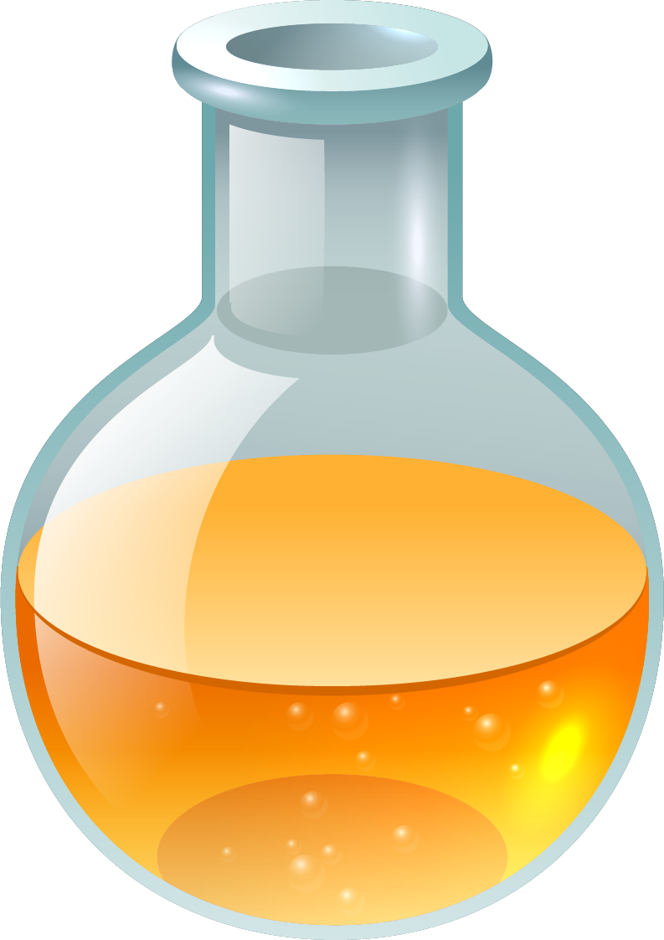
VCE Chemistry
2025
Mr Patience/Mr Pousoulis

Slide 2









What is VCE Chemistry?
The study of VCE Chemistry involves:
investigating and analysing the composition and behaviour of matter, and the chemical processes involved in producing useful materials for society in ways that minimise adverse effects on human health and the environment.
Chemistry underpins the generation of energy for use in homes and industry, the maintenance of clean air and water, the production of food, medicines and new materials, and the treatment of wastes.

Slide 3
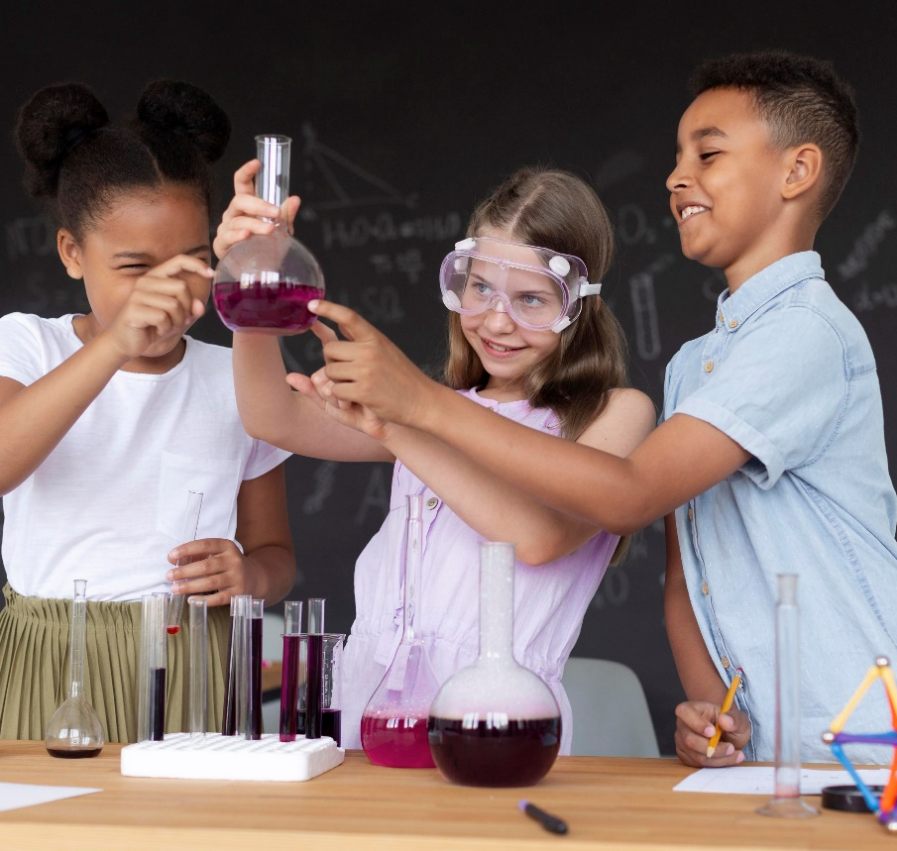
Focus of VCE Chemistry
Students to engage in a range of scientific investigation methodologies, to develop key science skills, and to interrogate the links between knowledge, theory and practice.
Students work collaboratively as well as independently on a range of scientific investigations involving controlled experiments, fieldwork, case studies, classification and identification, modelling, simulations, literature reviews, and the development of a product, process or system.
Knowledge and application of the safety considerations, including use of safety data sheets, and ethical guidelines associated with undertaking investigations is integral to the study of VCE Chemistry.
As well as increasing their understanding of scientific processes, students develop insights into how knowledge in chemistry has changed, and continues to change, in response to new evidence, discoveries and thinking.

Slide 4
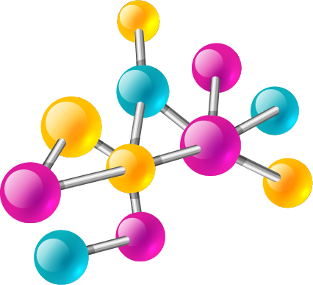
Unit 1: Chemistry
Unit 1: How can the diversity of materials be explained?
In this unit you will investigate the chemical structures and properties of a range of materials, including covalent compounds, metals, ionic compounds and polymers.
You will examine ways that chemical quantities are measured.
You will consider how manufacturing innovations lead to more sustainable products being produced for society through the use of renewable raw materials and a transition from a linear economy towards a circular economy.
You will also conduct multiple practical investigations involving the reactivity series of metals, separation of mixtures by chromatography, use of precipitation reactions to identify ionic compounds, determination of empirical formulas, and synthesis of polymers.

Slide 5



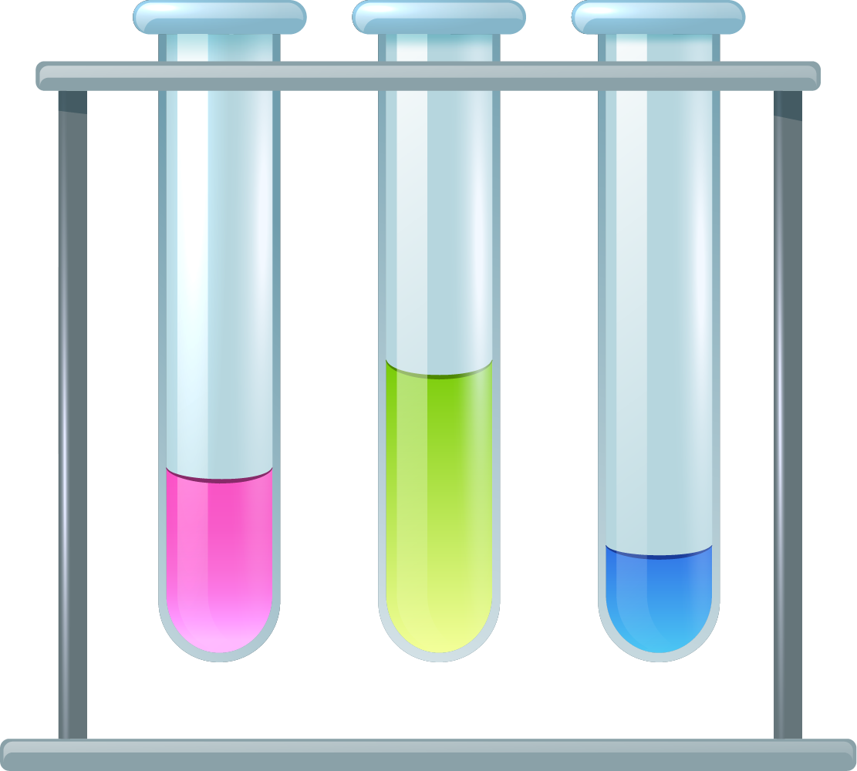



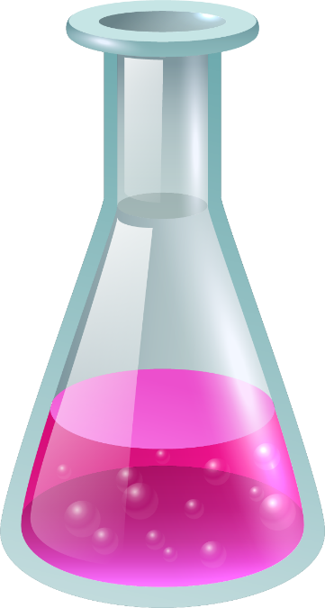

Unit 2: Chemistry
Unit 2: How do chemical reactions shape the natural world?
In this unit you will analyse and compare different substances dissolved in water and the gases that may be produced in chemical reactions. You will also explore applications of acid-base and redox reactions in society.
You will conduct practical investigations involving the specific heat capacity of water, acid-base and redox reactions, solubility, molar volume of a gas, volumetric analysis, and the use of a calibration curve.
At the end of unit 2 you will adapt or design and then conduct a scientific investigation related to chemical equations and/or analysis that involves the generation of primary data and is related to the production of gases, acid-base or redox reactions, or the analysis of substances in water.

Slide 6
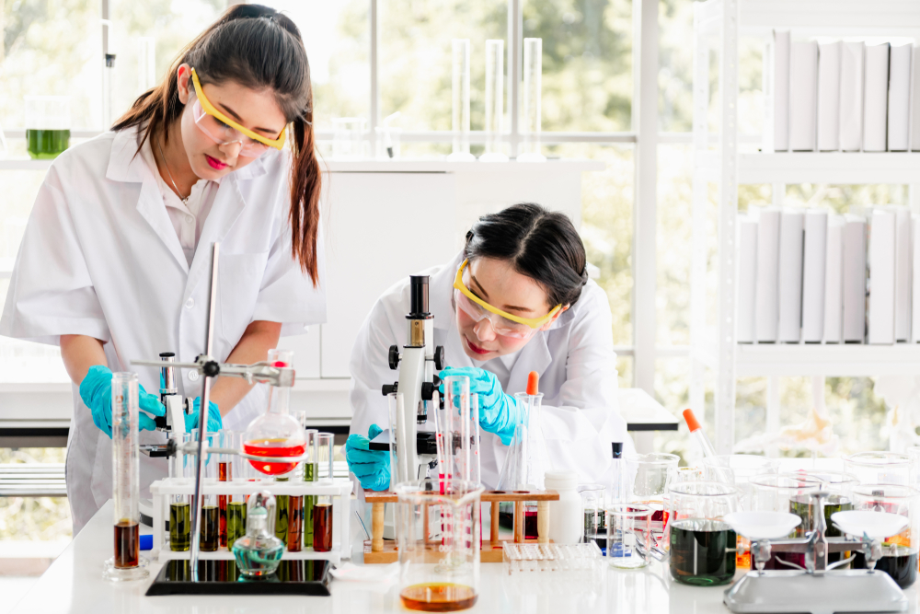
Unit 3: Chemistry
Unit 3: How can design and innovation help to optimise chemical processes?
In this unit you will investigate the chemical production of energy and materials. This will involve exploring how innovation, design and sustainability principles and concepts can be applied to produce energy and materials while minimising possible harmful effects of production on human health and the environment.
You will also analyse and compare different fuels as energy sources for society, with reference to the energy transformations and chemical reactions involved, energy efficiencies, environmental impacts and potential applications.
The purpose, design and operating principles of galvanic cells, fuel cells, rechargeable cells and electrolytic cells are considered when evaluating their suitability for supplying society’s needs for energy and materials.
You will also evaluate chemical processes with reference to factors that influence their reaction rates and extent. This includes investigating how the rate of a reaction can be controlled so that it occurs at the optimum rate while avoiding unwanted side reactions and by-products.

Slide 7
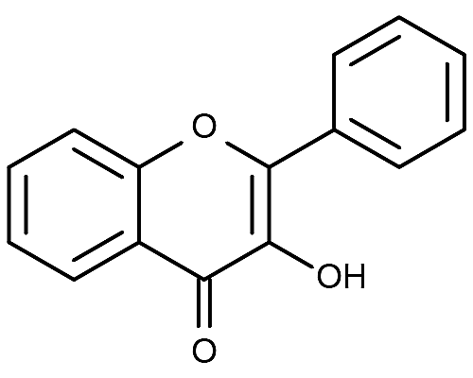
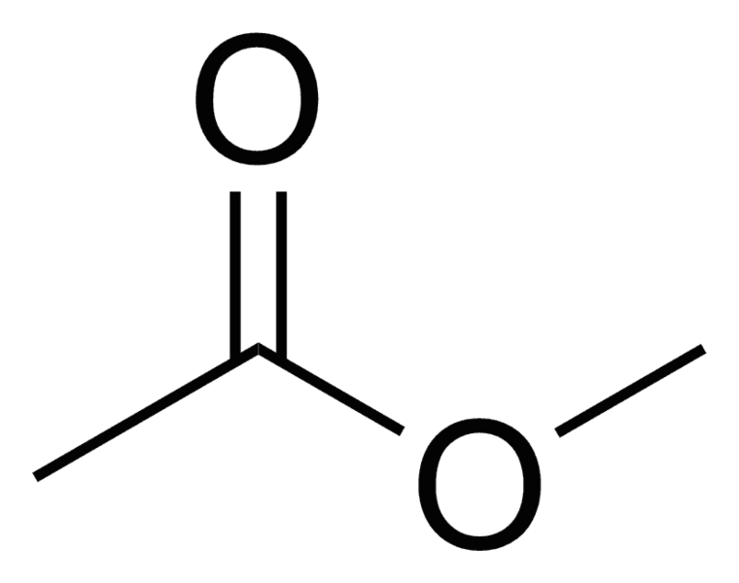
Unit 4: Chemistry
Unit 4: How are carbon-based compounds designed for purpose?
You will investigate the structures and reactions of carbon-based organic compounds, including considering how green chemistry principles are applied in the production of synthetic organic compounds.
You will examine the metabolism of food and the action of medicines in the body.
You will look at how laboratory analysis and various instrumentation techniques can be applied to analyse organic compounds in order to identify them and to ensure product purity.
Students conduct practical investigations related to the synthesis and analysis of organic compounds, involving reaction pathways, organic synthesis, identification of functional groups, direct redox titrations, solvent extraction and distillations.
A student-designed scientific investigation involving the generation of primary data related to the production of energy and/or chemicals and/or the analysis or synthesis of organic compounds is undertaken.

Slide 8
Unit 1 & 2 Assessment
Unit 1: How can the diversity of materials be explained?
Outcomes 1 & 2
At least one task selected from a list (next slide). The same task type cannot be used more than once across Outcomes 1 and 2.
Outcome 3
A response to a question involving the production or use of a selected material, including reference to sustainability
Unit 2: How do chemical reactions shape the natural world?
Outcomes 1 & 2
At least one task selected from a list. The same task type cannot be used more than once across Outcomes 1 and 2.
Outcome 3
A report of a student adapted or designed investigation, using a selected format (e.g. poster, oral presentation, report, multimedia)

Slide 9
Unit 1 & 2 Assessment List
a report of a laboratory or fieldwork activity, including the generation of primary data
comparison and evaluation of chemical concepts, methodologies and methods, and findings from at least two student practical activities
reflective annotations of one or more practical activities from a logbook
a summary report of selected practical investigations
critique of an experimental design, chemical process or apparatus
analysis and evaluation of generated primary and/or collated secondary data
a modelling or simulation activity
a media analysis/response
problem-solving involving chemical concepts, skills and/or issues
a report of an application of chemical concepts to a real-world context
analysis and evaluation of a chemical innovation, research study, case study, socio-scientific issue, secondary data or a media communication, with reference to sustainability (green chemistry principles, sustainable development and/or the transition to a circular economy)
an infographic
a scientific poster.

Slide 10
Unit 3 & 4 Assessment
Unit 3: How can design and innovation help to optimise chemical processes?
One task selected from for each outcome:
comparison and evaluation of chemical concepts, methodologies and methods, and findings from at least two practical activities
analysis and evaluation of primary and/or secondary data, including identified assumptions or data limitations, and conclusions
problem-solving, including calculations, using chemistry concepts and skills applied to real-world contexts
analysis and evaluation of a chemical innovation, research study, case study, socio-scientific issue, or media communication.
Unit 4: How are carbon-based compounds designed for purpose?
Outcomes 1 & 2
One task selected for each outcome from the same list as Unit 3
Outcome 3
Communication of the student-designed investigation through poster and logbook entries (max. 600 words).

Slide 11
% CONTRIBUTIONS TO THE STUDY SCORE
20%
UNIT 3
COURSEWORK
30%
UNIT 4
COURSEWORK
50%
END OF YEAR EXAM

Slide 12
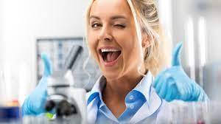
PRIOR KNOWLEDGE AND SKILLS
There are no requirements to undertake VCE chemistry, you’ve been doing science since year 7 already!

Slide 13
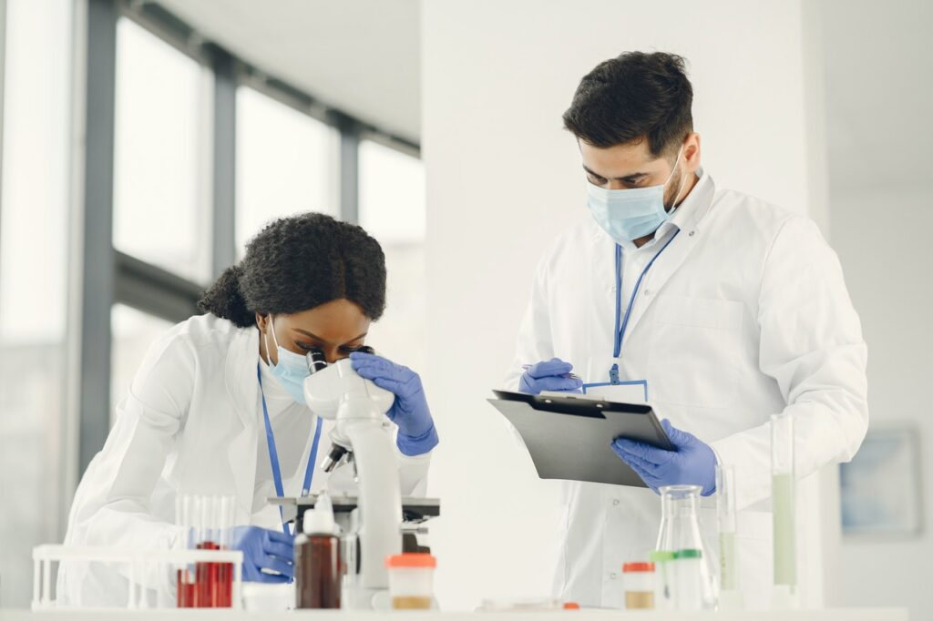
Career Prospects
Career pathways associated with this subject are:
VCE Chemistry provides for continuing study pathways within the discipline and can lead to a range of careers.
Branches of chemistry include organic chemistry, inorganic chemistry, analytical chemistry, physical chemistry and biochemistry.
Chemistry is also applied in many fields of human endeavour including agriculture, bushfire research, dentistry, dietetics, education, engineering, environmental science, forensic science, forestry, horticulture, medicine, metallurgy, meteorology, nursing, pharmacy, sports science, toxicology, veterinary science and viticulture.

