Slide 1
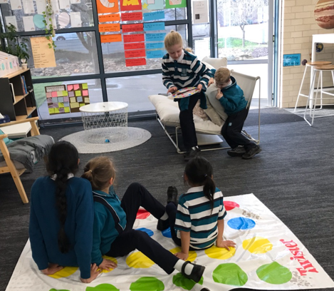
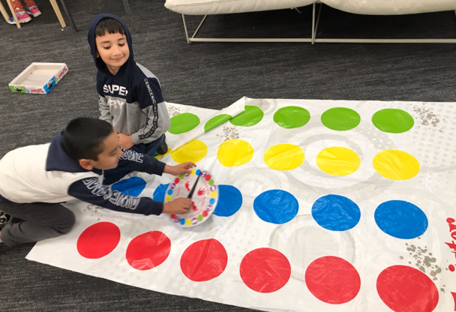
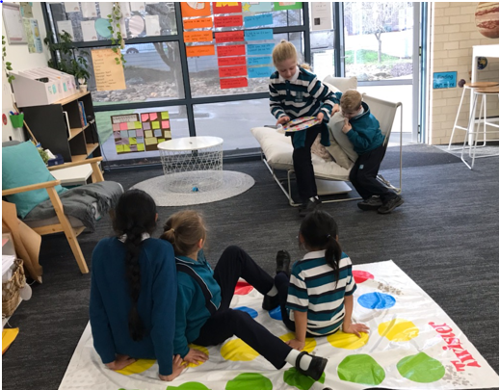

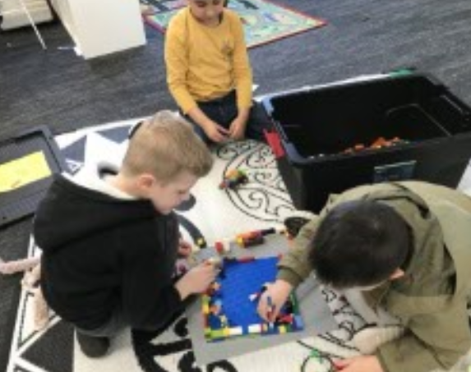
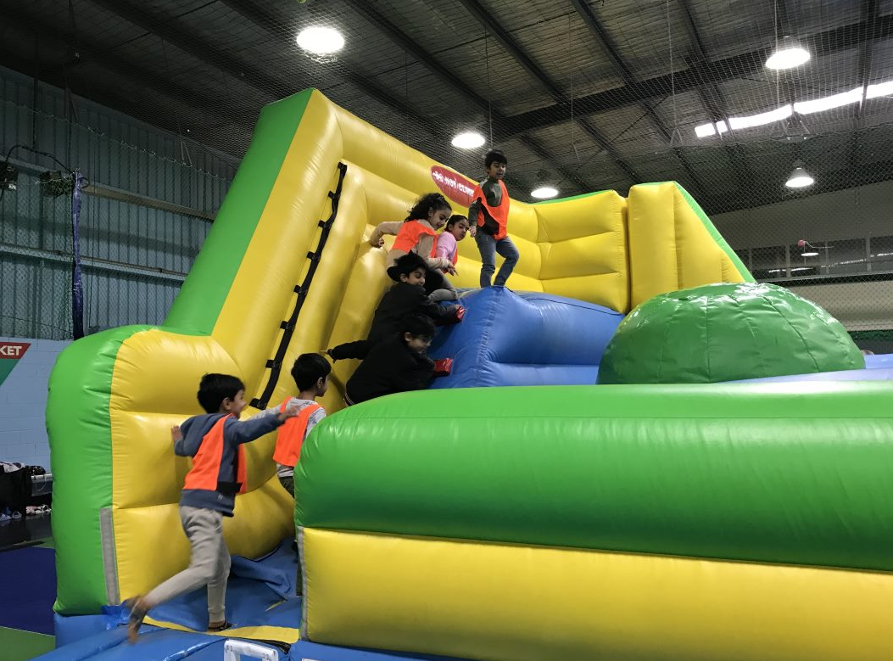
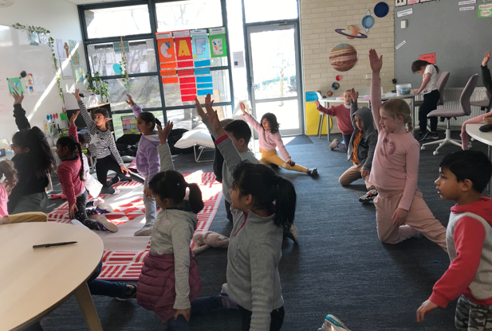
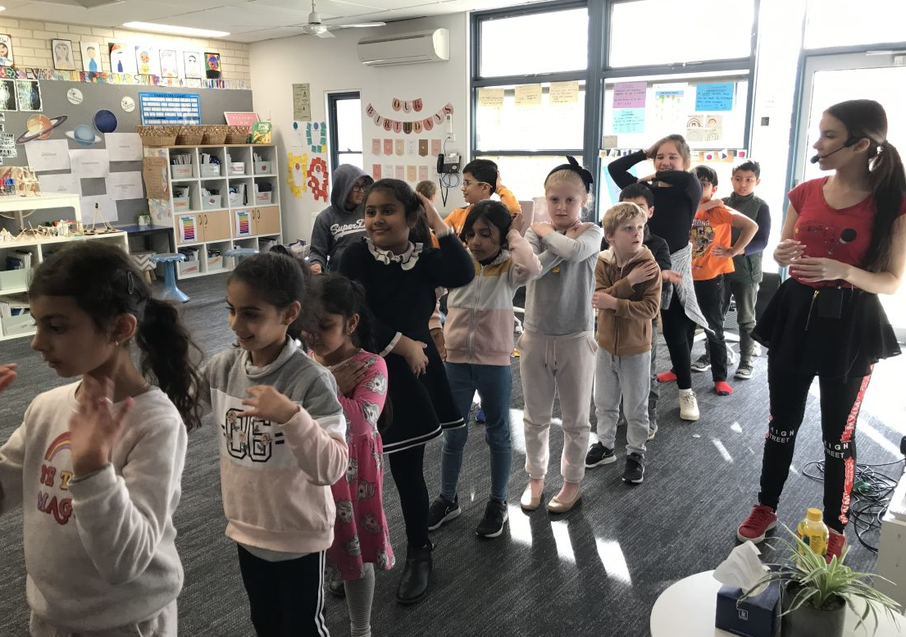



Good News Lutheran OSHCLUB
JULY 2021
Children at OSHCLUB have been loving our new game TWISTER!
WHAT’S BEEN HAPPENING…
During Winter Vacation Care children enjoyed many excursions and incursions that were held at OSHCLUB we enjoyed Karaoke, Building wooden carts, Creating Lego constructions and overall having fun in all aspects of play. Here are a few pictures of our times at VC
SPECIAL ANNOUNCEMENTS
Happy Birthday Vyom and Niral
We hope all your birthday wishes come true
Good News OSHclub
Mon-Fri
[6:30am-8:30am & 3:15pm-6:30pm]
oshclub.com.au
0437119635
goodnewslutheran@oshclub.com.au

Slide 2



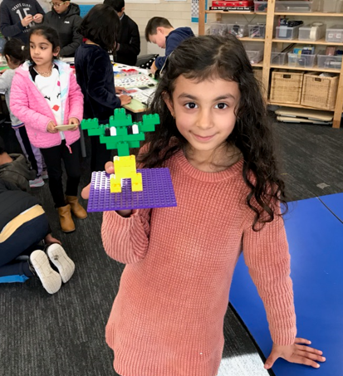
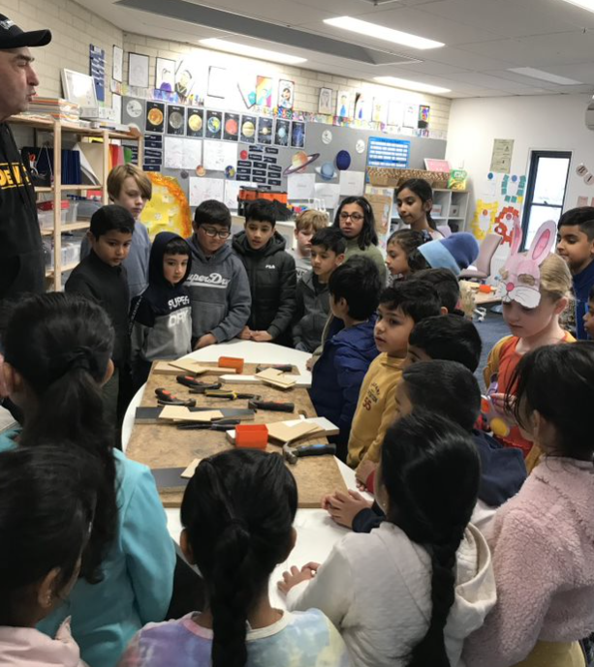
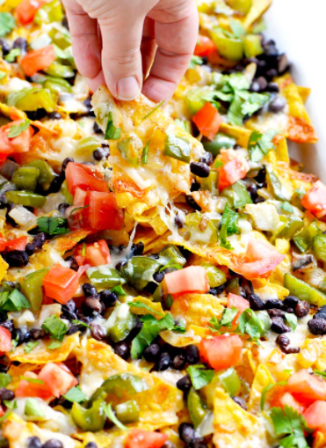
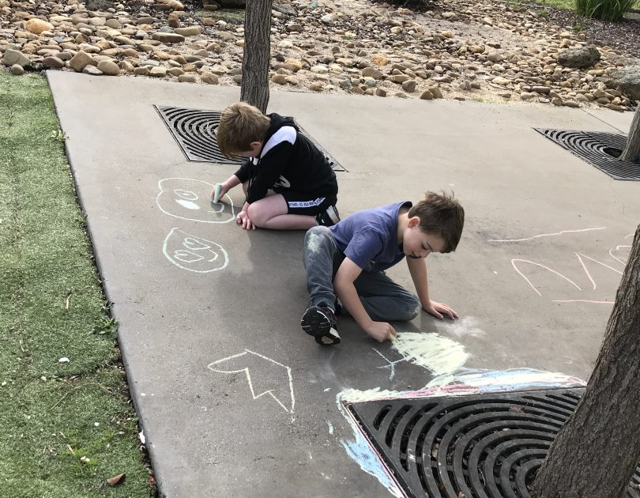
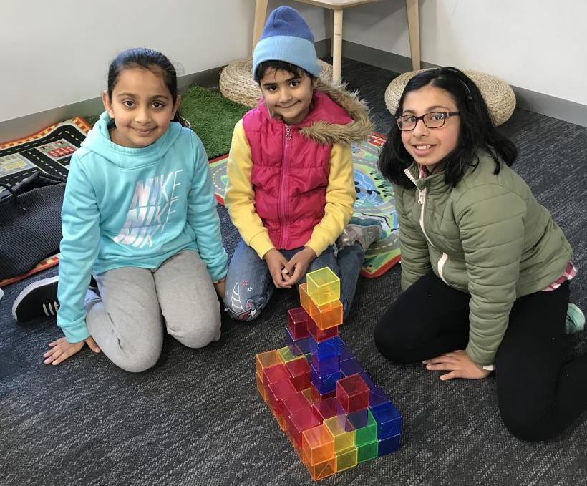
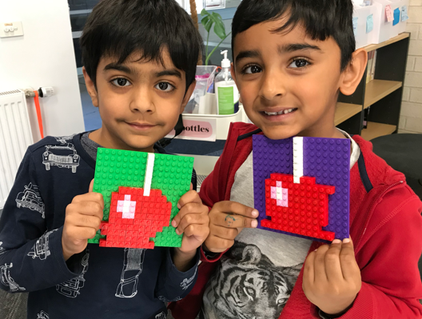
Good News Lutheran OSHclub
JULY 2021
A
RECIPE
COMING UP
16
JULY
Nacho Time!
Plain Doritos
Salsa Sauce
Cheese Sauce
Avocado
Shredded Cheese
Black Beans
World Snake Day
26
JULY
World Uncle & Aunty Day
PHOTO GALLERY
Good News OSHclub
Mon-Fri
[6:30am-8:30am & 3:15pm-6:30pm]
0437119635 goodnewslutheran@oshclub.com.au

