Slide 1
Grade 3/4
Curriculum, Events and Excursions
Term 4, 2021

Slide 2
Reading Curriculum
In Term 3, students will continue to develop comprehension strategies to better understand the purpose and meaning of texts. They will develop their ability to compare and contrast texts from different cultures and authors. Students will also correctly use forms of punctuations, including apostrophes and quotation marks.
Students will learn about the features of narrative texts, using The BFG as a mentor text. They will learn to identify a range of language features, including onomatopoeia and other poetic devices. Students will also revisit features of persuasive texts, including modal verbs and exaggeration.
Students will explore what authors and filmmakers use to create strong characters and settings through the use of descriptive language. This links to our Inquiry topic of Frame by Frame, where students will learn about storyboarding and animation.

Slide 3
Writing Curriculum
In Writing, students will further develop their understanding of the structural features to use when creating narrative and persuasive texts. Students will engage in insightful and deep discussions with their peers, and in writing, around the text The BFG; making thoughtful connections to their lives and the world around them.
Students will learn to create a storyboard in order to make their own stop motion video. This process will involve writing descriptive paragraphs about characters and setting. Students will continue developing their ability to edit their writing and provide feedback to their peers.
Finally, students will consolidate their learning on persuasive text by using the TEEL structure and writing a Shark Tank-style pitch of an invention

Slide 4
Mathematics Curriculum
During the term, students will be revisiting the relationship between addition, subtraction, multiplication and division, to increase their number fact recall fluency when calculating more challenging problems.
Students will explore units of measurement, such as length, mass, capacity and temperature, and calculate the area and volume of different shapes. They will have an exciting opportunity to apply this knowledge to designing their set for the Inquiry stock-motion animation.
Students will identify, compare and describe the features of two-dimensional and three-dimensional shapes and make models of three-dimensional shapes. Students will explore angles, symmetry and shapes in the built and natural environment and apply their knowledge to create artwork using symmetrical patterns and shapes.
Students will learn to read and create maps. They will learn how to collect and interpret data displays and conduct their own data investigation by planning, collecting and organising data into a column graph.

Slide 5
Inquiry Curriculum
Our Term 4 Inquiry unit is called Frame by Frame. In this unit, students will learn to plan, design, create and edit their very own stop-motion video. Students will develop an understanding and appreciation for what it means to create a story. They will become more confident with technology, attempting unfamiliar tasks with a 'give it a go' mentality.
Our planned excursions and events will help to further the learning of the Inquiry unit. Students will be involved in an interactive character creation session with renowned illustrator Ben Wood. They will develop their ability to build sets and props with a visit from CraftPower.
Towards the end of the term, students will trial new technology to plan, record and edit their own stop-motion animation. Their hard work will be shared at the Creativity Expo at the end of Term 4.

Slide 6
Prosocial Education
In Term 4, Grade 3 and 4 will work to gain an understanding of themselves and what makes them unique. They will learn to identify their own strengths, and to appreciate the strengths of others around them. Students will learn to practice persistence to push through challenges, and to set goals to improve on their personal qualities.
Our focus for the term is our school value of Learning. Grade 3 and 4 will use this school value to learn to…
Be curious, creative and ask questions
Explain their goals and thinking
Actively participate so they can progress
Push through challenges
Do their personal best

Slide 7
Whole School Special Events
Event​​​ | Week​​​ | Date(s)​​​
Numeracy Day​​ | 4​​ | Thursday 28th October ​​​
Remembrance Day​​ | 6​​ | Thursday 11th November​​
House Athletics Day​​ | 6​​ | Friday 12th November​​
Step Up Day​​ | 11​​ | Tuesday 14th December​​
Please note that events and excursions are subject to change. Stay tuned to what is going on through iNewsletters and Compass Newsfeeds.

Slide 8
Grade Level Events
Event | Week | Notes
Basketball Gala | 1 | Students will put their basketball skills to the test in a friendly, interschool basketball contest at MSAC, organised by Mr. Callum.
Ben Wood Incursion | 2 | Students will learn techniques for creating a story with pictures.
Swimming | 3 | Students will participate in swimming lessons at MSAC.
Sex Education Australia Parent Information Night | 4 | This parent-information session outlines what topics will be covered in student sessions, as well as tips for talking with children about their bodies.
Sex Education Australia Workshops | 6 - 8 | Students will engage in the Living and Growing program - 3 sessions with a professional from Sex Education Australia.
The Intersection Excursion | 7 | Students will travel by tram into the CBD for a guided walk to learn about the impacts of homelessness in Melbourne.
CraftPower Incursion | 8 | Students will have the opportunity to use tools to build their own theatre and character.
ACMI Excursion | 9 | Students will travel by tram to ACMI to learn about the principles and science behind animation. They will make their own stop-motion animation.
Grade 3/4 Camp | 10 | *see Camp slide
Please note that events and excursions are subject to change. Stay tuned to what is going on through iNewsletters and Compass Newsfeeds.

Slide 9
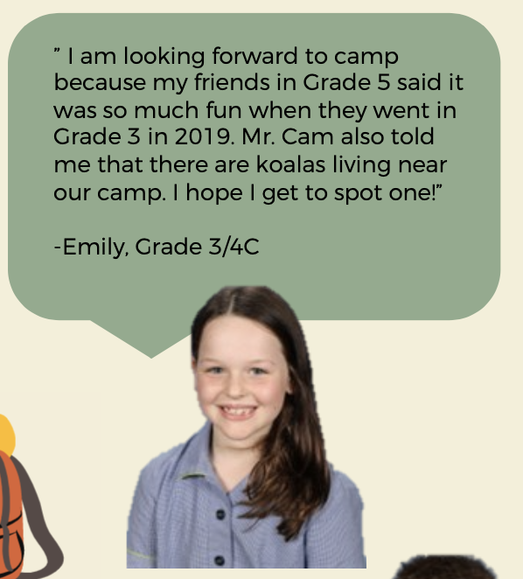
Camp 2021
At this stage, we are still planning to go to YMCA Lady Northcote for Grade 3/4 Camp from 6th-8th December 2021
If camp is cancelled due to restrictions, your child's spot in Camp and any payment will be held for Camp 2022
Payment can be made in full or through monthly payments on Compass
Please complete your child's medical form by clicking here. This form must be completed by Friday 5th November
A parent information night for camp will be held Thursday 25th November. This will most likely occur via WebEx
If you have any camp-related questions, please email your child's classroom teacher

Slide 10
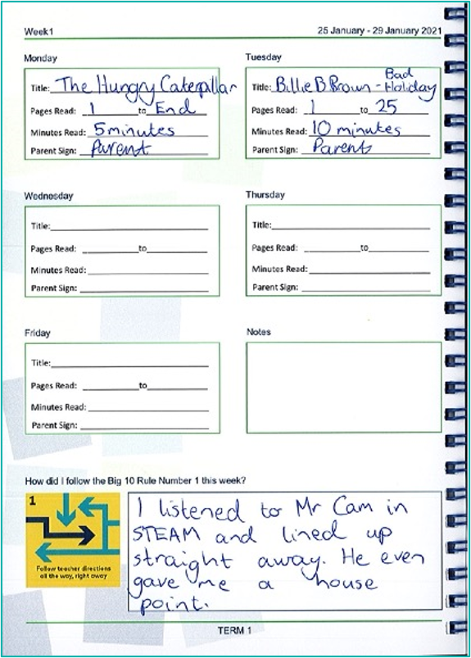
Other Notes and Reminders
Homework
Students are expected to read for 30 minutes a night 4 x a week. The Homework Diary must be signed by a parent or carer to evidence this.
200 – 1000 points of Mathletics activities should be completed this week.
Spelling tasks should be completed using the spelling sheet Monday-Thursday for 10 minutes.
Uniform
All summer or all winter is required
All additional items should be navy e.g. socks/hair ties etc.
All jackets/jumpers etc. should be SMPS branded
Shoes must be black and polishable
Please see the uniform policy on the SMPS website for more information
Communication
Please continue to check the School Newsletter for Grade Level information and the Compass NewsFeed for immediate, high level information sharing.

