Slide 2
“Grease”
Audition Song Workshop

Slide 3
LEAD FEMALE ROLES and their audition song
Sandy
Audition Song- Hopelessly Devoted to You
Rizzo
Audition Song- There Are Worse Things I Could Do or Sandra Dee
Frenchy, Jan and other Pink Ladies
Audition Song: Summer Loving or Sandra Dee
General: Summer Lovin

Slide 4
General: Summer Lovin’ (till 44 secs)
https://www.youtube.com/watch?v=xm-WIYglDPw
Till 44 seconds

Slide 5
Sandy: Hopelessly Devoted to You (till 1.55)
https://www.youtube.com/watch?v=jF4xOhCdrlo
Till 1.55

Slide 6
Rizzo-There Are Worse Things I can Do till 1.29
https://www.youtube.com/watch?v=DdesX8viZU0
Till 1.29

Slide 7
Rizzo/Pink Ladies: Sandra Dee till 55 seconds
https://www.youtube.com/watch?v=9pb4hob_aKA
Till 55 seconds

Slide 8
Marty: Freddy My Love-till 47 secs
https://www.youtube.com/watch?v=cTnMRUCO4sQ

Slide 9
LEAD “MALE” ROLES
Danny
Audition Song: Sandy
Kenickie
Audition Song:
Greased Lightning
Sonny, Doody and other Thunderbirds
Audition Song:
Those Magic Changes
Non Singing roles:
Vince Fontaine
Eugene
Coach
Johnny Casino (Dance Competition Band Leader) Audition Song: Born to Hand Jive
Teen Angel
Audition Song: Beauty School Dropout

Slide 10
Danny: Sandy from 24 seconds in till 1.40
https://www.youtube.com/watch?v=8do_yh1eii0
From 24 seconds till 1.40.

Slide 11
Kenickie: Greased Lightnin’ till 1 minute in
(see changed lyrics on next slide please!!)
https://www.youtube.com/watch?v=ZXsW45xQKi4
Till 1 minute.

Slide 12
Changed Lyrics to Greased Lightnin'
Well, this car could be automatic, systematic, hydromatic, Why it could be greased lightning! (Greased Lightning) We'll get some overhead lifters and four barrel quads, oh yeah (Keep talking, whoa, keep talking) Fuel injection cutoffs and chrome plated rods, oh yeah (I'll get the money I kill to get the money) With a four-speed on the floor, they'll be waiting at the door You know that I ain't bragging, she's a real dragon wagon Grease lightning (Go, go, go, go, go, go, go, go, go, go) Go grease lightning, you're burning up the quarter mile (Grease lightning, go grease lightning) Go grease lightning, you're coasting through the heat lap trials (Grease lightning, go grease lightning) You are supreme, the chicks'll scream for Greased lightning (Go, go, go, go, go, go, go, go, go, go)

Slide 13
Doody: Those Magic Changes till 2.23
https://www.youtube.com/watch?v=8Nkq6zDns2Q
Till 2.23

Slide 14
Johnny Casino- Hand Jive
https://www.youtube.com/watch?v=FFArH0e8h2w
From beginning till instrumental break

Slide 15
Teen Angel: Beauty School Dropout from instrumental break (45seconds) till 1.25.
https://www.youtube.com/watch?v=BzkFQl2bJV8

Slide 16
Week 2 Information Meeting and LEARN AUDITION SONG/S
Week 2
Tuesday afterschool:
Information Meeting PAC
(and repeated Thursday for Year 7’s on Camp)
Thursday afterschool: Learn Audition Songs
Years 8-11

Slide 17
Weeks 3 LEARN AUDITION SONG/S continued
Week 3
Learn audition songs
Thursday afterschool: Year 12 & 7

Slide 18
Week 4 AUDITIONS BEGIN
Week 4
Monday Period 1:
Year 11
Thursday afterschool:
Year 10 & Catchups

Slide 19
Week 5 AUDITIONS continued
Week 5
Monday Period 1: Year 12’s
Thursday afterschool: Year 8 & 9’s

Slide 20
Week 6 AUDITIONS continued
Week 6
Thursday afterschool: Year 7’s

Slide 21
WEEK 7 CALLBACKS AND FINALE DANCE
Monday afterschool-
Callbacks- Singing
Callbacks
Script
Thursday afterschool

Slide 22
WEEK 8 CALLBACKS # 2 AND FINALE DANCE
Monday afterschool-
Callbacks
Thursday afterschool
Callbacks cont

Slide 23
WEEK 9 CALLBACKS # 3 AND FINALE DANCE
Monday Afterschool
Final Callbacks
(if necessary)
Thursday
Afterschool
Final Callbacks
(if necessary)

Slide 24
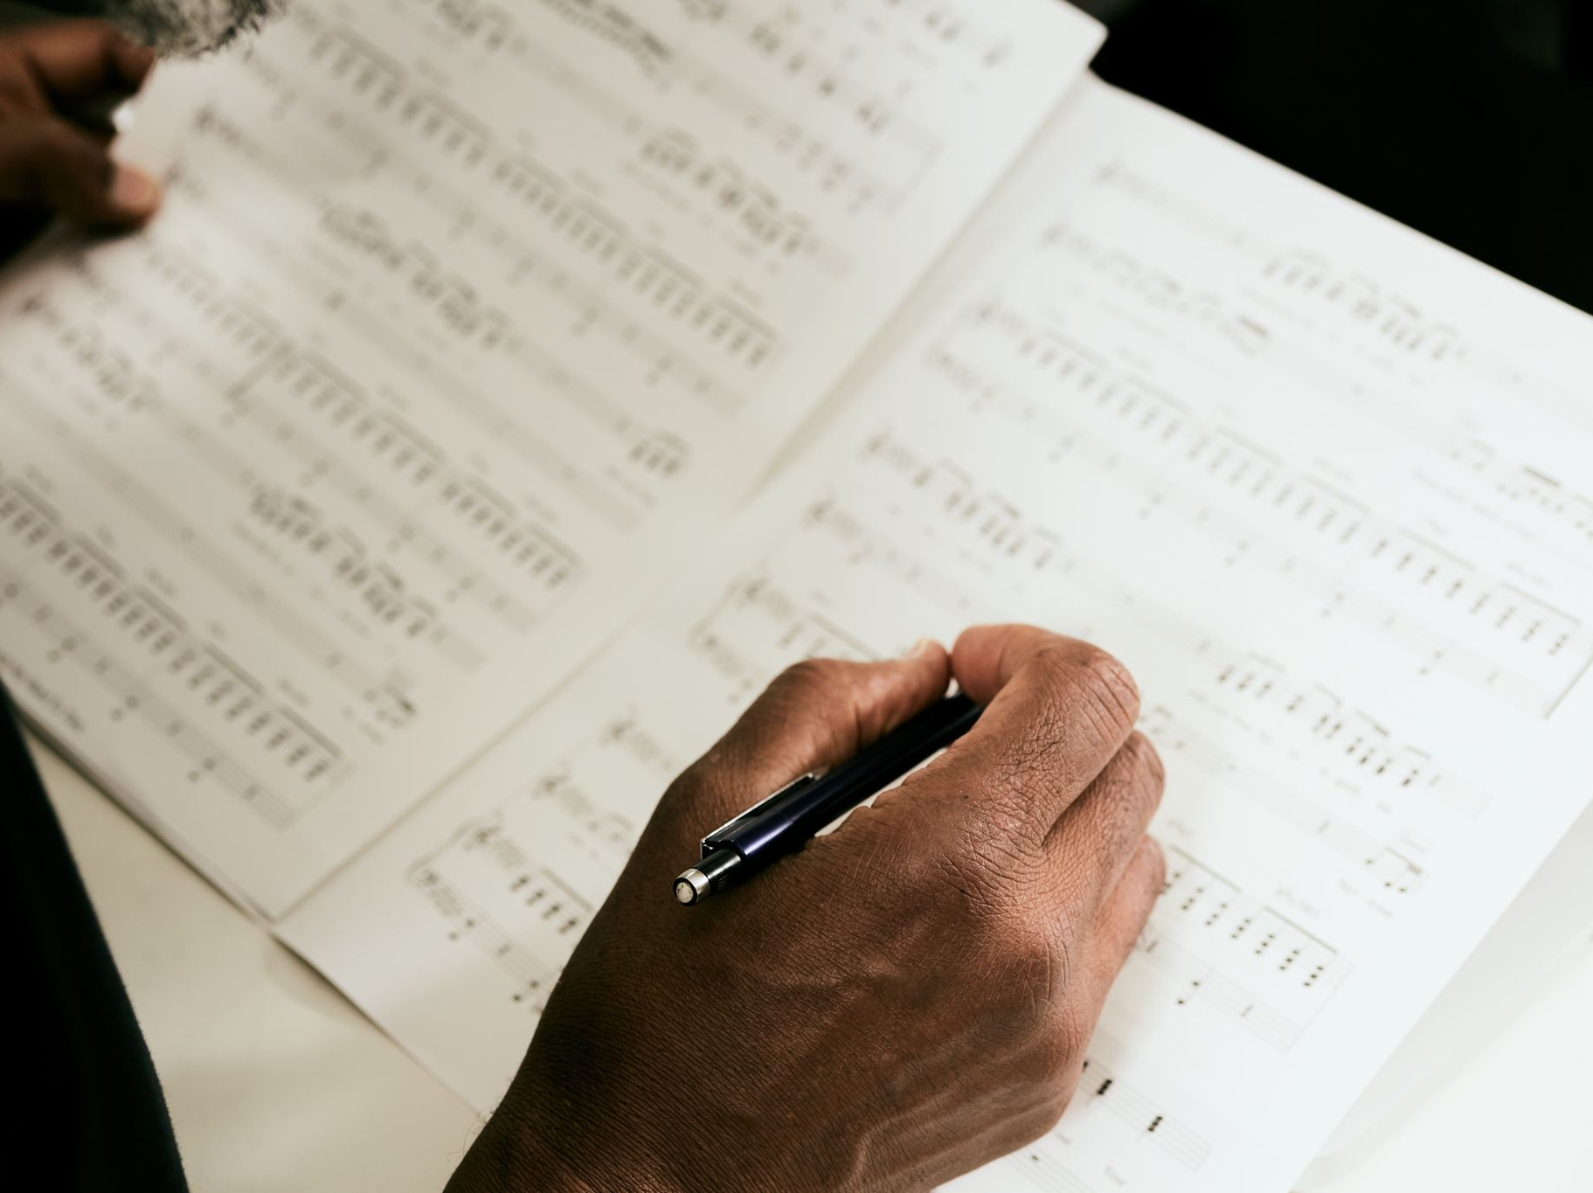
WEEK 10 CASTING ANNOUNCED
TUESDAY AFTERSCHOOL:
Announcement of Cast/s
Cast Meet and Greet and collection of scripts

Slide 25
CHOOKAS! ☺

