Slide 1
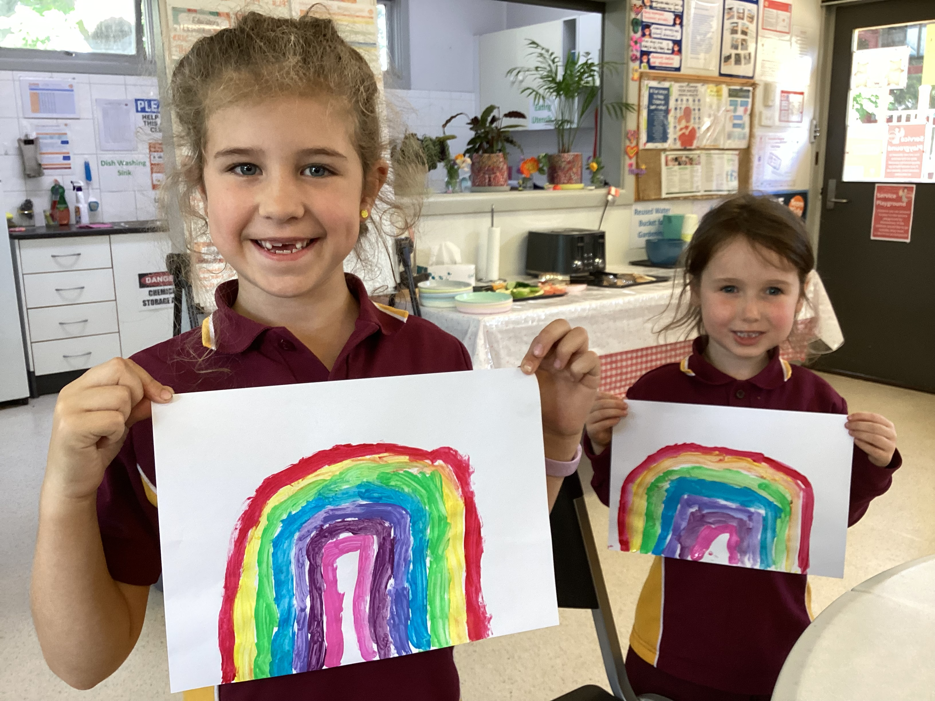
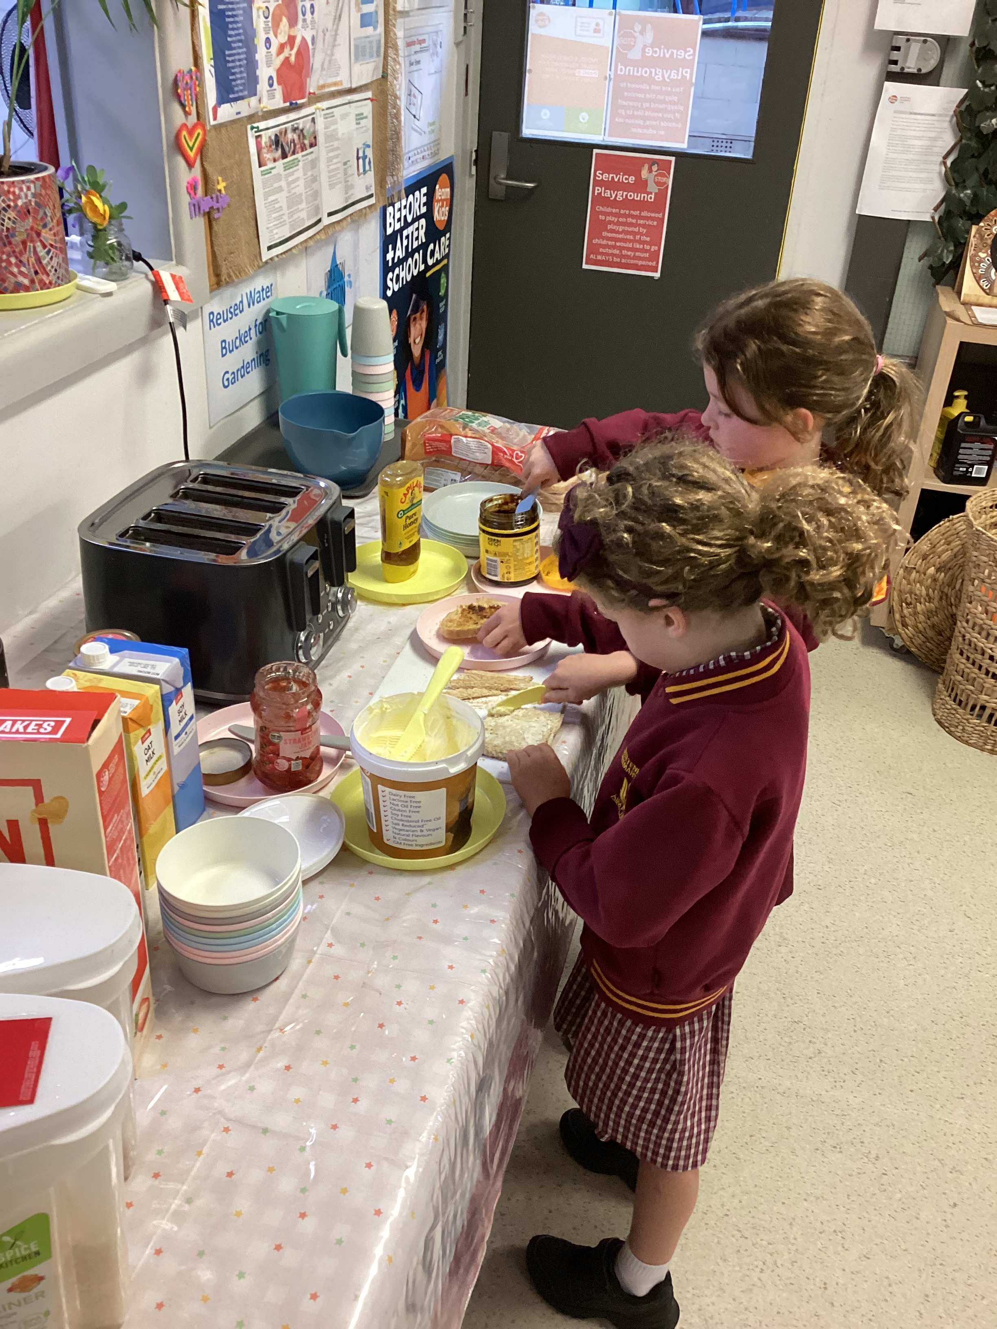
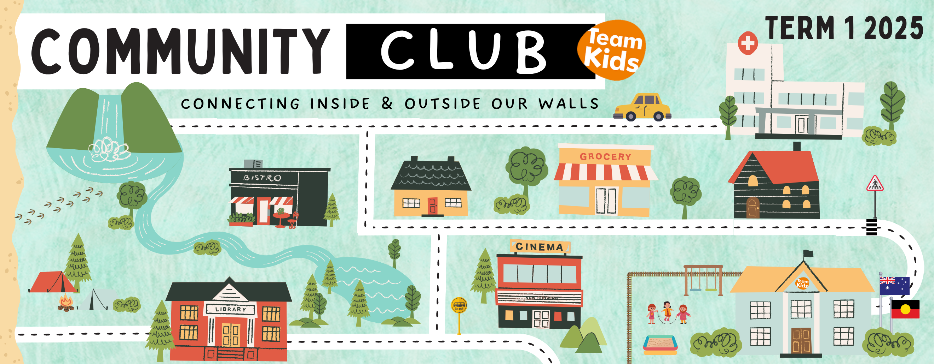
Cheltenham East Team Kids
Dear families,
We are stepping into Week 5, and we’re excited to launch our Community Club! This initiative will help children understand the importance of connecting with their community and contributing in meaningful ways.
We encourage children to take part in our Family Tree Project, where they can share and contribute alongside their families. This activity fosters a sense of belonging and appreciation for those around them.
We also welcome parents to participate! If you would like to share your expertise or organize an interactive activity, such as a presentation or hands-on experience, please reach out to us. Your involvement will provide valuable opportunities for children to engage with their community.
Additionally, we continue to focus on developing social skills, including self-regulation, problem-solving, empathy, and understanding. Through structured activities and supportive guidance, we help children navigate social interactions with confidence and kindness.
Thank you for your ongoing support! If you have any questions or would like to get involved, feel free to contact us.
Best regards,
Eric
Director of Team Kid Before and After School Care
5
Super Sports Club
Art Zone Club
Gardening Club
Super Sports Club
Art Zone Club
3rd March
World Wildlife Day
3rd March
Clean Up Australia Day
4th March
Pancake Day
0432 299 468
CheltenhamEastPS@teamkids.com.au
1300 035 000
info@teamkids.com.au

