Slide 1

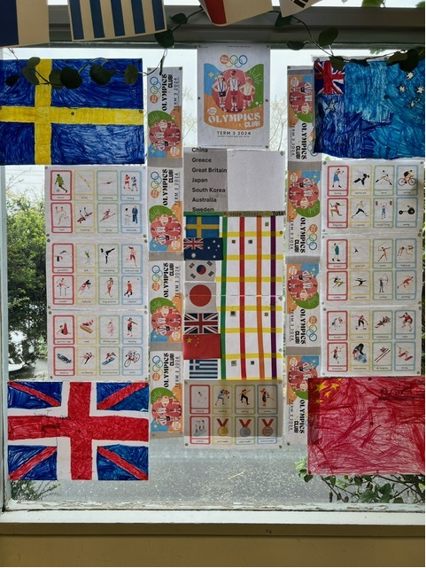


Cheltenham East Team Kids
Dear families,
This week, our children had an amazing time participating in the Olympics Club. They showcased incredible sportsmanship and teamwork in events like sprints and the long jump. It was heartwarming to see them support and cheer for each other, and everyone is eagerly awaiting the final tally to see how their teams performed!
In addition to our outdoor activities, the children enjoyed various creative indoor projects. They made DIY fossils, explored the basics of coding, and crafted unique paper plate creations. These activities were a great way for the children to express their creativity and develop fine motor skills.
What's Coming Up Next Week?
• Monday: Crazy Hair Day!
Let your creativity shine! We encourage all children to come with their most imaginative hairstyles.
• Wednesday: Educator Appreciation Cards
A special day to express our gratitude to the wonderful educators. The children will make appreciation cards to show their thanks.
• Friday: Principal Appreciation
We'll be focusing on our fantastic principals, with the children creating cards to acknowledge their hard work and dedication.
We look forward to another exciting week full of fun, creativity, and community spirit!
Warm regards,
Eric
Director of Team Kids Before and After School Care
3
Cooking club
Coding club
Adventure club
Cooking club
Adventure club
29th July
Crazy Hair Day
31st July
OSHC Educator Day
2nd August
Principal Appreciation Day
0432 299 468
CheltenhamEastPS@teamkids.com.au
1300 035 000
info@teamkids.com.au

