Slide 1


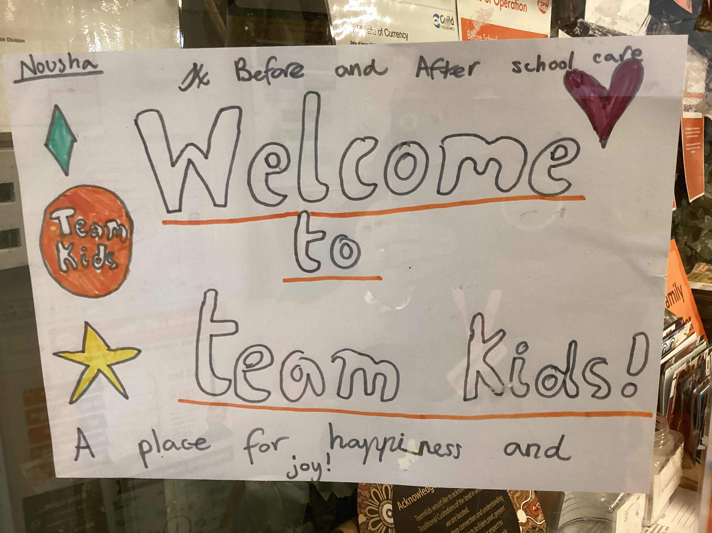

Cheltenham East Team Kids
Dear families,
We hope this newsletter finds you well and filled with excitement for the upcoming week! Here's a glimpse into what our wonderful children have been up to at before and after school care:
Activities Galore: This week, our children indulged in a myriad of engaging activities, igniting their creativity, and fostering friendships. From vibrant painting time to intricate Lego creations, from imaginative drawings to energetic gymnastics fun, and even outdoor disco! Witnessing our little artists' masterpieces and seeing their smiles light up the room has been truly heart-warming.
School Holiday Program: We're thrilled to announce that the eagerly anticipated school holiday program has been officially published! Parents, you can now explore the exciting line-up of activities and outings planned for the upcoming break. Simply visit the Team Kids website to access all the program details and secure your child's spot for an unforgettable holiday experience.
Lunch Time Legends: Mark your calendars for a special event coming up on 22/03 - Lunch Time Legends! We invite all school children to join us during lunchtime at before and after school care for an afternoon filled with laughter and games. It's the perfect opportunity for your child to unwind, make new friends, and create lasting memories.
As always, thank you for entrusting us with the care and enrichment of your precious children. We're committed to providing a nurturing environment where they can learn, grow, and thrive.
Warm regards,
Eric
Director of Team Kid Before and After School Care
8
Art Attack Club (BSC)
Super Sports Club (ASC)
Lego Masters Club (BSC)
Art Attack Club (ASC)
Super Sports Club (BSC)
Lego Masters Club (ASC)
20th March
International Day of Happiness
20th March
Lunchtime Legends
23rd March
Earth Hour
0432 299 468
CheltenhamEastPS@teamholiday.com.au
1300 035 000
info@teamkids.com.au

