Slide 1
Dear God, I know that You will help me to be strong and courageous, even when I'm scared.
Lord, I pray that you bless me with the courage to do what is right in your eyes. May I never shake in the face of temptation, but instead, stand firm in your word and make you proud.
Amen.

Slide 3
Courage

Slide 4
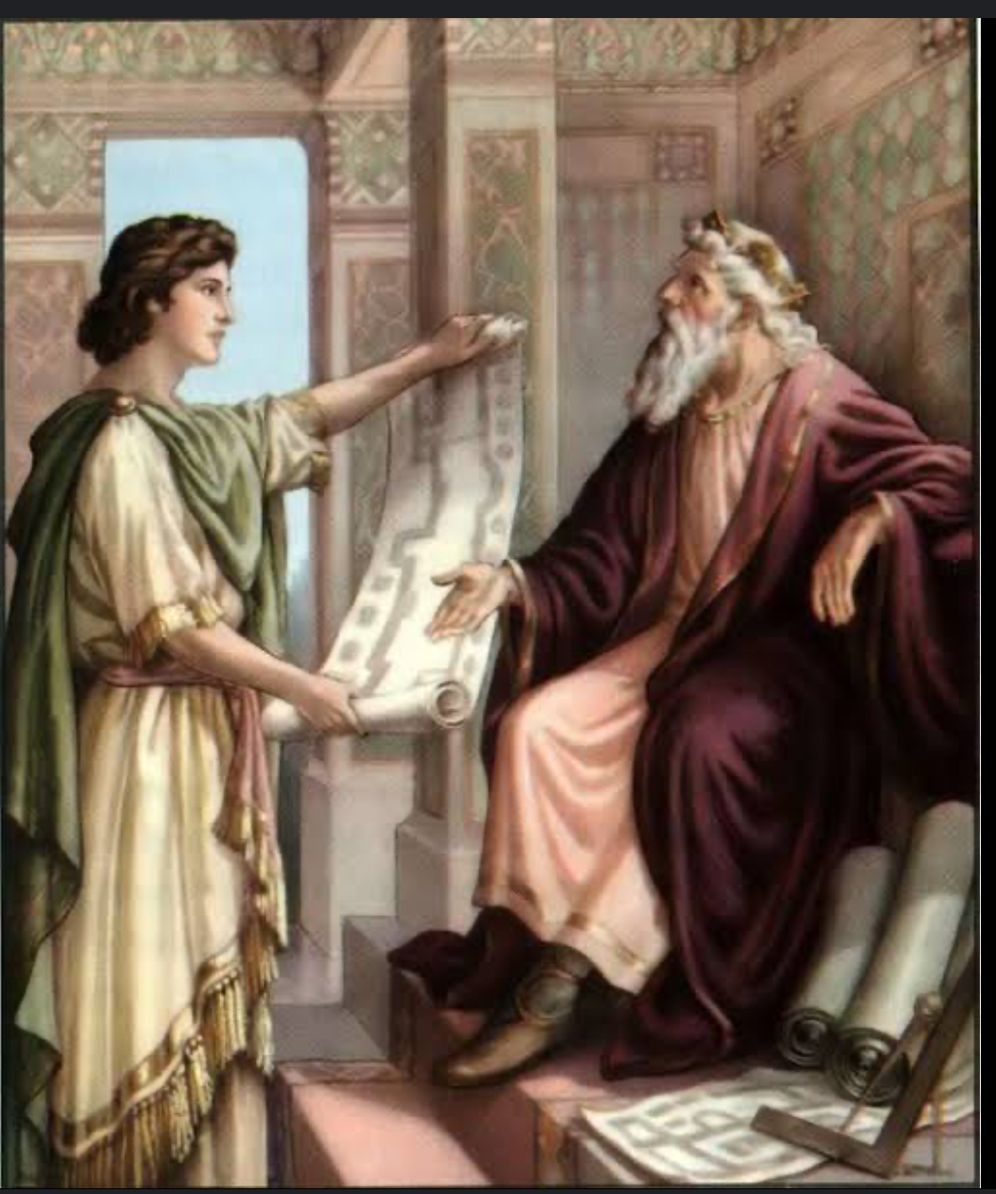
1 Chronicles 28:20
David also said to his son Solomon, "Be strong and courageous, and do the work. Do not be afraid or discouraged, for the Lord God, my God, is with you. He will not fail you or leave you until all the work for the service of the temple of the Lord is finished."

Slide 5
Quotes About Courage

Slide 6
Think about a time when you've been courageous.

Slide 7
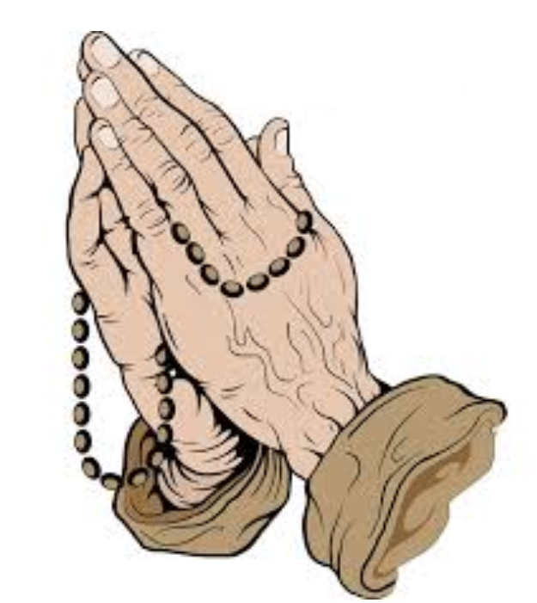
God, please help me have courage in life and help me give courage to my brothers and sisters. Amen

Slide 8
Video on Courage

