Slide 1

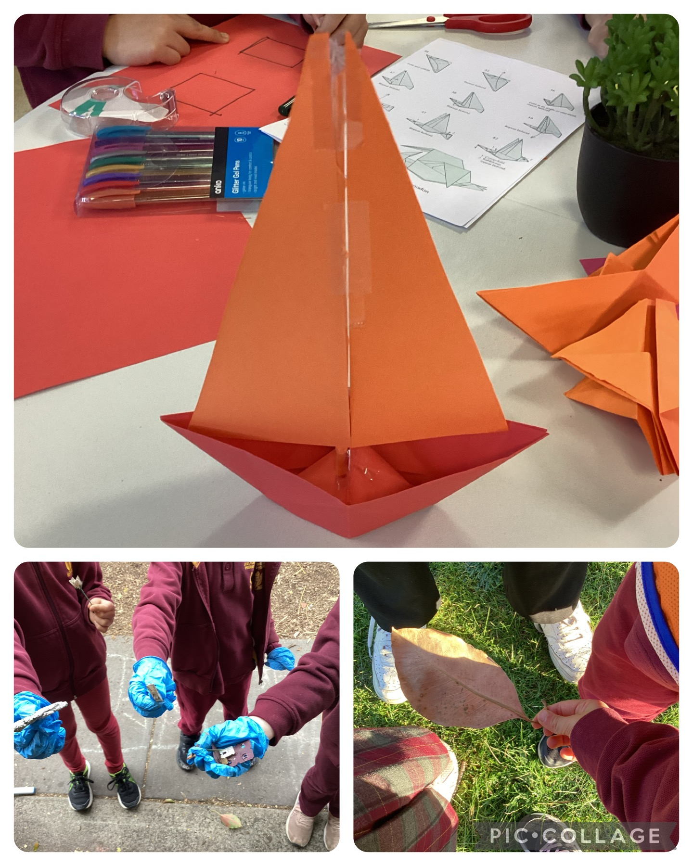

Cheltenham East Team Kids
Dear Parents and Guardians,
We hope this newsletter finds you all in good health and high spirits. We've had an incredible time at our Before and After School Care program, and we're excited to share some fantastic updates with you all.
Keeping Australia Clean and Beautiful: Busy Bees at Work! We couldn't be prouder of our little busy bees! Our service playground got cleaned up, all thanks to the hard work and enthusiasm of our wonderful children. They've shown tremendous dedication to keeping Australia clean and beautiful. A massive round of applause for our enthusiastic participants - you're the true heroes of our environment!
Science Week Extravaganza: Balloon Rockets, Mini Volcanoes and more! Get ready for a week full of scientific wonder and exploration! Our upcoming Science Week promises an array of exciting experiments that will leave your curious minds buzzing. From balloon rockets that zoom across the room to mini volcanoes that erupt with amazement, our science activities are set to ignite your passion for learning. And that's not all! Our expert educators will make sure to delve into the fun facts behind these experiments, ensuring that your scientific knowledge expands as you have a blast.
Calling All Book Lovers: Boost Our Mini Library! We believe in nurturing a love for reading from a young age. That's why we're reaching out to both our children and parents for a special request. Our mini library is eager to grow, and we're asking for your help. If you have any gently used or unused books lying around, why not consider donating them to our little bookworms? Your contribution will not only enhance our library's collection but also bring the joy of reading to countless young minds. Let's spread the magic of stories together! If you have any questions or suggestions, please don't hesitate to reach out to us.
Warmest regards,
Eric
6
Cooking Club
Origami Club
Game Club
Cooking Club
Origami Club
Monday 12th - Friday 20th August
World Science Week
Wednesday 15th August
World Honeybee Day
Wednesday 15th August
Relaxation Day
0432 299 468
CheltenhamEastPS@teamholiday.com.au
1300 035 000
info@teamkids.com.au

