Slide 1

ST JOSEPH’S
2026 Structure - Information Evening

Slide 2

Prayer
Loving God,
We gather this evening as a community united by a shared purpose - to nurture and support the growth of every child in our care.
As we discuss the changes ahead, we ask for open hearts and minds. Help us to see that change, while sometimes challenging, can bring renewal, opportunity, and growth.
May we trust that the decisions made are guided by thoughtfulness and a genuine desire to do what is best for our students. Grant us patience as we adapt, courage as we step forward, and faith that these changes will strengthen our school community.
Bless our teachers, students, and families as we continue to work together for the flourishing of all.
We ask this through Christ our Lord.
Amen.

Slide 3
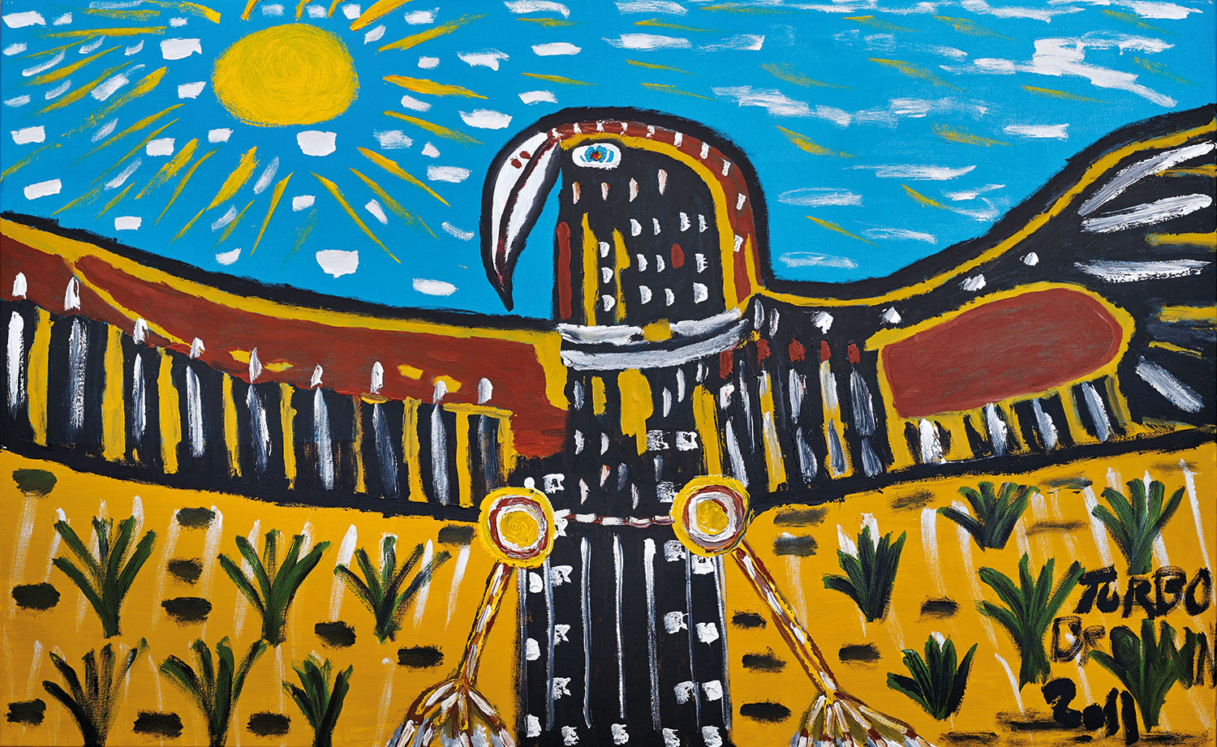
Acknowledgement of Country
We acknowledge Catholic schools in the Archdiocese of Melbourne are situated on the lands of the five language groups that make up the Kulin Nation, who have walked upon and cared for this land for thousands of years. We acknowledge our continued deep spiritual connection and relationship to Country. We pay our respects to their Elders past, present and future, and commit to the ongoing journey of reconciliation.

Slide 4

Purpose of Tonight’s Meeting
Outline the 2026 class structure
Updated school time and structure to align better with the EBA agreement
Answer any questions

Slide 5

2026 Class Structure
2 x Prep Classes
2 x Year 1 Classes
2 x Year 2 Classes
2 x Year 3 Classes
1 x Year 4 Class
1 x composite 5/6 Class
2026 Specialist Classes
Physical Education - weekly
Visual Arts - weekly
Italian - weekly
STEM/Sustainability - weekly
Performing Arts - fortnightly

Slide 6
Composite or Single-year Grades
The most important factor…
… comes down to the quality of teaching. It is the skill, expertise, and dedication of teachers that make the greatest difference to student learning.
St Joseph’s Malvern is in the top 5% of schools in Australia that consistently score higher than their expected level.
St Joseph’s Malvern is in the top 5% of schools in Australia that make a genuine difference and add value to learners.

Slide 7
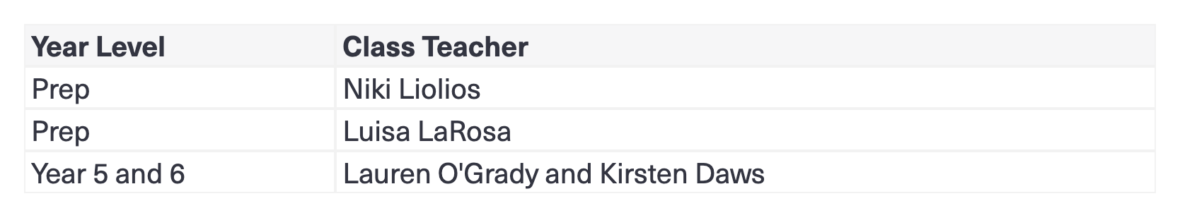
2026 Class Teachers
At this stage we proudly announce our Prep Teachers and Senior Teachers for 2026.
We look forward to sharing the full 2026 team with the school community next week.
Notes:
connection with kindergartens

Slide 8
Why the move to a composite at St. Joseph’s?
Efficient use of staffing and resources: Combining the two year levels allows the school to make the best use of expert experienced senior teachers, funding, and classroom space.
Consolidation of classes into a senior level: Creating a single Year 5/6 composite class forms a cohesive senior group within the school, strengthening leadership opportunities and identity among older students.
Balanced class sizes: A composite structure helps manage uneven enrolments
(e.g., one small Year 5 and one large Year 6), ensuring fair and equitable
student–teacher ratios.

Slide 9
Enhanced peer learning opportunities: Older students can act as mentors and leaders, while younger students benefit from support and role models within the same classroom.
Curriculum flexibility: Teachers can plan and deliver lessons that integrate outcomes across both year levels, allowing for effective differentiation and extension.
Best for students academically and socially: A composite setting supports a broader range of learning needs and fosters positive relationships, cooperation, and confidence.
Stronger sense of community: Multi-age learning promotes collaboration and connection across the school, enhancing the inclusive and supportive environment valued in small schools.

Slide 10
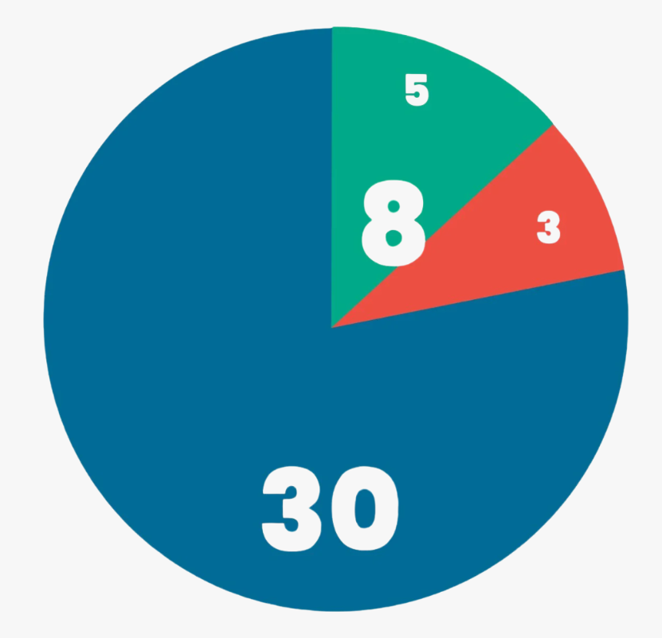
Enterprise agreement - EBA
An enterprise agreement has terms and conditions for the employees it covers. It sets out what entitlements the employer agrees to provide for those employees in their business or organisation.
We are legally bound to this model.
Notes:
Catholic Education Commission of Victoria
IEU
Fair Work Commission

Slide 11
2025 Changes
Change to morning classroom entry:
    Preps continued to enter classrooms before school
    Years 1 - 3 students dropped their bags outside their classrooms
    Years 4 - 6 students remained outside
    Calm space offered to support students requiring a calm transition
Why the changes? Our school had not been aligned with the EBA over the last few years- these changes brought us into alignment with the EBA and the teacher’s entitlements.This was an interim fix to ensure we were inline with the EBA. It had impact of leaders and finances.

Slide 12

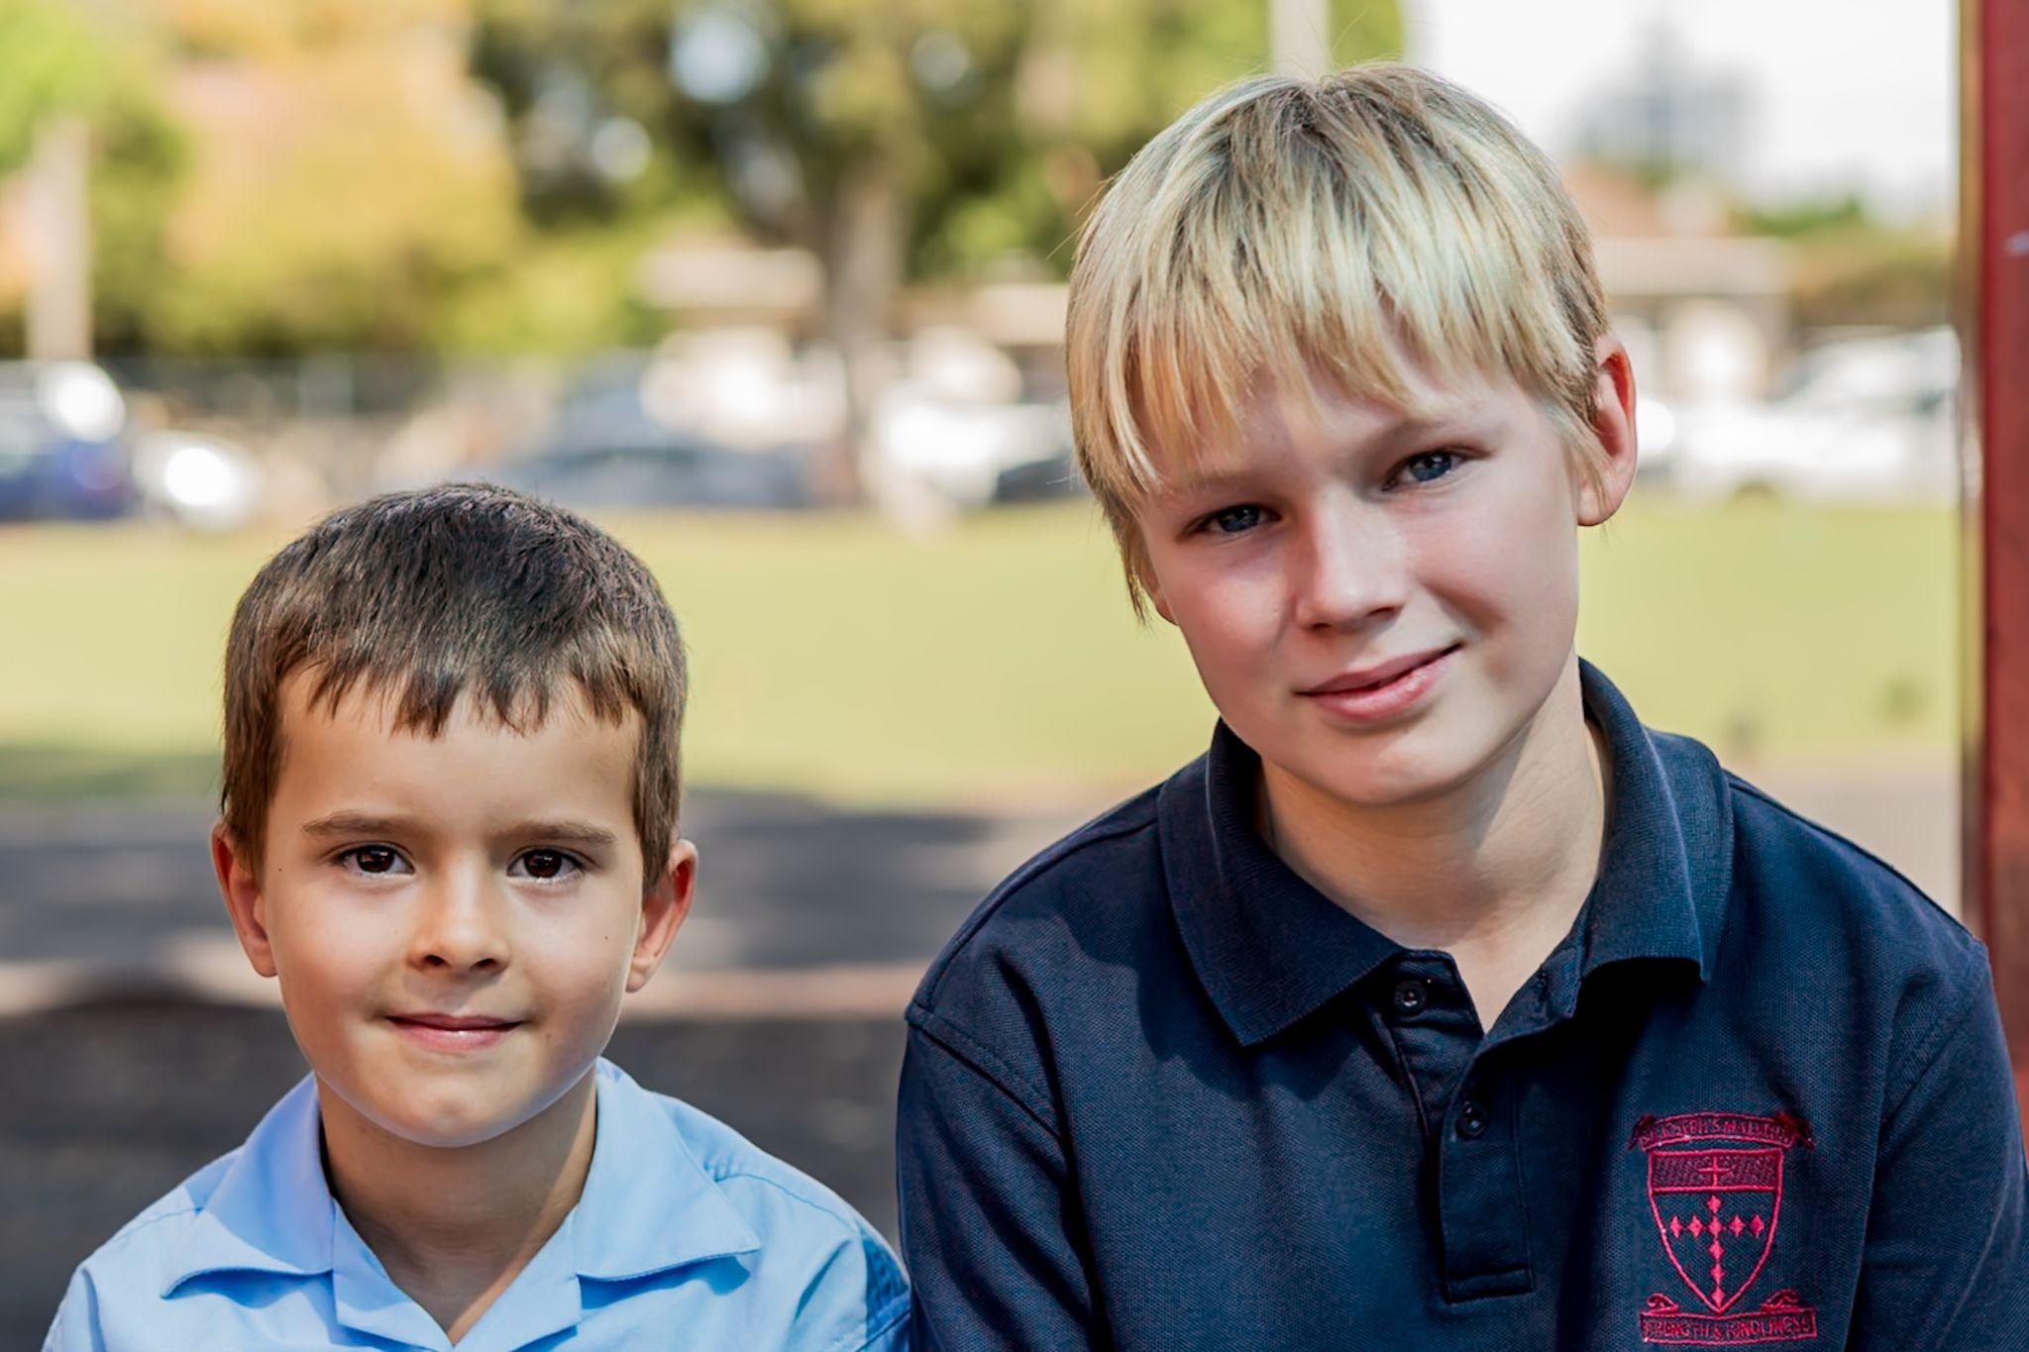

Reasons for change to our timetable:
Currently no seen changes to the 30/8 model. The current model will remain for another 4 years.
The current 2025 timetable runs at six specialist classes.
  Financial implications
  Over allocated release and under allocated face to face teaching
These changes have been made in consultation with committee members, SAC, other principals and DPs.

Slide 13
2026 Class Structure
Times | Activity | 2026 Changes
8:30 - 8:45 | Gates open All classrooms P-6 open from 8:33pm | Students able to access classrooms Class time begins 5 minutes earlier.
8:45 - 9:00 | Students line up on the grassed area and collected by the teacher. Students gather together in the class for roll, prayer, Circle Time (with a focus on SEL) | Extra 5 minutes for morning gathering to help foster class connection and wellbeing
9:00 - 11:15 | Scheduled class focus time | Longer middle block than current model (by 20 minutes) for explicit teaching of literacy
11:15 - 11:25 | Whole class eating time (Supervised outside - weather permitting) | No significant change to current model.
11:25 - 12:05 | First break | No significant change to current model.
12:05 - 1:45 | Scheduled class focus time | Longer middle block than current model (by 15 minutes) for explicit teaching of numeracy
1:45 - 1:55 | Whole class eating time (Supervised outside) | No significant change to current model.
1:55 - 2:25 | Second break | Reduced play by 10 minutes
2:25 - 3:15 | Scheduled class focus time | Reduced afternoon block by 15 minutes
3:15 | School concludes | Earlier departure time by 15 minutes
Notes:
connection with kindergartens

Slide 14
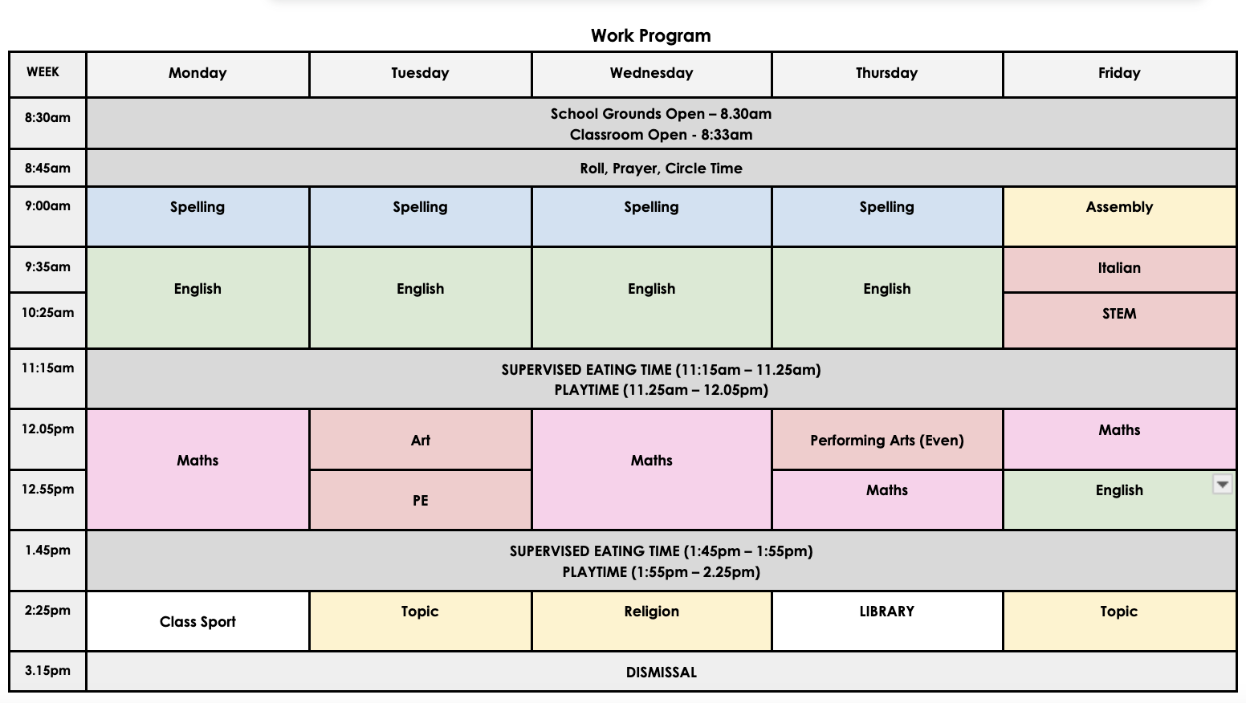
Work Program Example
5 hrs maths a week
10 hrs English a week
Notes:
connection with kindergartens

Slide 15

Main Challenge:
Parking is already a challenge and we will be competing against De La Salle with the earlier finish.
Unfortunately, this is something that we can’t control. We have tried for a ‘Kiss and Go’ zone, however, we are not eligible for this due to safety reason. The Parish car parks remains for staff and parish members only.
Students will be supervised at the end of the day until 3:30 and then will sit in the office until collected.

Slide 16
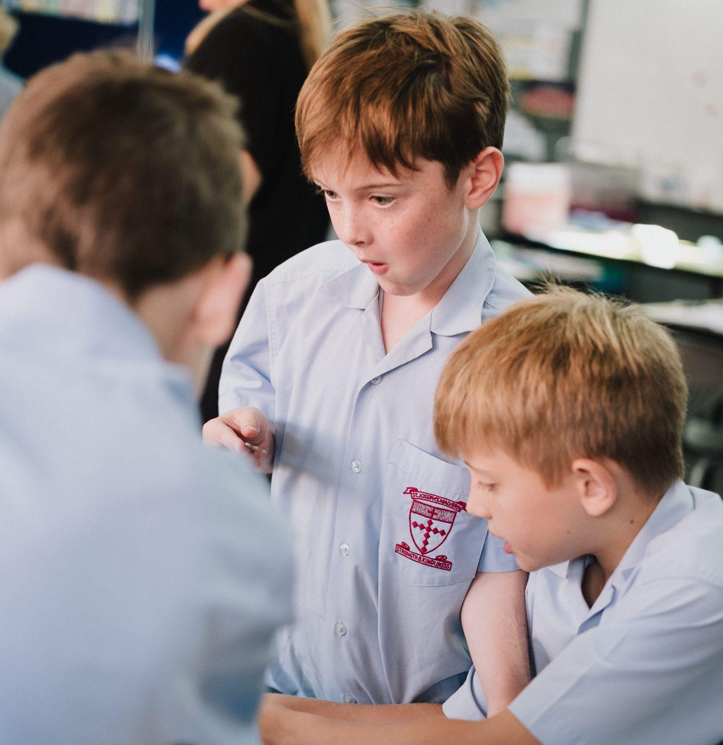





Small enough to care.
Big enough to excel.
www.sjmalvern.catholic.edu.au
office@sjmalvern.catholic.edu.au
stjosephsmalvern
(03) 9597 6300

