Slide 1
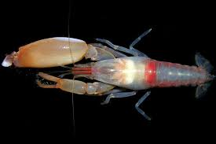
Pistol shrimp
By Lachie 🔫🦐

Slide 2
Contents
1 What is a pistol shrimp
2 attack strategy
3 diet
4 habitat

Slide 3
What is a pistol shrimp
Pistol shrimp File meet the pistol shrimp say hi
Other name Alphidae
Size 3 to 5 cm
Appearance one big claw and
one small one
Is very territorial.
hi

Slide 4
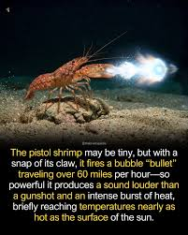
attack strategy
Uses it’s big claw to make a compressed are bubble and then shoots it at 93 kph an hour and as hot as the surface of the sun.

Slide 5
🗿 🔫🦐
Cannon event.
💥

Slide 6
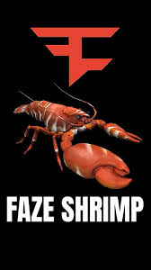
Diet
Schlep mussels and other shrimp.

Slide 7
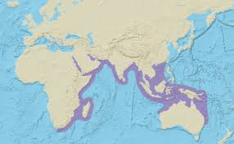
Habitat
coral reefs to temperate kelp forests to sponge dominated and rocky bottom.

Slide 8
🔫🔫🔫🔫🦐🔫🔫🔫🔫
🗿
💥💥💥 💥 💥💥💥💥

Slide 9
w Links.
https://en.wikipedia.org/wiki/Alpheidae
🍋🍋🍋🍋🍋🍋🍋🍋🍋🍋🍋🍋
https://en.wikipedia.org/wiki/Lemon
🍫🍫🍫🍫🍫🍫🍫🍫🍫🍫🍫
https://en.wikipedia.org/wiki/KitKat

Slide 10
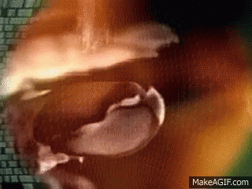
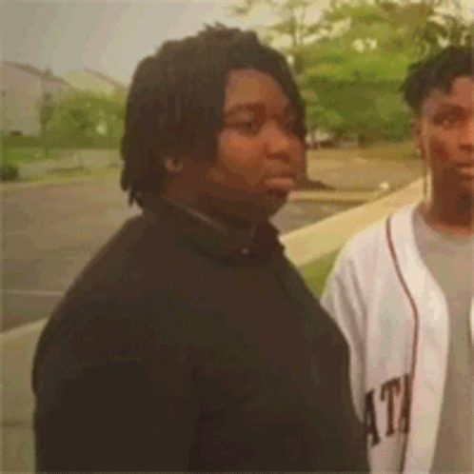
the end.

Slide 11

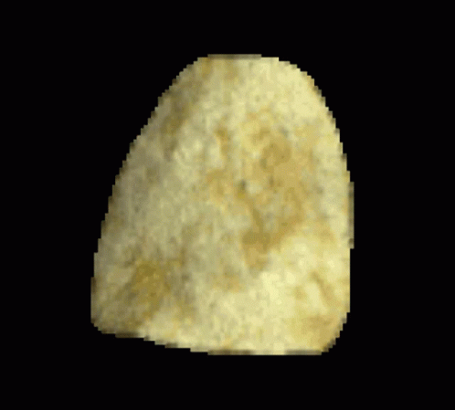

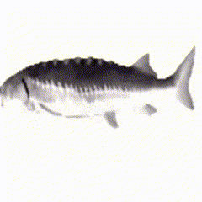
Gif jump scar.

