Slide 1
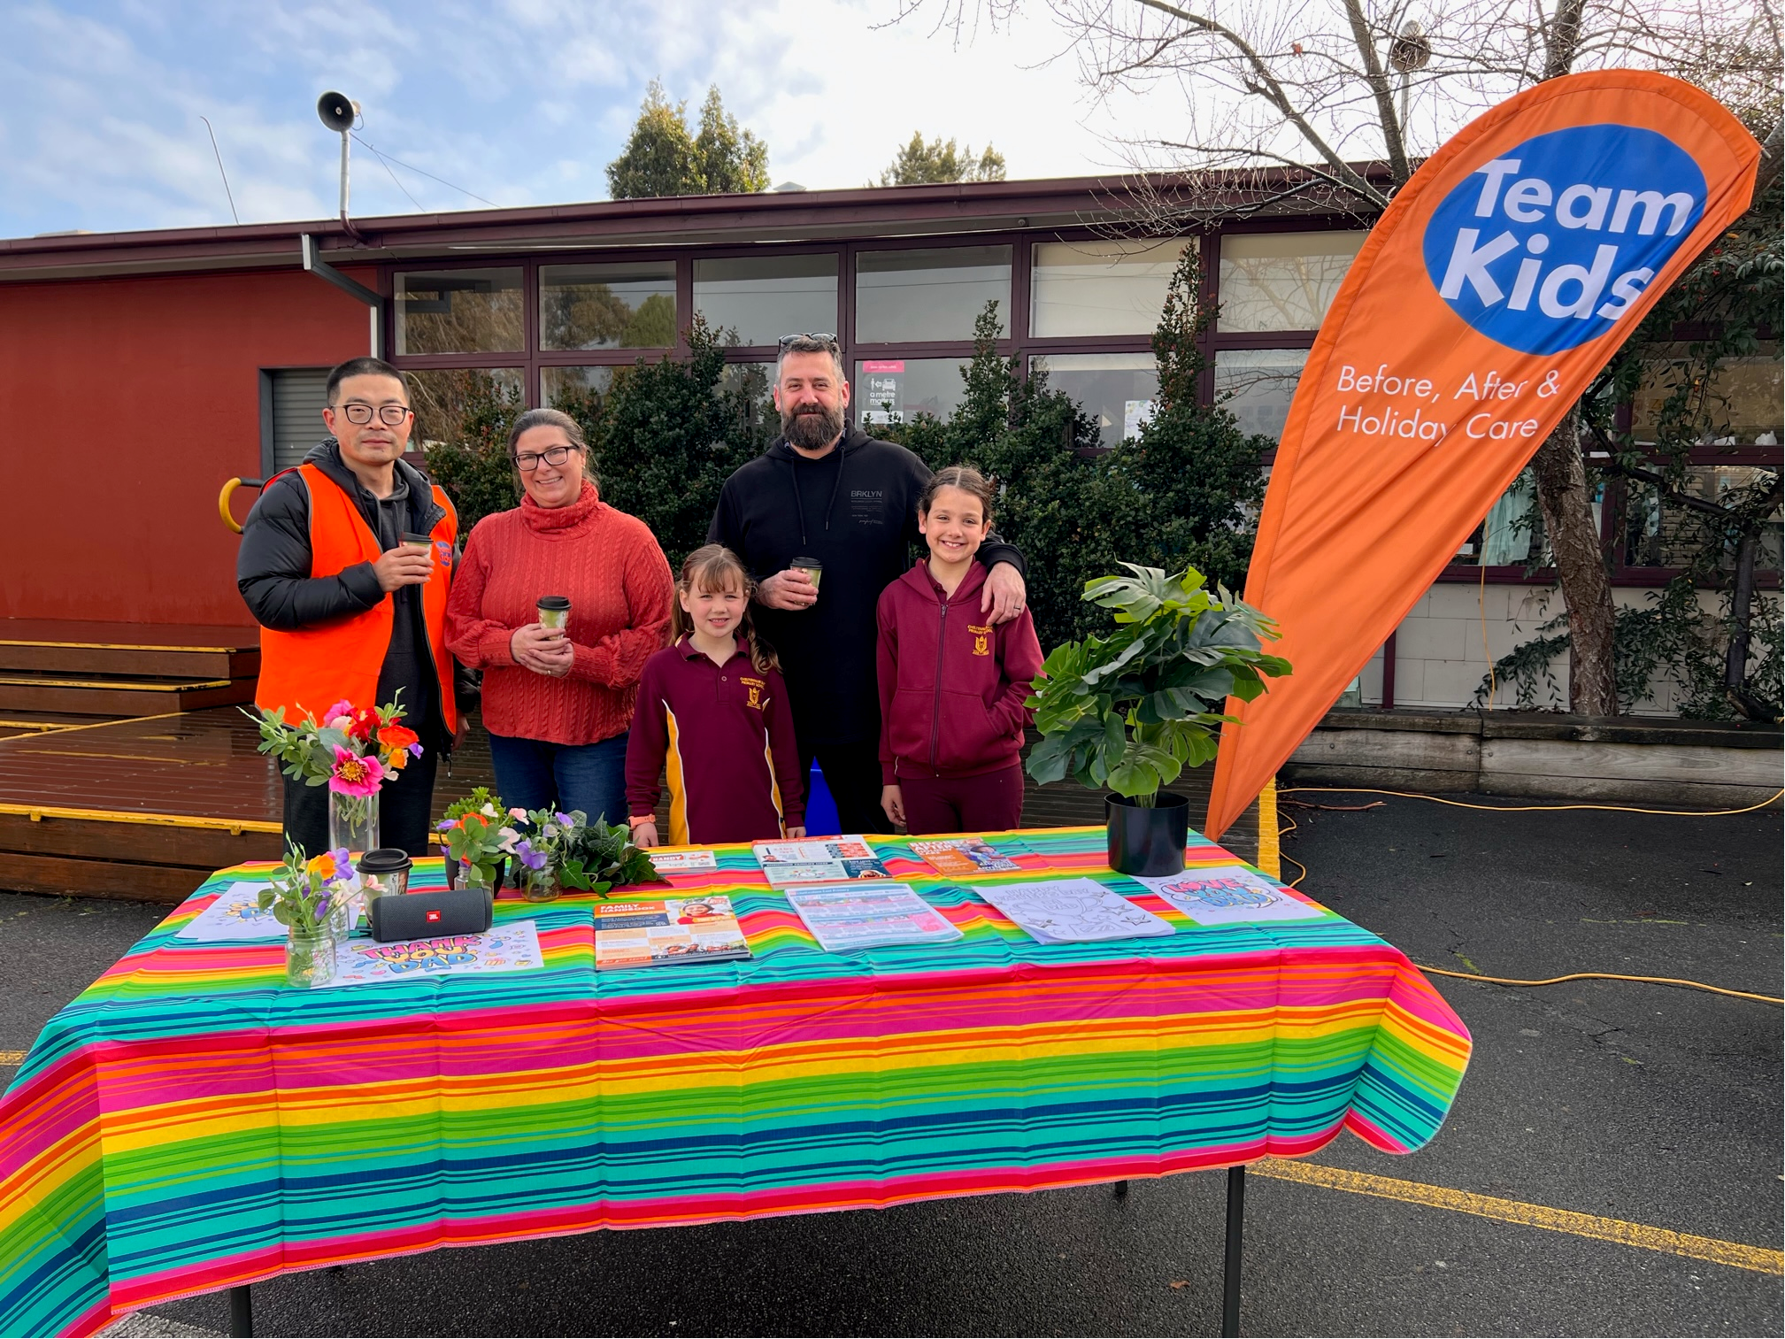



Cheltenham East Team Kids
Dear parents,
Dear Parents,
We hope this newsletter finds you well as we transition into the vibrant and exciting month of September! We have a line-up of engaging events and activities planned for your children at our Before and After School Care program. Here's a glimpse of what's in store:
Coffee Van Delight:
We're thrilled to report that our Father's Day coffee van event was a resounding success! The aroma of freshly brewed coffee and the cheerful camaraderie created a wonderful atmosphere. Thank you to all the fathers who joined us for this delightful morning. We look forward to more joyful moments in the future.
Spring Dance Party - September 6th: Mark your calendars for the much-anticipated Spring Dance Party on September 6th! The children will have the chance to let loose and show off their dance moves in a colourful and festive atmosphere. It's a fantastic opportunity for them to embrace the spirit of the season and create lasting memories with their friends.
Roald Dahl Day - September 13th: Calling all literature enthusiasts! On September 13th, we'll be celebrating the marvellous works of Roald Dahl. Prepare for a day filled with imagination and excitement as we dive into the enchanting tales created by this legendary storyteller. From the whimsical Chocolate Factory to the marvellous Giant Peach, we'll explore the magic of Dahl's worlds together.
😄 Emotion Management Activities on R U OK? Day - September 14th: As part of our commitment to your child's holistic development, we'll be observing R U OK? Day on September 14th. This day serves as a reminder to check in on one another's emotional well-being. Our dedicated team will guide the children through emotion management activities, helping them to develop the skills to recognize and express their feelings in healthy ways.
We're excited about the upcoming month and the opportunities it holds for growth, connection, and fun. Should you have any questions or suggestions, please don't hesitate to reach out to us. Wishing you all a wonderful September ahead!
Warm regards,
Eric
Director of Team Kid Before and After School Care
9
Cooking Club
Origami Club
Game Club
Cooking Club
Origami Club
6th September
Spring Dance Party
13th September
Roald Dahl Day
14th September
R U OK? Day
0432 299 468
CheltenhamEastPS@teamholiday.com.au
1300 035 000
info@teamkids.com.au

