Slide 1
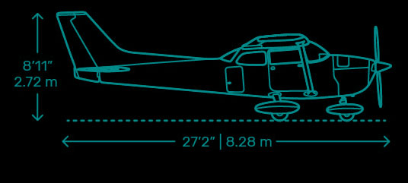
The Aerodynamics of Aircraft
Rachel Hoppe

Slide 2

Key Knowledge
describe the roles of the rudder, elevator and ailerons as the primary control surfaces on an aircraft
calculate lift and drag forces acting on an aircraft:

Slide 3
Primary Control Surfaces
Ailerons, Elevators, Rudder

Slide 4
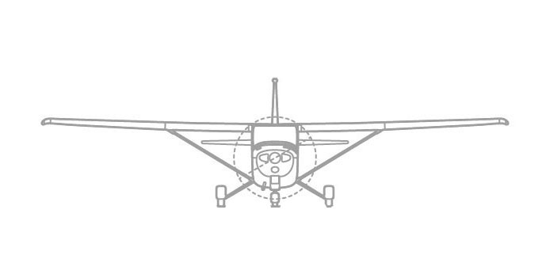
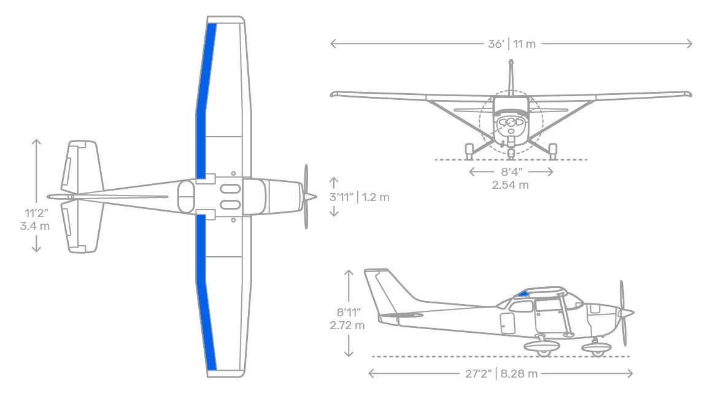
Ailerons
The ailerons control the longitudinal axis of an aircraft. In aviation terms, this is known as the roll of the aircraft.
They are built into the trailing edge of the wing (see figure 2) and counted as a part of the wing’s surface area
Figure 1 - Cessna 172 diagram showing rotation around the longitudinal axis
Figure 2 - Cessna 172 diagram showing location of ailerons

Slide 5
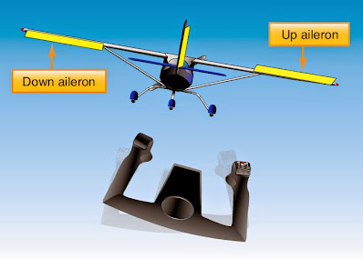
Ailerons
They are controlled with a side to side movement of the yoke (control stick). When the aileron on one wing is deflected down, the opposite aileron is deflected up. The lift on the wing with lifted aileron is decreased, causing the aircraft to roll over that wing.
Figure 3 – Yoke control of ailerons

Slide 6
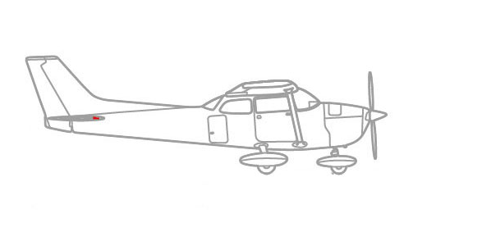
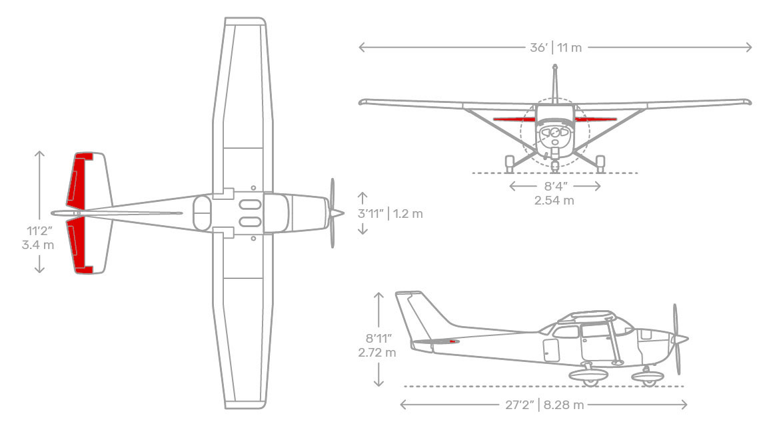
Elevators
The elevators control the lateral axis of an aircraft (see figure 4). In aviation terms, this is known as the pitch of the aircraft.
They are located in the horizontal stabiliser in the aft of the aircraft (see figure 5). They controlled with the yoke by moving it forward and backwards.
They divert air, creating a load on the back of the aircraft, making it pitch upwards or downwards.
Figure 4 – Cessna 172 diagram showing rotation around the lateral axis
Figure 5 – Cessna 172 diagram showing location of elevators

Slide 7
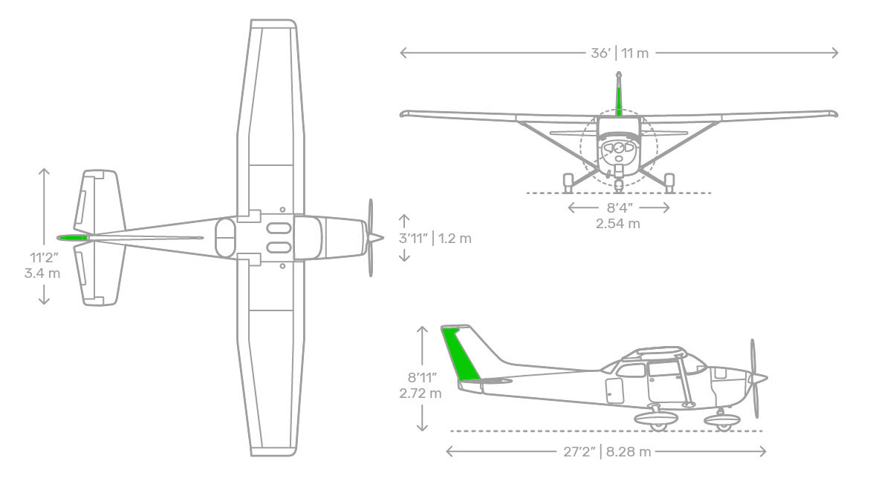
Rudder
The rudder controls the directional axis of the aircraft (see figure 6). In aviation terms, this is known as the yaw of the aircraft.
The rudder is located in the vertical stabiliser in the aft of the aircraft (see figure 7). It is controlled by the foot pedals in the floor of cabin.
The rudder swings the aircraft left or right, depending on how it is deflected. It is used in conjunction with the ailerons to make turns.
Figure 6 – Cessna 172 diagram showing rotation around the directional axis
Figure 7 – Cessna 172 diagram showing location of rudder

Slide 8
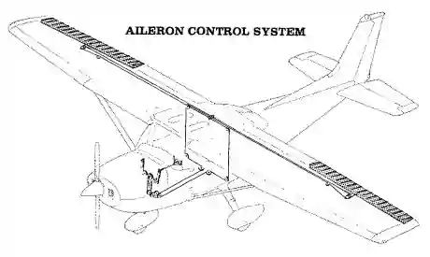
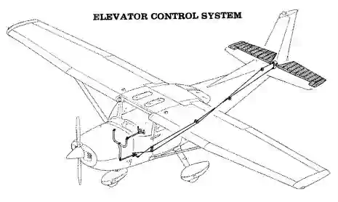
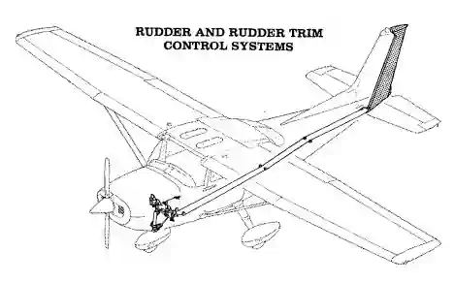
Controlling the Primary Control Surfaces
The movements of the yoke are translated to movement of the ailerons with cables and pulleys or push-pull tubes in light aircraft. Larger aircraft can use a combination of hydraulics, electric, push-pull tubes, and cable/pulley systems.
From left to right: Figure 8 – aileron control system in Cessna 172, Figure 9 – elevator control system in Cessna 172, Figure 10 – rudder control system in Cessna 172

Slide 9
Lift and Drag of an Aircraft
Cessna 172 at range of Altitudes

Slide 10
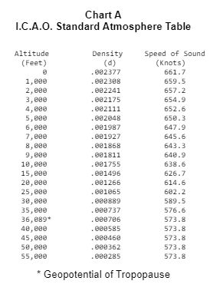
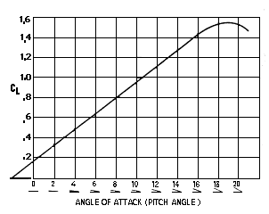
Lift Coefficient and Atmosphere Density
Figure 11 – Lift coefficient based on wing angle of attack
Figure 12 – Density values based on altitude

Slide 11


Drag Coefficient
$Cd_{0}$ is zero-lift drag coefficient. The given range for zero-lift drag coefficient for small, fixed gear, single engine aircraft is 0.025 – 0.040.
$Cd_{i}$ is induced drag or drag induced by lift
Lift coefficient – 1.425
Area Ratio of the wing – 7.52
e (efficiency factor for rectangle wings) – 0.70
$$C_{D}=Cd_{0}+Cd_{i}$$
$$Cd_{0}=\frac{0.025−0.040}{2}=0.0325$$
$$Cd_{i}=\frac{{\left(C_{L}\right)}^{2}}{π×AR×ⅇ}$$
$$Cd_{i}=\frac{{1.425}^{2}}{π×7.52×0.70}$$
$$Cd_{i}=0.12$$
$$C_{D}=0.0325+0.12=0.1525$$

Slide 12
Figures used for calculations
Optimal cruise speed – 140.43 mph (226 km/h)
Wing area – 174 sq ft (53 m²)
Lift Coefficient – 1.425
  Estimate from graph with an angle of attack of 16 degrees
Drag Coefficient (from previous calculations) – 0.1525
Service Ceiling – 14,000 feet
  Calculations will be restricted to heights below this altitude

Slide 13

Lift Equation
$$F_{L}=\frac{1}{2}C_{L}ρv^{2}A$$
$F_{L}$ is the lift force (N)
$C_{L}$ is the lift coefficient
$ρ$ is the density of the atmosphere
$v^{2}$ is the velocity the aircraft is travelling at squared
$A$ is the area of the wing

Slide 14

Lift Calculations
$$F_{L}=\frac{1}{2}C_{L}ρv^{2}A$$
$F_{L}=$ $\frac{1}{2}×1.425×0.001755×{226}^{2}×53$ $=3384.97N$
$F_{L}=\frac{1}{2}×1.425×0.001868$ $×$ ${226}^{2}×53=3602.92N$
$F_{L}=\frac{1}{2}×1.425×0.001987×$ ${226}^{2}×53 =$ $3832.44N$
$F_{L}=\frac{1}{2}×1.425×0.002111× {226}^{2}×53=4071.61N$
Lift at 10,000 feet is 3384.97 N
Lift at 8,000 feet is 3602.92 N
Lift at 6,000 feet is 3832.44 N
Lift at 4,000 feet is 4071.61N

Slide 15

Drag Equation
$$F_{D}=\frac{1}{2}C_{D}ρv^{2}A$$
$F_{D}$ is the force of drag (N)
$C_{D}$ is the drag coefficient
$ρ$ is the density of the atmosphere
$v^{2}$ is the velocity the aircraft is travelling at squared
$A$ is the area of the wing

Slide 16

Drag Calculations
$$F_{D}=\frac{1}{2}C_{D}pv^{2}A$$
$F_{D}=\frac{1}{2}×0.1525×0.001755×$ ${226}^{2}×53=362.25N$
$F_{D}=\frac{1}{2}×0.1525×0.001868×$ ${226}^{2}×53=385.58N$
$F_{D}=\frac{1}{2}×0.1525×0.001987×$ ${226}^{2}×53=410.14N$
$F_{D}=\frac{1}{2}×0.1525×0.002111×$ ${226}^{2}×93=435.73N$
Drag at 10,000 feet is 362.25 N
Drag at 8,000 feet is 385.58 N
Drag at 6,000 feet is 410.14 N
Drag at 4,000 feet is 435.73 N

Slide 17
What do these calculations show?
As altitude increases, the calculated force of lift decreases. This is caused by the fact that air density changes at different altitudes. The higher the altitude, the less dense the air is. Therefore, less lift is created as you increase your altitude.
However, by the same logic, drag also decreases as altitude increases.
Lift at 10,000 feet is 3384.97 N
Lift at 8,000 feet is 3602.92 N
Lift at 6,000 feet is 3832.44 N
Lift at 4,000 feet is 4071.61N
Drag at 10,000 feet is 362.25 N
Drag at 8,000 feet is 385.58 N
Drag at 6,000 feet is 410.14 N
Drag at 4,000 feet is 435.73 N
Notes:
This is why aeroplanes descend to lower altitudes to get out of stall situations

Slide 18
Bibliography
Aeronautics Guide, N/A. Primary Flight Control Surfaces and Dual-Purpose Flight Control Surfaces of a Fixed-wing Aircraft. [Online]
Available at: https://www.aircraftsystemstech.com/p/flight-control-surfaces-directional.html
[Accessed 3 October 2021].
Aviation Stack Exchange, 2017. How is the zero-lift drag coefficient calculated?. [Online]
Available at: https://aviation.stackexchange.com/questions/43410/how-is-the-zero-lift-drag-coefficient-calculated
[Accessed 3 October 2021].
CFI Notebook.net, N/A. Flight Control Systems. [Online]
Available at: https://www.cfinotebook.net/notebook/operation-of-aircraft-systems/flight-controls
[Accessed 3 October 2021].
Maddock, B., 2020. Cessna 172 Skyhawk Aircraft. [Online]
Available at: https://www.dimensions.com/element/cessna-172-skyhawk-aircraft
[Accessed 3 October 2021].
McIver, J., 2003. Cessna Skyhawk II / 100 (172) Performance Assessment. [Online]
Available at: http://www.temporal.com.au/c172.pdf
[Accessed 3 October 2021].

Slide 19
Bibliography
National Aeronautics and Space Administration, 2021. Lift Coefficient. [Online]
Available at: https://www.grc.nasa.gov/www/k-12/airplane/liftco.html
[Accessed 3 October 2021].
National Aeronautics and Space Administration, 2021. Lift Formula. [Online]
Available at: https://www.grc.nasa.gov/www/k-12/WindTunnel/Activities/lift_formula.html
[Accessed 3 October 2021].
National Aeronautics and Space Administration, 2021. The Drag Coefficient. [Online]
Available at: https://www.grc.nasa.gov/www/k-12/airplane/dragco.html
[Accessed 3 October 2021].
National Aeronautics and Space Administration, 2021. The Lift Equation. [Online]
Available at: https://www.grc.nasa.gov/www/k-12/airplane/lifteq.html
[Accessed 3 October 2021].
National Aeronautics and Space Administration, N/A. How Lift Changes. [Online]
Available at: https://www.grc.nasa.gov/WWW/K-12/FoilSim/Manual/fsim0005.htm
[Accessed 3 October 2021].

Slide 20
Bibliography
National Aeronautics and Space Administration, N/A. The Lift Coefficient. [Online]
Available at: https://www.grc.nasa.gov/WWW/K-12/FoilSim/Manual/fsim0007.htm
[Accessed 3 October 2021].
Plane.org, 2010. Basic Stalling. [Online]
Available at: https://forums.x-plane.org/index.php?/forums/topic/44867-07-basic-stalling/
[Accessed 3 October 2021].
Textron Aviation, N/A. Cessna Skyhawk. [Online]
Available at: https://cessna.txtav.com/en/piston/cessna-skyhawk
[Accessed 3 October 2021].
Wikipedia, 2021. Cessna 172. [Online]
Available at: https://en.wikipedia.org/wiki/Cessna_172#:~:text=The%20aircraft%20had%20a%20gross,hp%20(15%20kW)%20less
[Accessed 3 October 2021].

