Slide 1
Wheelers Hill Secondary College
VCE VET MUSIC (CERTIFICATE III in MUSIC)
Notes:
Hello, future music enthusiasts! Today, let's explore how the VCE VET Music program can equip you with the skills, qualifications, and experiences you need, whether you're planning a music career or looking to enrich your life with music.

Slide 2
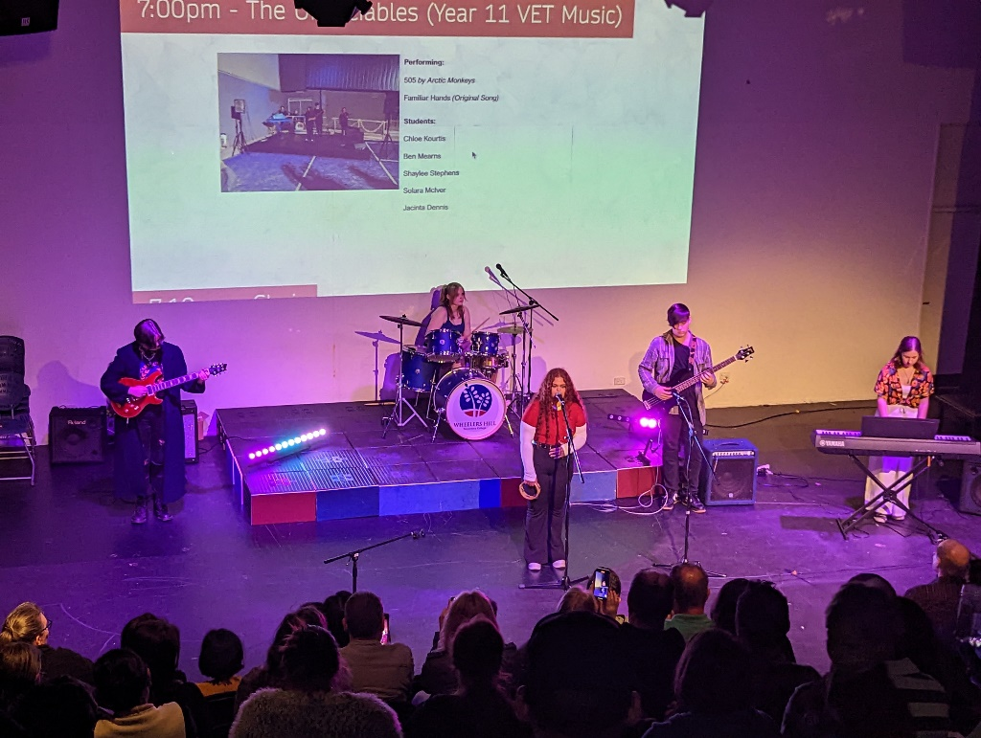
Wheelers Hill Secondary College
VCE VET MUSIC
VCE VET MUSIC: BUILDING YOUR SKILLS
In partnership with COSAMP (RTO 41549)
Extend practical music skills
Focus on songwriting, arranging, and music production
Regular performances and song recordings
Notes:
Our program is designed to extend your practical music skills, including songwriting, arranging, and music production. We offer a hands-on approach to learning, so you'll be regularly performing and recording songs.

Slide 3
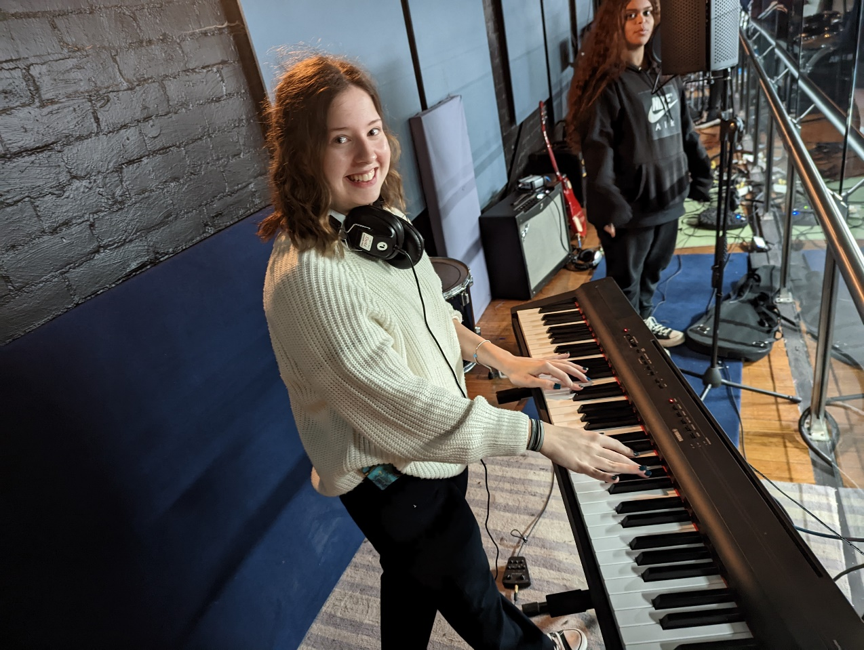
Wheelers Hill Secondary College
VCE VET MUSIC
ADVANCING WITH A CERTIFICATE III
Gain a nationally recognised qualification
Enhances employment opportunities
A valued addition to your resume
Notes:
With our program, you will earn a Certificate III in Music, a nationally recognised qualification that enhances your employment opportunities and stands out on your resume. It demonstrates commitment, skill proficiency, and a broad knowledge base to future employers.

Slide 4
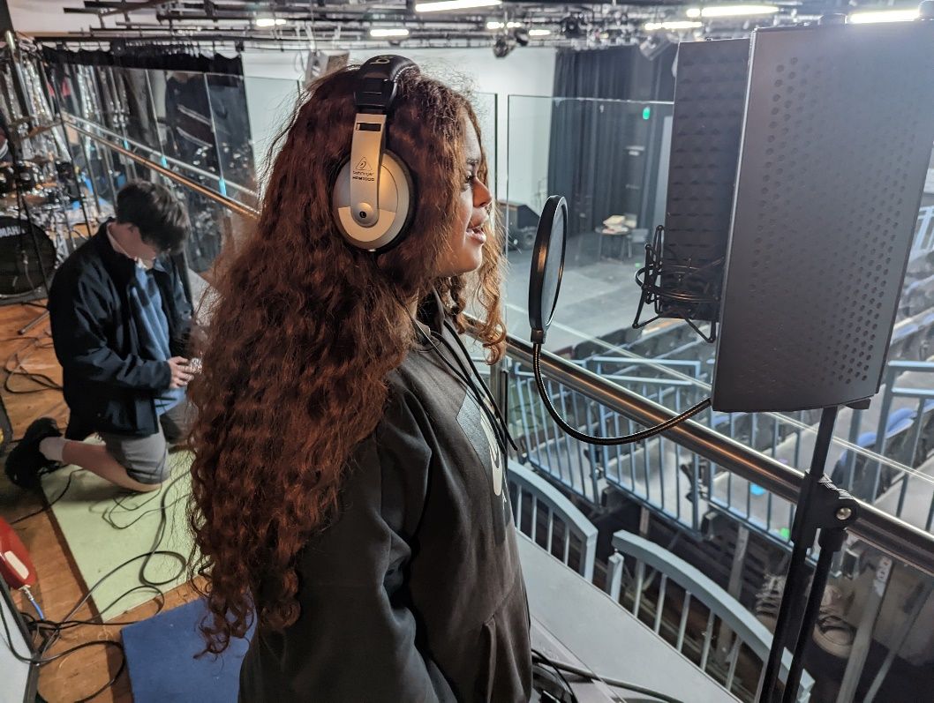
Wheelers Hill Secondary College
VCE VET MUSIC
TAKING YOUR MUSIC TO THE NEXT LEVEL
Create a music demo
Compose simple songs or musical pieces
Understand Copyright
Create a Resume
Prepare for performances
Notes:
VCE VET Music is designed to take your music to the next level. You'll be creating a music demo, composing simple songs or musical pieces, and preparing for performances in Units 1 and 2.

Slide 5
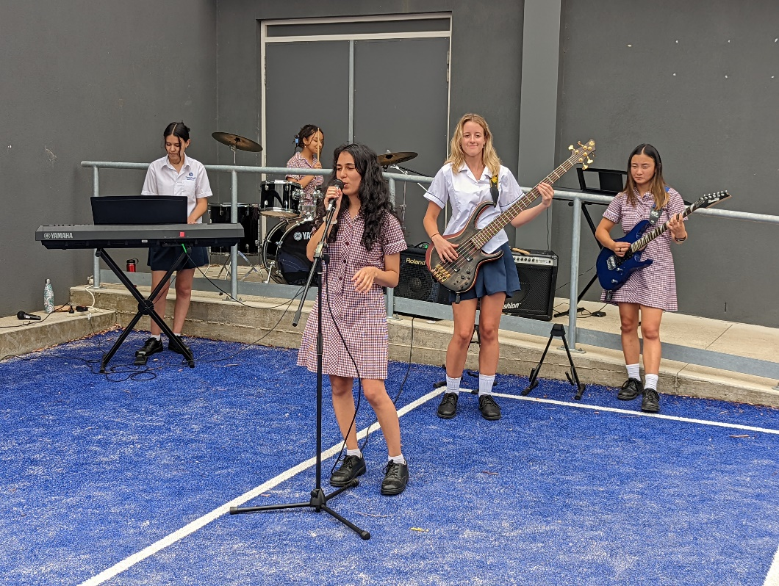
Wheelers Hill Secondary College
VCE VET MUSIC
SCORED ASSESSMENTS AND PERFORMING MUSIC
Develop improvisation skills
Apply knowledge of genre to music making
Perform music as a soloist or part of a group
Notes:
In Units 3 and 4, we offer scored assessments, including units on developing improvisation skills, applying knowledge of genre to music making, and performing music as a soloist or part of a group. These hands-on experiences build your confidence and your skills.

Slide 6
Wheelers Hill Secondary College
VCE VET MUSIC
CREDITS AND QUALIFICATIONS
Contributes to your VCE study score
Provides credits towards your VM Pathway
Notes:
The VCE VET Music course not only contributes to your VCE study score but also provides credits towards your VCAL.

Slide 7
Wheelers Hill Secondary College
VCE VET MUSIC
COURSE REQUIREMENTS AND EXPECTATIONS
Foundational understanding of music theory and piano skills
Proficiency on chosen instrument
Undertake private tuition
Participate in college functions and programs
Notes:
To start on your Certificate III journey, you'll need a foundational understanding of music theory, piano skills, and proficiency on your chosen instrument. All students are also expected to undertake private tuition and actively participate in college functions and programs.

Slide 8
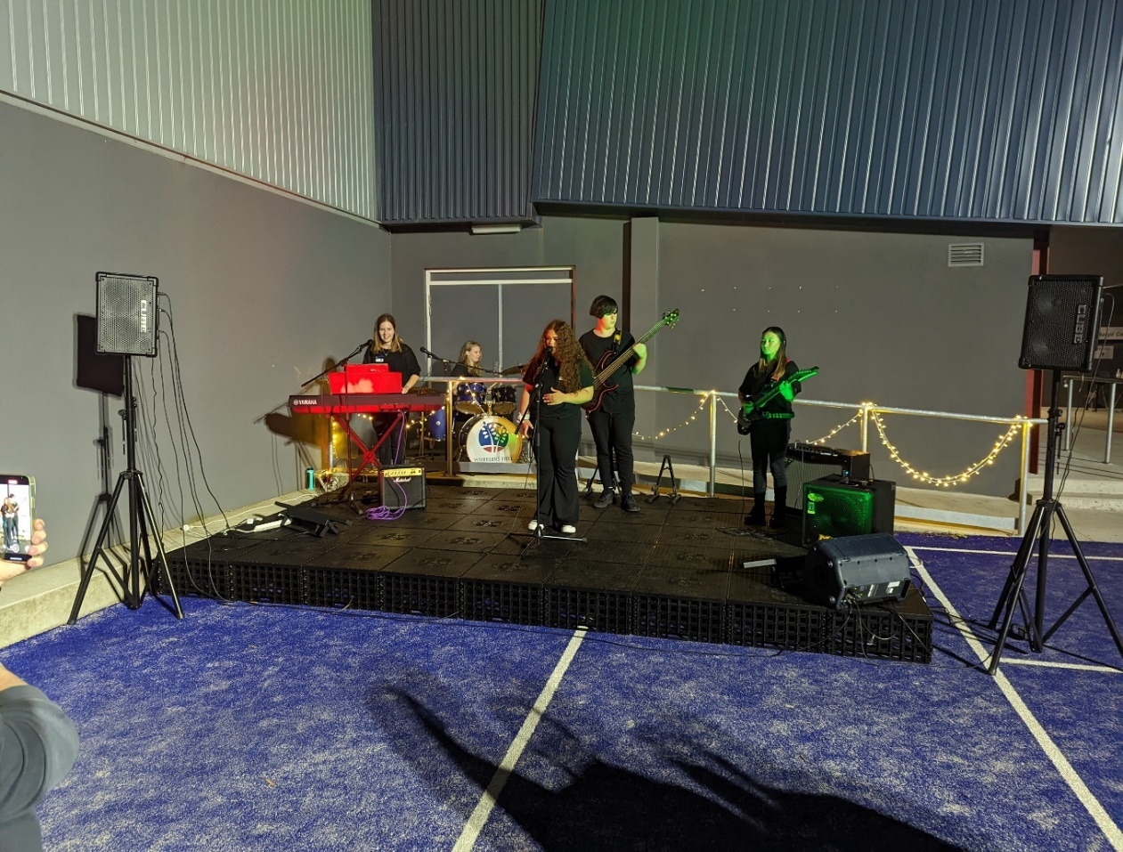
Wheelers Hill Secondary College
VCE VET MUSIC
PERFORMANCE OPPORTUNITIES and
COMMUNITY ENGAGEMENT
Perform at college functions
Participate in a school ensemble or program
Notes:
As part of your learning experience, you may be asked to perform at college functions, and you'll be required to participate in a school ensemble or program. These opportunities allow you to showcase your skills and contribute to our vibrant school community.

Slide 9
Wheelers Hill Secondary College
VCE VET MUSIC
CAREER PATHWAYS AND LIFE SKILLS
Potential careers: Band Member, Songwriter, Music Therapist, Music Teacher, Arranger, Promoter, Audio Engineer, Performer
Skills valuable in any field: creativity, discipline, teamwork, technical know-how
Notes:
This program can pave the way for many career opportunities, including being a Band Member, Songwriter, Music Therapist, Music Teacher, Arranger, Promoter, Audio Engineer, and Performer. But beyond that, the skills you learn here – creativity, discipline, teamwork, and technical know-how – will serve you in any field you choose

Slide 10
Wheelers Hill Secondary College
VCE VET MUSIC
WHSC MUSIC ALUMNI

Slide 11
Wheelers Hill Secondary College
VCE VET MUSIC
START YOUR JOURNEY WITH
VCE VET MUSIC!
Speak to Mr Gill, Ms Mechielsen, or your Instrumental Music Teacher!
Notes:
Whether your goal is a career in music, or you simply want to enrich your life with musical skills and experiences, VCE VET Music is a powerful step forward. The skills you acquire, the qualifications you earn, and the experiences you have can open doors and create opportunities. So, are you ready to start your journey with VCE VET Music?

