Slide 1
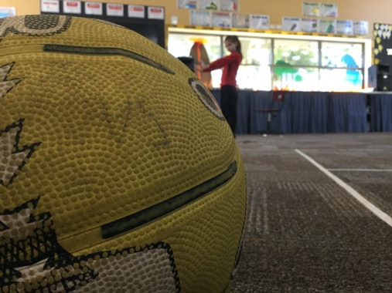
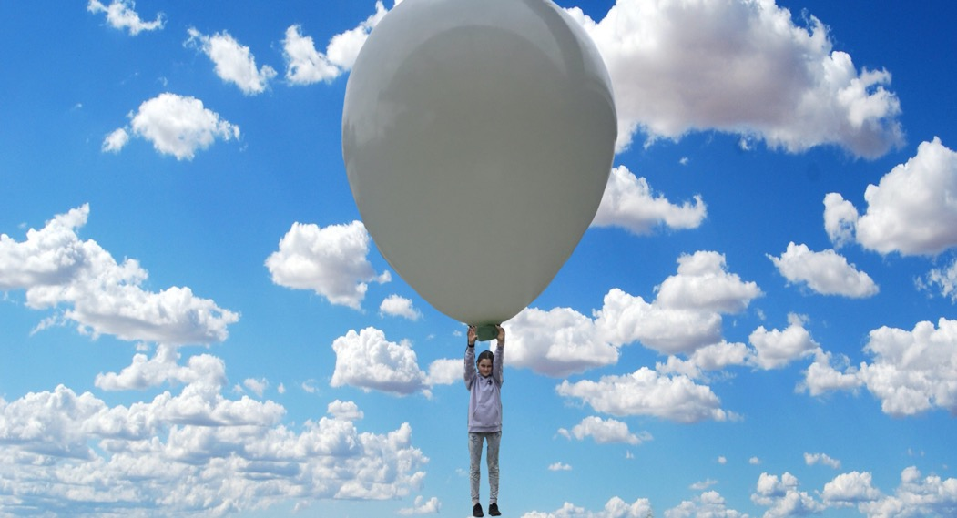
Forced Photography Wk5 RL Art activity Forced perspective photography is an optical Illusion. In a forced perspective photo, the subject of the photo is made to look smaller, larger, closer or further away than it actually is. To make an object appear larger than it is, you hold it closer to the lens of the camera. To make an object appear smaller than it is, you put it further away from the camera. It helps to have someone else hold the camera if you want to be in the shot but you can do it alone too.
Mia C
Rose H
Tyla O is flying high.

Slide 2
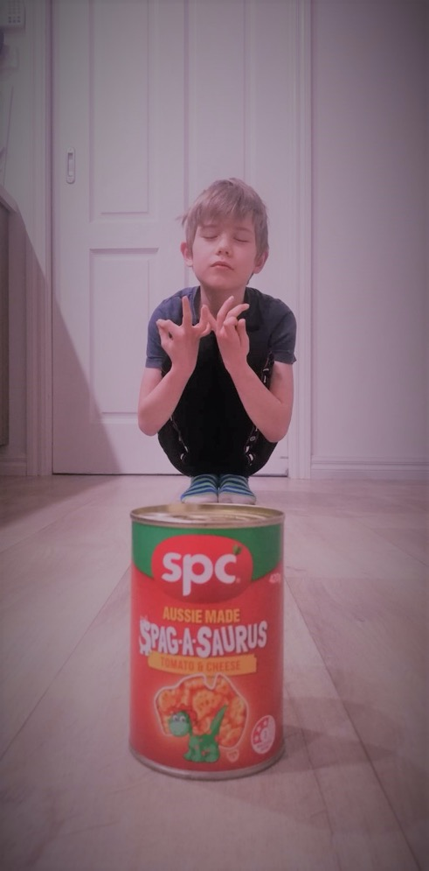
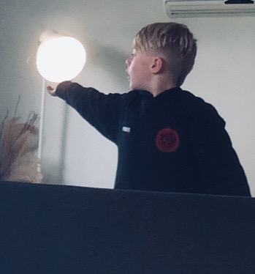
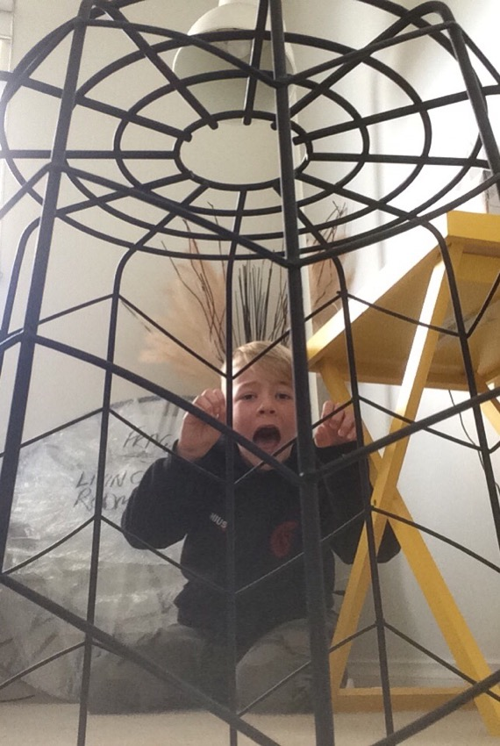
Aiden B
Dylan W

Slide 3
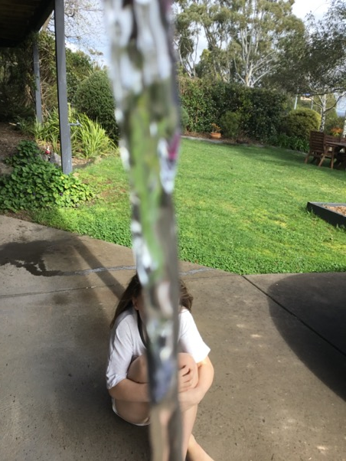
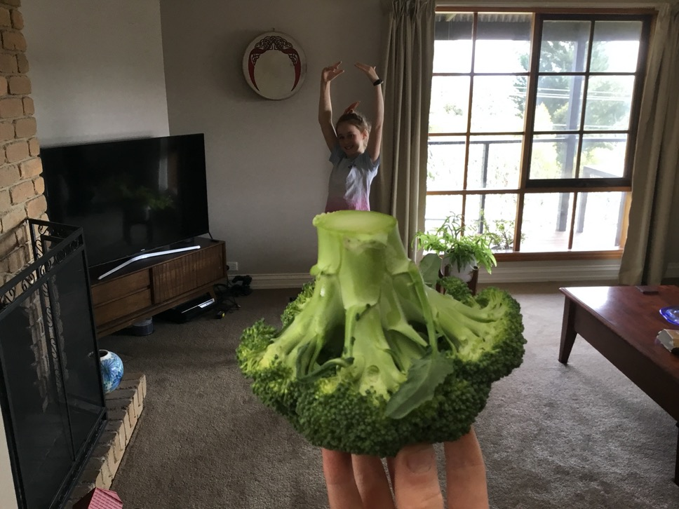
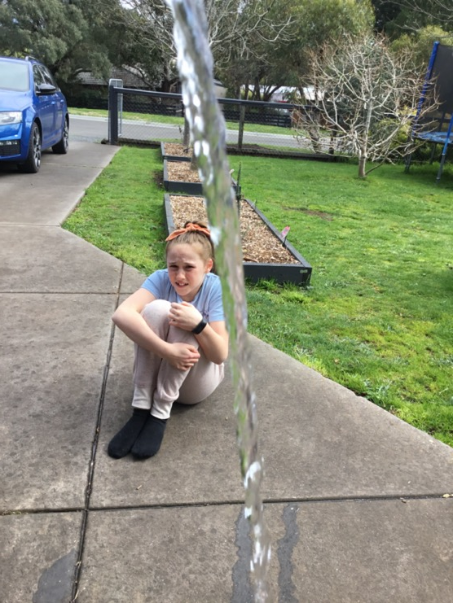
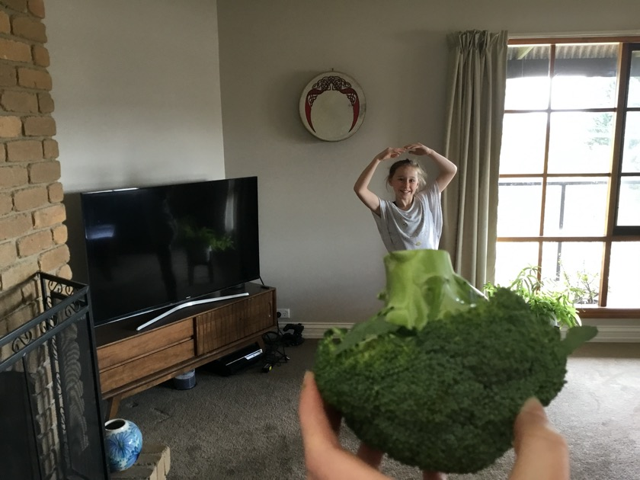
Matilda C and Elara C

Slide 4
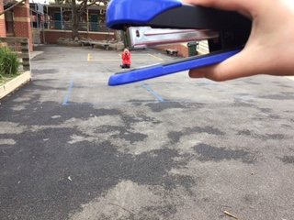
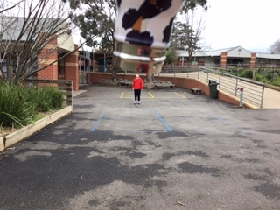
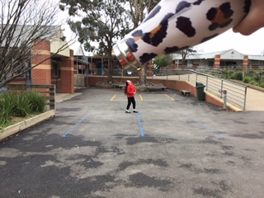
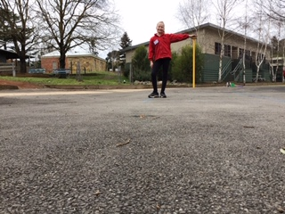
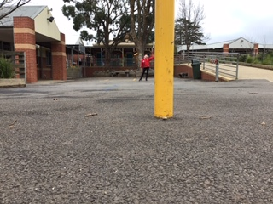
Olivia C

Slide 5
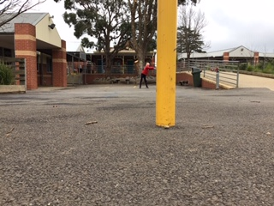
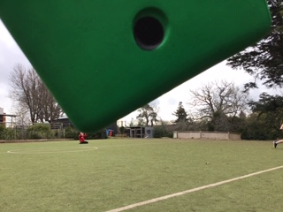
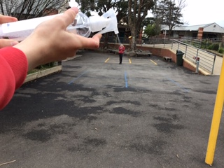
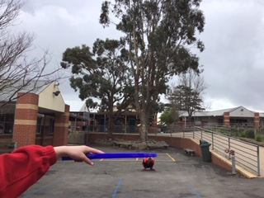
Olivia C
Wow! Olivia has worked really hard to produce all these different examples of ‘Forced Photography’.
Look at all these optical illusions she has created…..….great work!

