Slide 1
Term 3 Middle School Assembly
July 16th, 2021
Notes:
Mr bond will settle the students and introduce Zefang and Ashwina

Slide 2



Acknowledgement of Country
“We would like to acknowledge the Wurundjeri people the Traditional Owners of the land on which we are gathered and pay our respects to their Elders both past, present and emerging.”
Notes:
Ashwina: First of all we would like make an acknowledgement of country. “We would like to acknowledge the Wurundjeri people, the traditional owners of the land on which we gather and pay our respects to their elders both past and present.”
Ashwina: I would now like to welcome the Middle School vice Captains Ashnela, Diya Audrey and Harris who will be taking part in this assembly at various stages.

Slide 3
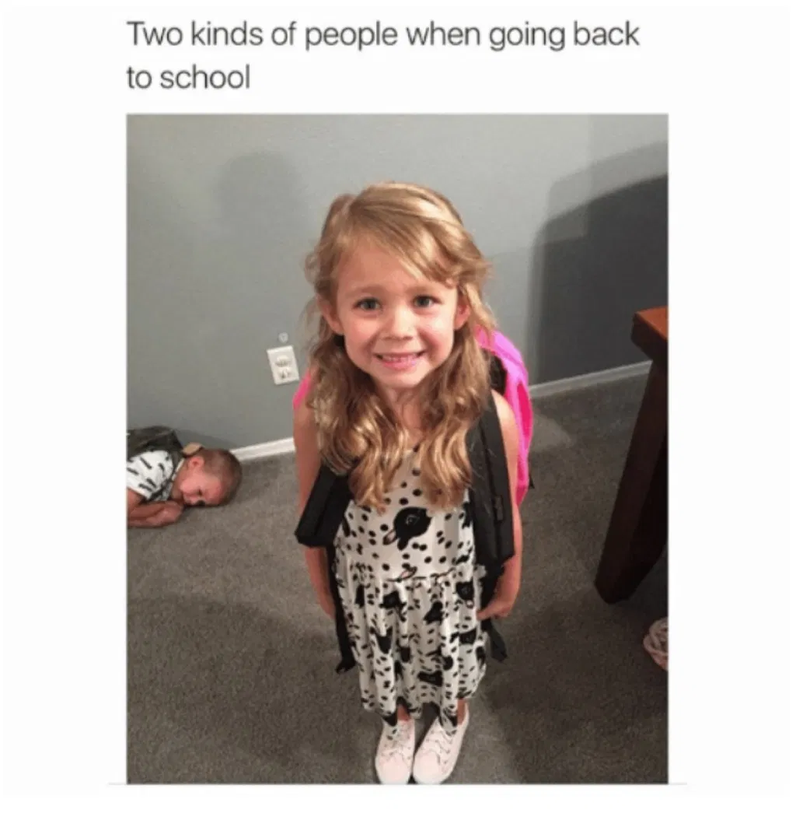
Which one are you?
No matter which child you might identify with, coming back to school is inevitable. Make the most of your opportunities and be grateful!

Slide 4
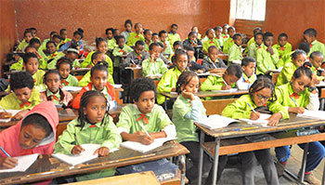
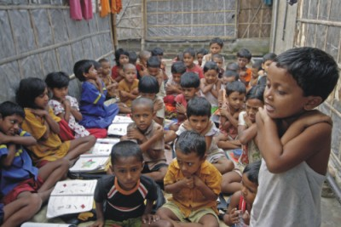
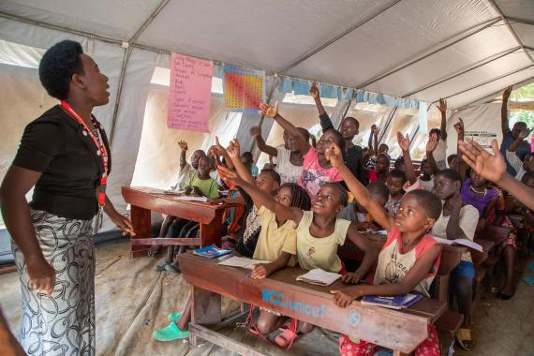
Check out the learning opportunities for others across the world compared to what we have on the following slide.
Be grateful for the opportunities that exist rather than waste your chances of success.

Slide 5
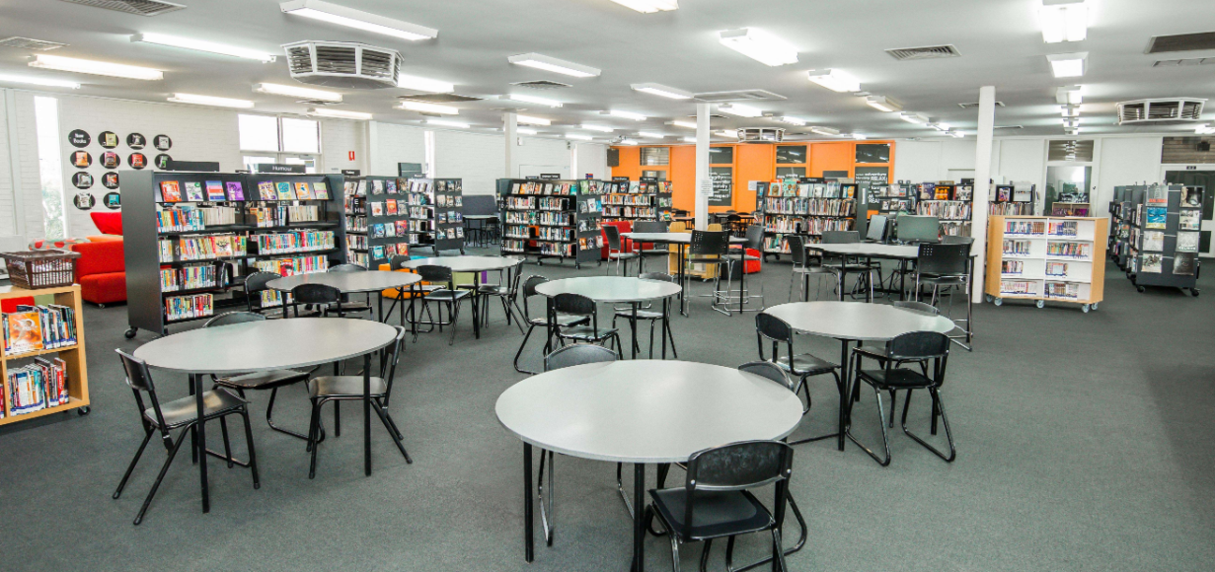
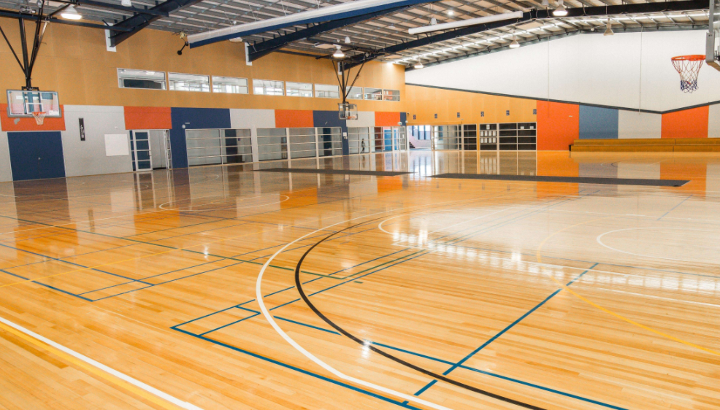
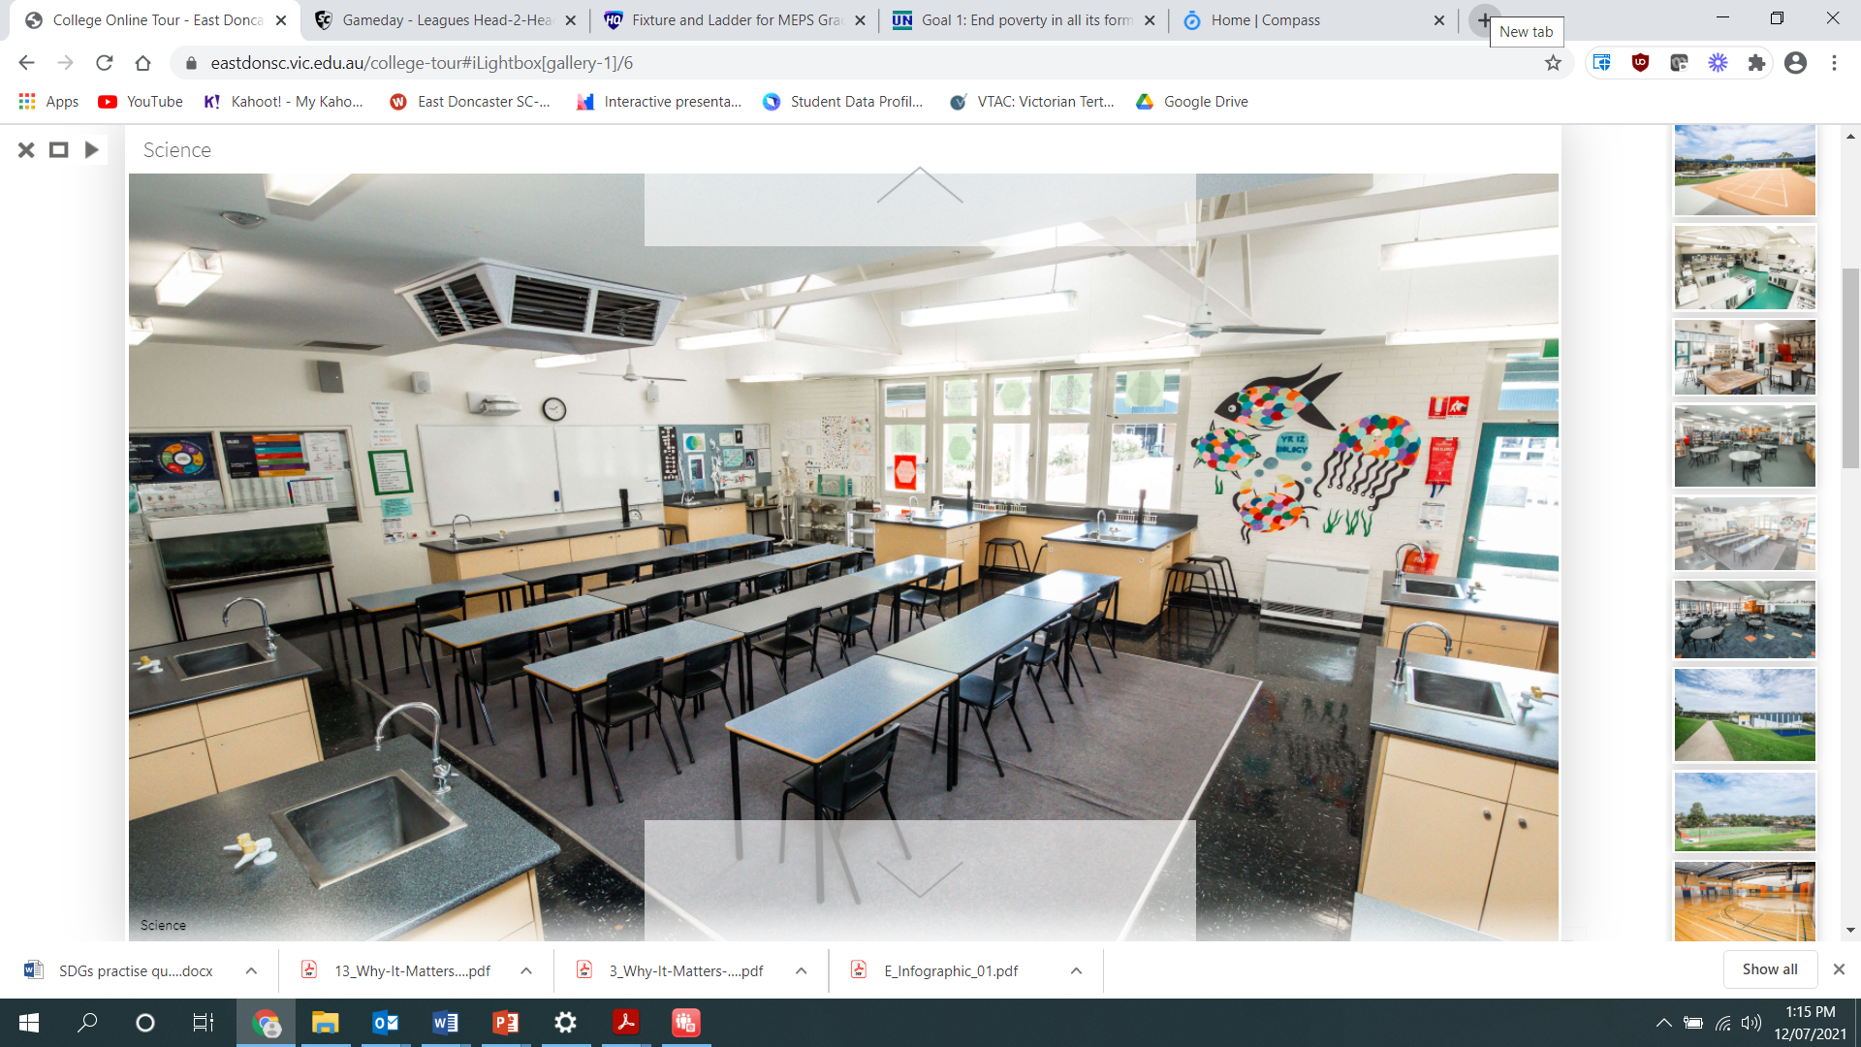
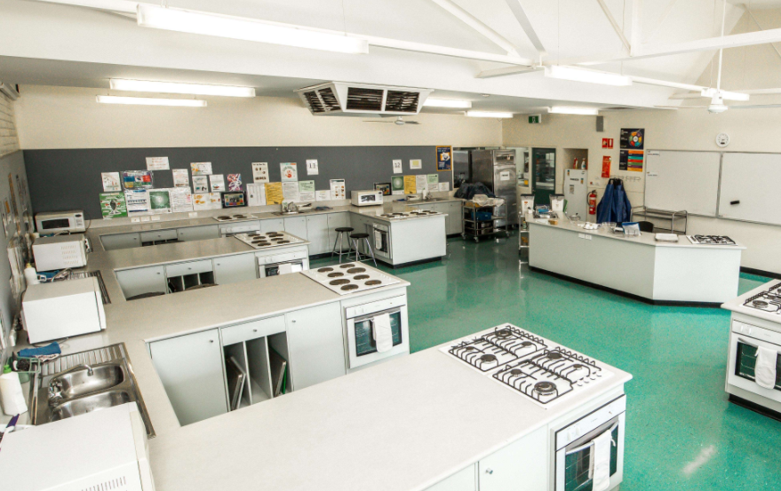

Slide 6
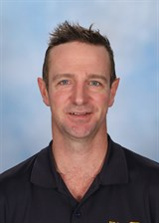
Head of Middle School
Congratulations on getting through the first half of the year
Communicate with teachers
Focus on breaks between classes
Notify coordinators if you have any issues
Uniform Standards and Procedures (onsite)
Lockers (onsite)
The School Environment!
Respect

Slide 7
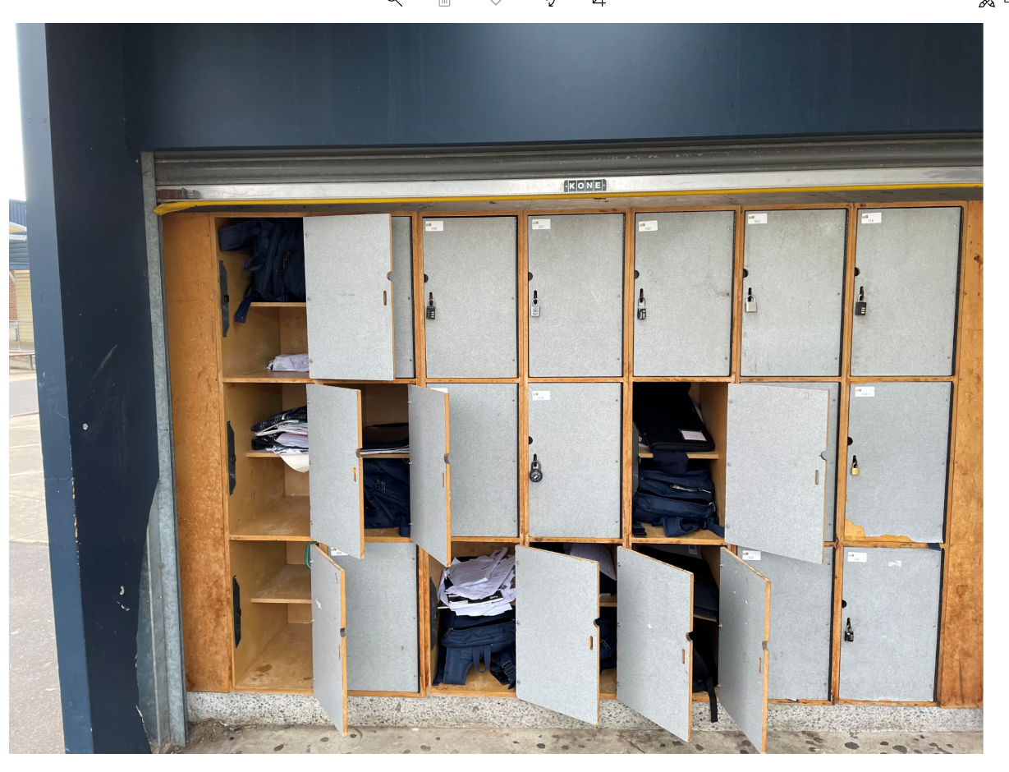
Unlocked lockers
No locks
Phones/belongings unsafe
Not acceptable

Slide 8
Term 3 Update – EDSC House Championship 2021
Term 3 Update - EDSC House Championship 2021
The EDSC House Championship for 2021 continues.
The following activities have recently contributed to house points being earned by students this term:
- Demonstration of college Values during remote and on-site learning
- Cycle 2/3 Academic Excellence
- Participation in College Events
Updates were received during PF in regards to the upcoming House Athletics Carnival. GET INVOLVED to contribute to your House’s overall total. Compass Newsfeed for Reminders.

Slide 9
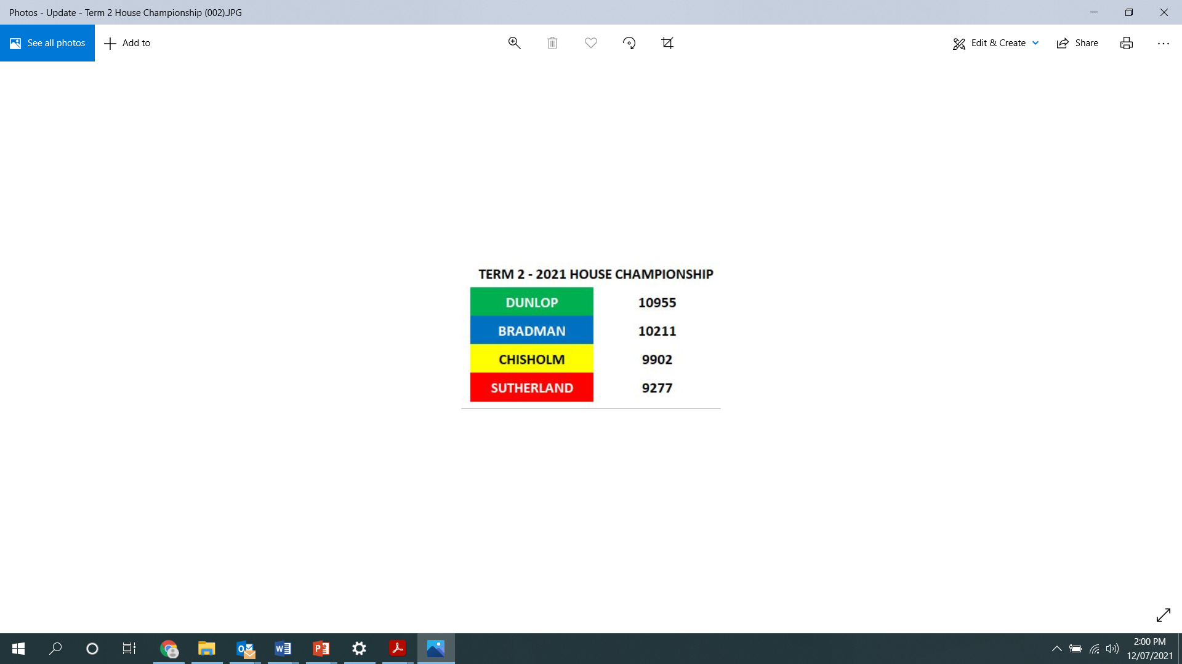

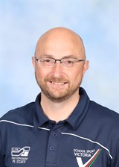
Only You Can Make a Difference!!

Slide 10
Interschool Sport Results
Slides Prepared by Brandon Wood

Slide 11
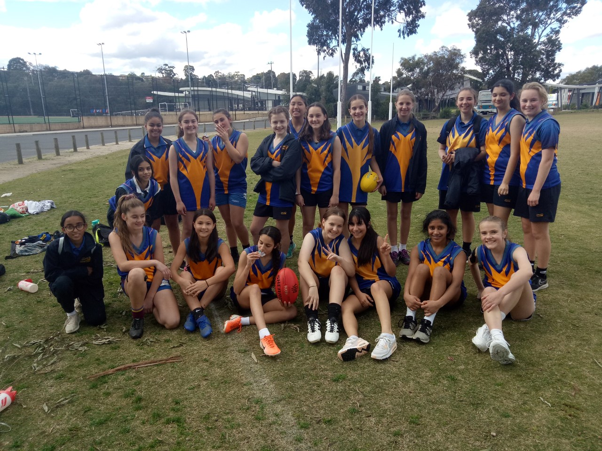
Girls 7/8 AFL Runners Up Whitehorse Division

Slide 12
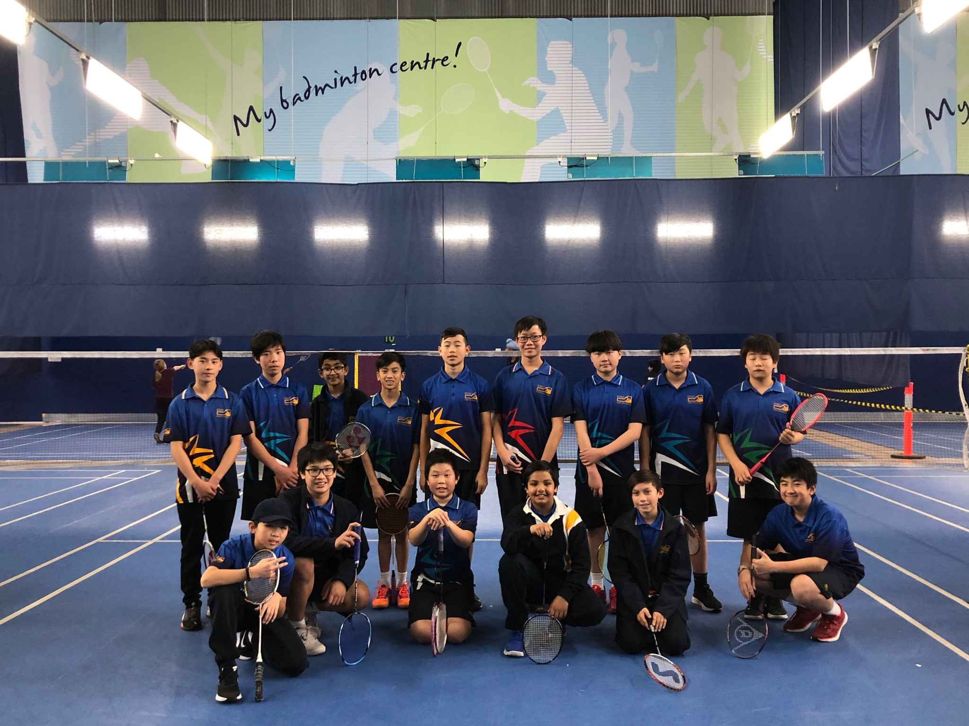
7 Boys/Girls Badminton Winners Whitehorse Division

Slide 13
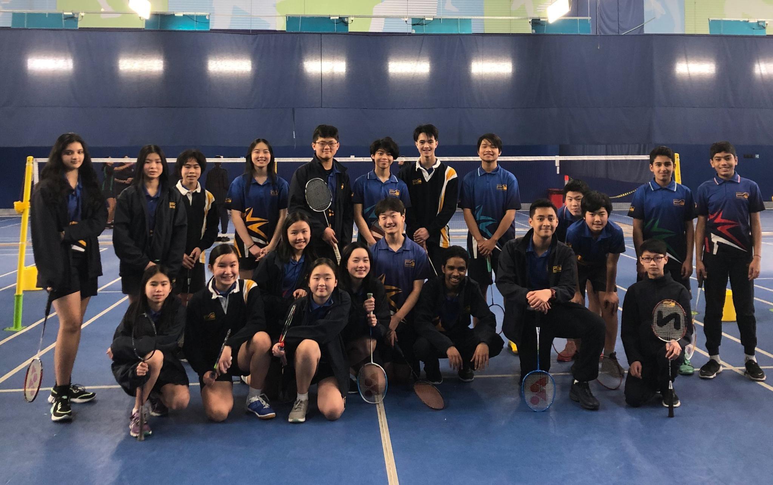
Year 8 Boys/Girls Badminton Winners Whitehorse Division

Slide 14
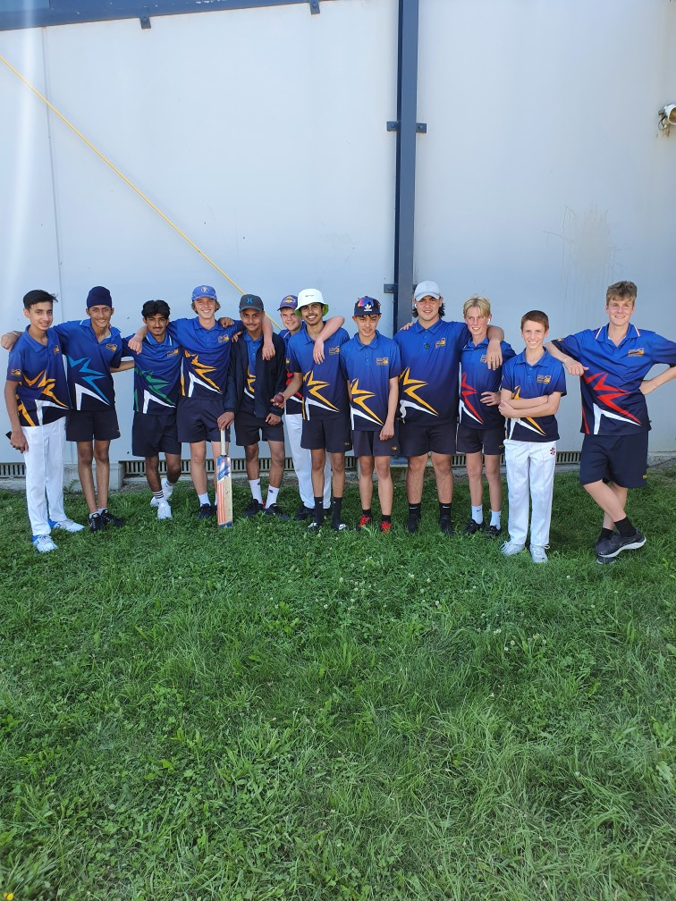
Intermediate Boys Cricket Runners Up Whitehorse Division

Slide 15
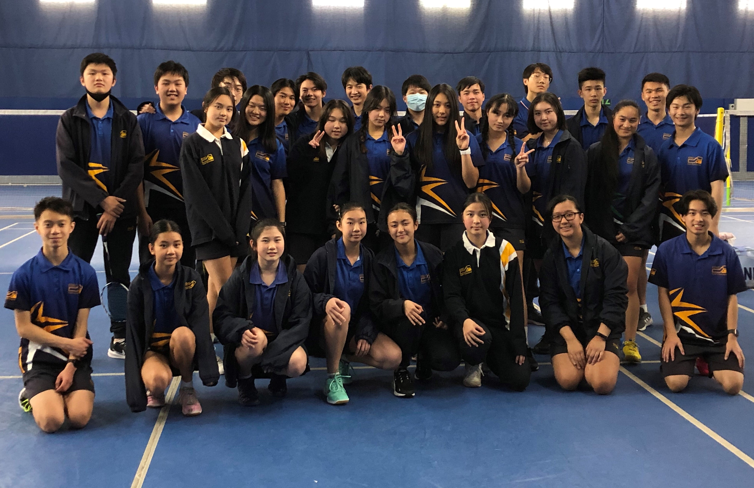
Boys & Girls Badminton Winners Whitehorse Division

Slide 16
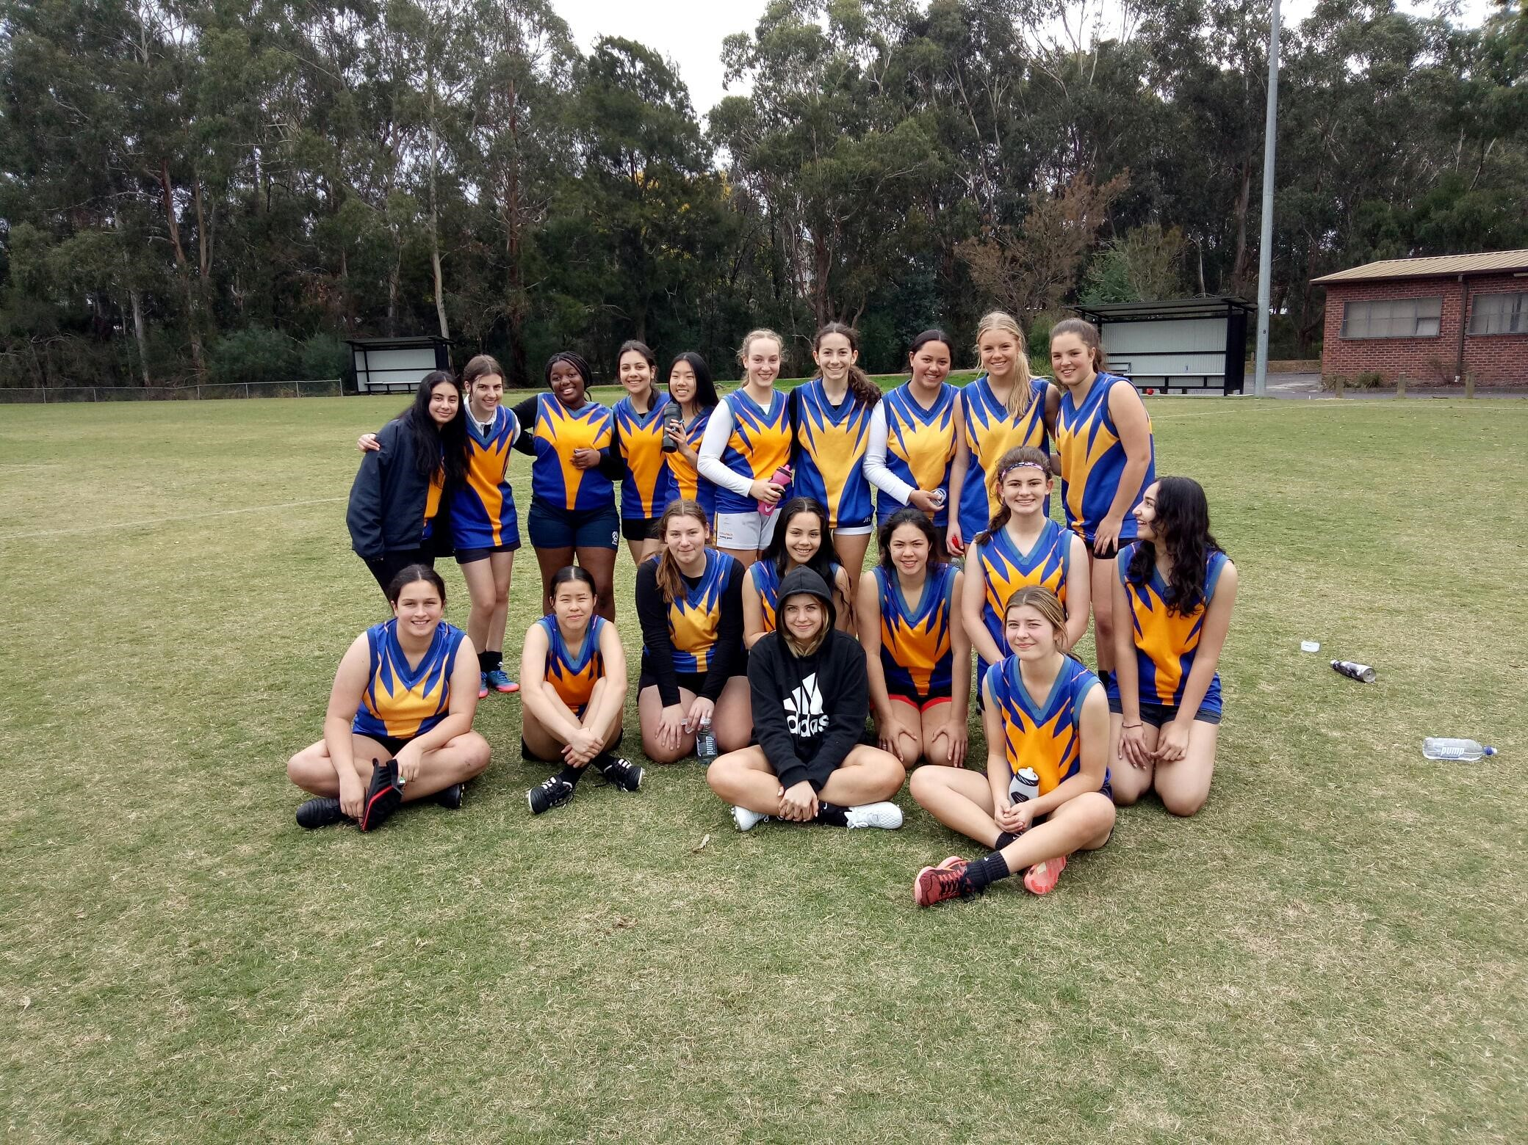
Girls AFL runners Up Whitehorse Division

Slide 17
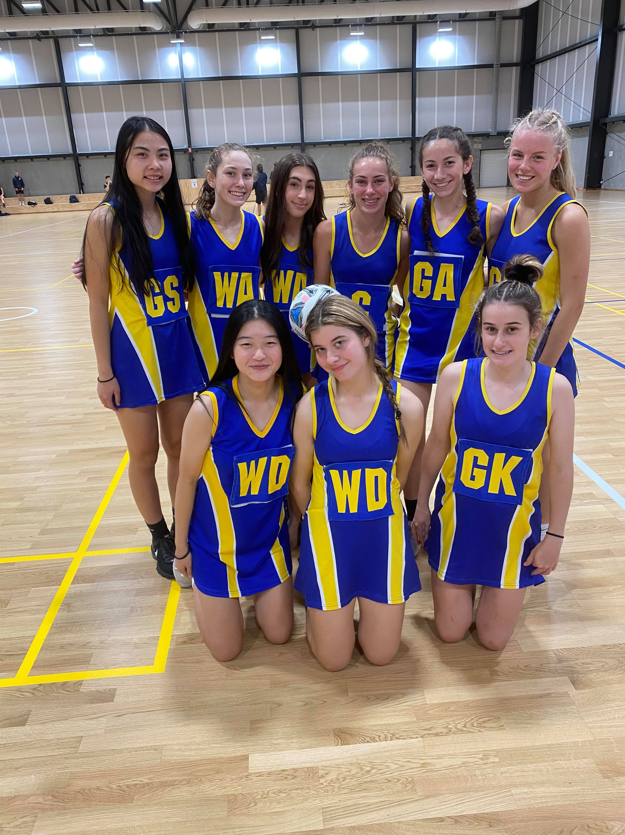
Girls Netball Winners Whitehorse Division

Slide 18
Other Intermediate Results
Boys Football Runners-Up Whitehorse Division
Boys Netball Runners-Up Whitehorse Division
Boys Soccer Winners Whitehorse Division
Girls Soccer Runners-Up Whitehorse Division

Slide 19
Term 3 Events
House Athletics Carnival: Tuesday 20th July (Cancelled)
Big Freeze Day: Tuesday 13th July (Great Success)
Year 8 Art Excursions: Wed – Thursday 4th and 5th August
and Friday 13th August (Cancelled)
Attitudes Community Event: Thursday – Friday 26th – 27th August
Year 8 Camp: Monday 6th September to Wednesday 8th September

Slide 20
Values Awards
The following slides contain comments made by teachers about why they nominated a student for a values award.
Notes:
J: We now move to the main focus of today’s assembly – our values awards for Term 3. Throughout the term you have been demonstrating our values each day through the actions you’ve have taken in class and around the school. Our values are in some ways the most important part of our learning at school. If we can manage incorporate these values into our everyday life, it will ensure that we become productive members of our community.
A: In the spirit of promoting the importance of these values we’ve asked teachers to nominate students who have demonstrated these values for an award. We will now award the recipients with their awards. Please hold your applause until the end of each category. Please put your hand together for John Roberts college principal who will be joining us to present the awards.

Slide 21
Y7 Values Awards: Respect
Rights of all members of the community to achieve full potential
Care of the physical environment and property of others
Acceptance of individual differences and the cultural diversity of the school diversity
Self respect
Victoria C
Victoria is always a respectful and kind student in class and throughout remote learning. Activiely engaged in both classroom and remote learning. Always supportive and encouraging to students around her.
Notes:
Nominated by Mr Jones: William has been really focused in class the last two weeks, filmed with his group and today was working away on his film edit without any disruptions. Well done Will.
Samantha Lydia and Le Anne were nominated by Mr Basford for their respect in always listening to instructions, completing set work to a high standard and contributing to class discussion

Slide 22
Y8 Values Awards: Respect
Hazel T 8E
Consistently demonstrates respect to teachers and peers. Attentive in class, listens to others, shares ideas, uses initiative, takes notes without being prompted. Work is a pleasure to read.
Rights of all members of the community to achieve full potential
Care of the physical environment and property of others
Acceptance of individual differences and the cultural diversity of the school diversity
Self respect
Notes:
Nominated by Mr Jones: William has been really focused in class the last two weeks, filmed with his group and today was working away on his film edit without any disruptions. Well done Will.
Samantha Lydia and Le Anne were nominated by Mr Basford for their respect in always listening to instructions, completing set work to a high standard and contributing to class discussion

Slide 23
Y9 Values Awards: Respect
Rights of all members of the community to achieve full potential
Care of the physical environment and property of others
Acceptance of individual differences and the cultural diversity of the school diversity
Self respect
Simon A
Simon demonstrates the value of respect through his interactions with his peers, in listening and contributing positively in all class activities, and in the work he produces. He stands up for himself and his friends and insists on respectful behaviour at the college.
Notes:
Nominated by Mr Jones: William has been really focused in class the last two weeks, filmed with his group and today was working away on his film edit without any disruptions. Well done Will.
Samantha Lydia and Le Anne were nominated by Mr Basford for their respect in always listening to instructions, completing set work to a high standard and contributing to class discussion

Slide 24
Y7 Values Awards: Resilience
Maisie H
Maisie has demonstrated the school value of Excellence in her work for Maths throughout Lockdown 4.0. She has also demonstrated the school value of Resilience by asking for and then applying the feedback to improve her work. She also was also nominated for her work and application in HDP during term 2 too.
Persistence
Courage to give and accept advice for improvement
Positively adapting to change
Trying again to get it right
Notes:
J: Awarded to all students, staff and parents for dealing with the COVID-19 pandemic so far

Slide 25
Y8 Values Awards: Resilience
Anton A
Anton has continued to demonstrate persistence to push himself to achieve his personal best in all events in PE.
Persistence
Courage to give and accept advice for improvement
Positively adapting to change
Trying again to get it right
Notes:
J: Awarded to all students, staff and parents for dealing with the COVID-19 pandemic so far

Slide 26
Y9 Values Awards: Resilience
Alissa P
Alissa has worked consistently hard in Textiles and has shown enthusiasm and perseverance to build skills in garment construction. In English Alissa always persists in tasks no matter how difficult. She is always asking for feedback to improve and if she does hit a road block or cannot work something out she is able to find ways through trial and error and talking things out to overcome this and achieve the desired result.
Persistence
Courage to give and accept advice for improvement
Positively adapting to change
Trying again to get it right
Notes:
J: Awarded to all students, staff and parents for dealing with the COVID-19 pandemic so far

Slide 27
Y7 Values Awards: Curiosity
Love of learning
Trying new things
Developing an awareness of our global community
Developing a sense of interest and wonder
Caitlyn T
Ciaitlin has demonstrated an number of values, including curiosity in completing a challenging task in Science, She also used great teamwork in supporting the group to strive for excellence. She has also been nominated for her curious approach to her work in Health and Human Developmenrt, consistently working well in HPD during term 2.
Notes:
Amin and Parsa were were nominated by Mr Basford for Always asking questions in Science during class but also following up with further inquiry and questioning in their own time.

Slide 28
Y8 Values Awards: Curiosity
Arwa A
Arwa has demonstrated time after time her willingness to work hard to improve her work in Humanities. She shows great interest in the subject and is a great participator in class. Arwa approaches everything put before her with positive energy and is always open to advice.
Love of learning
Trying new things
Developing an awareness of our global community
Developing a sense of interest and wonder
Notes:
Amin and Parsa were were nominated by Mr Basford for Always asking questions in Science during class but also following up with further inquiry and questioning in their own time.

Slide 29
Y9 Values Awards: Curiosity
Love of learning
Trying new things
Developing an awareness of our global community
Developing a sense of interest and wonder
Jesse Y
Jesse has shown great enthusiasm and curiosity in Maths and Science this year. He asks insightful questions which help all of the class to develop a deeper understanding of the concepts. During City Experience he participated actively and vocally asking probing questions to find out more about each of the excursions we attended. Teachers report he always goes above and beyond in his efforts, and he has excellent results across all subjects in Cycle 2.
Notes:
Amin and Parsa were were nominated by Mr Basford for Always asking questions in Science during class but also following up with further inquiry and questioning in their own time.

Slide 30
Y7 Values Awards: Excellence
The development of self discipline and pursuit of improvement in academic results, sport, the arts and personal development
Always doing your best and supporting and celebrating others to do the same
The continuous improvement in the teaching and learning program
Kelly Y
Kelly demonstrated the EDSC value of Excellence by completing a difficult task really quickly and accurately in Music. She added in her own extra parts and showed advanced skills using the Soundtrap software.
Notes:
Nominated by Mr Jones: Edward has been terrific in Media. Picking up new skills straight away, showing other students how to edit and always thinking of others. An example was today he noted upon leaving "someone was away from our group, should I bring a USB next lesson so they can get the files they missed?“
Nominated by Ms Denton Layth did a really good job presenting his Health Learning Task today-a Personal Identity presentation. I'm sure he was really nervous but he did really well and I'm proud of him for being ready and getting the work done.

Slide 31
Y8 Values Awards: Excellence
The development of self discipline and pursuit of improvement in academic results, sport, the arts and personal development
Always doing your best and supporting and celebrating others to do the same
The continuous improvement in the teaching and learning program
Malcolm P 8B
Malcom recently completed a 12 bar blues recording using music software. He followed instructions perfectly and his recording as accurate as well as creative. He has shown high ability in music - practical and written.
Notes:
Nominated by Mr Jones: Edward has been terrific in Media. Picking up new skills straight away, showing other students how to edit and always thinking of others. An example was today he noted upon leaving "someone was away from our group, should I bring a USB next lesson so they can get the files they missed?“
Nominated by Ms Denton Layth did a really good job presenting his Health Learning Task today-a Personal Identity presentation. I'm sure he was really nervous but he did really well and I'm proud of him for being ready and getting the work done.

Slide 32
Y9 Values Awards: Excellence
The development of self discipline and pursuit of improvement in academic results, sport, the arts and personal development
Always doing your best and supporting and celebrating others to do the same
The continuous improvement in the teaching and learning program
Yiting L
Yiting has achieved consistently excellent results across all subjects in Cycle 2 and achieved a perfect score of 100% on the Maths exam.
Notes:
Nominated by Mr Jones: Edward has been terrific in Media. Picking up new skills straight away, showing other students how to edit and always thinking of others. An example was today he noted upon leaving "someone was away from our group, should I bring a USB next lesson so they can get the files they missed?“
Nominated by Ms Denton Layth did a really good job presenting his Health Learning Task today-a Personal Identity presentation. I'm sure he was really nervous but he did really well and I'm proud of him for being ready and getting the work done.

Slide 33
Y7 Values Awards: Fairness
Kevin Z
Kevin helped out with Fashion Revolution Week, always having his hand up to do do jobs like put up posters and help with events over the week. As a student leader, he facilitated the Zoom round table talk with guest speakers. Kevin also sold Anzac Day badges for the week raising signifant amount of money for the Anzac Day appeal.
Providing opportunities for everyone to participate
Consistency of approach
Respect for individual differences

Slide 34
Y8 Values Awards: Fairness
Providing opportunities for everyone to participate
Consistency of approach
Respect for individual differences
Connor O 8J
Connor took the time to include all students in today's activities and to ensure they felt included. Connor demonstrated extreme kindness towards a student who required extra assistance who was left out when the class was instructed to get into pairs for an activity. By noticing and asking that student if she would like to partner with him, resulted in that student really enjoying their lesson and the whole class coming together.

Slide 35
Y9 Values Awards: Fairness
Kevin (Xuanze) C
Kevin has shown the value of fairness as he has consistently made a big effort to support his fellow students in EAL to participate and succeed with his learning. Kevin is always ready to help others with translation and explanations in his first language, and in supporting them to understand and complete work.
Providing opportunities for everyone to participate
Consistency of approach
Respect for individual differences

Slide 36
Y7 Values Awards: Care and Compassion
Christian D
When a student in Christians class had an unfortunate accident and slipped in mud, he showed great initiative and cleaned her muddy class equipment.
Concern for the welfare of others
Playing a positive role in your school community
Being sensitive and understanding to the needs of others
Notes:
Nominated by Mr White: Lachlan overheard that he had left his drink bottle in room 305, he then had class in the 300s so he, without being asked, returned it to my office for me
Nominated by Ms Pham Isobel has been very helpful in helping Jennifer and Georgie to use the overlocker to complete their stitch sampler learning tasks.

Slide 37
Y8 Values Awards: Care and Compassion
Farah A 8F
For taking the time to help new students settle in to the class.
Concern for the welfare of others
Playing a positive role in your school community
Being sensitive and understanding to the needs of others
Notes:
Nominated by Mr White: Lachlan overheard that he had left his drink bottle in room 305, he then had class in the 300s so he, without being asked, returned it to my office for me
Nominated by Ms Pham Isobel has been very helpful in helping Jennifer and Georgie to use the overlocker to complete their stitch sampler learning tasks.

Slide 38
Y9 Values Awards: Care and Compassion
Otis S
Otis showed the value of ‘Care and Compassion’ when he participated in the World's Greatest Shave, sacrificing his luxurious mane to help to fundraise significant amounts of money for the Leukaemia Foundation.
Concern for the welfare of others
Playing a positive role in your school community
Being sensitive and understanding to the needs of others
Notes:
Nominated by Mr White: Lachlan overheard that he had left his drink bottle in room 305, he then had class in the 300s so he, without being asked, returned it to my office for me
Nominated by Ms Pham Isobel has been very helpful in helping Jennifer and Georgie to use the overlocker to complete their stitch sampler learning tasks.

Slide 39
Y7 Values Awards: Teamwork
Orfeas D
Working well with others, Orpheus has been showing excellent work practices and leadership during remote learning - providing advice and guidance to other students online.
The encouragement of collaboration and cooperation
Support given to all members of the college community
Contributing to a safe environment
Strong partnerships between parents, teachers and students
Working together in a positive and constructive way
Notes:
Nominated by Mr Jones: In Year 9 Media both Daran and Sahil helped me teach other students how to edit using a software program. As this was
the classes first efforts at editing it was a major hand. Absolutely terrific.
Nominated by Ms Kissane who told us that various other students were arguing about who should put away the tools they'd been using, Gabrielle quietly got up and tidied away the materials and equipment.

Slide 40
Y8 Values Awards: Teamwork
Mat L 8K
For helping to coordinate and run the Year 8 Dodgeball Tournament.
The encouragement of collaboration and cooperation
Support given to all members of the college community
Contributing to a safe environment
Strong partnerships between parents, teachers and students
Working together in a positive and constructive way
Notes:
Nominated by Mr Jones: In Year 9 Media both Daran and Sahil helped me teach other students how to edit using a software program. As this was
the classes first efforts at editing it was a major hand. Absolutely terrific.
Nominated by Ms Kissane who told us that various other students were arguing about who should put away the tools they'd been using, Gabrielle quietly got up and tidied away the materials and equipment.

Slide 41
Y9 Values Awards: Teamwork
The encouragement of collaboration and cooperation
Support given to all members of the college community
Contributing to a safe environment
Strong partnerships between parents, teachers and students
Working together in a positive and constructive way
Kristen T
Kaela T
Charlaine L
Kylie L
Sienna G
Krish B
These students worked well as a team to win the Amazing Race on City Experience.
Notes:
Nominated by Mr Jones: In Year 9 Media both Daran and Sahil helped me teach other students how to edit using a software program. As this was
the classes first efforts at editing it was a major hand. Absolutely terrific.
Nominated by Ms Kissane who told us that various other students were arguing about who should put away the tools they'd been using, Gabrielle quietly got up and tidied away the materials and equipment.

