Slide 1
Australian sea lions
By Pippa M

Slide 2
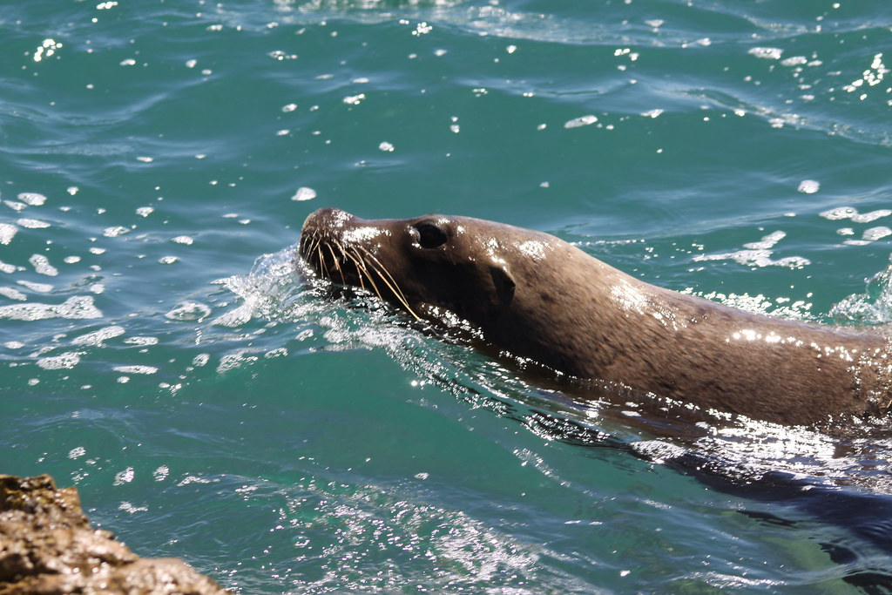
Definition
Australian sea lions have big heads, long narrow muzzles and small ears. The female sea lion is sliver and the male and young sea lions are dark brown. Australian sea lions are a type of sea mammal ,they are endangered.

Slide 3
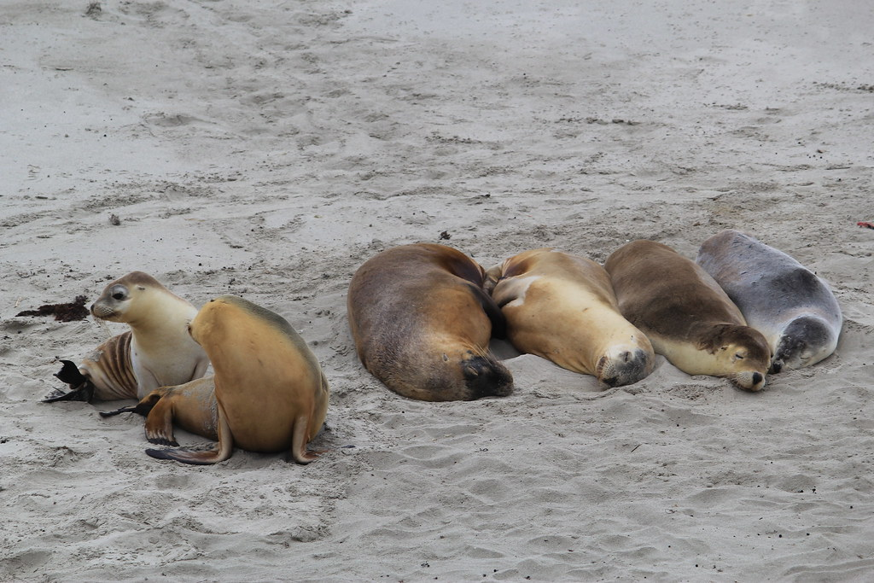
Habitat
Australian sea lions live on the sandy beaches of South and Western Australia. Big groups of them live at Dangerous Reef in the Spencer Gulf and Seal Bay on Kangaroo Island. They eat octopus, cuttlefish ,small rays and rock lobster.

Slide 4
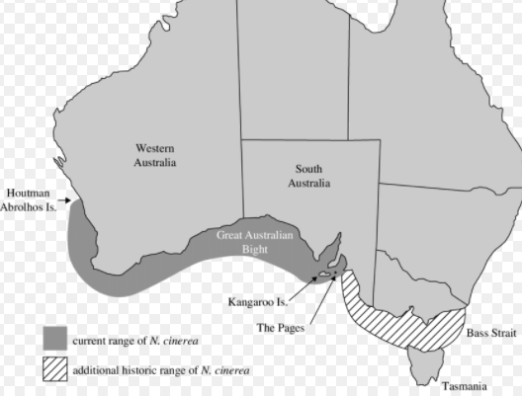

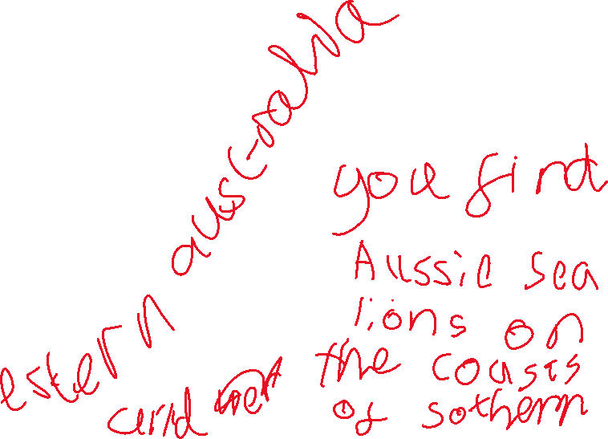
Where they live
The scientific name for the Australian sea lion is Neophoca cinerea

Slide 5
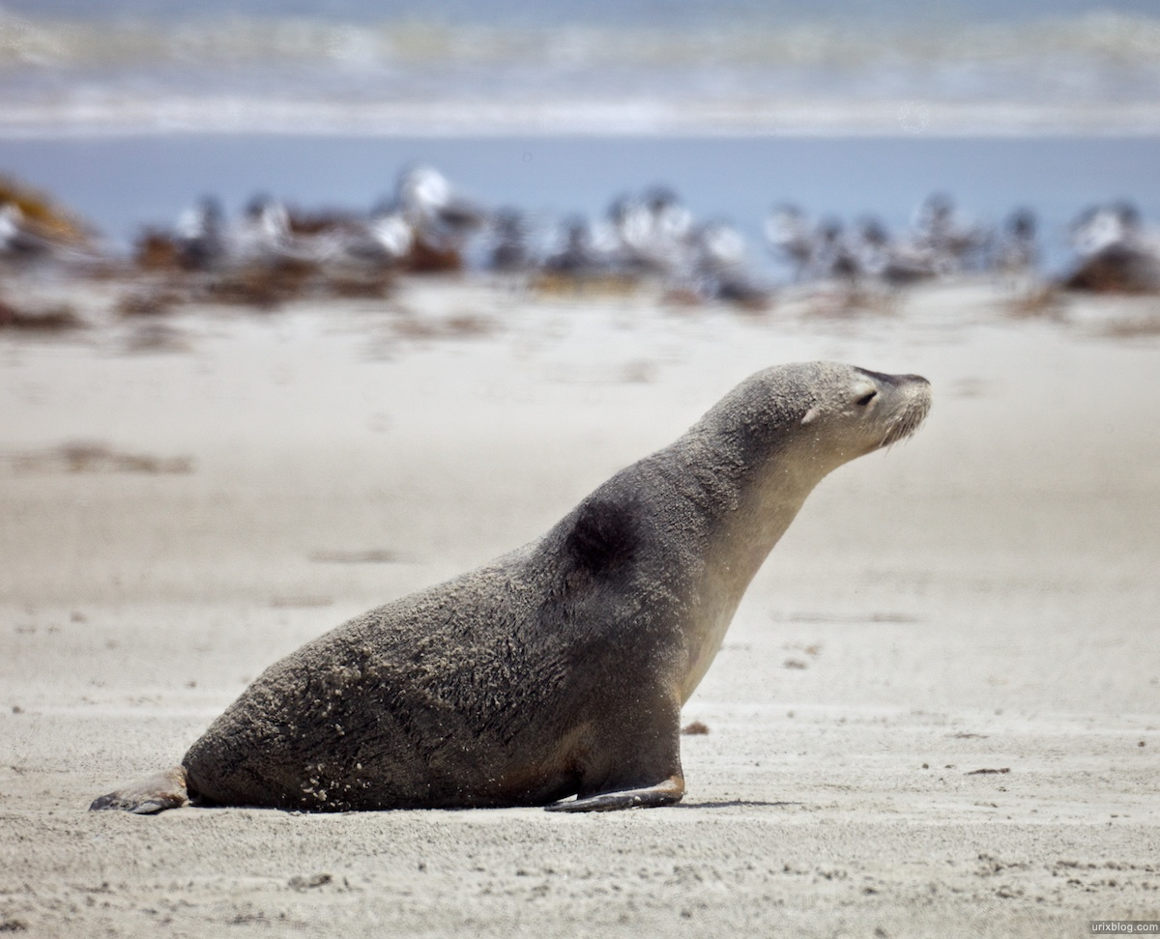
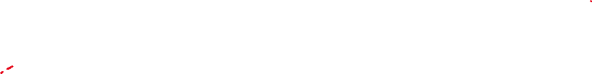
Threats
The threats to the Australian sea lion are fishing nets and rubbish dropped by people visiting the beach. Australian sea lions were heavily hunted in the 19th century for their skin
and oil and the species never came back.

Slide 6
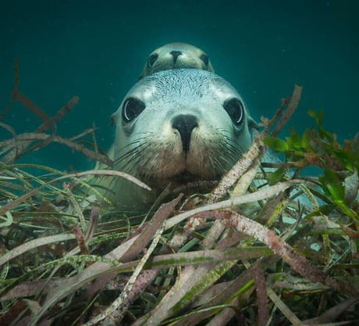
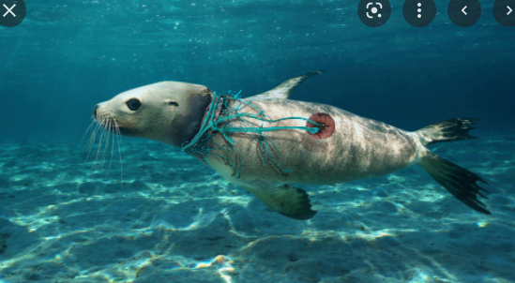
How to help
How to help the Australian sea lion is not littering and fishing with gillnets and share their story

Slide 7
Facts
Australian sea lions can live up to 17 to 25 years
Australian sea lions are a type of pinniped
which are walruses, seals and sea lions
Female Australian sea lions only breed at the beach they were born at

Slide 8
References
https://www.marineconservation.org.au
https://animalia.bio/australian-sea-lion
https://australian.museum/learn/animals/mammals/australian-sea-lion/
https://www.parks.sa.gov.au/experiences/seal-bay/australian-sea-lion/frequently-asked-questions#:~:text=Sea%20lions%20are%20unique%20to,Kangaroo%20Island%20an

