Slide 1
cats
By indie

Slide 2
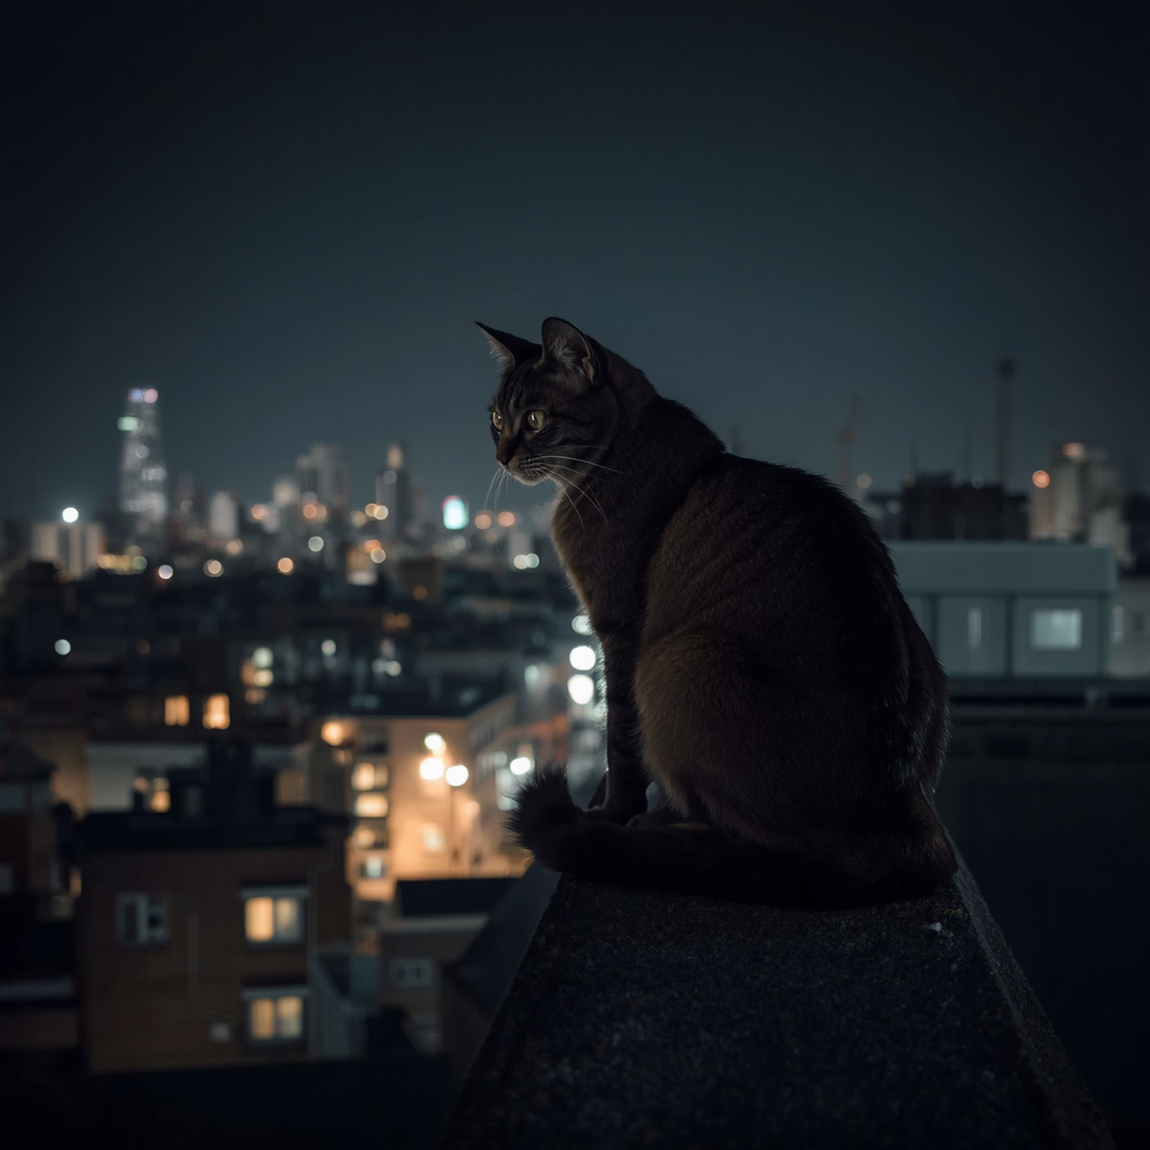
contexts
7. reproduction
1 introduction
2. appearance
8. Status and threats
3. Habitat
4. Diet
5. Behavior
6. Hunting Technique

Slide 3
what is the introduction
Cats are known as domestic cats
(felids cantus) They also been around humans for almost 10,000 years. There are about 60 different breeds. They can eat vegetables, salmon, tuna, meat and milk

Slide 4
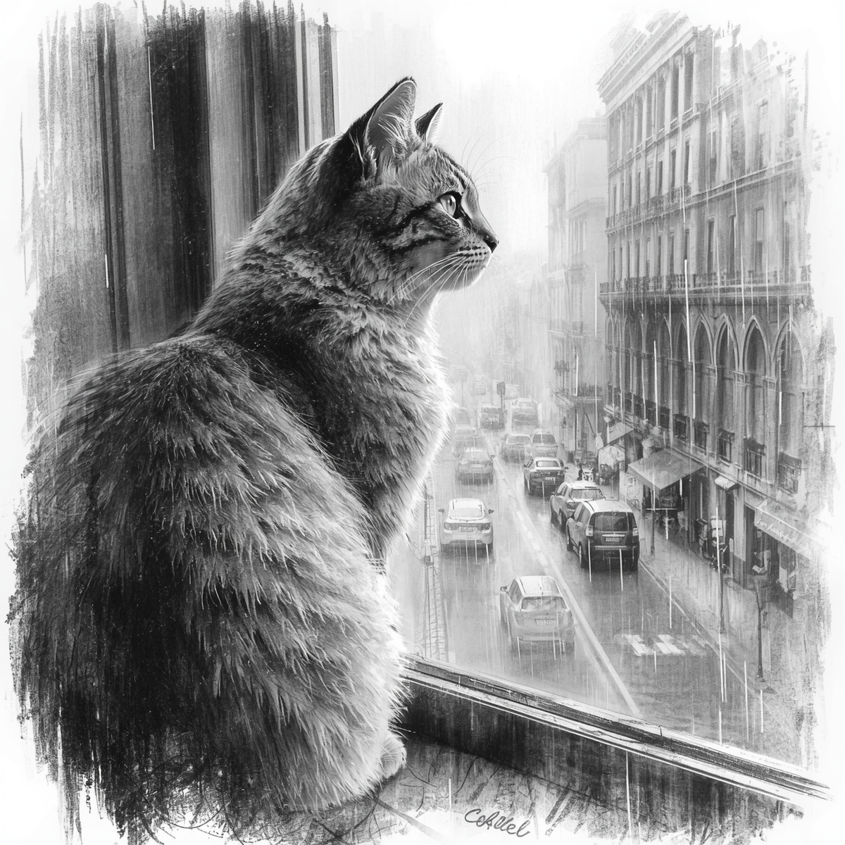
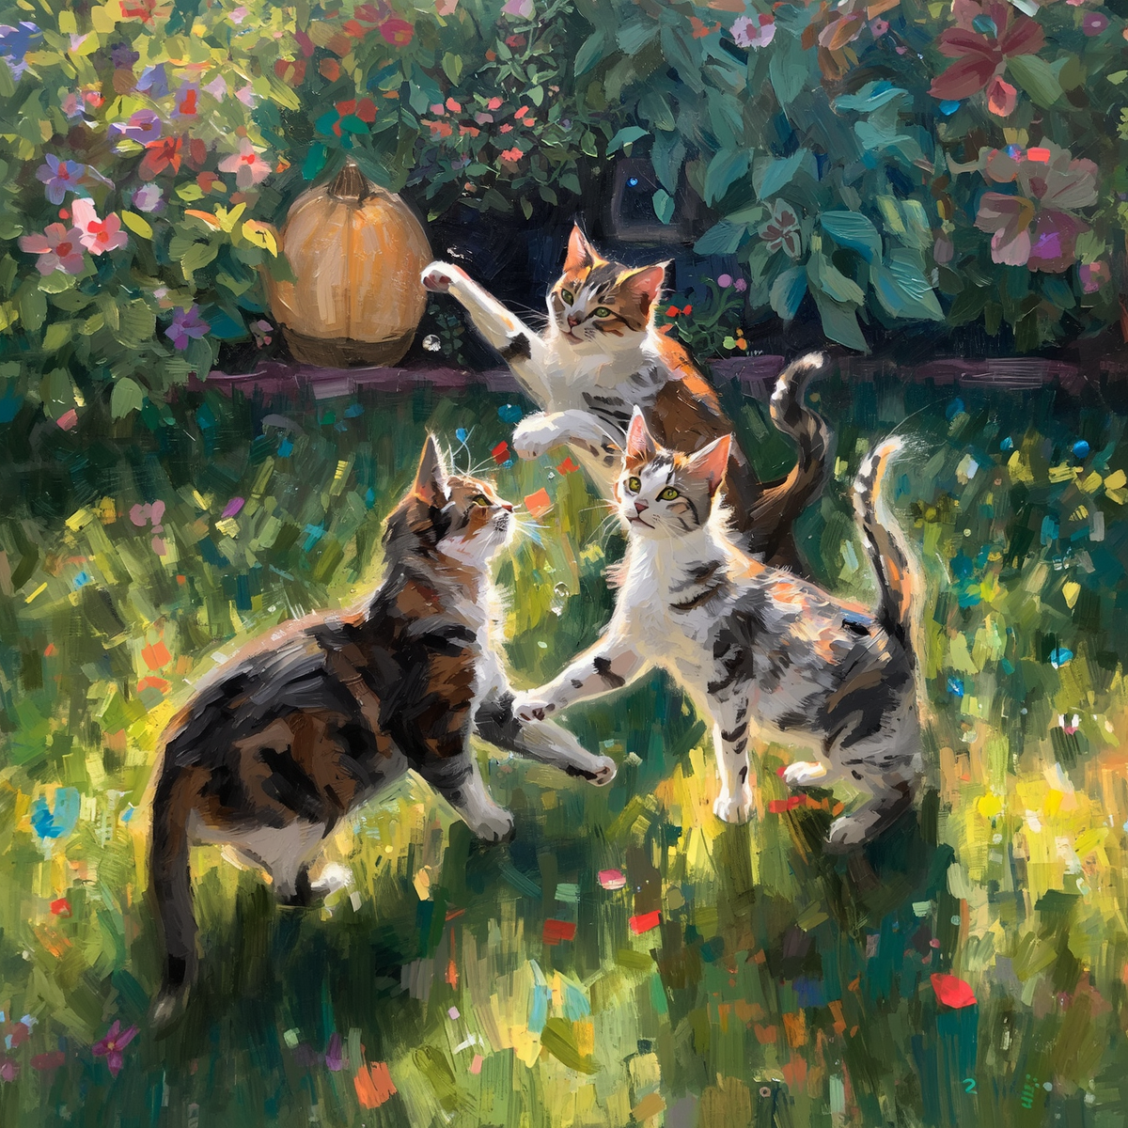
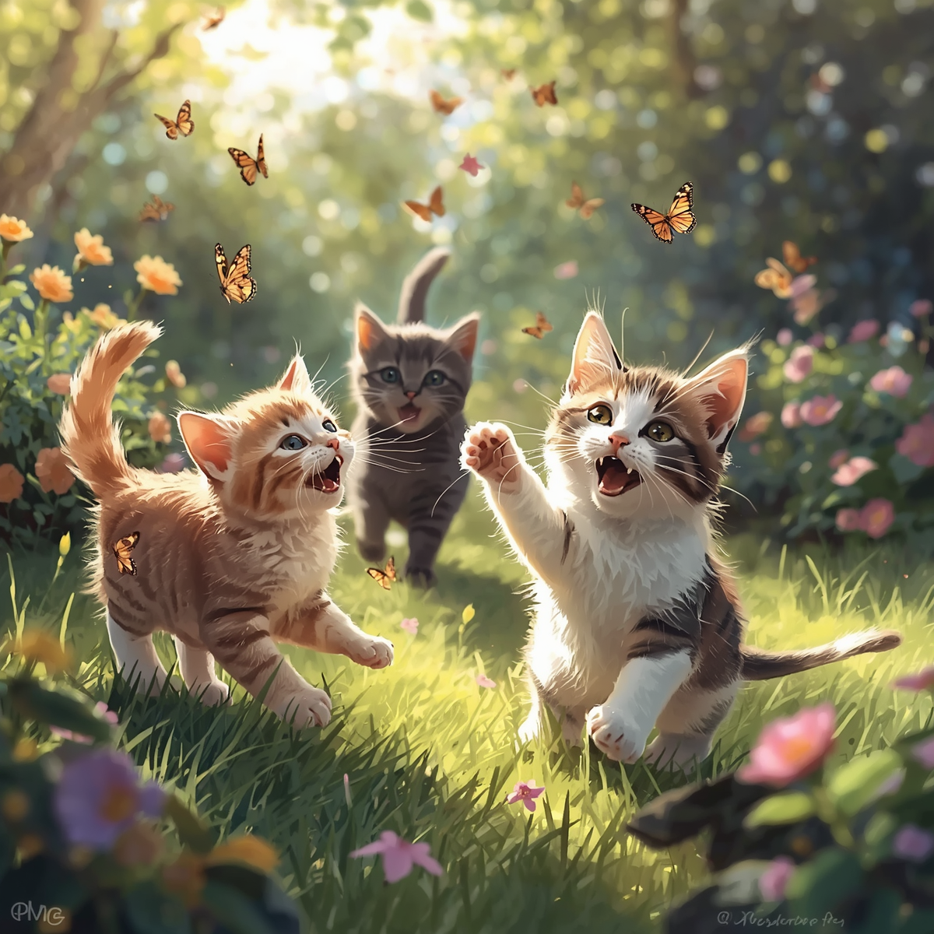
Cats have the same life like lions, tigers, jaguars, leopards, puma and cheetahs
There whiskers lead the cats in the dark so they can travel through spaces.
To me that is just WOW

Slide 5
what do they look like (Appearance)
Cats have amazing night vision they also have lot’s of moveable whiskers these are called vibrissae
Most cats have five claws on their front paws and also they have four claws on their back paws

Slide 6
Their front leg go’s on one side and the back leg on the opposite side move at the same time.
Some cats do a slow blink its also pretty rare to show that they love you.
Wow I did not know that

Slide 7
Cats have a great senses of smell and very sharp hearing because. what if they hear something and it is bad
Did you know that male cats are about 28 inches long (71cm) and females are about 20
Inches long (51cm) and large eyes so they
can see at night.

Slide 8
can you tell us what their habitat is?
Cats live in various habitats like homes, apartments, even outdoors and much more.
But normally they stay inside in homes if their homes cats.

Slide 9
Can you tell us what cat’s diet is
Well if you did not know cats can eat
Vegetables, salmon, tuna, meat, fruits and milk
cats can not eat much fruits because fruit has high sugar it can could make your cat overweight or cause diabetes

Slide 10
please tell us more I want a cat now (behaviour)
Cats are playful animals but some times they not.

