Slide 1
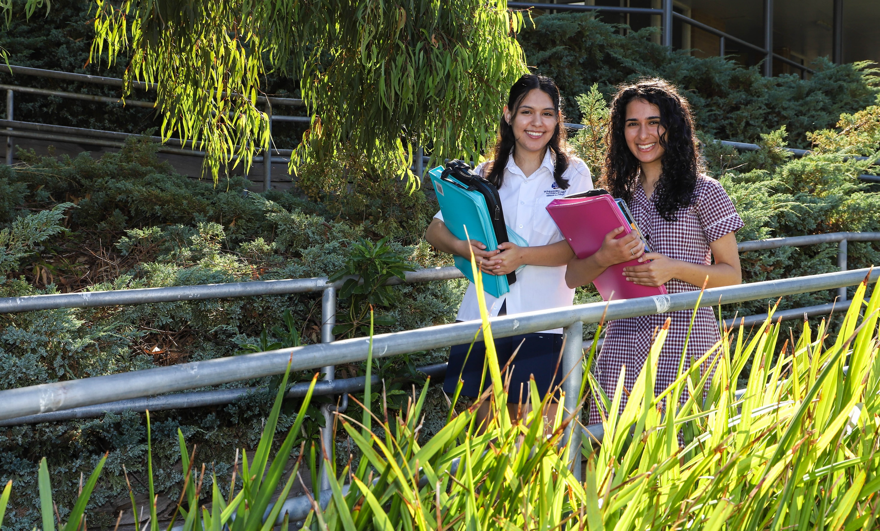
Mathematical Methods

Slide 2
WHAT IS MATHEMATICAL METHODS?
Mathematical Methods aims to equip students with essential mathematical skills and problem-solving techniques. Both Units 1/2 and 3/4 focus the same main areas of study:
Algebra, number and structure
Functions, relations and graphs
Data analysis, probability and statistics
Calculus
Mathematical Methods encourages:
Critical thinking
Logical reasoning
Precise mathematical communication

Slide 3
PRIOR KNOWLEDGE AND SKILLS
Year 10
Year 11
Year 12
General Maths
General Maths
General Maths
Maths Methods
Maths Methods
Maths Methods
If studying Specialist Maths, you must also study Maths Methods
Specialist Maths
Specialist Maths
Common Pathways

Slide 4
a+b=c
WHAT IS THE FOCUS OF MATHEMATICAL METHODS?

Slide 5
UNITS 1 AND 2: MATHEMATICAL METHODS
This is the progression from Year 10 Methods
The topics you will cover are:
1. Linear Equations (solving with and without technology).
2. Coordinate Geometry (distance, sectors, tangents)
3. Quadratics (graphing $x$ to the power of 2 equations)
4. A gallery of graphs (graphing hyperbolas, truncus, cubics, quartics, circular functions)
5. Functions and Relations (defining functions and stating domain, range)
6. Transformations (stating how the graphs have been dilated/reflected, moved vertically, horizontally).
7. Probability (combinatorics, binomial distribution)
8. Calculus (differentiation, antidifferentiations)

Slide 6
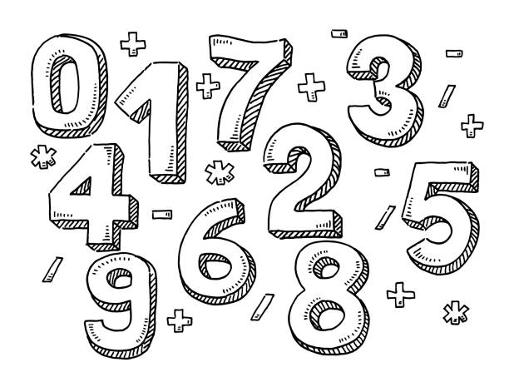
UNIT 1 & 2: ASSESSMENT
All assessments for Units 1 and 2 are school-based.
Demonstration of outcomes are based on the student's performance on a selection of the following assessment tasks:
• Assignments
• Tests
• Solutions to sets of worked questions
• Summary notes or review notes.

Slide 7
a+b=c
May I use CAS to solve ALL the questions?
No, you cannot use your CAS to solve all the questions in SACs and Exams.
In a technology free assessment students will not be able to use summary notes or a CAS calculator.
In a technology active assessment students are allowed to use summary notes and a CAS calculator.

Slide 8
UNIT 3 & 4: MATHEMATICAL METHODS
Assumed knowledge and skills for Mathematical Methods Units 3 and 4 are contained in Mathematical Methods Units 1 and 2, and will be drawn on, as applicable, in the development of related content from the areas of study, and key knowledge and key skills for the outcomes of Mathematical Methods Units 3 and 4.
Units 3 and 4 builds extends on the content from Units 1 and 2.
Area of study 1: Functions, relations and graphs
Transformations of the plane and the behaviour of some elementary functions of a single real variable, including key features of their graphs such as axis intercepts, stationary points, points of inflection, domain (including maximal, implied or natural domain), co-domain and range, asymptotic behaviour and symmetry.
The behaviour of functions and their graphs is to be explored in a variety of modelling contexts and theoretical investigations.

Slide 9
UNIT 3 & 4: MATHEMATICAL METHODS
Area of study 2: Algebra, number and structure
The algebra of functions, including composition of functions, inverse functions and the solution of equations.
The identification of appropriate solution processes for solving equations, and systems of simultaneous equations, presented in various forms.
Recognition of equations and systems of equations that are solvable using inverse operations or factorisation, and the use of graphical and numerical approaches for problems involving equations where exact value solutions are not required, or which are not solvable by other methods.

Slide 10
UNIT 3 & 4: MATHEMATICAL METHODS
Area of study 3: Calculus
Graphical treatment of limits, continuity and differentiability of functions of a single real variable, and differentiation, anti-differentiation and integration of these functions.
Applications of differentiation/integration.
Area of study 4: Data Analysis, Probability and Statistics
Discrete and continuous random variables, their representation using tables, probability functions (specified by rule and defining parameters as appropriate)
The calculation and interpretation of central measures and measures of spread; and statistical inference for sample proportions.
Understanding the notion of a random variable, related parameters, properties and application and interpretation in context for a given probability distribution.

Slide 11
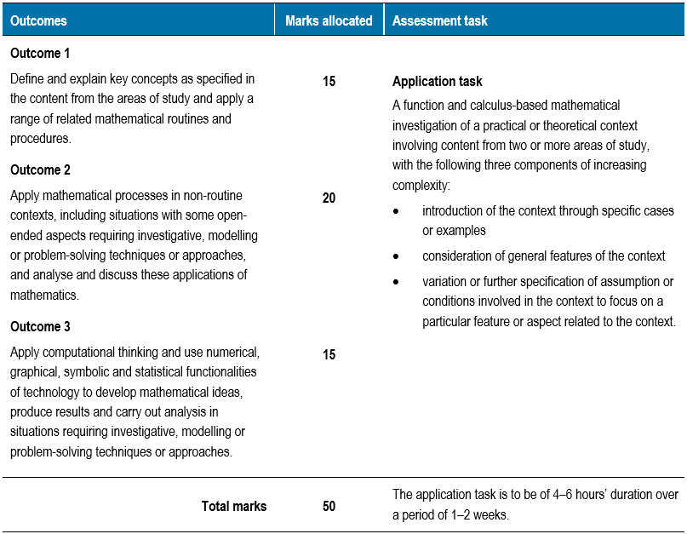
UNIT 3 & 4: ASSESSMENT
School assessed coursework for Unit 3 contributes 20% to the study score.

Slide 12
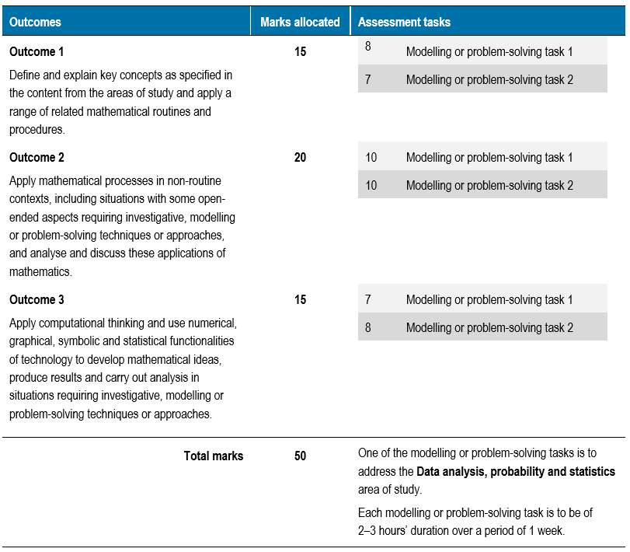
UNIT 3 & 4: ASSESSMENT
School assessed coursework for Unit 4 contributes 20% to the study score.

Slide 13
UNIT 3 & 4: ASSESSMENT
External Assessment:
Methods has two end of year exams:
Examination 1: This is a technology free exam (no calculator, no notes) and will contribute 20% to the study score.
Examination 2: This is technology active exam (calculator, notes) and will contribute 40% to the study score.

Slide 14
LEADS TO…
This could lead to:
Bachelor of Engineering*
Bachelor of Commerce*
Bachelor of Biomedical Science*
Bachelor of Computer Science*
Bachelor of Health Science
Bachelor of Law
As well as any of the options listed for Further Mathematics
*These degrees require a study score of 25 in Mathematical Methods (Monash University).

Slide 15
FURTHER INFO…
You can find more information on the study design.
Click here to visit the Mathematical Methods page on the VCAA website.

Slide 16
CONTACT US…
2024 Teachers:
Year 10 Mathematical Methods: Laura McClure (laura.mcclure@education.vic.gov.au)
Nicholas Gramatakos (nicholas.gramatakos@education.vic.gov.au)
Year 11 Mathematical Methods: Laura McClure (laura.mcclure@education.vic.gov.au)
Year 12 Mathematical Methods: Vincent Lam (mansing.lam@education.vic.gov.au)
Numeracy Specialist: Andrew Steele (andrew.steele@education.vic.gov.au)
School Contact:
Wheelers Hill Secondary College
2-28 Raphael Drive, Wheelers Hill 3150
Phone: (03) 9561 5811
General Office Enquiries: wheelers.hill.sc@education.vic.gov.au

