Slide 1
St Patrick’s Primary
Parent Information Night
Tuesday 20th February 2024

Slide 2
Acknowledgement of Country
As we gather today, let us acknowledge the traditional custodians of this land, the local Dunghutti People and the Aboriginal and Torres Strait Islander people participating in this event.
Let us acknowledge this living culture and its unique role in the life of Australia today.
We pay our respects to Elders past and present and recognise and celebrate the diversity of Aboriginal peoples and their ongoing cultures and connections to the lands and waters of Australia.
Notes:
EDIT SLIDE: Insert the First Nation People on which your school sits upon in slide
LEADER NOTES: Yaama and welcome to Term 1 2024. As a valued staff member of <insert school name here> we are going to dedicate some time to reflecting on what it means to work in a Catholic school in the Armidale Diocese. For all staff (new and old), it’s important we understand that the Catholic life and Mission of our schools is at the centre of everything we do.
Let us start by acknowledging the traditional custodians of the land we meet upon today.

Slide 3
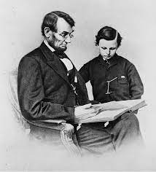
A Reflection To Begin This Meeting
Abraham Lincoln’s letter that he wrote to his son’s teacher
Reflection

Slide 4
Once again, we express our gratitude for an exceptional year in 2023! As a united school community, we have accomplished numerous achievements across various domains, such as academics, sports, performing arts, and beyond.

Slide 5
In order to attain greater accomplishments, it is imperative for us to embrace the ever-evolving era. Our primary objective remains to mentor and equip our students with the essential proficiencies required for careers that have not yet been conceived. Nevertheless, we must also preserve and nurture the sense of belonging, community, and familial atmosphere that we offer, a quality that many other educational institutions aspire to possess.

Slide 6
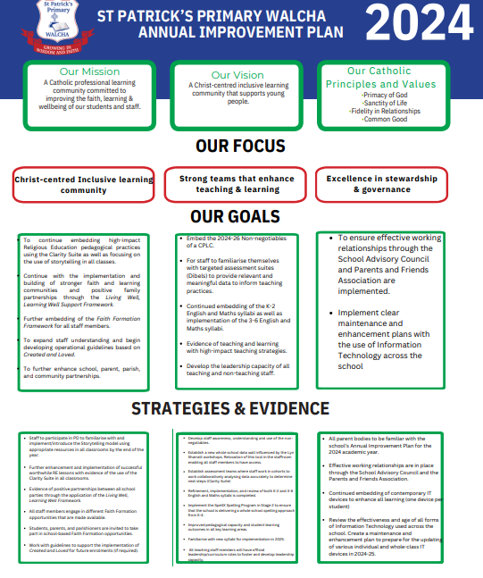

Slide 7
Let’s break this down in more parent friendly language!
Further enhance school, parish, parent and community partnerships;
Improved classroom practice;
Intense targeted assessments- learning based on student’s needs and abilities (small group work);
Implementing the new 3-6 English and Mathematics Syllabus;
Preparing for the new curriculums that will be introduced in 2025.

Slide 8
Continuing working as a system with all of the other schools in the diocese;
Minimising disruptions to key learning time (hence some changes);
Further revising and updating of all Information Technology Equipment;
Improved learning outcomes for all of our students.

Slide 9
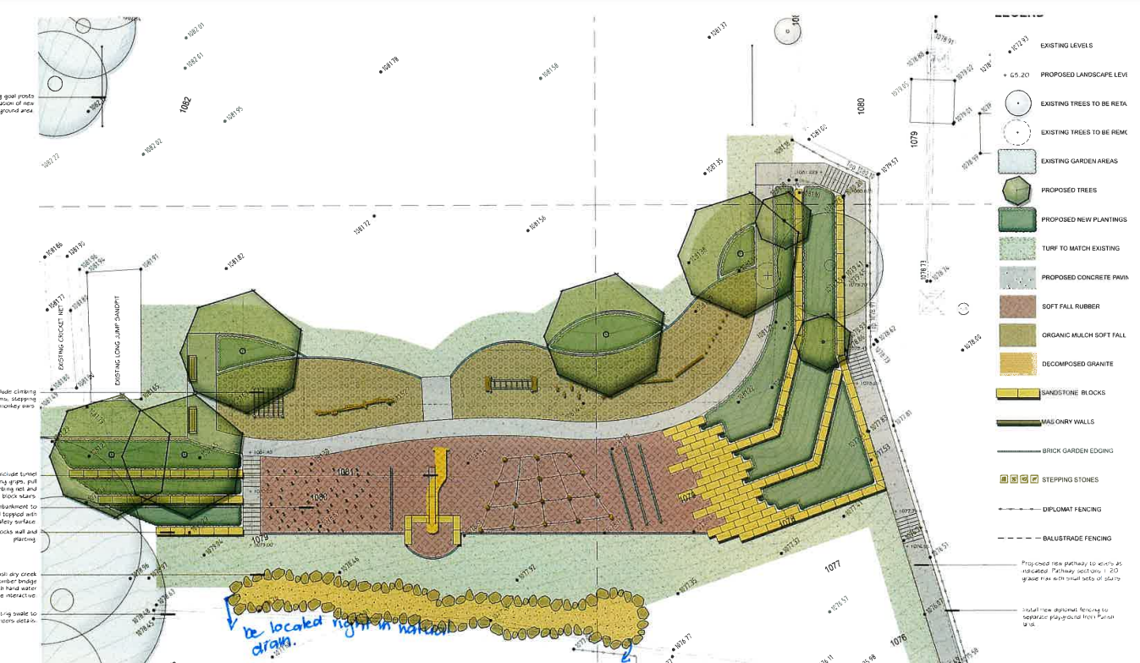
Update of Major Drainage Works

Slide 11
What else are we going to do here at
St Patrick’s?
RESILIENCE BUILDING
Arrangements have been made with Centacare Tamworth about having a 5 week program continuing on with the next stage of the Resilience program that was conducted last year. This will commence later this week.
We have been successful in obtaining a grant for welfare funding from the state government. We will be using this funding to subsidise the cost of buses for all year groups’ major excursions.

Slide 12
MORE GOALS FOR 2024
Continue fostering relations between ourselves and Walcha Central.
A big focus on having uninterrupted time for our literacy and maths learning block (changes have been made with band, Mini Minstrels and sport times and the days these will be implemented.)
Continuing to ensure all staff and students utilise up to date IT resources on a daily basis.
Hosting more Sporting and Challenge Days (Mini Olympics)
Development of faith formation between all members of the school and parish.
Lunch time clubs- ie, gardening, sporting competitions
Continue participating in mind challenge tournaments like Brain Olympia and the Da Vinci Decathlon at TAS
Continuation of our weekly ‘Uniform with Pride’ Awards.

Slide 13
Communication.
Term 1 interviews will occur in a few weeks so learning and homework goals can be established.
Continued use of Compass and the School Facebook page.
Weekly articles in The Advocate.
School newsletter will have a class segment to let parents know what is happening in one of the classrooms each week.

Slide 14
WEEKLY EVENTS
Sports uniform (Wednesday and Friday)
Canteen (Monday and Friday)
Library lessons for all classes will be conducted on Wednesday.
Band for Years 3-6 students (Wednesday)
Mini Minstrels-(Every Second Thursday)-continues next week.
Dates have been announced for School Assembly
Centacare (counselling services) every second Thursday

Slide 15
What Else is Happening?
Excursions:
Year 5-6: Canberra (4 nights in Term 4)
Year 3-4: Lake Keepit (1 night excursion-Term 4)
K-2 Capitol Theatre, Tamworth in September-The Gruffalo
Kindergarten-Teddy Bears Picnic at Thalgarrah

Slide 16
Assessment and Initialit Program- Mrs Makeham

Slide 17
InitiaLit
InitiaLit is an evidence-based whole-class literacy program which provides all children with the essential core knowledge and strong foundations to become successful readers and writers.
InitiaLit is a three-year program, covering the first three years of school (typically Kindergarten to Year 2).
InitiaLit is taught in all but one school in the Armidale Diocese. The delivery of this program is systematic, consistent and it works.

Slide 18
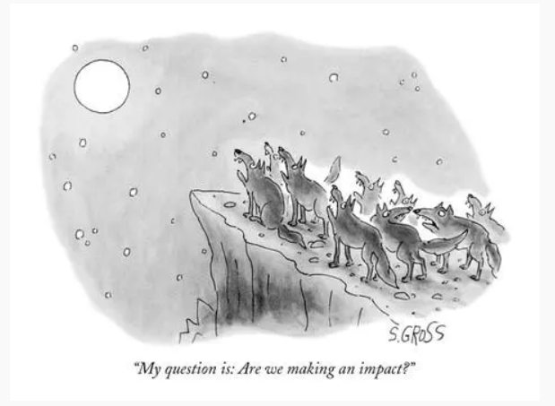
Assessment

Slide 19
Assessment
Assessment can be formal (pen and paper) and informal (observation, questioning etc)
We assess for three purposes only:
Assessment For Learning (Pre – testing)
Assessment As Learning occurs
Assessment of Learning (NAPLAN type testing)
Assessment happens everyday in a variety of ways and it is CRUCIAL to ensuring the academic growth of students.
Once we have collected assessment data our teachers work together to analyse and evaluate each student’s results.
It is through these discussions that we are able to diagnose issues and case manage those students who may need support and those who need extension.
Assessment is fundamental to the teaching and learning cycle.

Slide 20
Kindergarten
Kindergarten is the first year of your child's formal education. It is an important year as it is the foundation for all literacy and mathematical concepts.
School attendance is crucial as the curriculum moves very quickly.
Your child will participate in all key learning areas; English, Mathematics, Science, History, Geography, Physical Education, Health and Personal Development, Creative Arts and Technology.

Slide 21
Ms Wilson will be on class on Monday, Tuesday, Thursday 11.30 -3.00, Friday
Mrs Hoy will be on class on Wednesday and Thursday morning for my RFF.
Homework (will start next week)
Reading every night (reading journal).
Show and Tell (weekly topic)
Sounds and tricky words. (as introduced)

Slide 22
Handyman Needed
For assembling Kindergarten’s beautiful new desks.
Putting a couple of shelves in storage area.

Slide 23
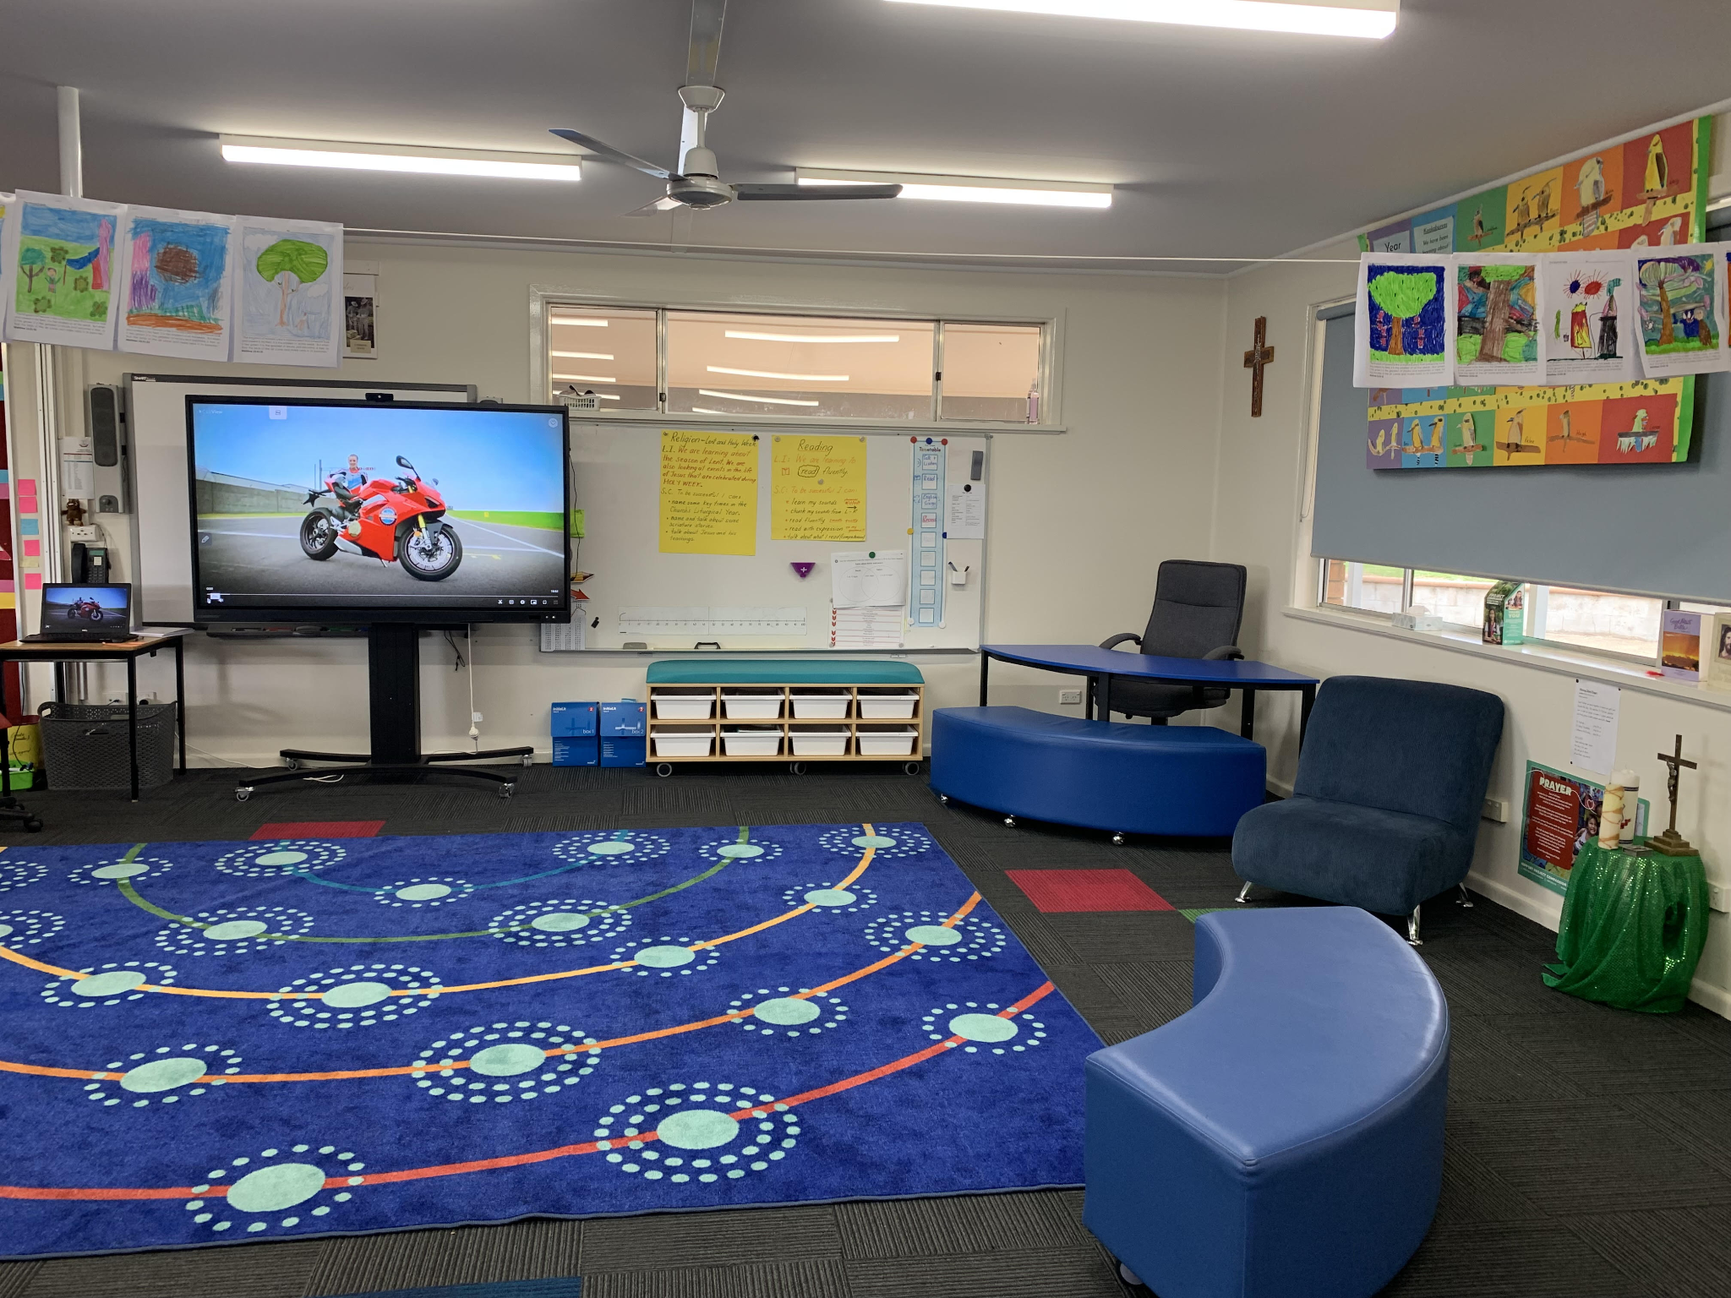
Year 1-2
Welcome to Year 1/2 with Mrs Flanagan and Mrs Hoy.

Slide 24
Year 1/2 is known as Stage One
Stage One is a two year process. All outcomes to be covered by the children in our class are explored over this two year period. At this stage of development, priority is given to the important areas of literacy and numeracy development. Obviously English and Mathematics are the core subjects for Literacy and Numeracy but both are embedded in all subject areas.
Our Syllabus: English, Mathematics, Religion, HSIE (History and Geography)
Science, Creative Arts (Music, Drama, Visual Art and Dance), PDHPE (Personal Development, Health and Physical Education)
Year 1/2 is taught by Anna Flanagan every Monday - Thursday
and Sarah Hoy every Friday.

Slide 25
Year 1/2
Change: longer attention spans, friendship groups become important, age of reason (right from wrong), communicate with a growing vocabulary (and sometimes some modelled behaviour we don’t want) teeth fall out, growth spurts, discovering identity.
Data collected for Growth: Maths, reading, writing and spelling are closely monitored. e.g. Writing…From Kinder - Yr 1/2 . symbols, letters, sounds, decoding and encoding, phrases, sentences, paragraphs, pieces of writing.
Homework (will start next week)
Reading every night (reading journal) with discussion about the text.
Worksheet, which is optional. Parents can indicate at Parent/Teacher interviews if they would like a worksheet sent home.

Slide 26
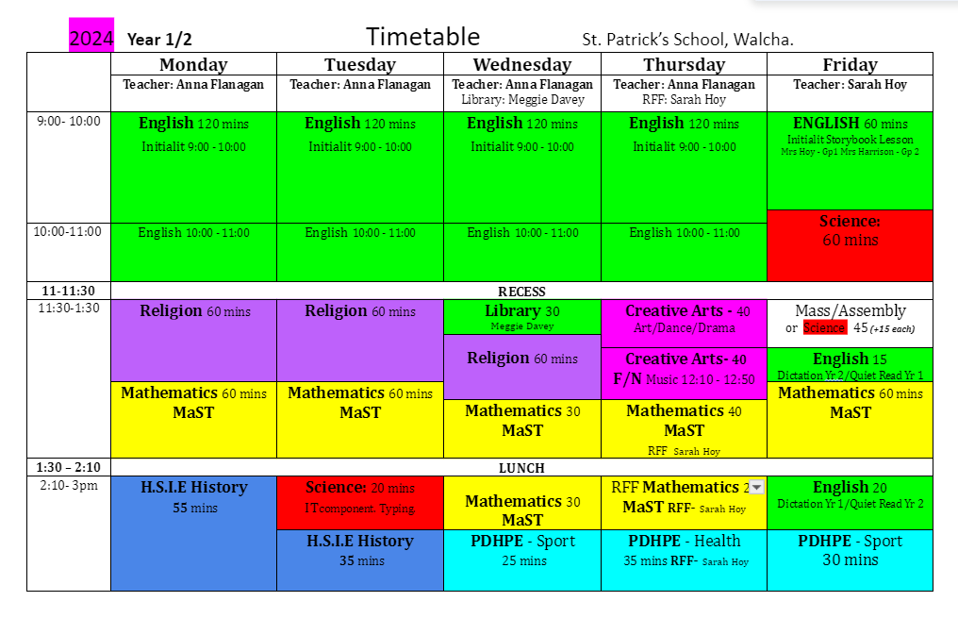

Slide 27
Year 3-4
English block
SpellEx Program / InitaLit2, Reading fluency, Handwriting, Vocabulary,
Reading comprehension - engage with Squiz Kids, Kids News Online, Behind the News (BTN).
Writing - Punctuation, Grammar, structure, word-level, sentence-level.
Maths
Mental Maths - 3 min - quick recall. Focus on Number and Place Value.
Homework (will start next week)
Maths - Times Tables
Reading every night (reading journal).

Slide 28
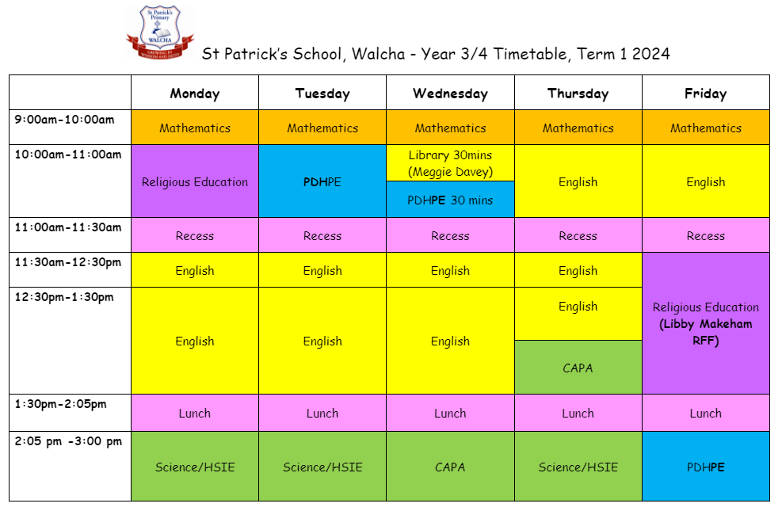

Slide 29
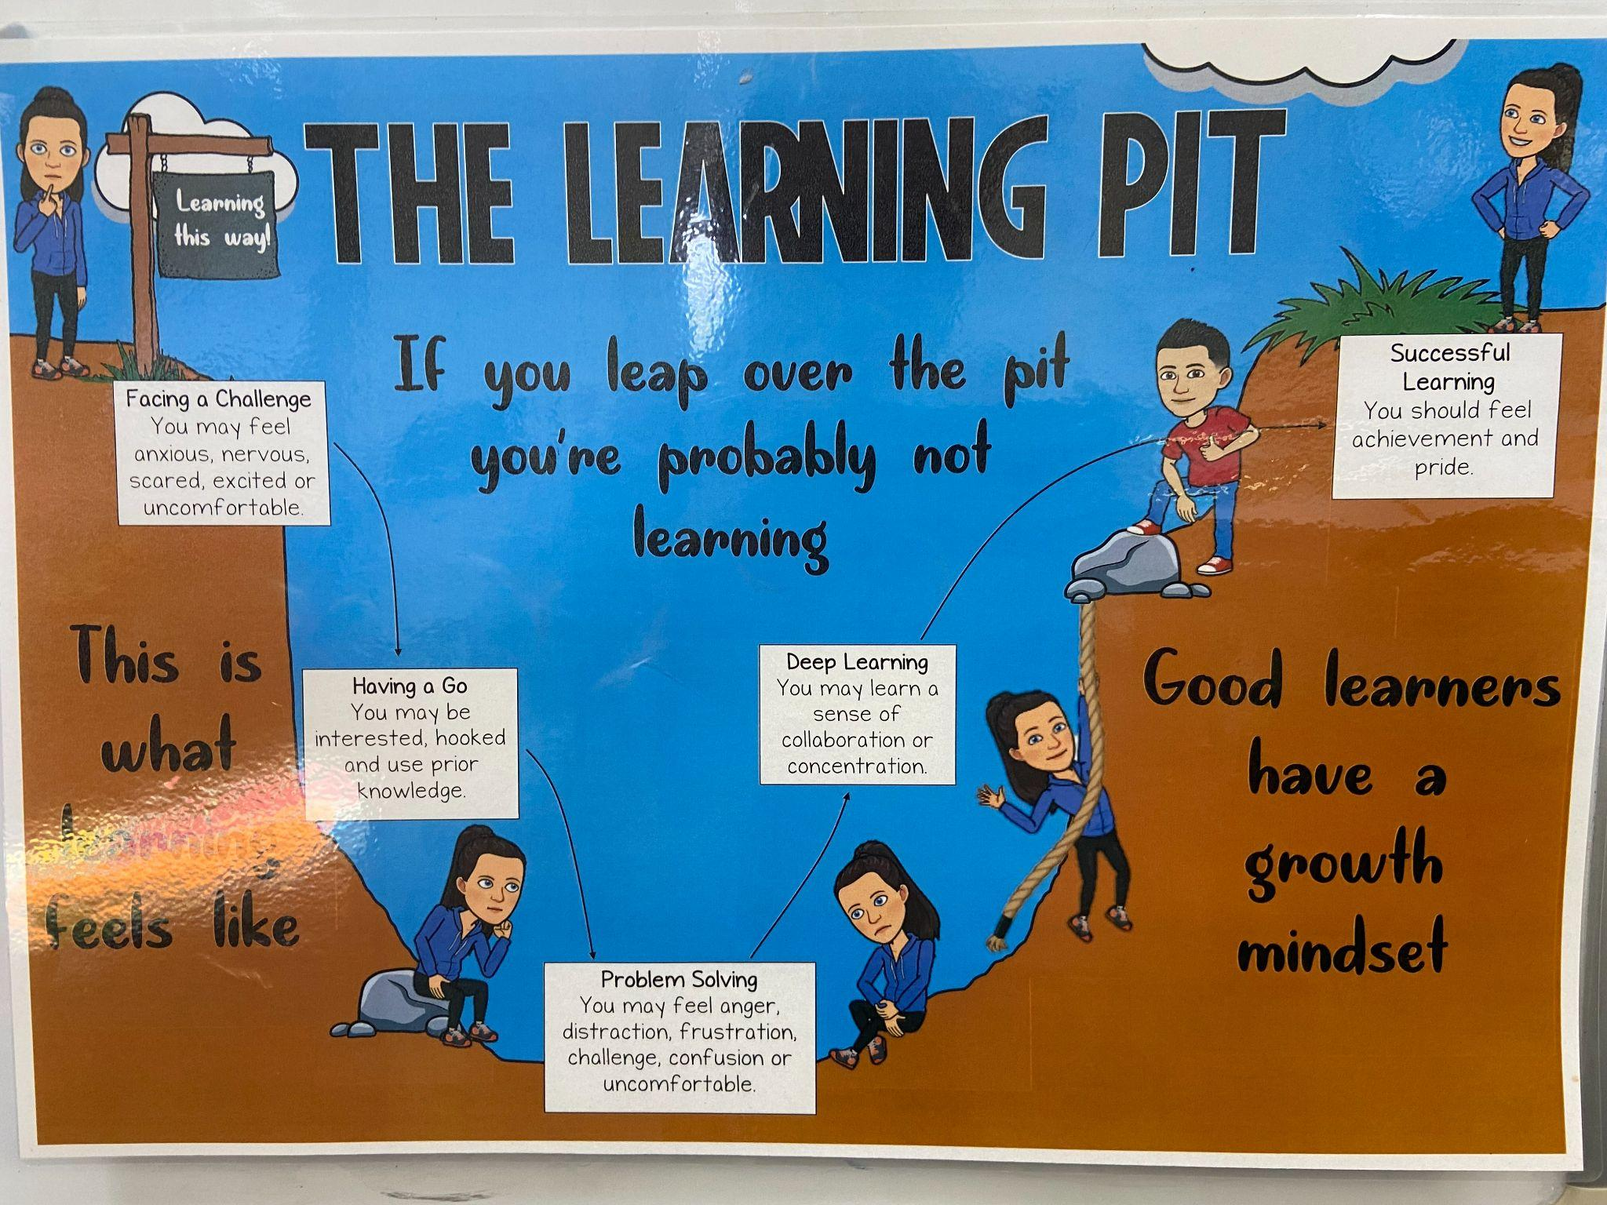
The Learning Pit
‘Get comfortable with being uncomfortable’
“The learning pit is a place on your learning journey. When you’re learning something new, it can be challenging. But, that means you’re learning!
When you get into the learning pit, the deepest learning is happening. It’s important for us to be able to identify where we are in the learning pit during our learning journey.”

Slide 30
The Learning Pit
‘Get comfortable with being uncomfortable’
The Learning Pit helps students to be more comfortable with challenge; to develop problem solving strategies; and to articulate their learning.
What do students gain from the Learning Pit?

Slide 31
Year 5-6
Outcomes for Years 5 and 6 are organised together into ‘Stage 3’ Our 7 compulsory Key Learning Areas are as follows:
English
Mathematics
Religion
HSIE (History and Geography)
Science
Creative Arts (Music, Drama, Visual Art and Dance)
PDHPE (Personal Development, Health and Physical Education)
Additionally, we are learning a language other than English, Chinese (Mandarin). Meg Language provide us with an online and innovative language program where we access our teacher via Zoom, once per week from her home in Huizhou, China.
Meg Language: We build global citizens by exposing students to life in the target-language countries. Students are not only developing language skills but gaining curiosity and appreciation of other cultures.

Slide 32
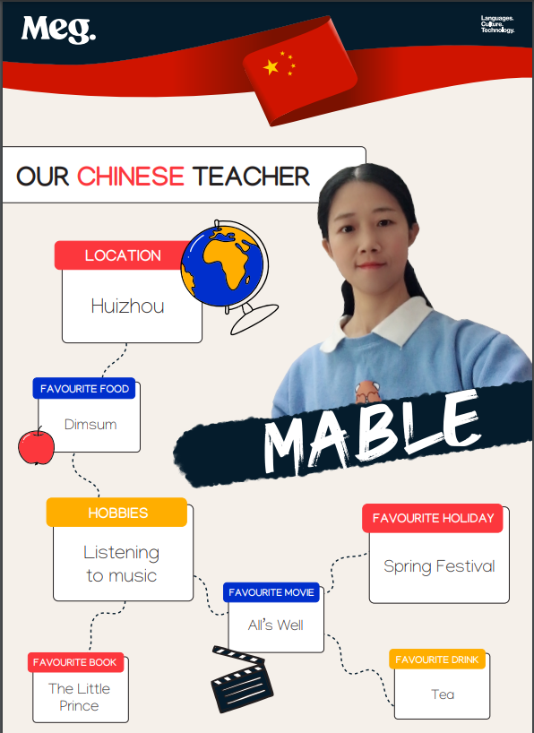

Slide 33
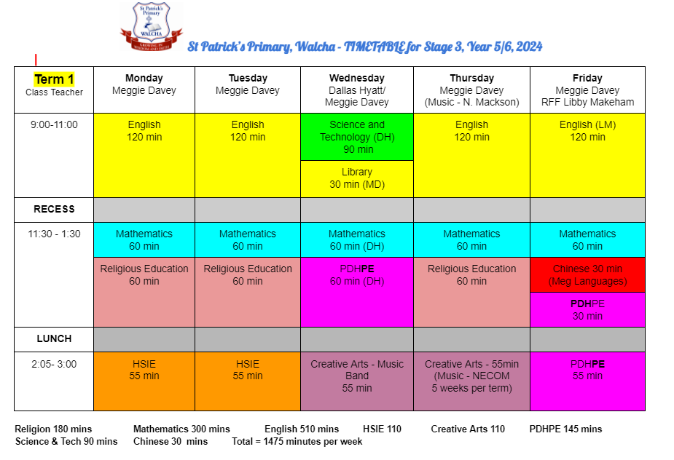

Slide 34
5/6 Organisation and Expectations
As we prepare for high school, dedication and commitment to learning is expected and essential as we strive for personal growth. Everyone’s learning journey is different and I’m here to support your child in the best way that I can.
As leaders in the school 5/6 are expected to be kind and courteous role models at all times. We have high expectations for their behaviour. They have many opportunities to help out and demonstrate their leadership skills. Uniform is expected to be correct, neat and tidy at all times.
Homework will begin next week (Week 5). Students will have a reading journal to record their home reading as well as a weekly unit of work to complete. Practise of their instrument is also essential to the success of our school band.
I’m looking forward to seeing you all individually in Week 7 at parent teacher interviews!

Slide 35
Thank you!!
Are there any questions?

