Slide 1


Parents
Please switch your Phone to silent for Assembly.

Slide 2
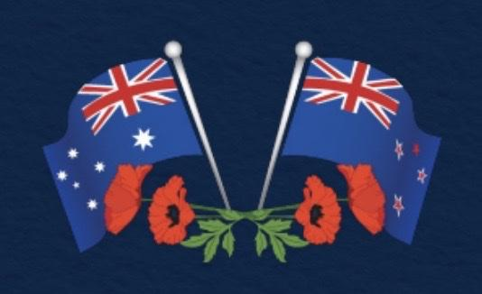

Welcome to our
ANZAC Day Prayer Liturgy

Slide 3

Acknowledgement of the land

Slide 4

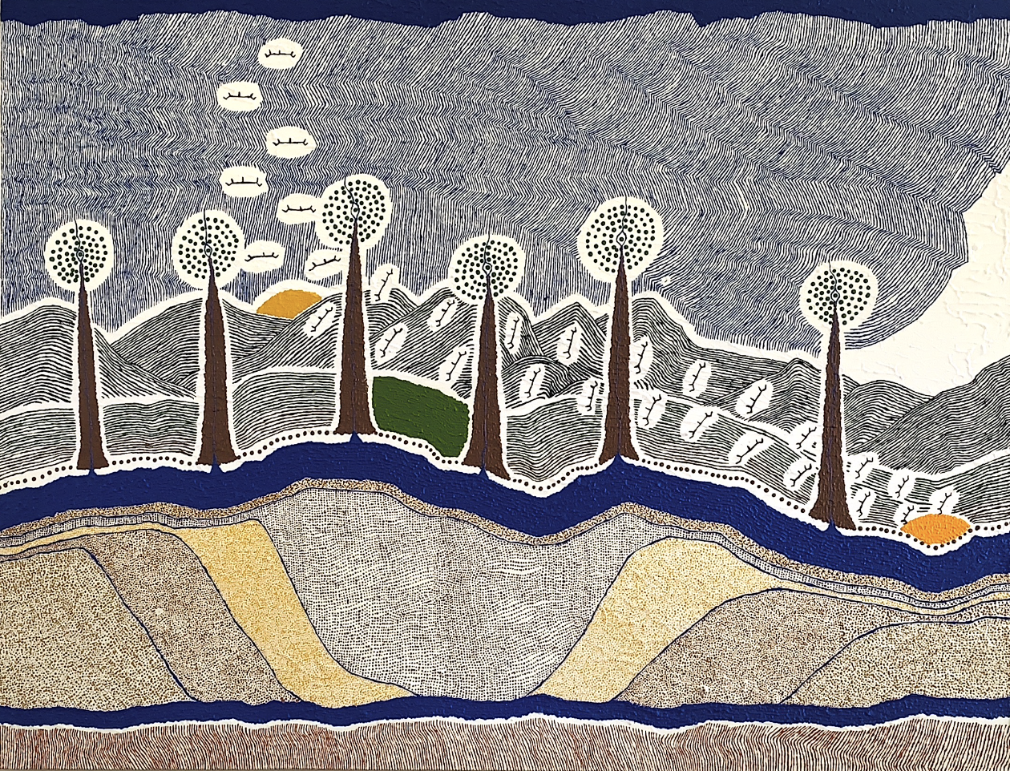
St Michael’s Primary Acknowledgement of Country
Wominjeka, Welcome!
We at St Michael’s acknowledge the traditional custodians of the land, sky and waterways.
Our school sits on the land of the Wurundjeri people of the Kulin Nation, we pay respects to them.
We thank the people who have nurtured and preserved the land so that we can live, learn and pray and thank them for their care and love of country.
May we continue to show respect to our land and each other, for the years to come.
Embedded Wisdom -
It Takes A Universe to Educate a Child
Glenn Loughery

Slide 5
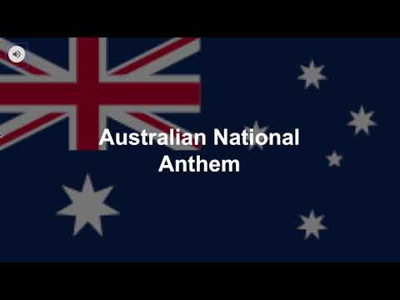
ADVANCE AUSTRALIA FAIR

Slide 6
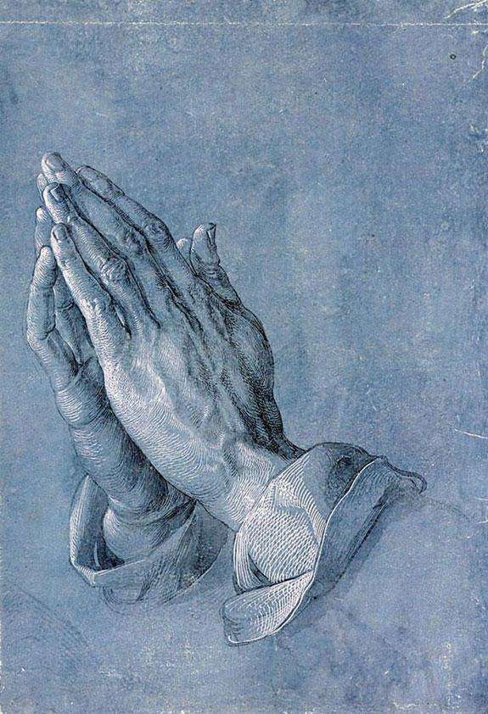
ANZAC Day Prayer Liturgy
We begin with the Sign of the Cross.
In the name of the Father
and of the Son
and the Holy Spirit.
Amen.

Slide 7
ANZAC Day Prayer Liturgy
Opening Prayer
God of love and peace, we gather to pray for those who gave so much for their country.
May we always remember their gifts of freedom and peace.
We ask this in the name of Jesus
All: Amen

Slide 8
ANZAC Day Prayer Liturgy
ANZAC fact
In 1915 many thousands of soldiers from Australia and New Zealand were in Egypt and Palestine getting ready to attack Turkey.
The two armies were known as the ANZACs. This is a name taking the first letters of the words Australian and New Zealand Army Corps.

Slide 9
ANZAC Day Prayer Liturgy
ANZAC fact
In the cold grey dawn on the 25th of April in 1915, the ANZACs landed on a small strip of beach at Gallipoli, in Turkey’s south. As they made their way to the beach and up the steep rocky cliffs and hills they were attacked by the Turkish soldiers. Sadly many soldiers from
both sides were killed or injured.

Slide 10
ANZAC Day Prayer Liturgy
ANZAC fact
Anzac Day was originally designed for returned service men and women to come together and share the spirit of mateship that was formed fighting side by side. The day means much more than this today. It celebrates the spirit of mateship that is
central to our culture today.

Slide 11
ANZAC Day Prayer Liturgy
The words of Jesus
Jesus said to his disciples: “Just as my Father has loved me so I have loved you. My command to you is this: love one another, just as I love you.
The greatest love a person can have for his friends is to give his life for them. You are my friends if you do what I command you to do.”

Slide 12
ANZAC Day Prayer Liturgy
Prayers
In this time of reflection, we call on our God who is full of love and compassion.
Confidently, in the hope of the resurrection we pray:

Slide 13
ANZAC Day Prayer Liturgy
Prayers
We pray for all who served and bravely lost their lives in battle during times of conflict, especially members of the Australian and New Zealand Army Corps.
May they rest in the peace of Christ.
Lord hear us
All: Lord hear our prayer

Slide 14
ANZAC Day Prayer Liturgy
Prayers
We remember all families, parents and children who lost loved ones through war.
May the light of God’s hope and strength comfort them.
Lord hear us
All: Lord hear our prayer

Slide 15
ANZAC Day Prayer Liturgy
Prayers
We pray for all who work for peace in our world.
May they continue their respectful negotiations and willingness to foster a mutual understanding.
Lord hear us
All: Lord hear our prayer

Slide 16
ANZAC Day Prayer Liturgy
Prayers
We pray for all political leaders.
May the Holy Spirit help them to make wise decisions and to build relationships that lead to peace.
Lord hear us
All: Lord hear our prayer

Slide 17
ANZAC Day Prayer Liturgy
Prayers
God of mercy, send forth your Spirit of peace to our world as we ask you to grant our prayers for those who have fallen in war.
We ask this prayer through Jesus Christ our Lord.
All: Amen

Slide 18
ANZAC Day Prayer Liturgy
Ode of Remembrance
They shall not grow old, as we that are left grow old,
Age shall not weary them, nor the years condemn,
At the going down of the sun, and in the morning,
We will remember them.
All: We will remember them.

Slide 19
ANZAC Day Prayer Liturgy
Pause to remember
Please stand for The Last Post and a
minute’s silence to remember those
who have died in war.
After the minute’s silence we will listen to The Rouse which signifies the awakening of the soul into new life.
The Last Post
The Rouse

