Slide 1








ACEN eBook of the Week
LIBRARY LOVERS’ DAY
Wednesday 14 February 2024
People who love their library

Slide 2




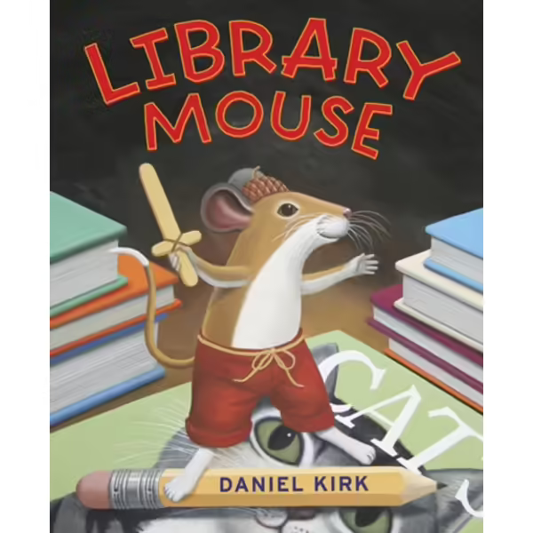


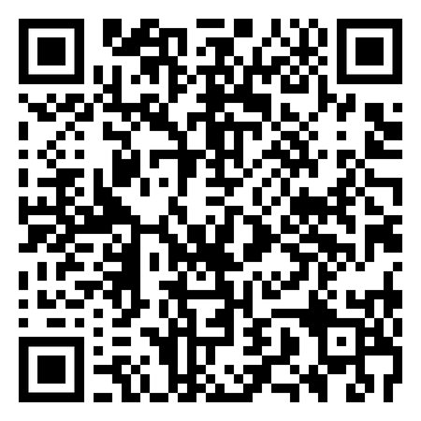


Juvenile Reader
Library Mouse
by Daniel Kirk
A small creature offers his big voice for aspiring authors everywhere every child can be a writer-and Library Mouse shows them how!Beloved children's books author and illustrator Daniel Kirk wonderfully brings to life the story of Sam, a library mouse. Sam's home was in a little hole in the wall in the children's reference books section, and he thought that life was very good indeed. For Sam loved to read. He read picture books and chapter books, biographies and poetry, and ghost stories and mysteries. Sam read so much that finally one day he decided to write books himself!Sam shared his books with other library visitors by placing them on a bookshelf at night. Until there came the time that people wanted to meet this talented author. Whatever was Sam to do? The joy of reading, writing, and sharing is brought to life in this warm hearted tale.
I’m a Series!

Slide 3







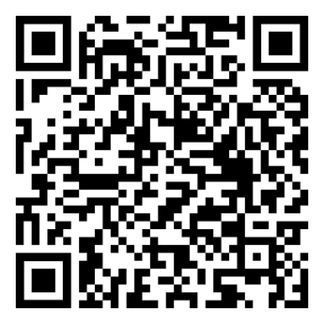

The Forbidden Library
by Django Wexler
Young Adult Reader
Late one night Alice Creighton hears her father having an argument with a fairy – a snarling, bald beast with warts and needle-like teeth.
The next day her father disappears, never to return. And Alice is sent to live with Master Geryon, an uncle she never even knew existed.
Geryon has a dark, mysterious library which is strictly off-limits to Alice. But after meeting a talking cat who is willing to sneak her in, Alice opens a book and suddenly finds herself inside it – and the only way out is by conquering the dangerous creatures within . . .
I’m a Series!

Slide 4



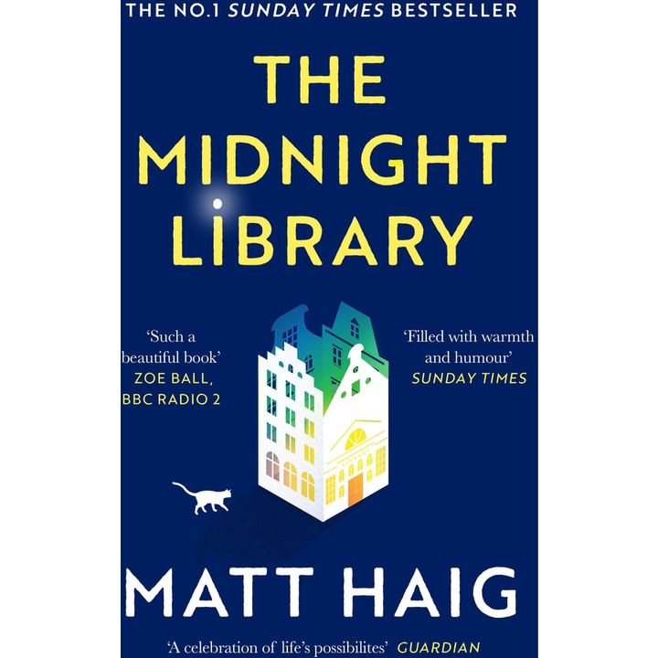


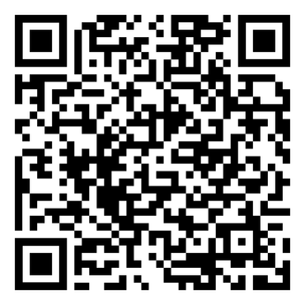

The Midnight Library
by Michael Haig
Nora's life has been going from bad to worse. Then at the stroke of midnight on her last day on earth she finds herself transported to a library. There she is given the chance to undo her regrets and try out each of the other lives she might have lived. Which raises the ultimate question: with infinite choices, what is the best way to live?
Adult Reader

Slide 5


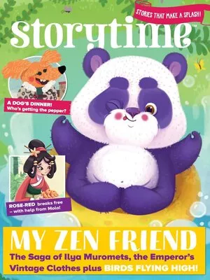
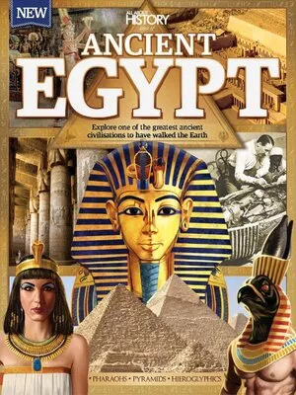
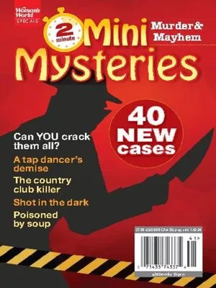
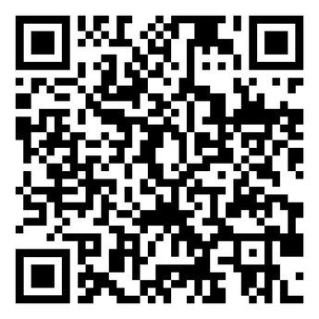
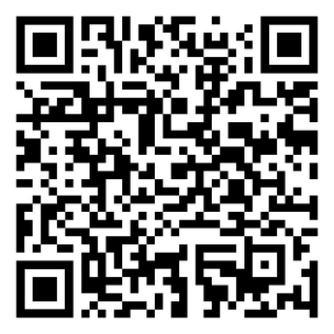
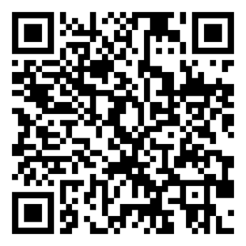

Magazines
Juvenile Reader
Young Adult Reader
Adult Reader

