Slide 1
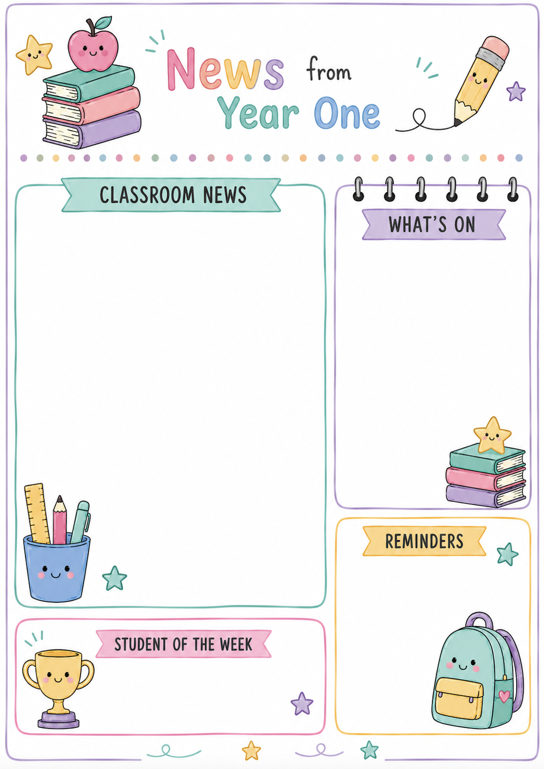
TERM 3 WEEK 9 & 10
Here is a snapshot of what has been happening in our busy Year 1 classrooms during the final two weeks of Term 3.
LITERACY:
LLLL: We have been learning two graphemes that make a long /e/ sound over the past two weeks. The first is a split digraph called ‘delete’ /e_e/. We learnt how the bossy ‘silent final e’ jumps over the consonant to make the e say its long sound. The second grapheme making a long e sound is ‘me she he’/e/. We learned that open syllables end in a vowel and say their long sound (e.g. e/ven, me, se/cret).
Writing: We have completed our narratives and they have been sent home today. Your child has worked very hard over the term to plan, draft and publish their story. They are very proud of what they have achieved and are super excited to share their wonderful writing with you!
NUMERACY: We have been exploring mass, using hefting and balance scales to compare and order the mass of objects in the classroom. We ordered our objects from lightest to heaviest and discovered that something small in size can be heavier than something large.
INQUIRY: We have loved watching all our students present their Special Place projects. We can see how much effort everyone has put into these presentations, and it has been wonderful to see how much their confidence has grown since first presenting in Term 1. Thank you for supporting your child to complete this task at home.
Monday, 5th October: First day of Term Four
Thursday, 22nd October: Whole School Photo
Monday, 2nd November: Curriculum Day - Student Free Day
Tuesday, 3rd November: Melbourne Cup Day
Wednesday, 9th December: Christmas Singalong
Friday 18 December -
Last Day of the year -
1:30 dismissal
Have a wonderful, relaxing holiday break!
CONGRATULATIONS to these students who received their certificate over the past two weeks:
Riley, Zara and All of 1C.

