Slide 1
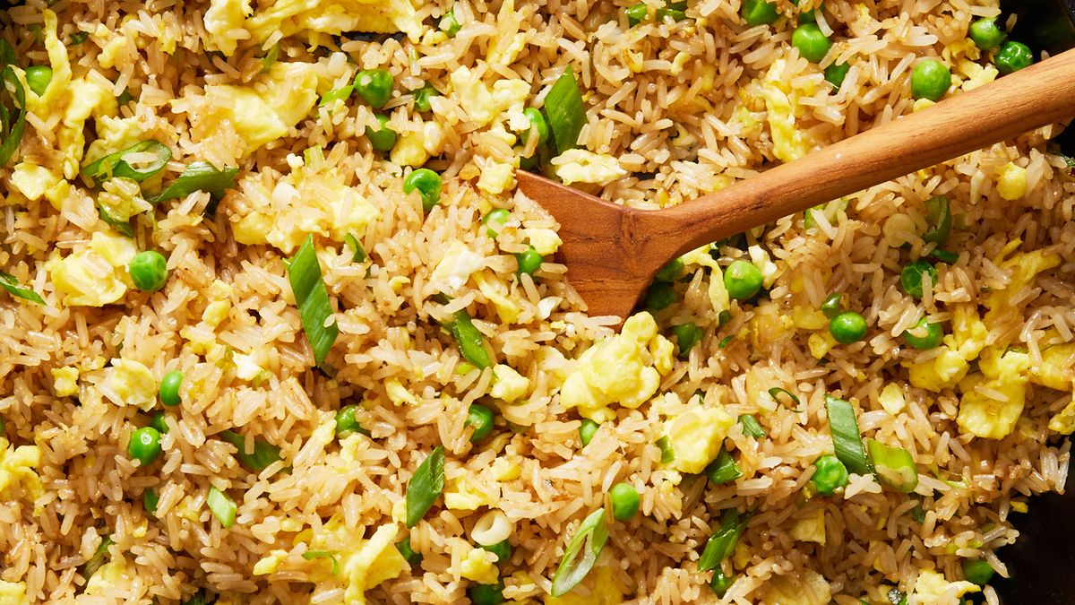
Nasi goreng
By Harley Harry dan Roman, Kelas 7 Indonesia

Slide 2
Bahan
2 senduk zaitun Minyak=2 tbl olive oil
Coklat bawang kurus potong=brown onion thinly sliced
Wortel kurus sayatan bisul satu menit= thinly sliced carrot boiled for 1 minute
Dua ratus grams daging sapi koki sampai coklat =200 grams of beef mince cooked until browned
Satu sendok teh sambal sauc=chillie hot sauce
Dua senduk tomat sauc=2 spoon tomato sauce
tiga tawang matang melate nasi=3 cups cooked jasmie rice
dua sendok kecap manis=2 spoons sweet soy sauce
dua telur=2 eggs

Slide 3
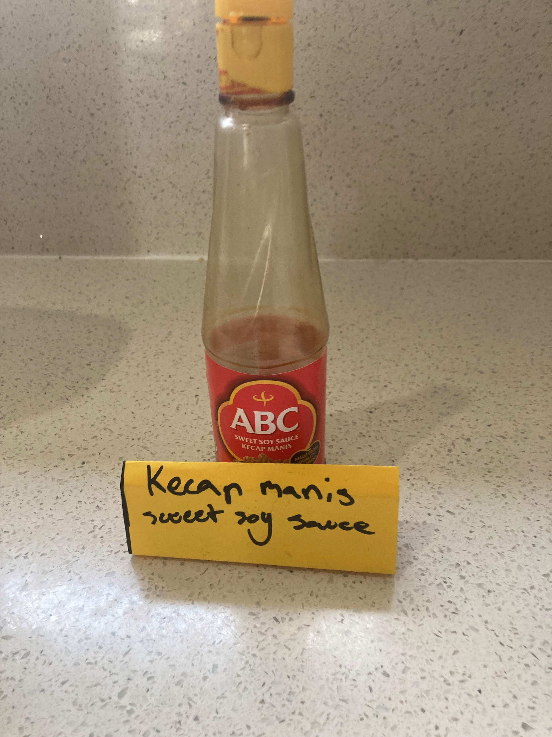
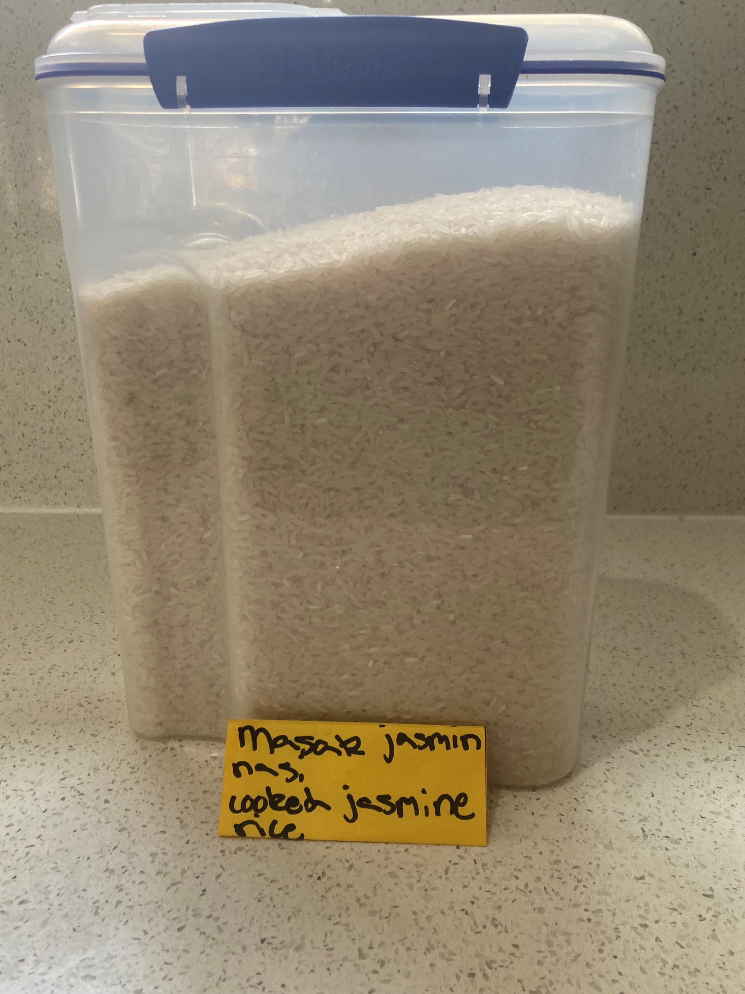
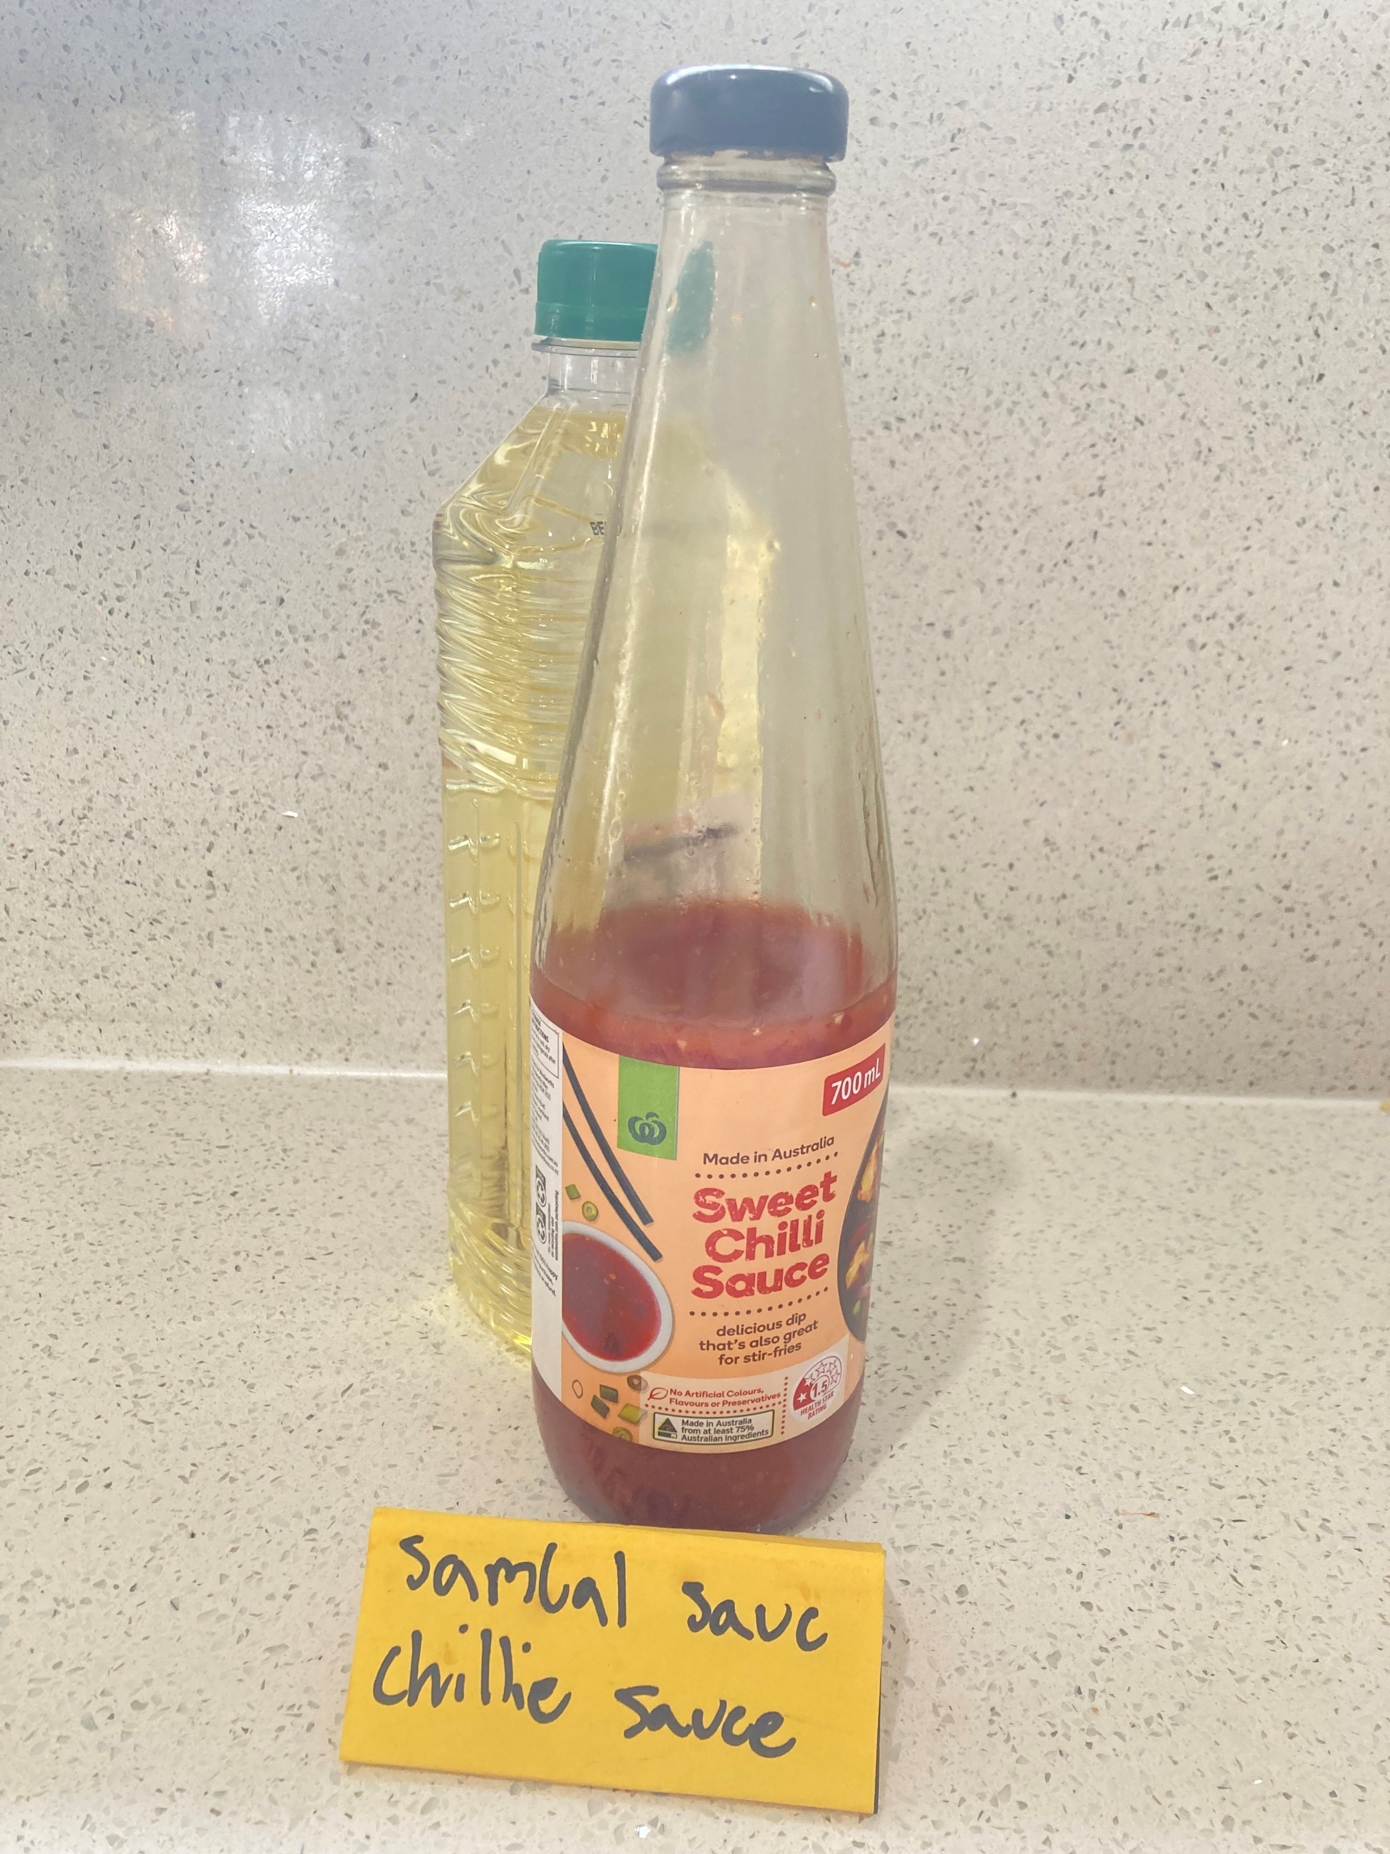
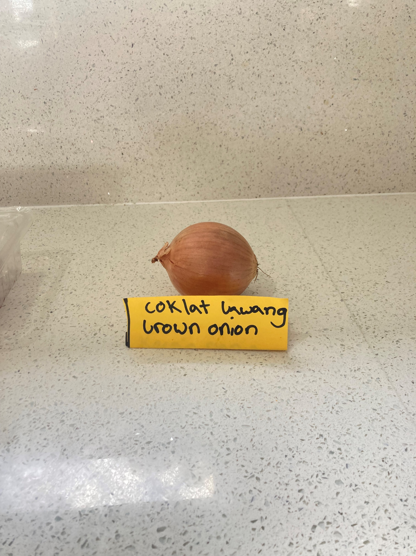
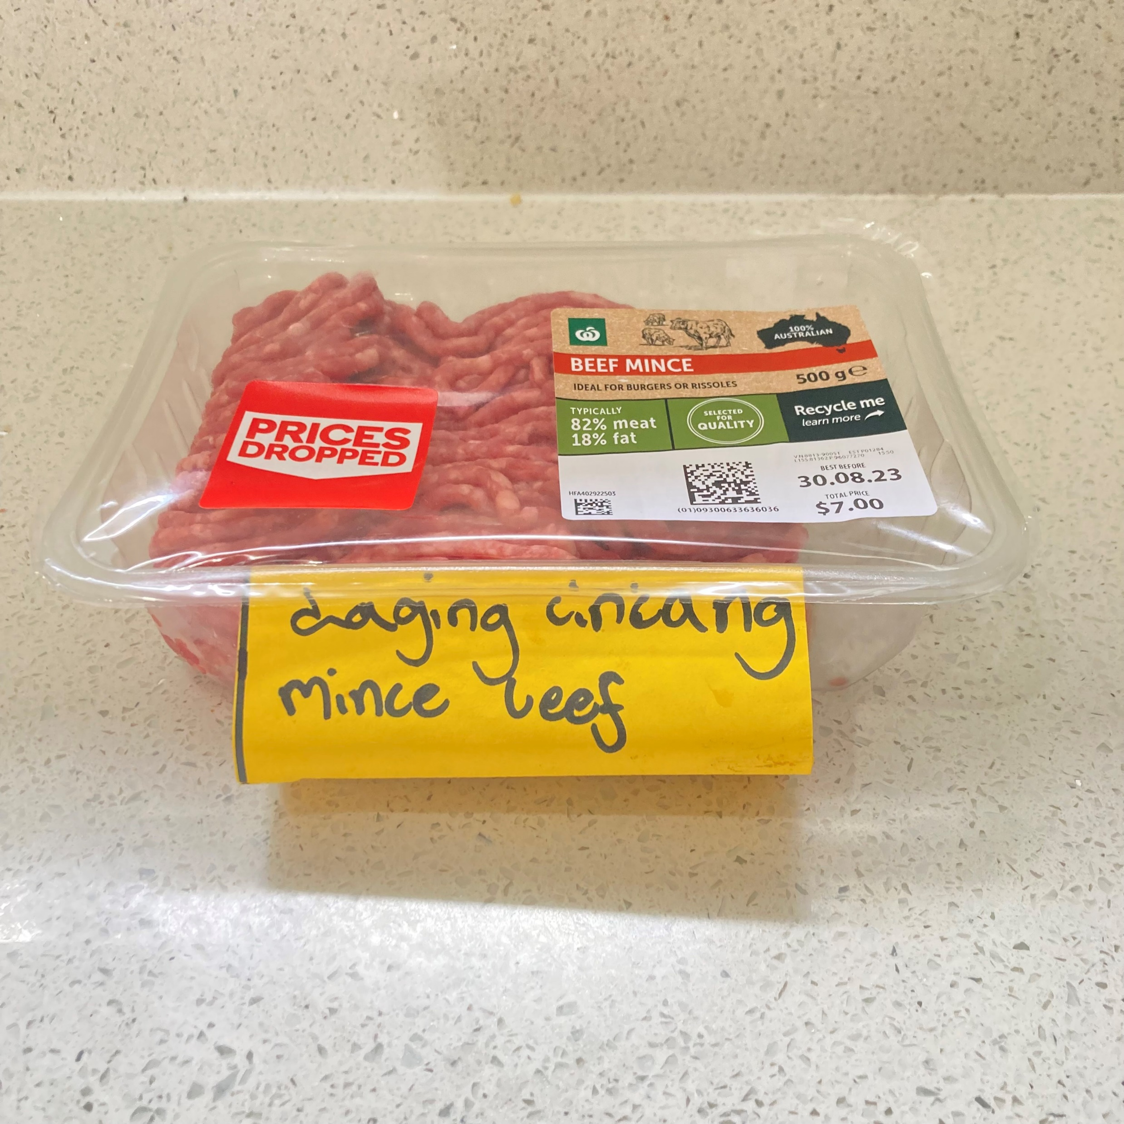
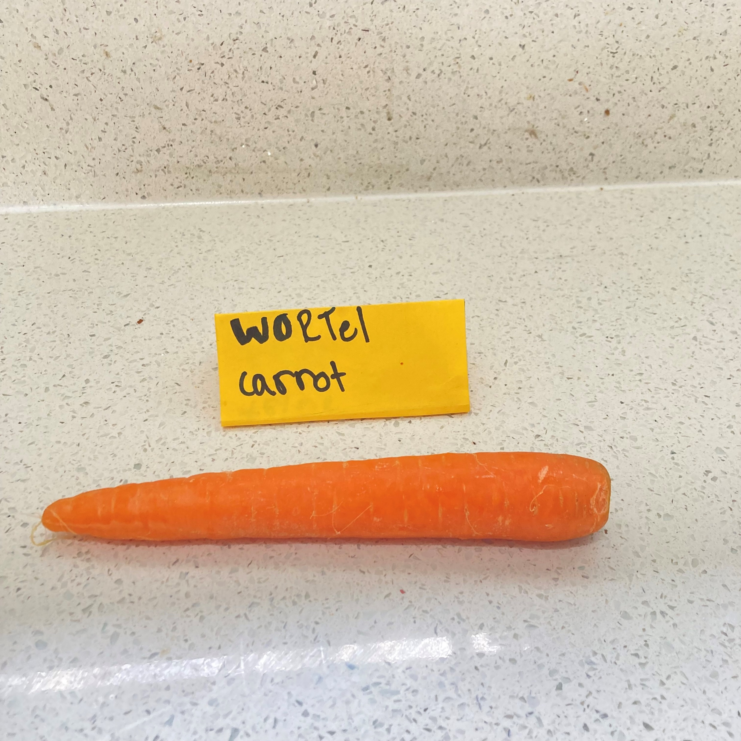
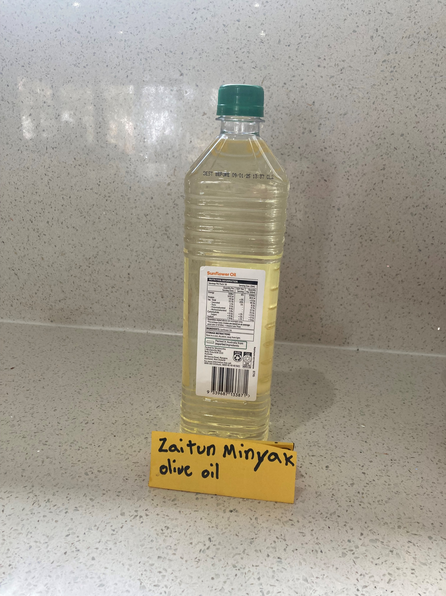
Bahan masak

Slide 4
Nasi goreng
english
1 fried rice is from Indonesia.
2 fried rice is a savoury food with a nutty and buttery taste.
3 I like it because it is salty and spicy.
indonesian
1 nasi goreng dari Indonesia
2 nasi goreng gurih dan berminyak
3 saya suka nasi goreng karena nasi goreng enak dan manis

Slide 5
Cara masak
The cooking process

Slide 6
1 2 3 4

Slide 7
Nasi goreng

Slide 8
Cara masak

Slide 9
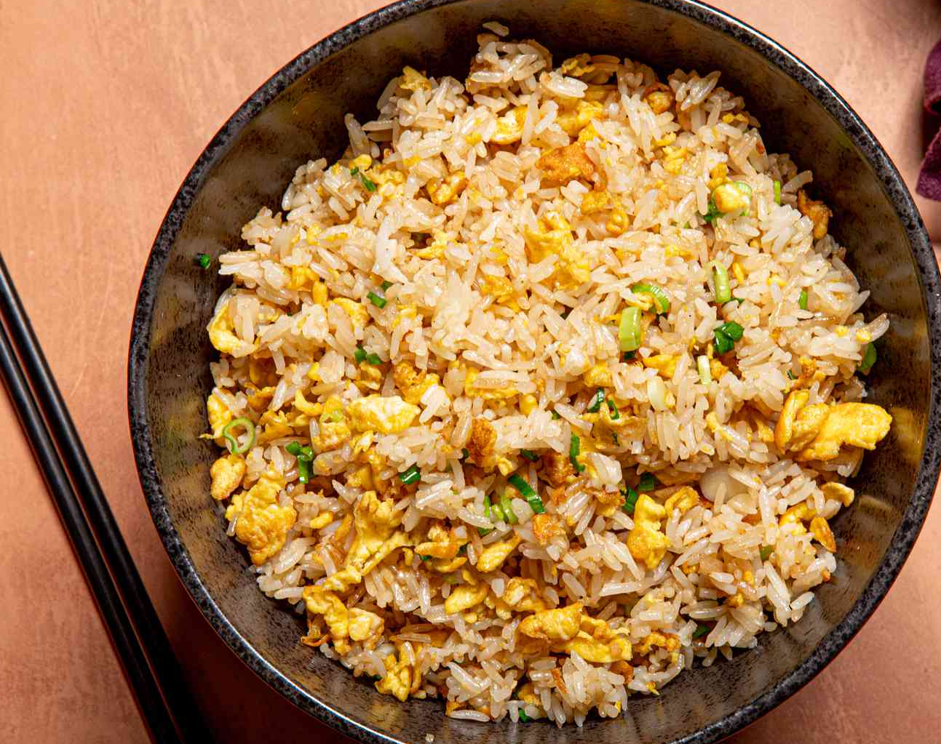
Terima kasih untuk membaca

