Slide 1
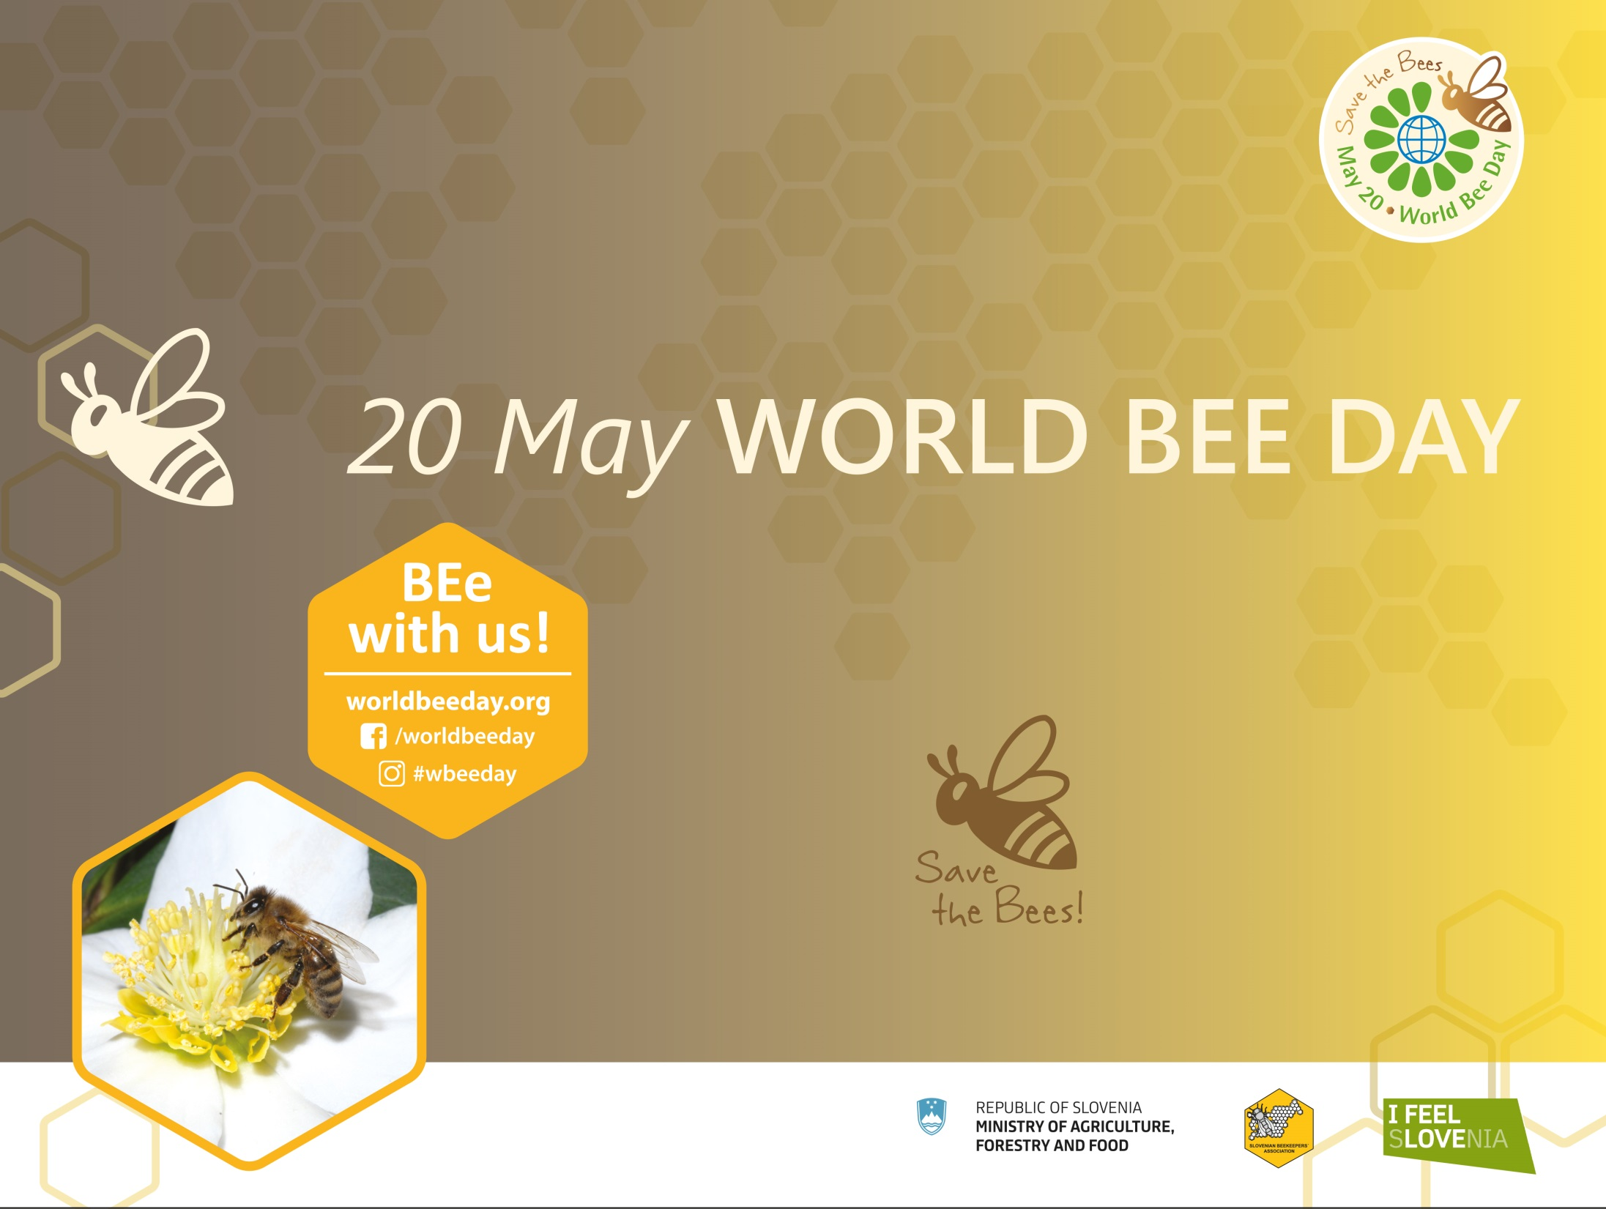
20 May – World Bee Day
BEe with us – save the bees!

Slide 2
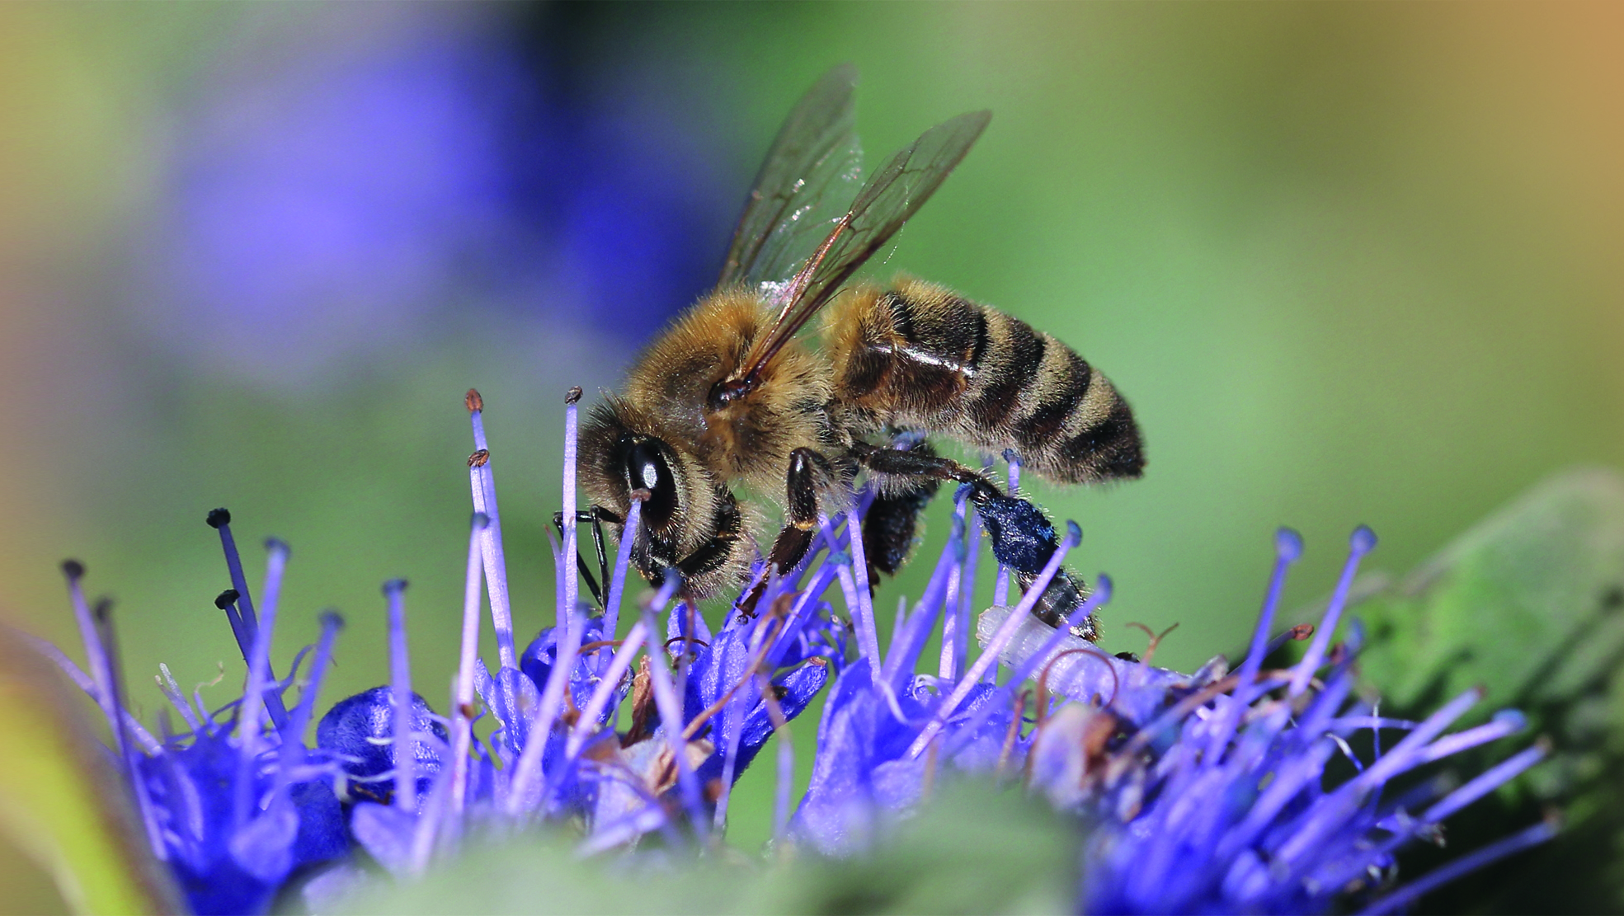
Slovenia‘s initiative for World Bee Day
Slovenia proposed that May 20 should be declared as World Bee Day at the UN. On 20 December 2017, after three years of international efforts, the UN unanimously endorsed Slovenia's proposal and 20 May was proclaimed as World Bee Day.
The Slovenian initiative was supported by 115 countries, including the USA, Canada, China, the Russian Federation, India, Brazil, Argentina, Australia and all the EU member states.

Slide 3
Key milestones in the proclamation of WBD
15/9/2014 │ President of the Slovenian Beekeeping Association, Boštjan Noč, hits
upon the idea of a World Bee Day.
26/9/2014 │ Minister of Agriculture, Forestry and Food, Dejan Židan, supports the
initiative in writing and pledges that the ministry will seek to implement it.
6/10/2014 │ Slovenian president Borut Pahor supports the World Bee Day initiative.
2/4/2015 │ The Government of Slovenia gives support to the initiative.
11/5/2015 │ Slovenia’s initiative is presented to the EU agriculture ministers;
more than 20 countries support it.
20/9/2015 │ The initiative is backed by the World Beekeeping Association Apimondia.
5/7/2017 │ The FAO Conference in Rome adopts the decision to submit a resolution
to the UN General Assembly.
20/12/2017 │ The UN General Assembly in New York unanimously adopts the resolution
proclaiming 20 May as World Bee Day.

Slide 4
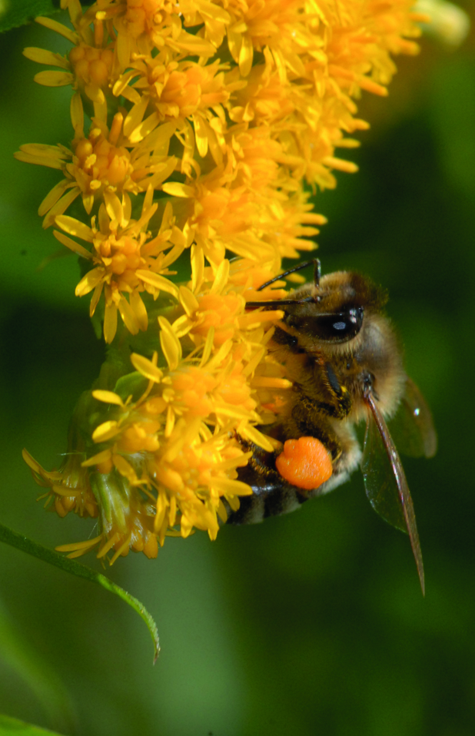
Why are bees important for mankind?
For ensuring food security in the world
Every third spoon of world food depends on pollination
Bee products are a rich source of essential nutrients
For sustainable agriculture and jobs
Contributing to the agricultural production with pollination
Providing jobs and income to farmers
For the environment
Positive effects on the entire ecosystem, they help preserve the biodiversity
A good biological indicator of environment conditions

Slide 5
Are bees and other pollinators really at risk?
The main causes are:
diseases such as varroa, nosema disease and viral infections;
a lack of food sources due to intensive agriculture (monoculture, frequent meadow mowing). Bees are thus provided with the necessary food only for a short period in a year, which is also less diverse than in the past;
the use of pesticides in agriculture and their impact on pollinators;
new pests that spread rapidly across the world due to globalisation;
the growth of cities, which shrink habitats;
climate change.
In Europe, extinction threatens nearly 10 %
of all the bee species!

Slide 6
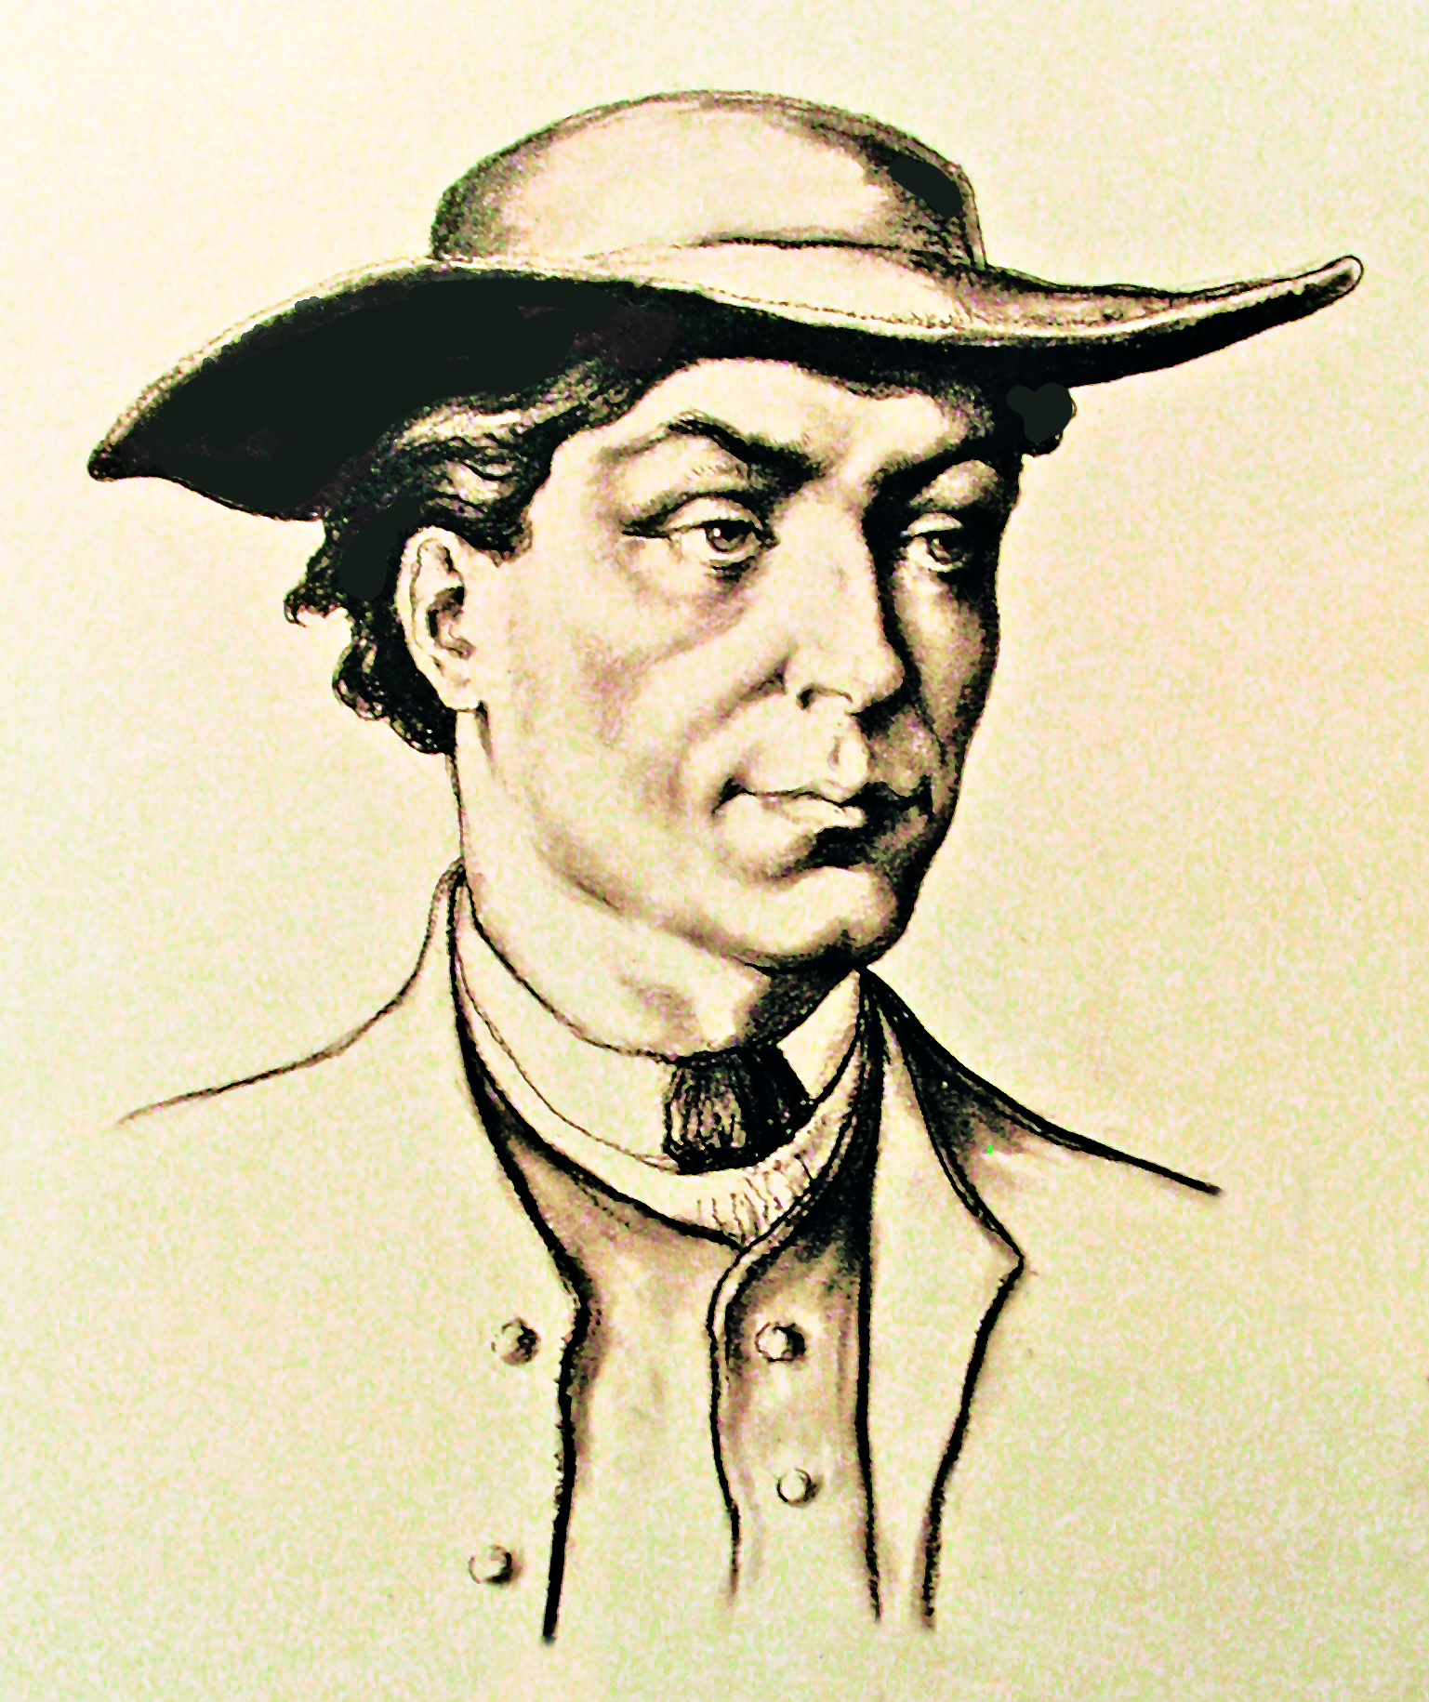
Why 20 May – World Bee Day?
May is the month of bees:
in the northern hemisphere: the development of bees is in full swing, bee colonies swarm and are the most numerous;
in the southern hemisphere: autumn, time for harvesting bee products.
20 May is the birthdate of Anton Janša
(1734–1773), a pioneer of modern beekeeping and one of the greatest experts in this field in his day.

Slide 7
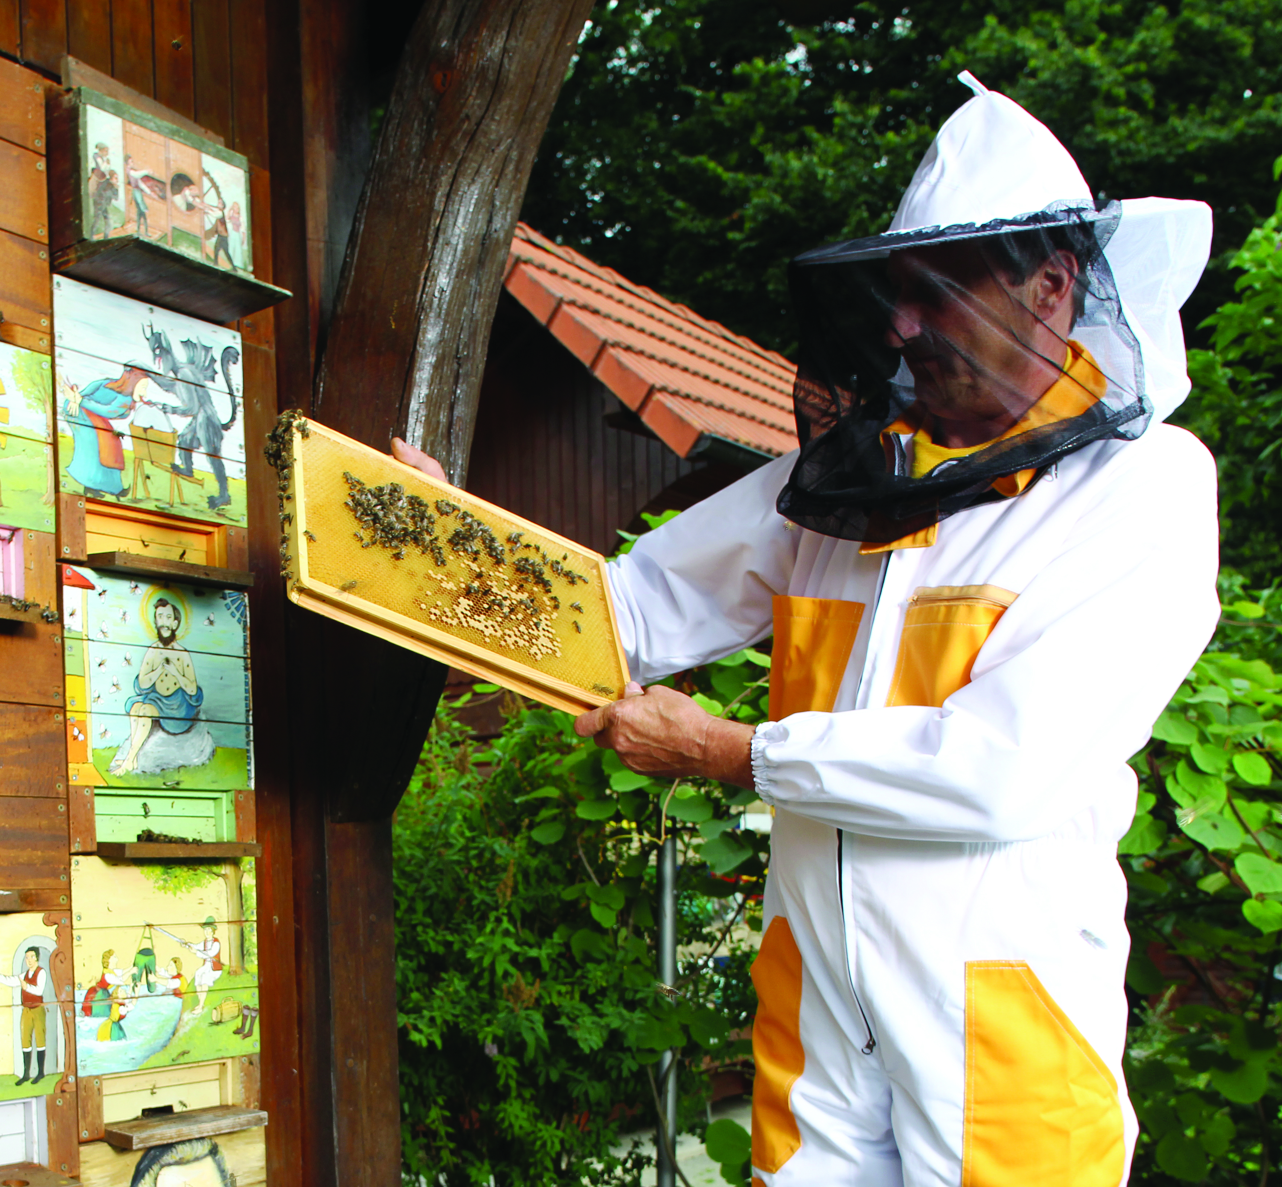
Why Slovenia?
Slovenia ranks among the best in the world regarding the number of beekeepers per capita – one in 200 Slovenians is a beekeeper.
Slovenia was the first EU member state that protected its honey bee with legal means.
In 2011 Slovenia became one of the first EU countries to prohibit the use of certain pesticides most harmful to bees in its territory.

Slide 8
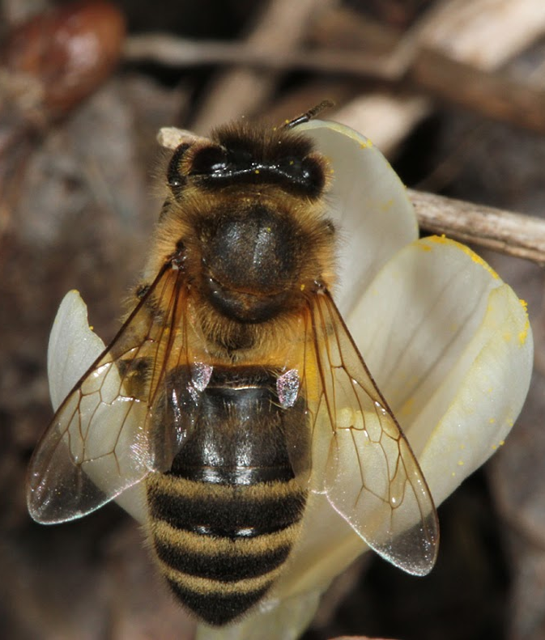
Why Slovenia?
Slovenian beekeepers are known for their professionalism, advanced beekeeping technologies and unique features, such as painted beehive panels, bee houses and traditional beehives.
Bee, especially the indigenous Carniolan honey bee (Apis mellifera carnica), which is the second most widespread subspecies in the world, is part of the Slovenian national identity.

Slide 9
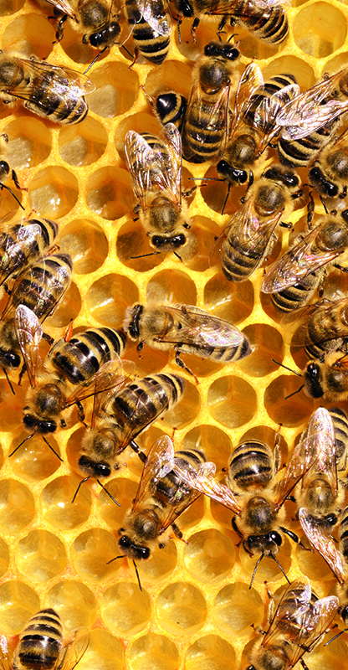
Five things you can do for bees
Plant or sow honey plants on balconies, terraces and gardens for decorative purposes.
Set up a nesting box for bees on your balcony, terrace or garden - you can do it yourself or buy it.
Avoid mowing grass during the peak flourishing of plants and mow grass in the evening hours.
As regards spraying, use pesticides that are harmless to bees and spray plants in windless weather conditions early in the morning or late in the evening.
Raise children's and teenagers' awareness about importance of bees, and buy honey and other bee products from a local beekeeper.

