Slide 1

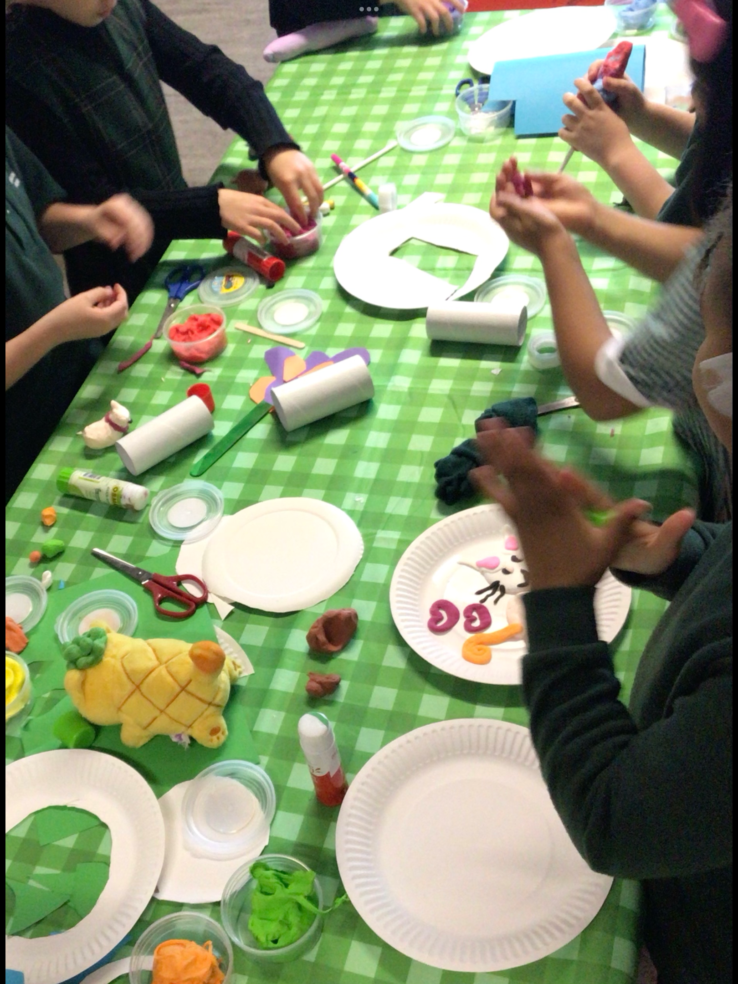

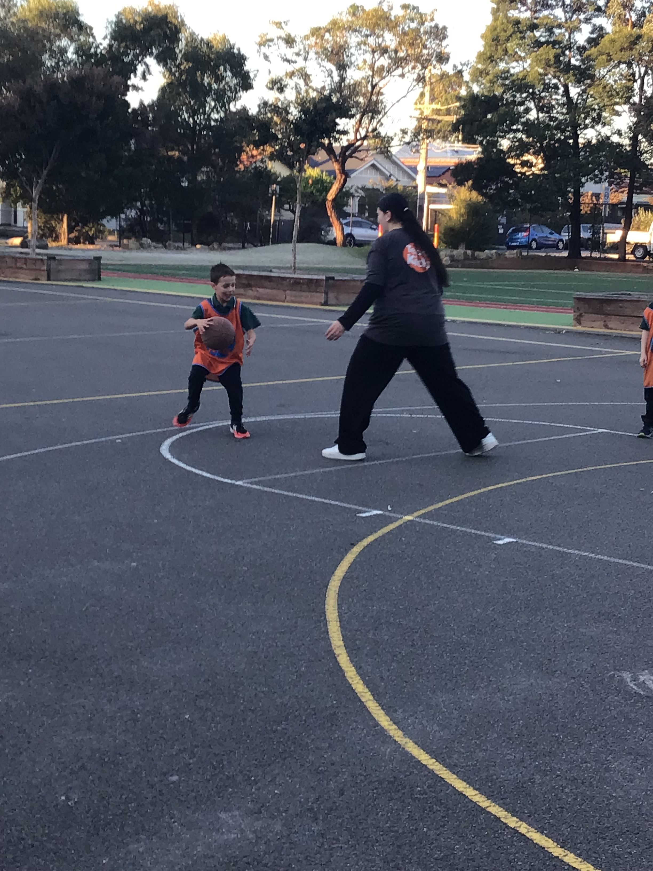
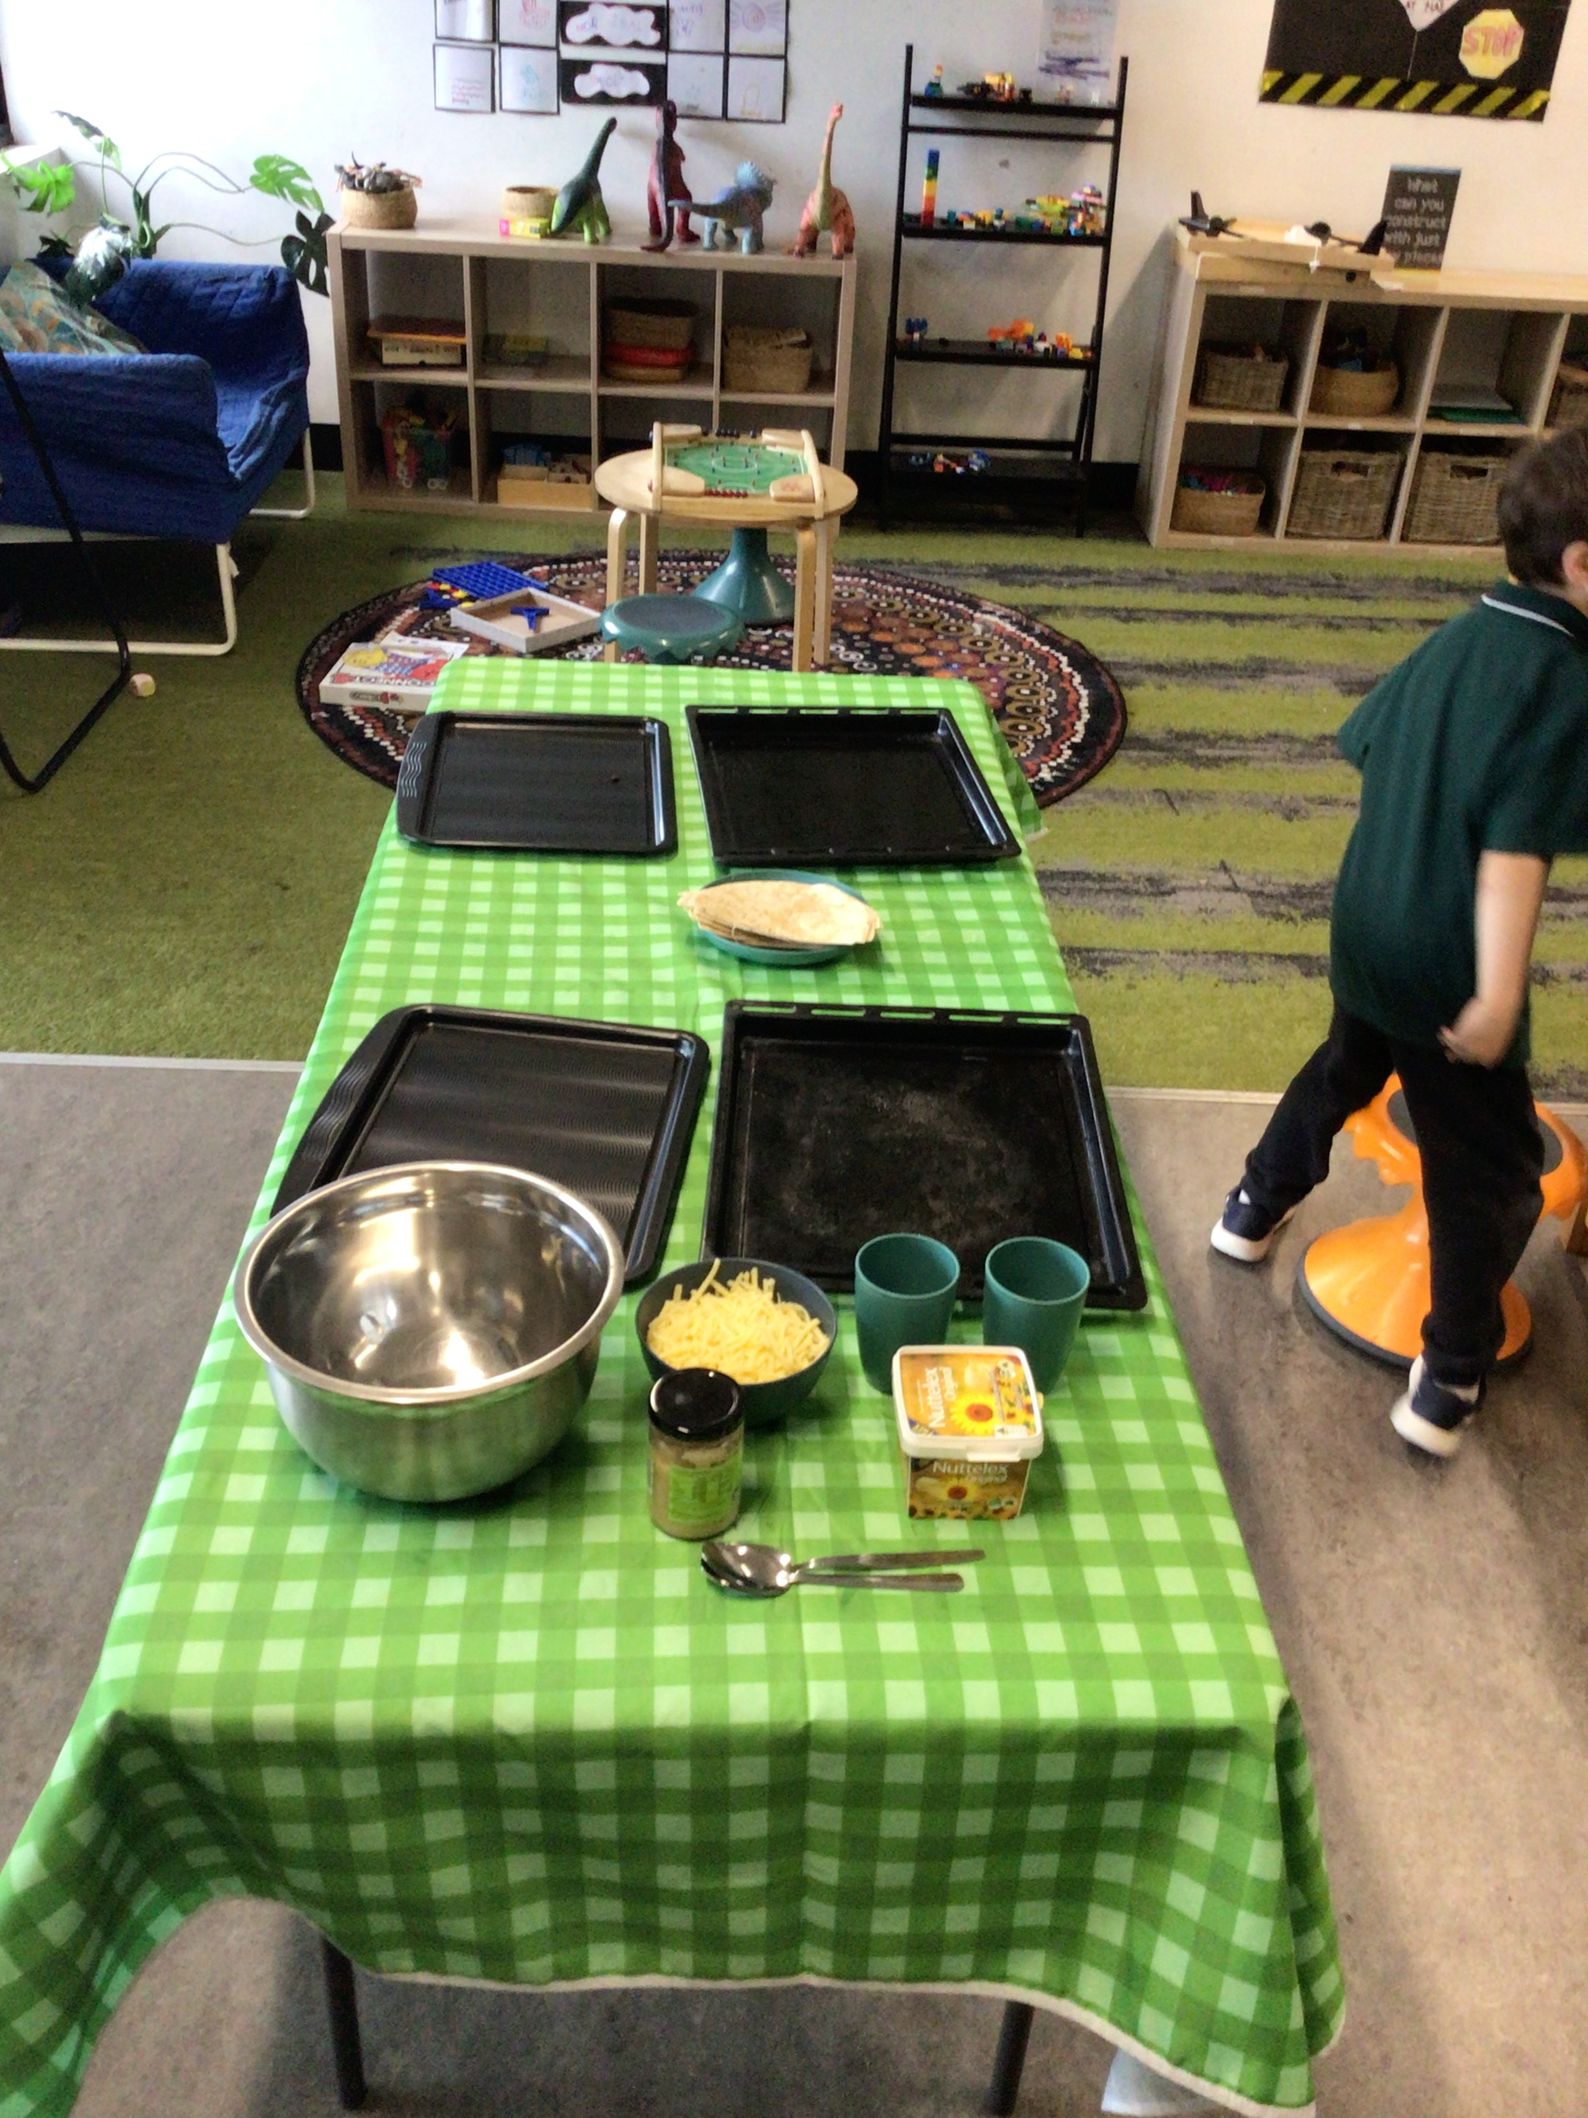
BRUNSWICK NORTH TEAMKIDS
3-10
Wow, time flies! We have been having so much fun at TeamKids.We have had an amazing start to our clubs, with the children getting involved, being creative, and getting messy. A highlight from Culture Cooking Club was making garlic and herb pizzas to accompany our afternoon tea of lentil bolognese. The children really enjoyed this experience, and many were surprised by how much they liked it!We have also been skipping our way through Term 2. The children have been practising their skills and are becoming more confident with their skipping every day.Here at TeamKids, we recently held a Grab-and-Go Breakfast for parents. Families were very appreciative of the gesture, and we cannot wait to do it again.Next week, we pause to acknowledge and celebrate our Indigenous community. We will be taking part in many activities related to National Sorry Day and National Reconciliation Week as we continue to learn, reflect, and connect together.
Monday the 25th May
National sorry day
Wednesday 27th May
Super sports club
Reconciliation week begins
Monday 1st June
LEGO masters club
Global parents' day
Culture cooking club
S.T.E.M Club
BrunswickNorthPS@teamkids.com.au
0484 300 092
info@teamkids.com.au
1300 035 000

