Slide 1
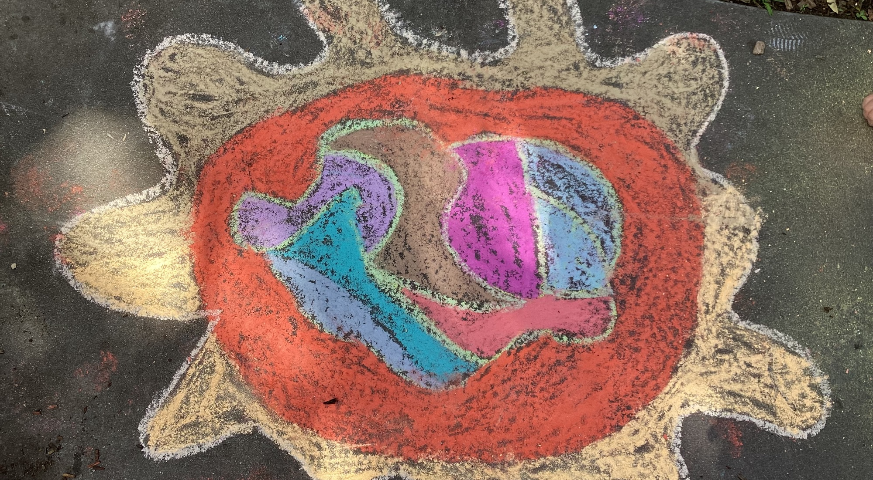
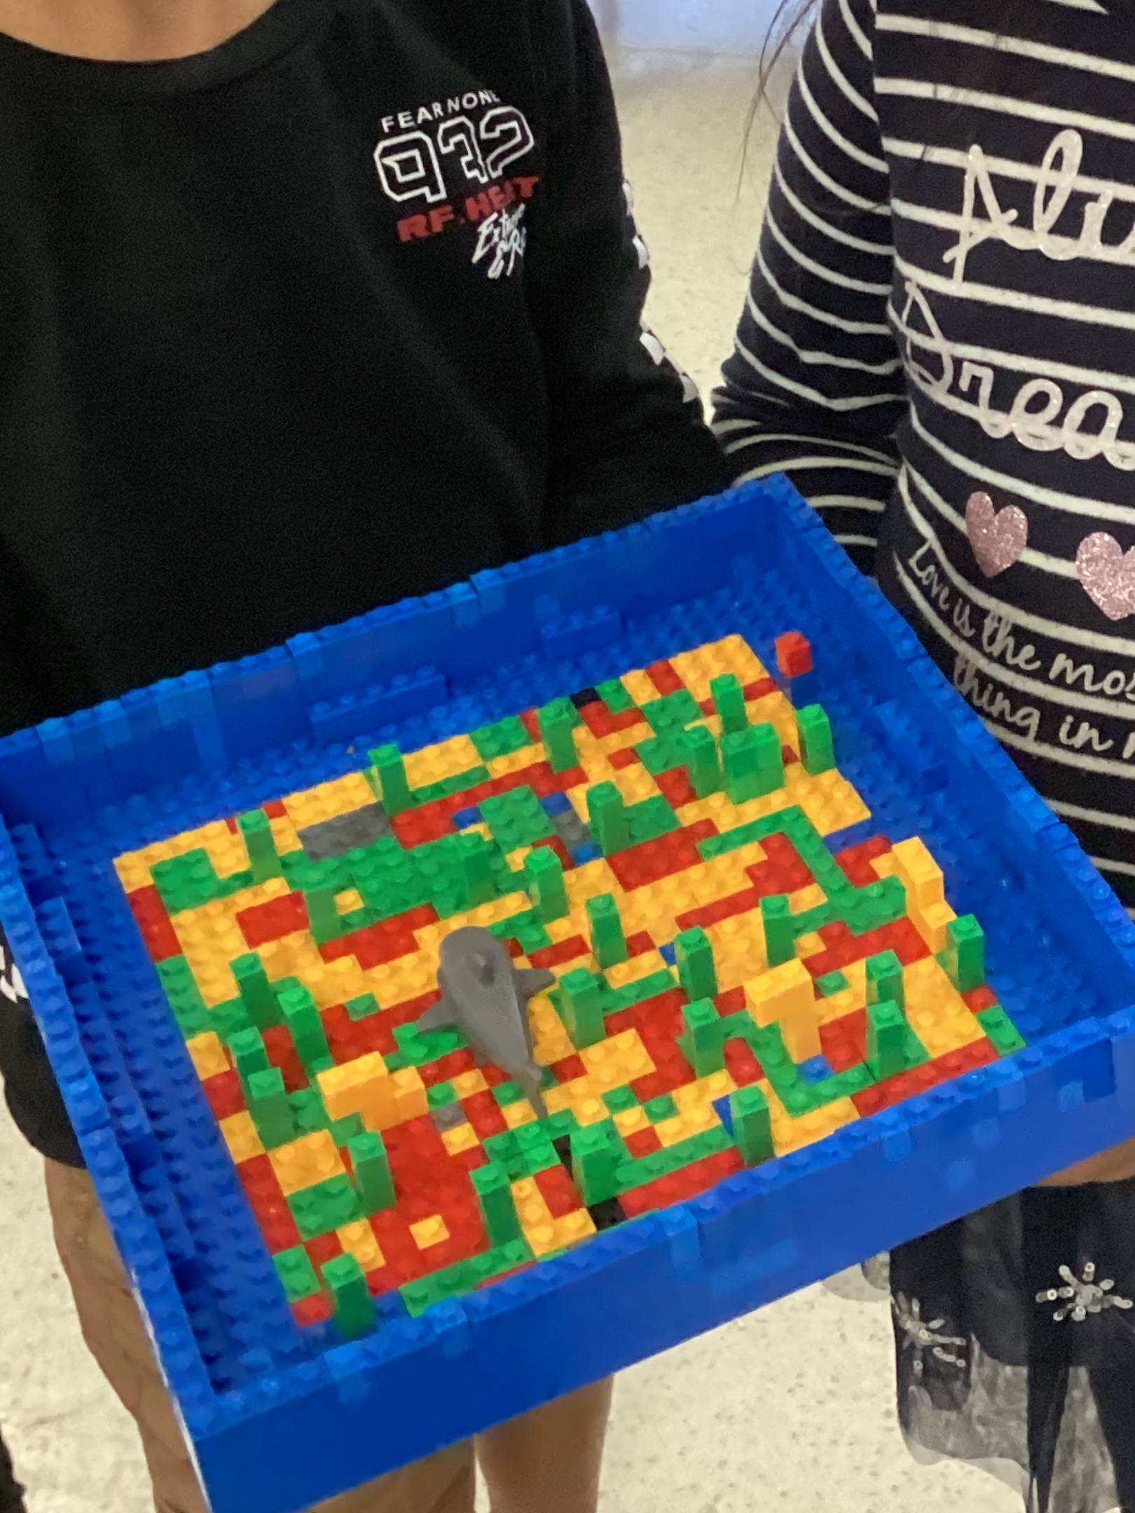
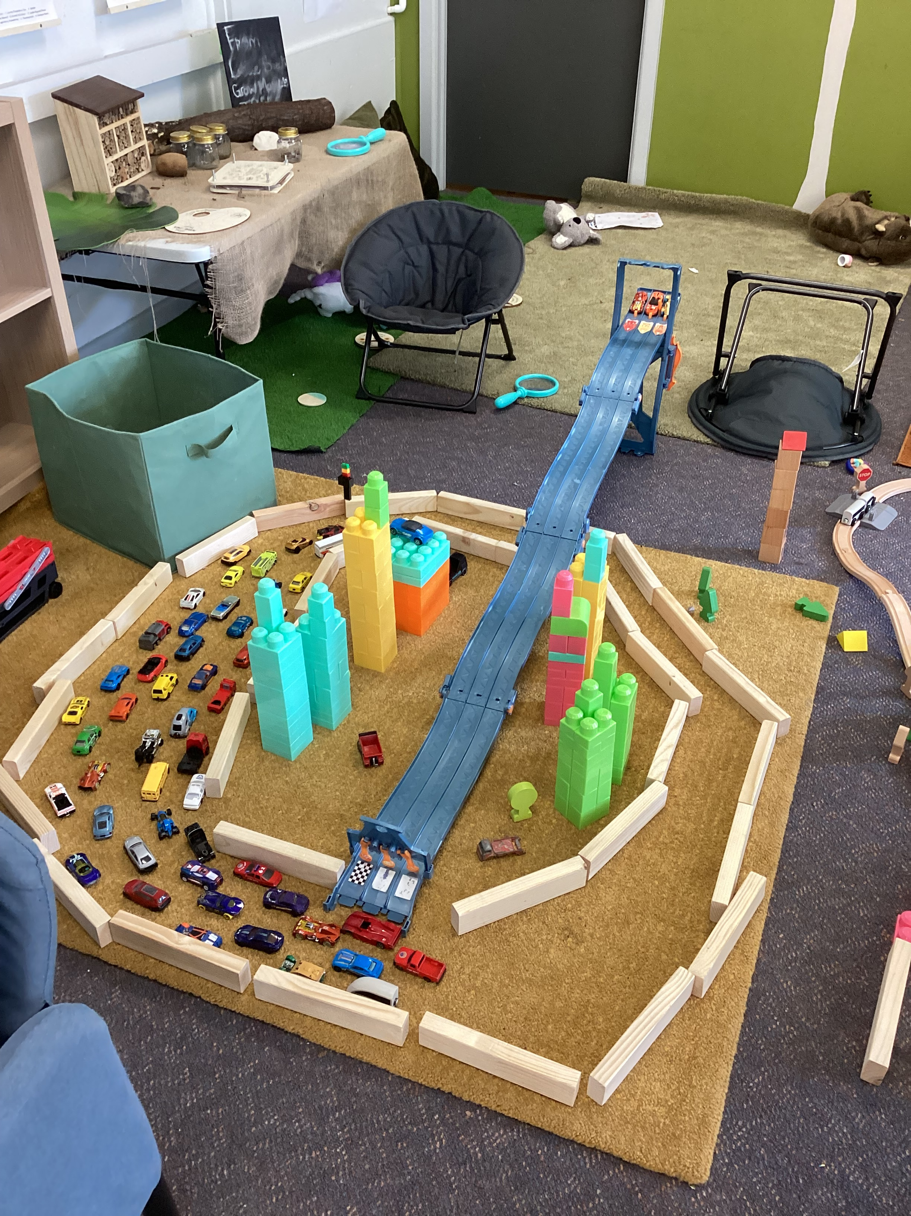
Cheltenham East Team Kids
Dear Parents and Guardians,
Welcome to the second week of our Before and After School Care program! We hope that everyone had a fantastic summer break and is ready to jump back into learning and fun activities.
Our program provides a safe and nurturing environment for your child before and after school hours. This week, our focus will be on getting to know new children and improve routines. We will be engaging in a range of activities that promote socialization, creativity, and physical activity.
We have planned exciting activities for children have fun to such as arts and crafts, board games, outdoor games, and free play. We also provide a designated time for homework help and assistance.
We encourage you to communicate any specific needs or concerns that you may have for your child. Our team is committed to providing individualized attention and ensuring that every child feels comfortable and engaged.
We look forward to a wonderful second week. If you have any questions or concerns, please do not hesitate to reach out to us.
Sincerely yours,
Eric
2
Reading Club
Musical Theatre Club
Super Sports Club
Reading Club
Super Sports Club
Tue 02th May
Harry Potter Day
Fri 05th May
StarWars Day
Fri 12th May
Coffee Van for Mother’s Day
0432 299 468
CheltenhamEastPS@teamholiday.com.au
1300 035 000
info@teamkids.com.au

