Slide 1
INTRODUCING OUR NEW RECYCLING BINS THROUGHOUT NHS WITH ECOBIN.
Ever unsure about what goes in which bin?
You now have 3 choices
YELLOW mixed recyclables RED general waste. GREEN organic waste

Slide 2
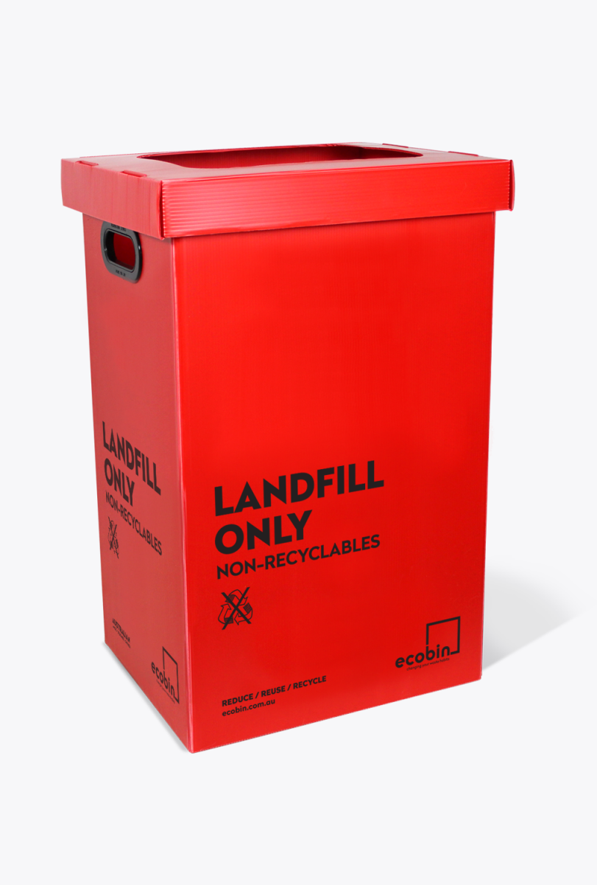
RED = General waste ( landfill)
Alright – let’s get down to the nitty-gritty of Landfill, folks. They’re filling up faster than you can say ‘An Inconvenient Truth’ and that’s not even the worst part. With rotting fruit, pesticides and pharmaceuticals being discarded as general waste the air above is being poisoned with gases nastier than your farts (i.e. methane, ammonia etc) and our land below is being contaminated with chemicals from disinfectants and other cleaning products, potentially leading to our soil and groundwater. Queue that sinking feeling in your stomach now.
Nobody stands around at a landfill site waiting around to sort through the garbo’s dump and dash. There’s no checking to see if any recyclables took the wrong exit and ended up in the wrong place. It is quite literally a dump onto the already mountainous piles and then covered with soil as if nothing ever happened.
85% of landfill material is…wait for it… RECYCLABLE! It’s up to you to chuck it in the right bin!

Slide 3
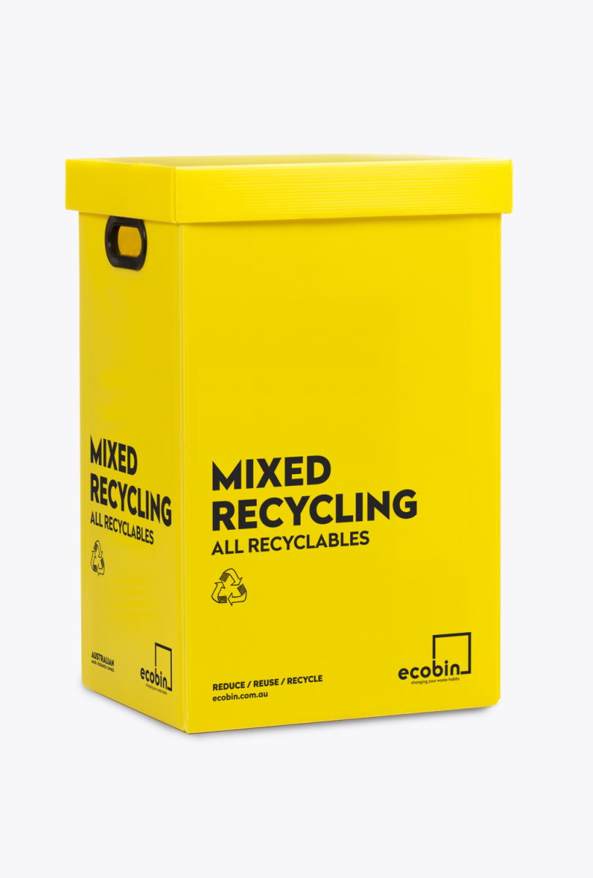
YELLOW BIN IS MIXED RECYCLABLES
Dispose your plastics, paper, glass and aluminium here.
Bike parts, appliances, clothing, carpet, fiberglass – these are all things your mixed recyclables can become if recycled properly!
Disposing of the incorrect type of plastic can contaminate recycling, meaning it can’t be processed into a shiny new sustainable product and will most likely be sent to loathsome Landfill.
Refuse, reduce, reuse, recycle!

Slide 4
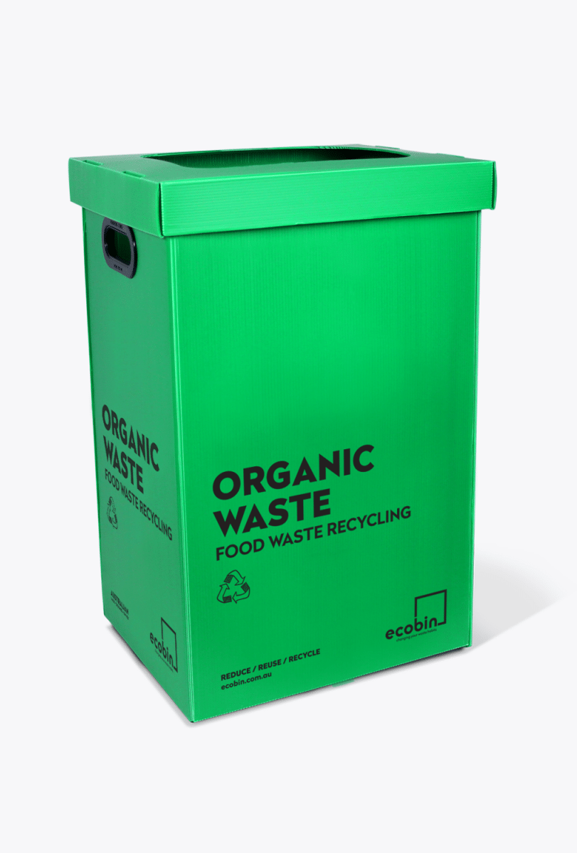
GREEN BIN IS YOUR ORGANIC BIN
You will find this conveniently placed in the atrium around the school canteen.
Include banana peels, food leftovers, E.T.C
No meat or citrus.
Due to the lack of oxygen in our landfills (because they’re stuffed to the brim), the organic waste undergoes a process called anaerobic decomposition and generates the Cobra Kai Sensei of gases called methane, which is 25 times more potent a greenhouse gas than carbon dioxide.

Slide 5

More than ever it is important you dispose your waste responsibly!
REFUSE RETHINK REDUCE
REUSE RECYCLE
PLEASE USE THE ECO BINS
Did you know that 99% of the items we buy end up being thrown in the trash within six months, and that the average Australian produces 1.5 tonnes of waste per year!
With all the trash humans generate each year, it’s no surprise that the environment is suffering. However, there is an easy and effective way to address this issue: proper waste management.

