Slide 2
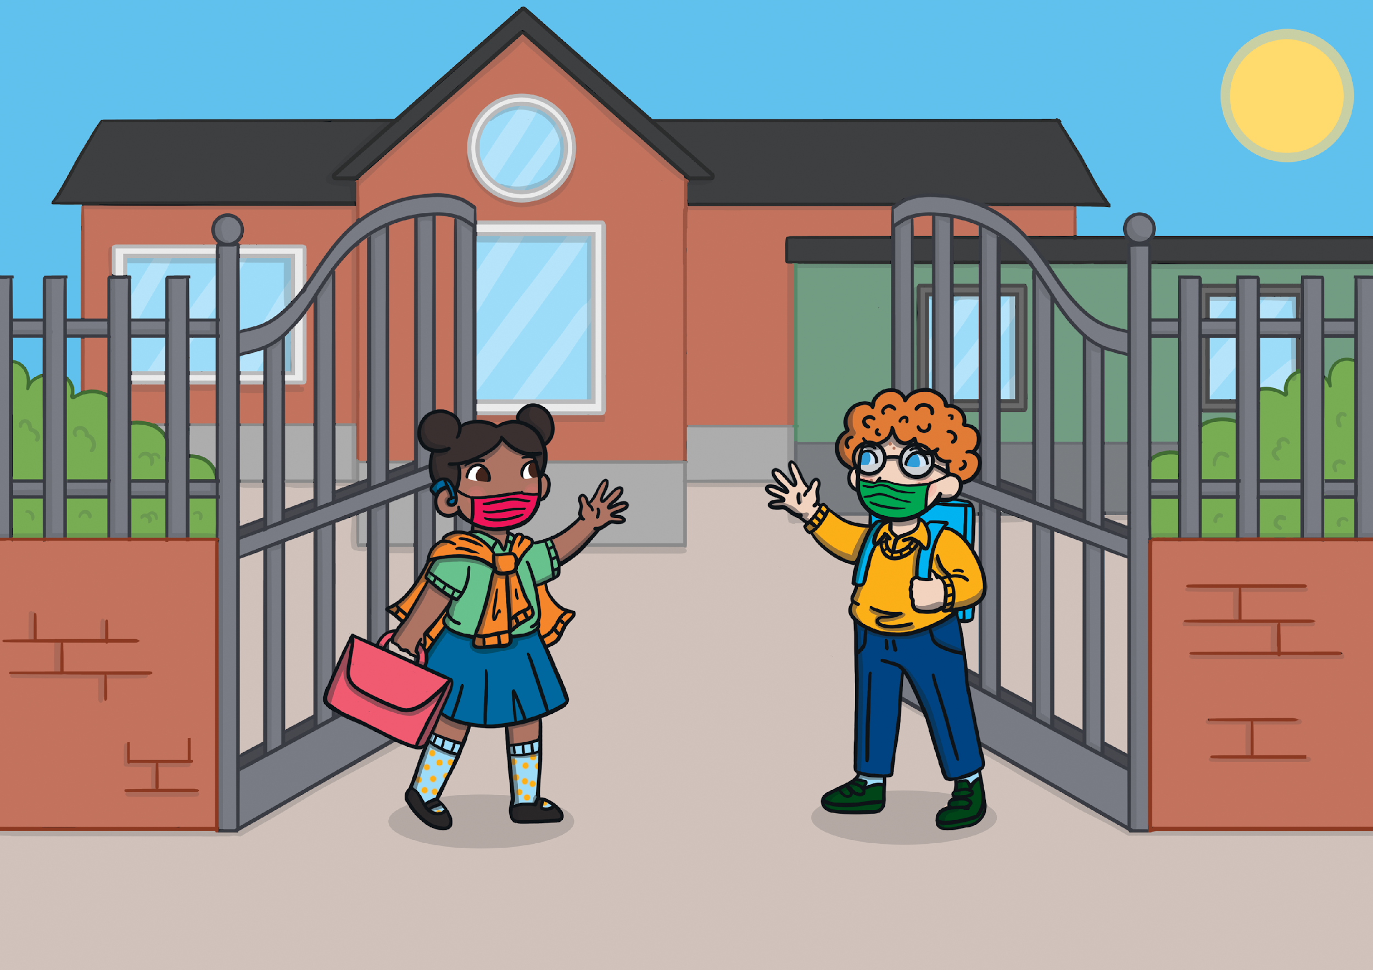
I am required to wear mask at school.
Everyone in grades 3-6 will need to do their part.

Slide 3
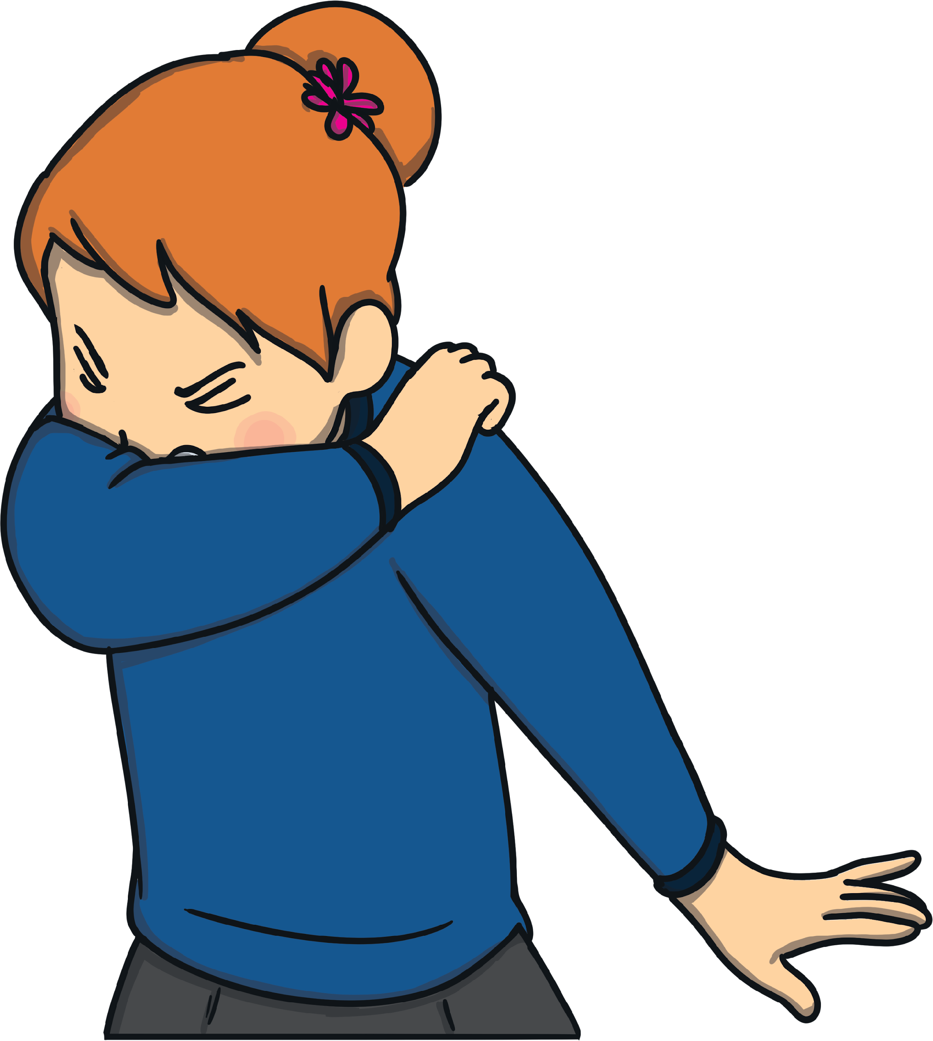
Wearing a mask can help keep me safe from germs.
A mask may prevent any germs in the air from entering my body.

Slide 4
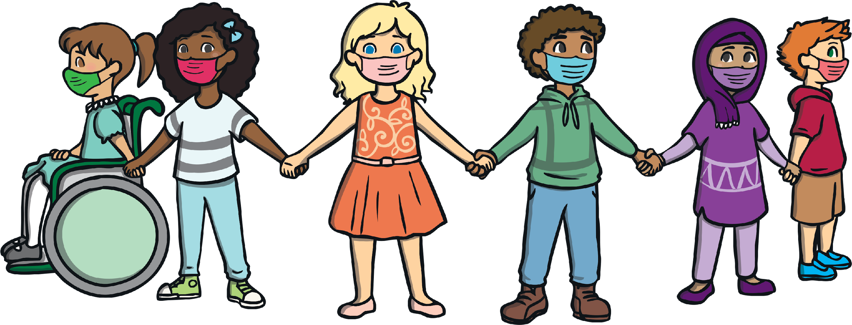
All of my friends will be wearing masks too.
We will be keeping ourselves and each other safe together.

Slide 5
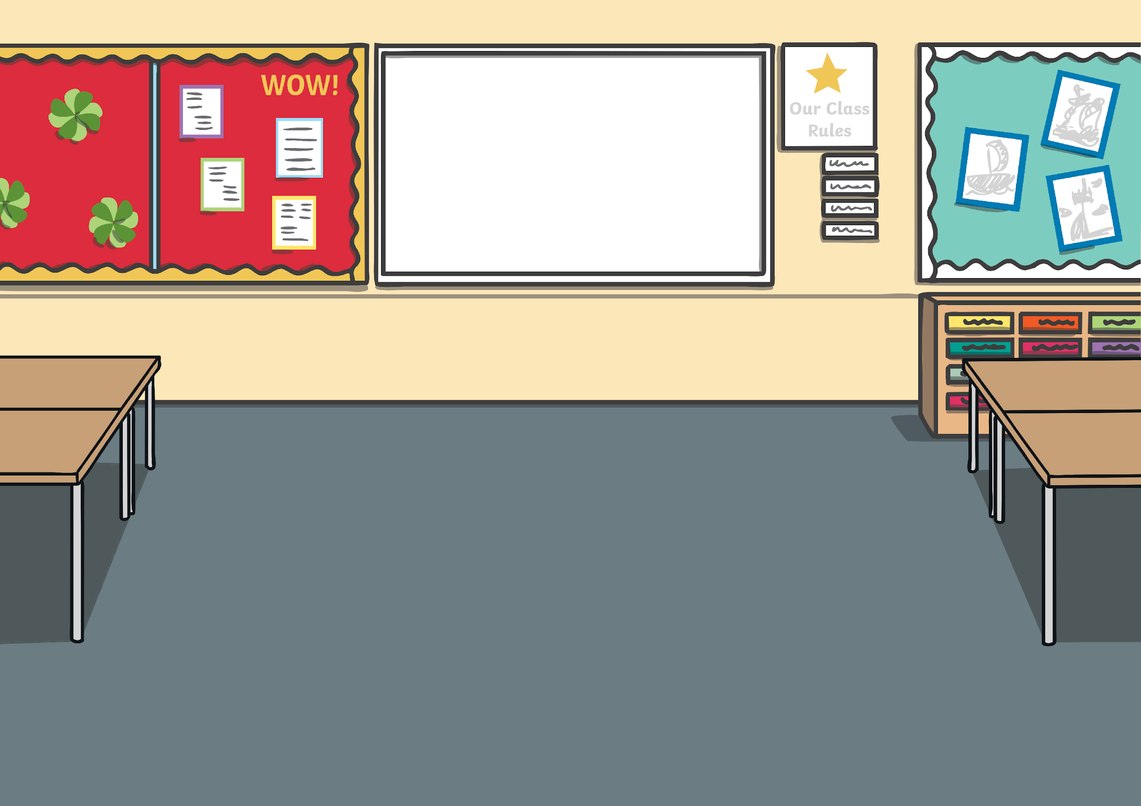
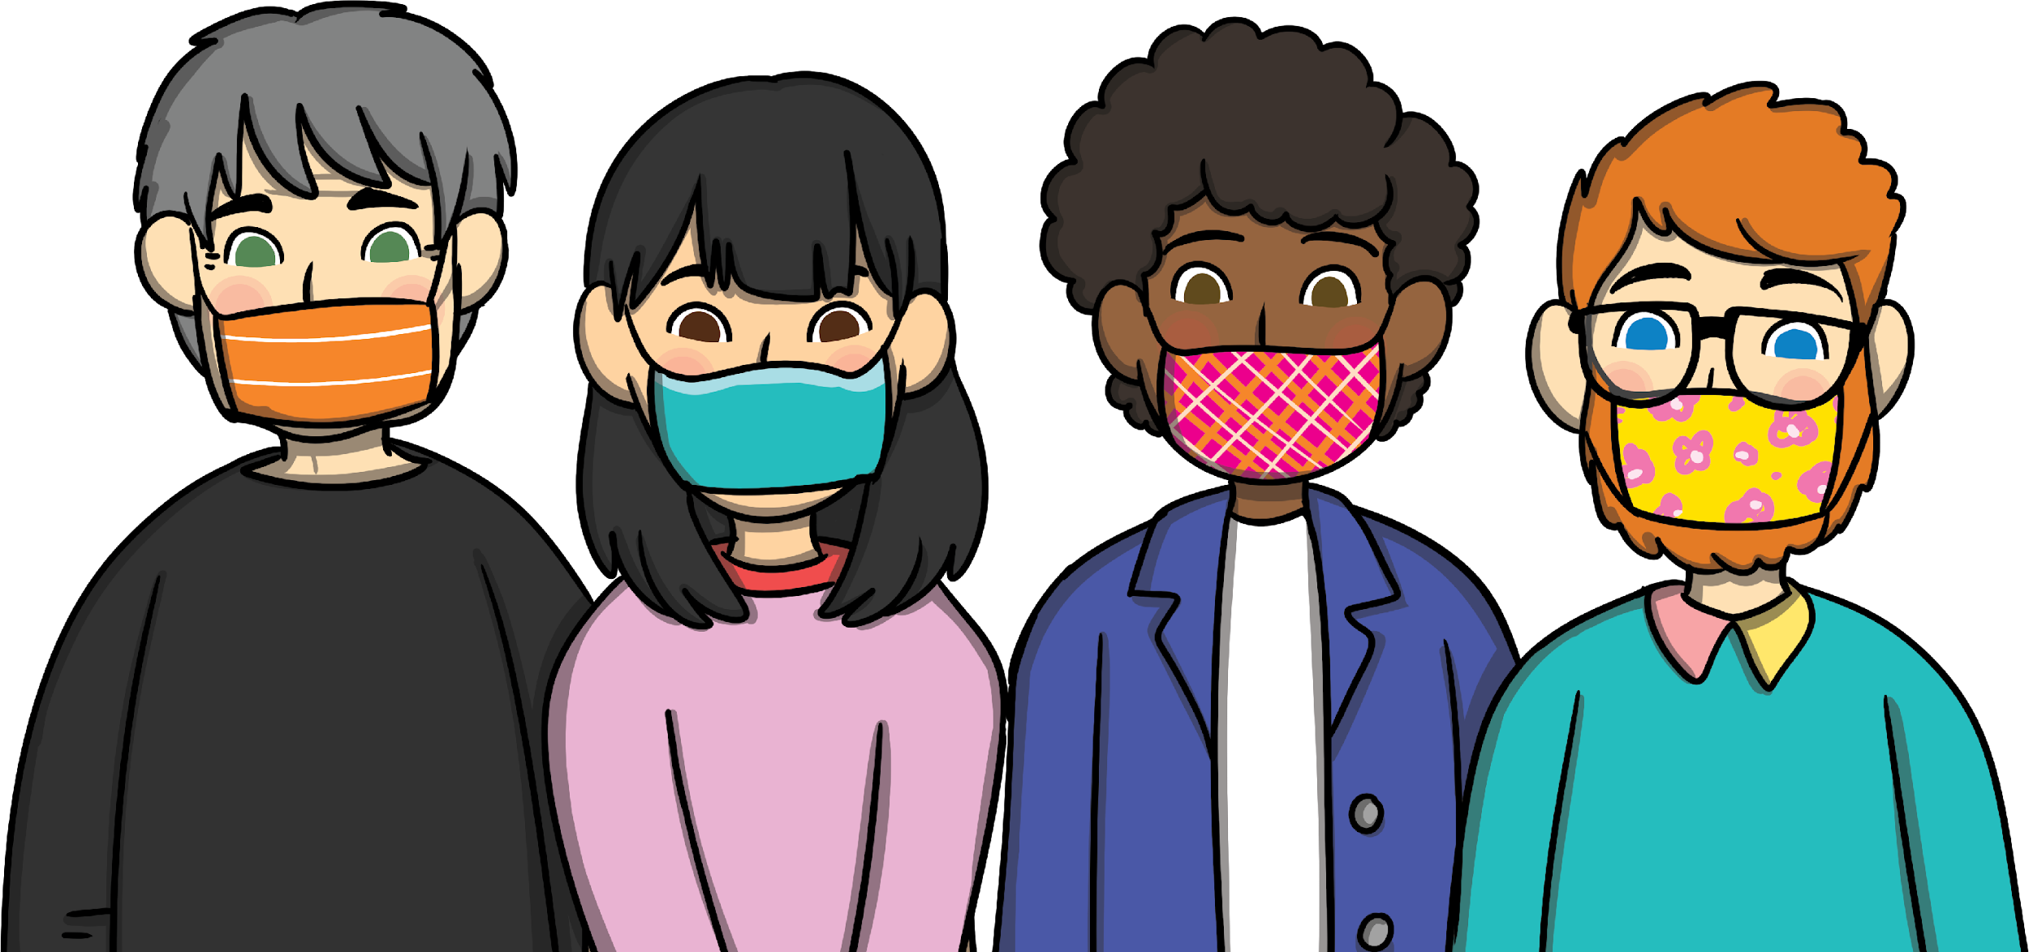
My teachers and the other adults will be wearing masks in the classroom and outside.

Slide 6
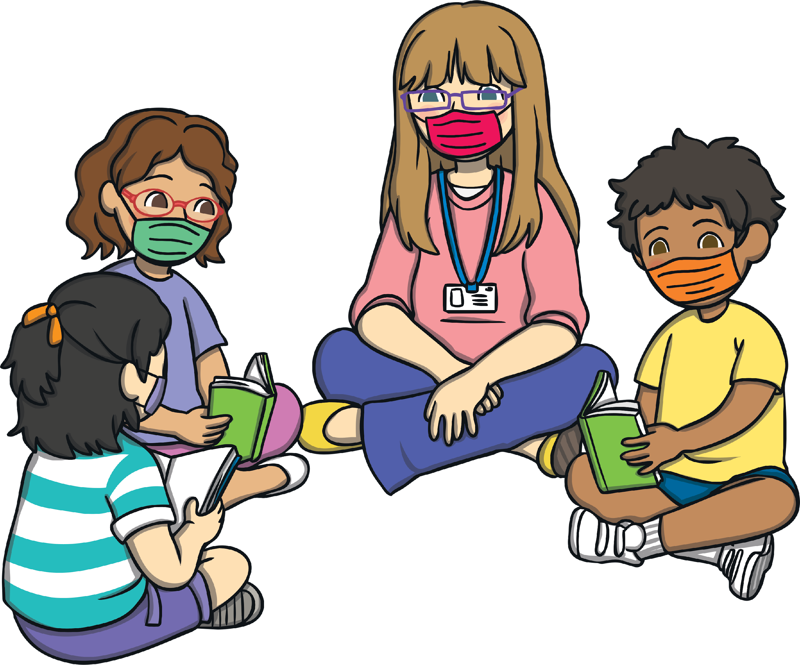
I will need to wear a mask when I am learning.
This will be something different for everyone.

Slide 7
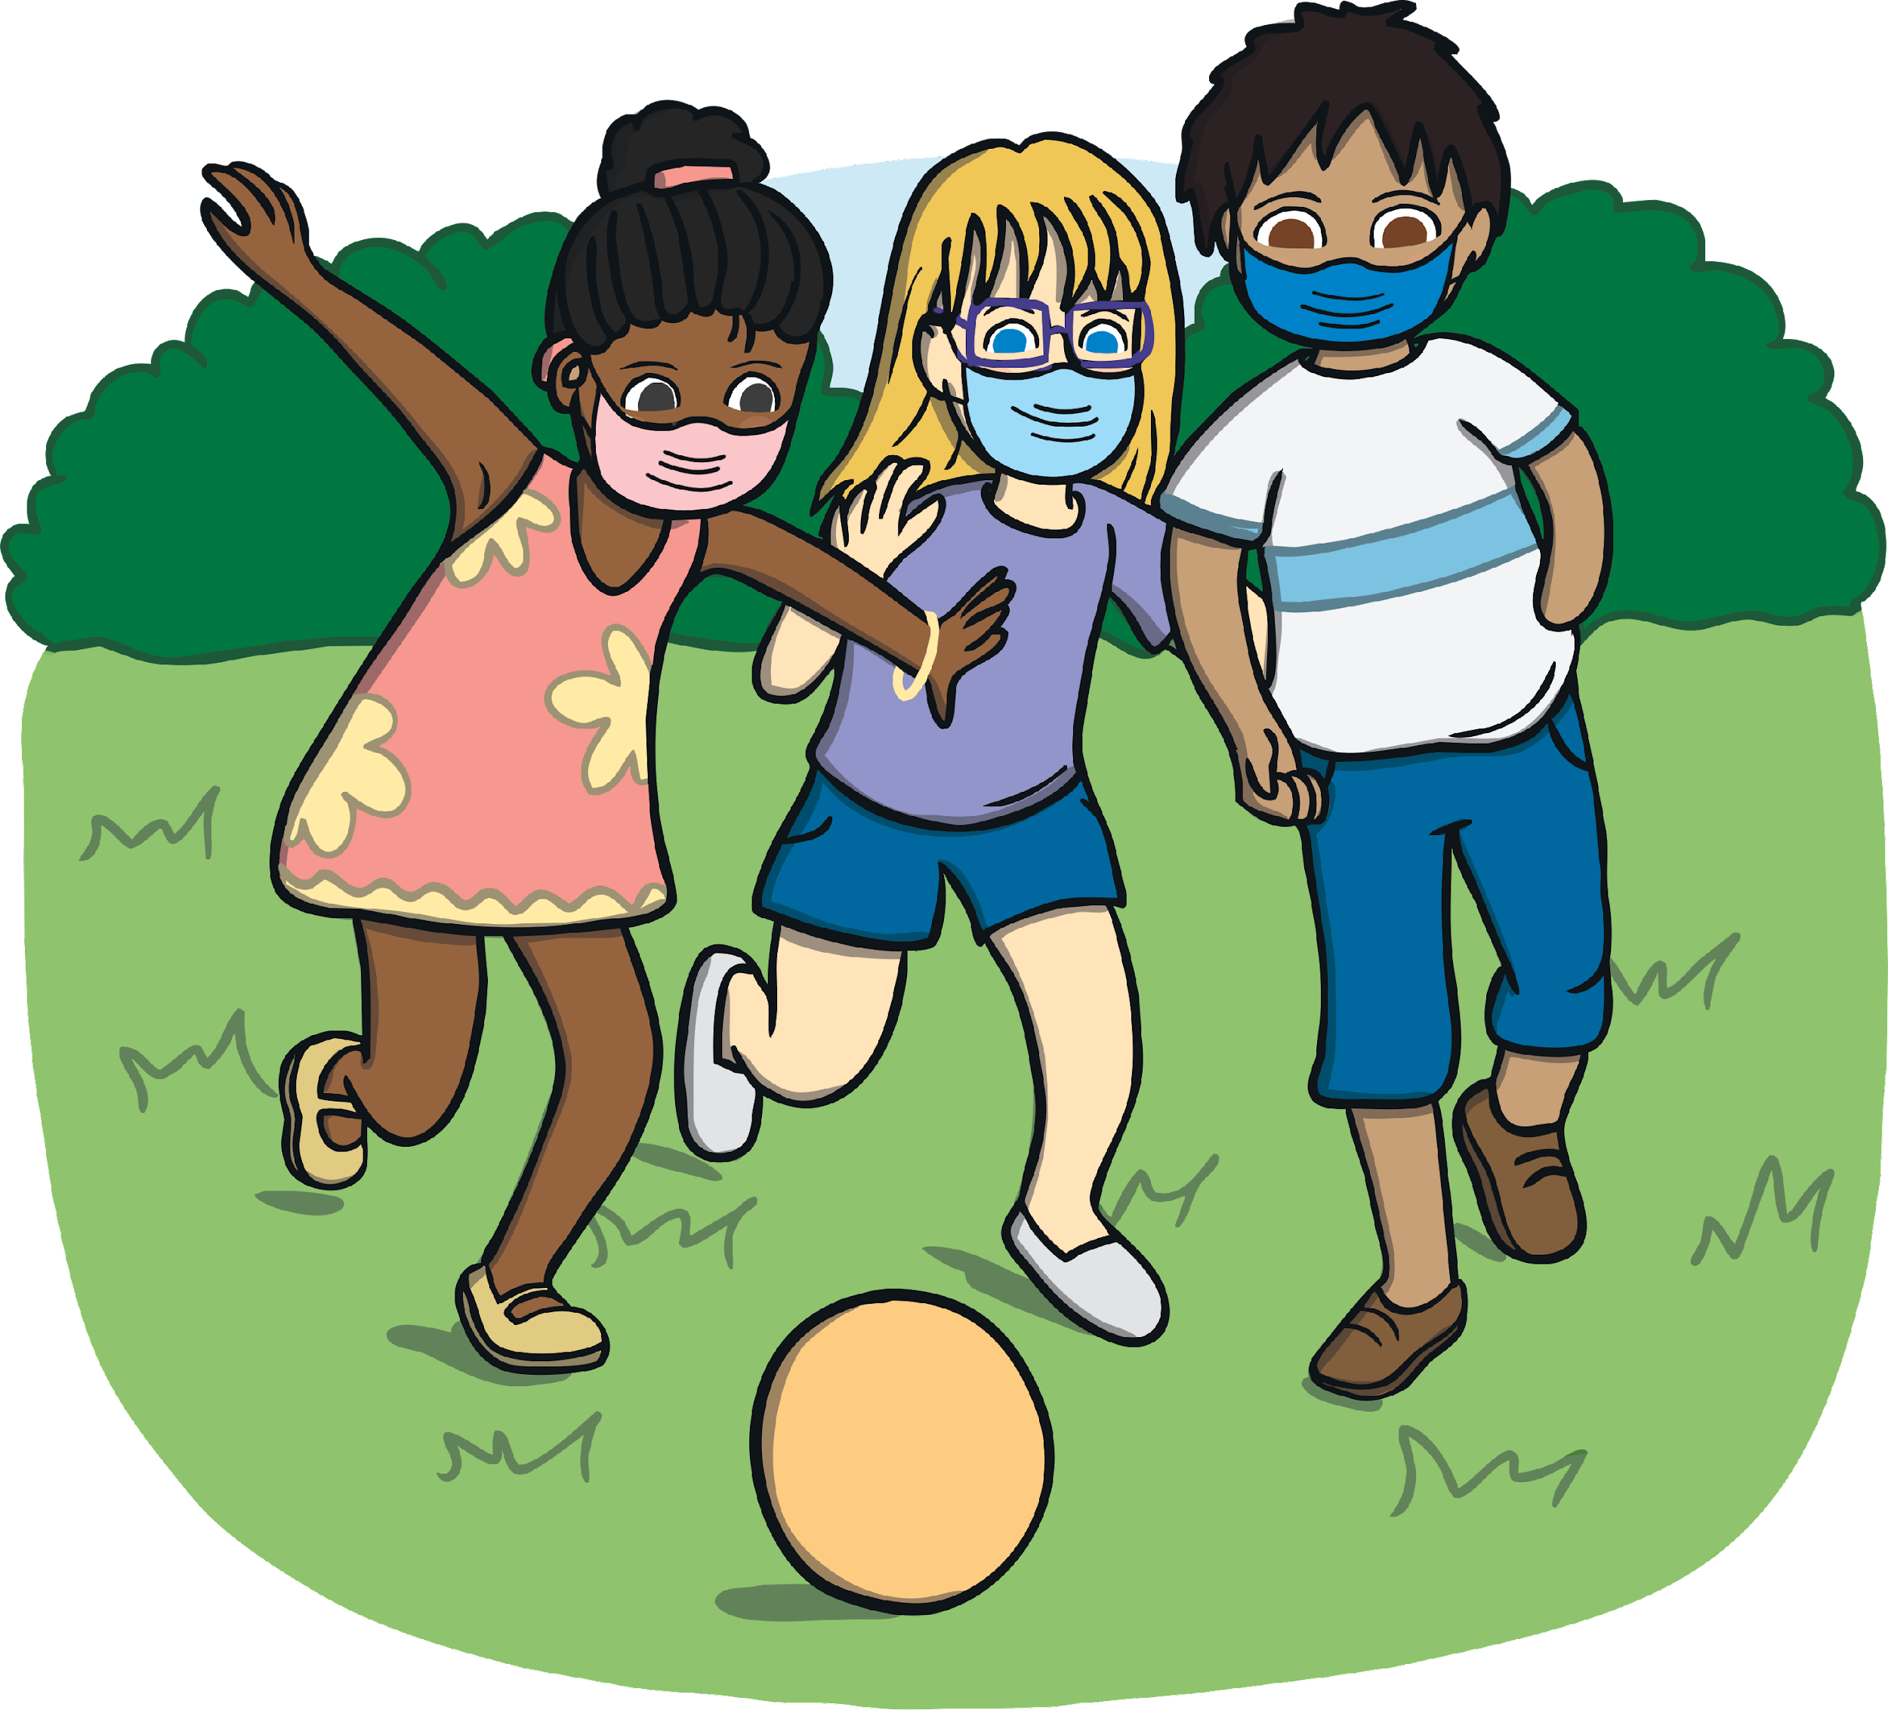
I can wear a mask when I am playing.
If I am playing a high energy sport, I can keep my mask somewhere safe.

Slide 8
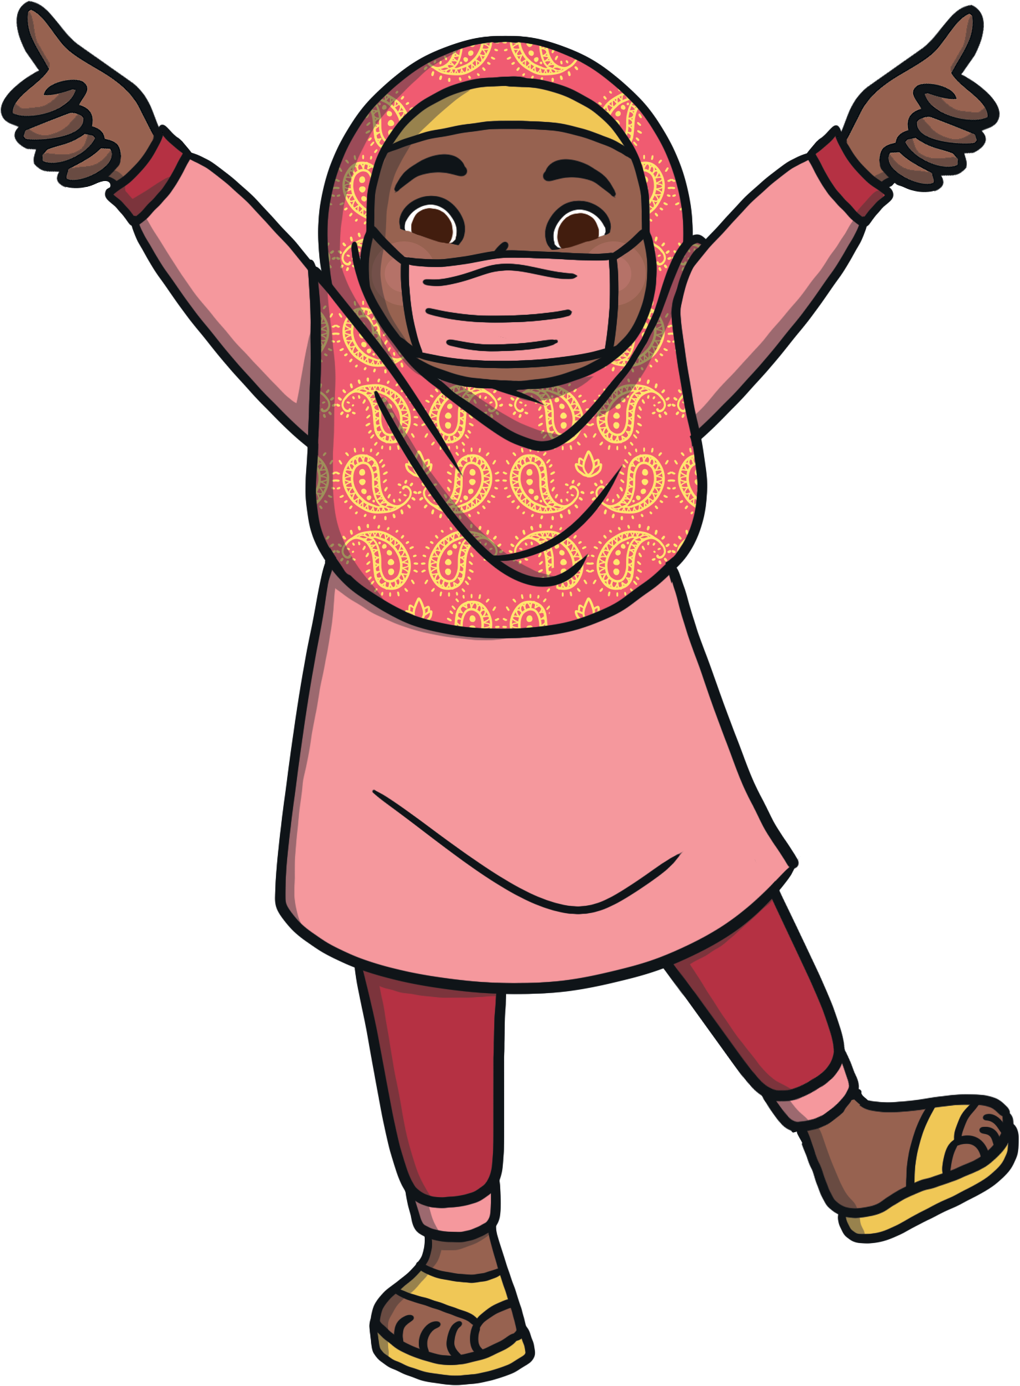
This is the correct way to wear my mask.

Slide 9
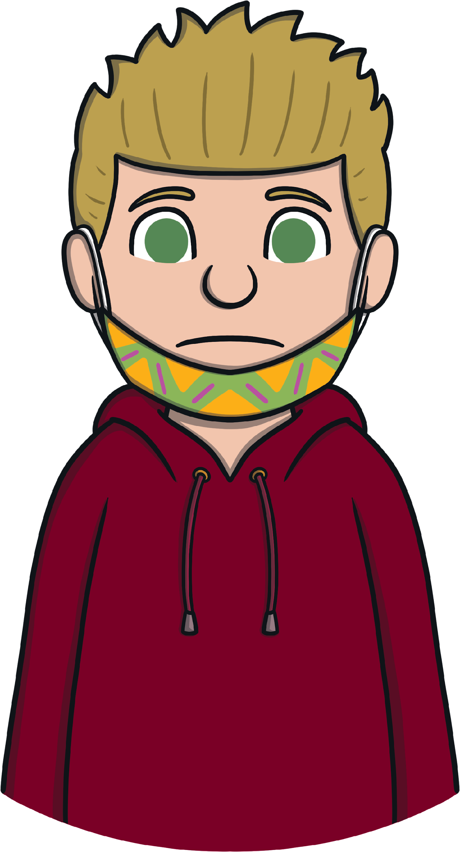
I do not wear my mask like this.
This will not keep me or other people safe.

Slide 10
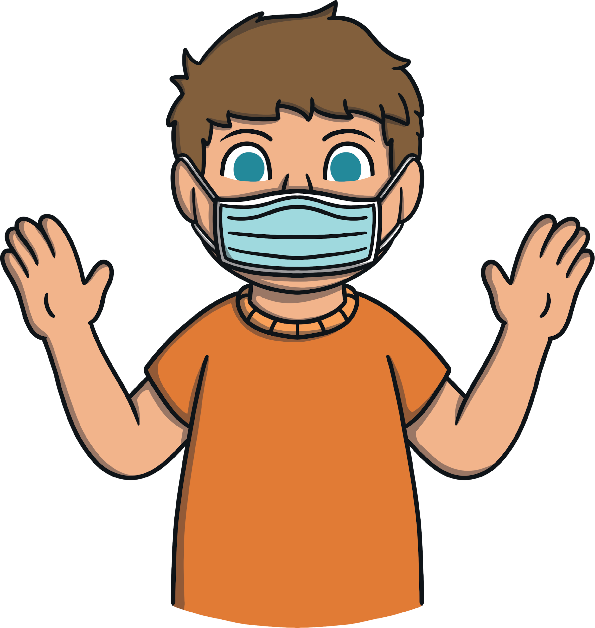
I do not touch my face or mask.
If I do touch my face or mask, I must wash or sanitise my hands.

Slide 11
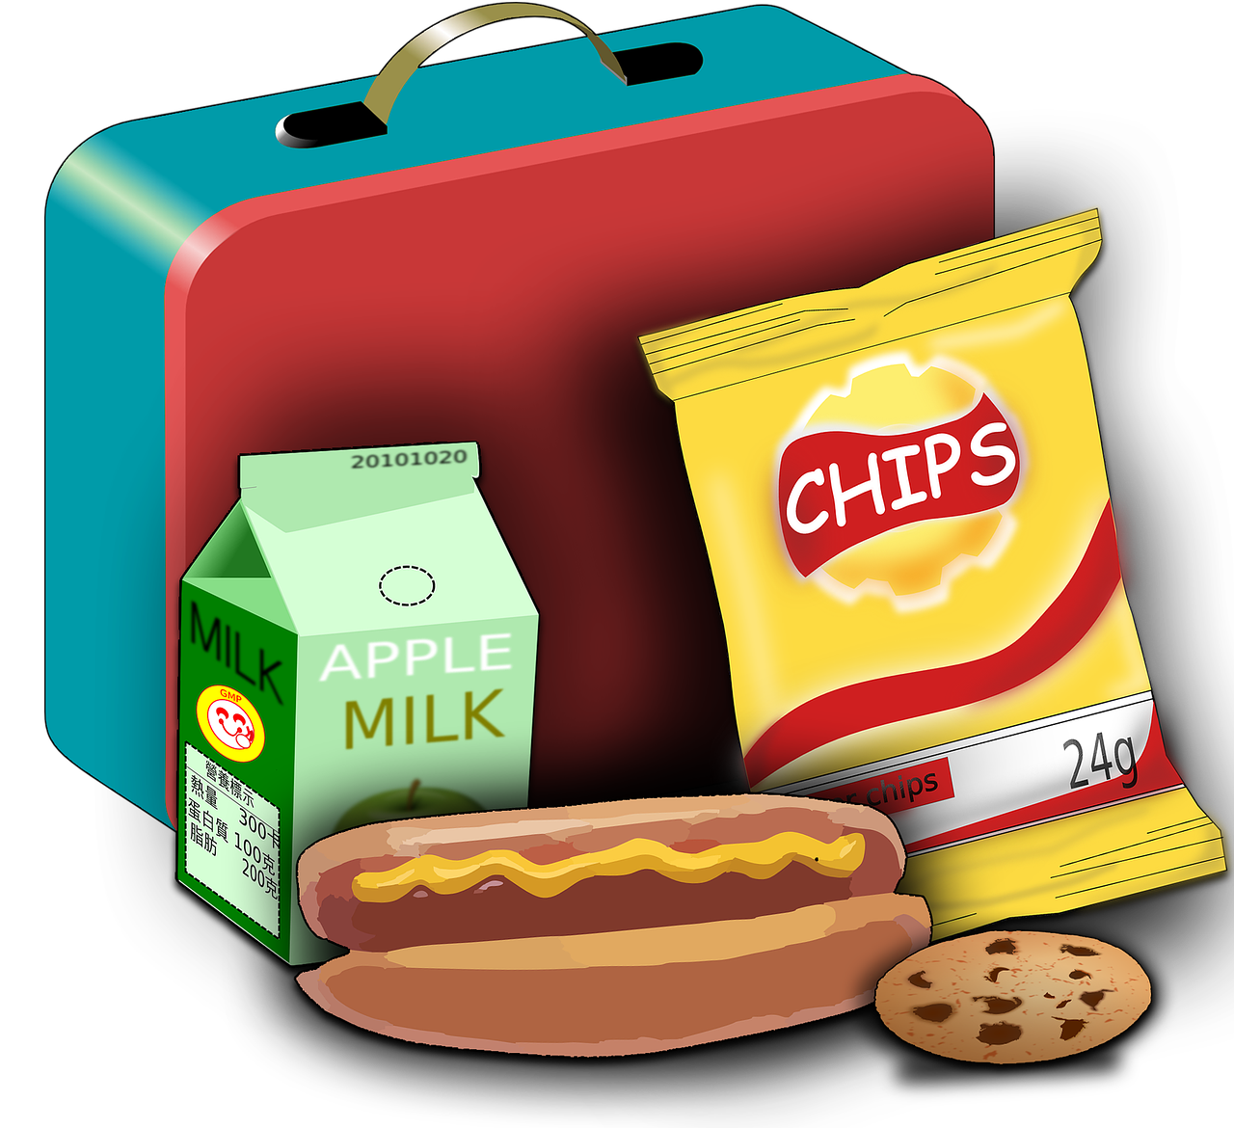
When I am eating, I can place my mask in a bag to be kept clean.
At the end of the day, I can throw my mask away if it is disposable, or have it washed.

Slide 12
Welcome back to school!
Things will be a bit different for a while,
but it’s great that we can all be back together!

