Slide 1
Curriculum, Events and Excursions
Term 4, 2021

Slide 2
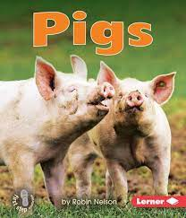
Reading Curriculum
In Reading this term, students are exploring and comparing fiction (fairy tales) and non-fiction texts. They will practise reading a range of stories as they develop further reading strategies. Students will develop their comprehension skills by making predictions, discussing the main characters / setting and completing retells. They will develop an understanding that texts take many forms by reading and exploring letters from The Jolly Postman.
In Phonics, students will complete Phase 3 of the Letters and Sounds Program. They will move onto Phase 4 which provides the opportunity to practise and apply all previously learnt phonemes.

Slide 3
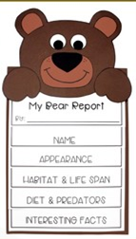
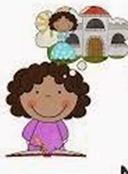
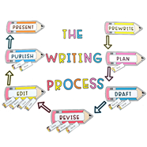
Writing Curriculum
In Writing this term, students will link their understanding of fiction and non-fiction texts from Reading by creating their own narratives and information reports. They will explore the elements of each text type and include these features in their own writing. When writing these pieces, students will also take part in writing process of planning, drafting, editing to publishing. Students will also be revising sentence structure and identifying the key elements that create a cohesive sentence and including these features in their own writing.

Slide 4
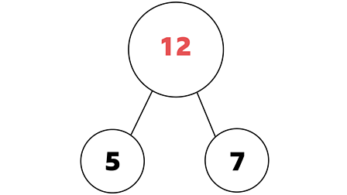
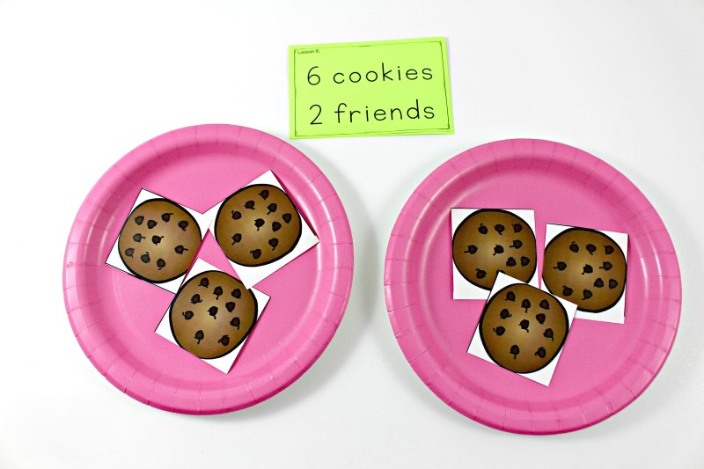
Mathematics Curriculum
In Maths this term, students will continue to explore addition and subtraction. They will develop an understanding of the links between these concepts through the part, part, whole model. Students will explore money by identifying Australian coins and engaging in role play activities. The students will also learn about the concept of sharing into equal groups.
In Measurement and Geometry, Students will compare mass and capacity. They will practise talking about positive and movement.
In Statistics and Data, the students will collect data by asking 'yes' or 'no' questions. They will organise this data into a pictograph and talk about the results.

Slide 5
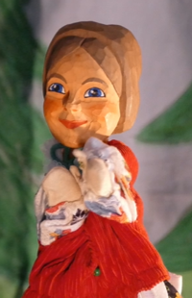
Inquiry Curriculum: Topsy Turvy Tales
Students will practise thinking creatively and use their imagination as they explore traditional tales. They will learn words that describe the properties of different materials. Students will apply their creative thinking tools to modify a traditional tale character. They will then design and make their own puppet based on this character.

Slide 6
Prosocial Education
As we near the transition to Grade 1, students will be supported to understand change. They will learn to recognise that problems or challenges are a normal part of life and that there are actions that can be undertaken to manage problems.
Students will also be encouraged to consider their strengths and goals. They will write a letter to their new teacher outlining their hopes and wonderings about the year ahead.

Slide 7
Whole School Special Events
Event​​ | Week​​ | Date(s)​​
Numeracy Day​ | 4​ | Thursday 28th October ​​
Remembrance Day​ | 6​ | Thursday 11th November​
House Athletics Day​ | 6​ | Friday 12th November​
Step Up Day​ | 11​ | Tuesday 14th December​

Slide 8
Grade Level Events
Event | Week | Date | Notes
Itsy Bitsy Chef – Cooking class | 2 | TBC | Students will take part in a cooking class, where they will link their learning of turn taking and fairness. They will develop life skills of measuring and following the procedural text of a recipe. At the conclusion of the session students will not only have learnt more about the importance of fairness in the kitchen but they will have a delicious, cooked creation to enjoy.
Captain Trash | 5 | TBC | Captain Trash educates kids of all ages on the 5 ARRRGHS: Reduce, Reuse, Recycle, Refuse and Remove. His message is to leave only footprints on the sand ... not litter.
Trash Puppets | 7 | TBC | In this workshop, students gather their own recycled materials from home and use them to make their own puppet. Through this activity, students learn a valuable lesson about sustainability.
TriPod - Solve it | 8 | TBC | Students will work as a class to practice their teamwork, fairness and friendship in a hands-on incursion. Students will work as a team to solve a crime that has been committed. It’s time for the students to put on detective hats and have magnifying glasses at the ready as students work in teams to investigate. They navigate clues from the scene and gather evidence using critical thinking, problem-solving skills and teamwork.
Swimming | 10 | 6/12/21 to 10/12/21 | Swimming Program for Grade Prep
End of Year Treat | 11 | TBC | A treat to congratulate students on their hard work across the year!

Slide 9
Other Notes and Reminders
When back on site, Home Reading folders are to be brought to school every Monday and Thursday for book changing.
Please continue to check Seesaw Family for further insights into classroom activities and learning.
Please continue to check the School Newsletter for Grade Level information and the Compass NewsFeed for immediate, high level information sharing.

