Slide 1


Slide 2
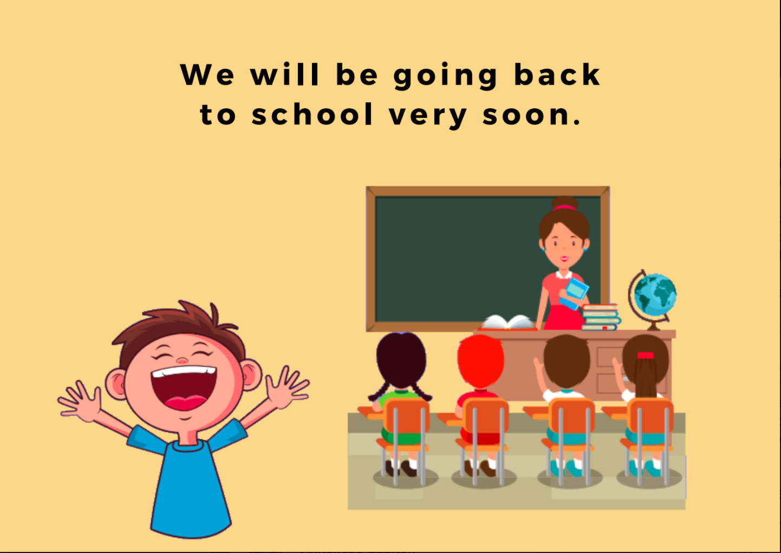

Slide 3
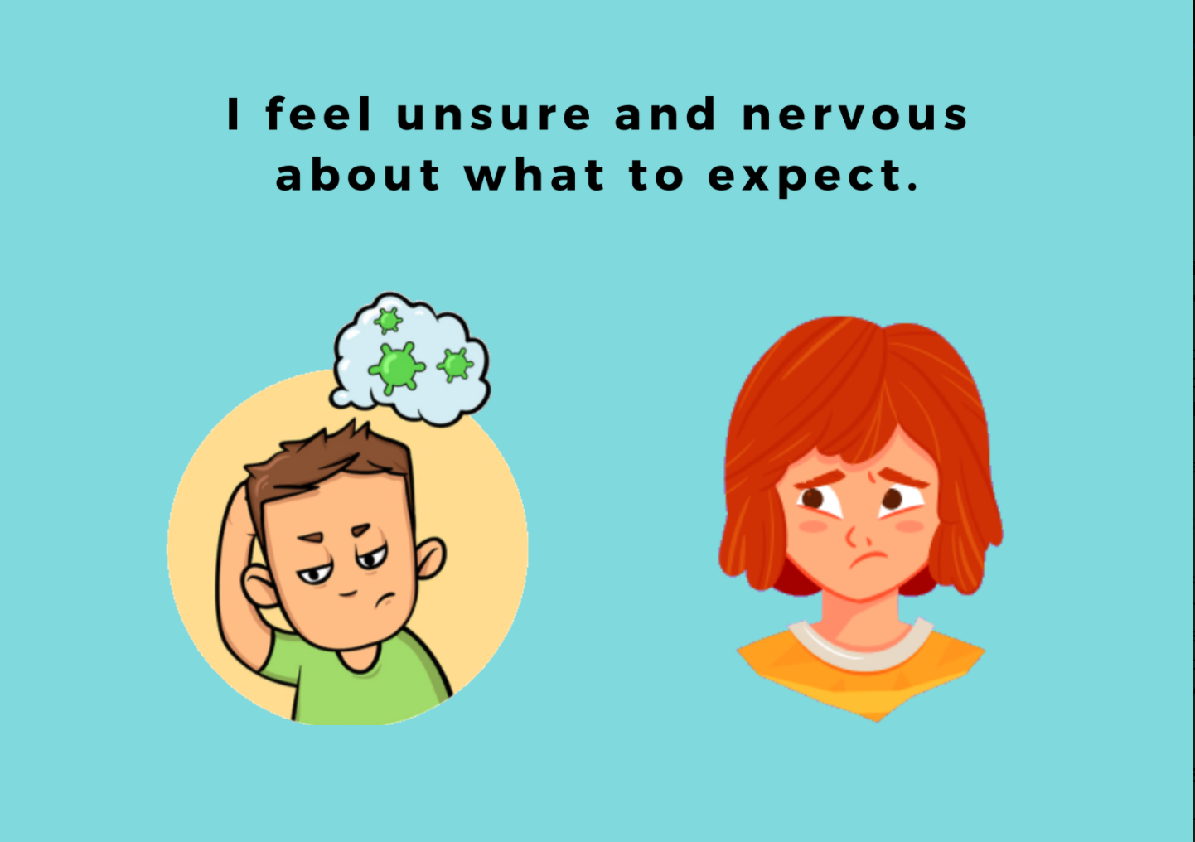
I might feel unsure and nervous about what to expect.

Slide 4
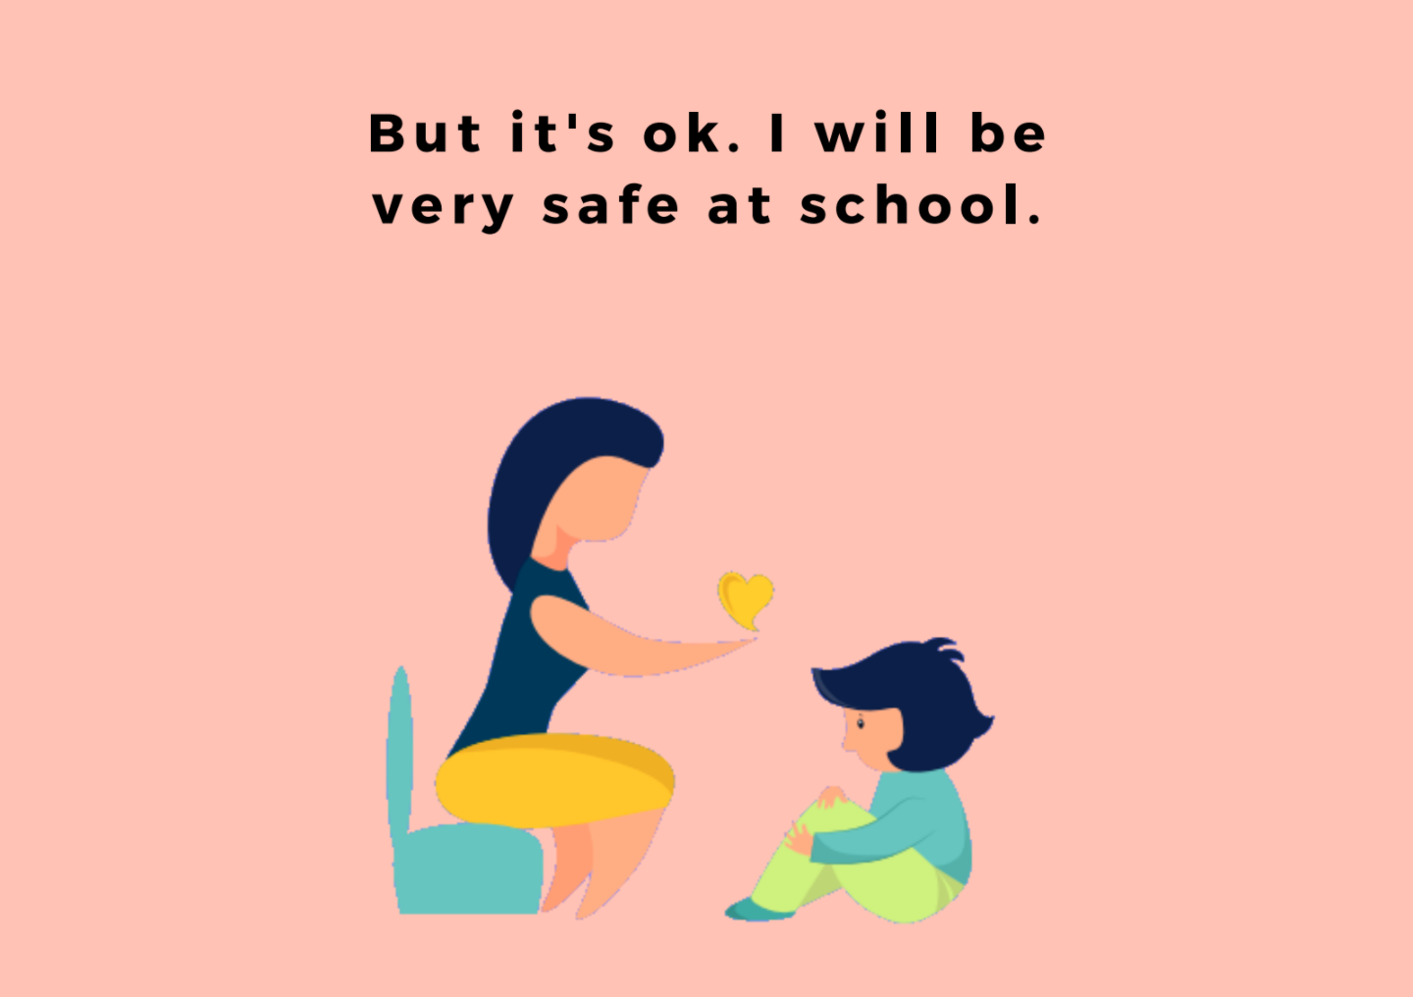

Slide 5
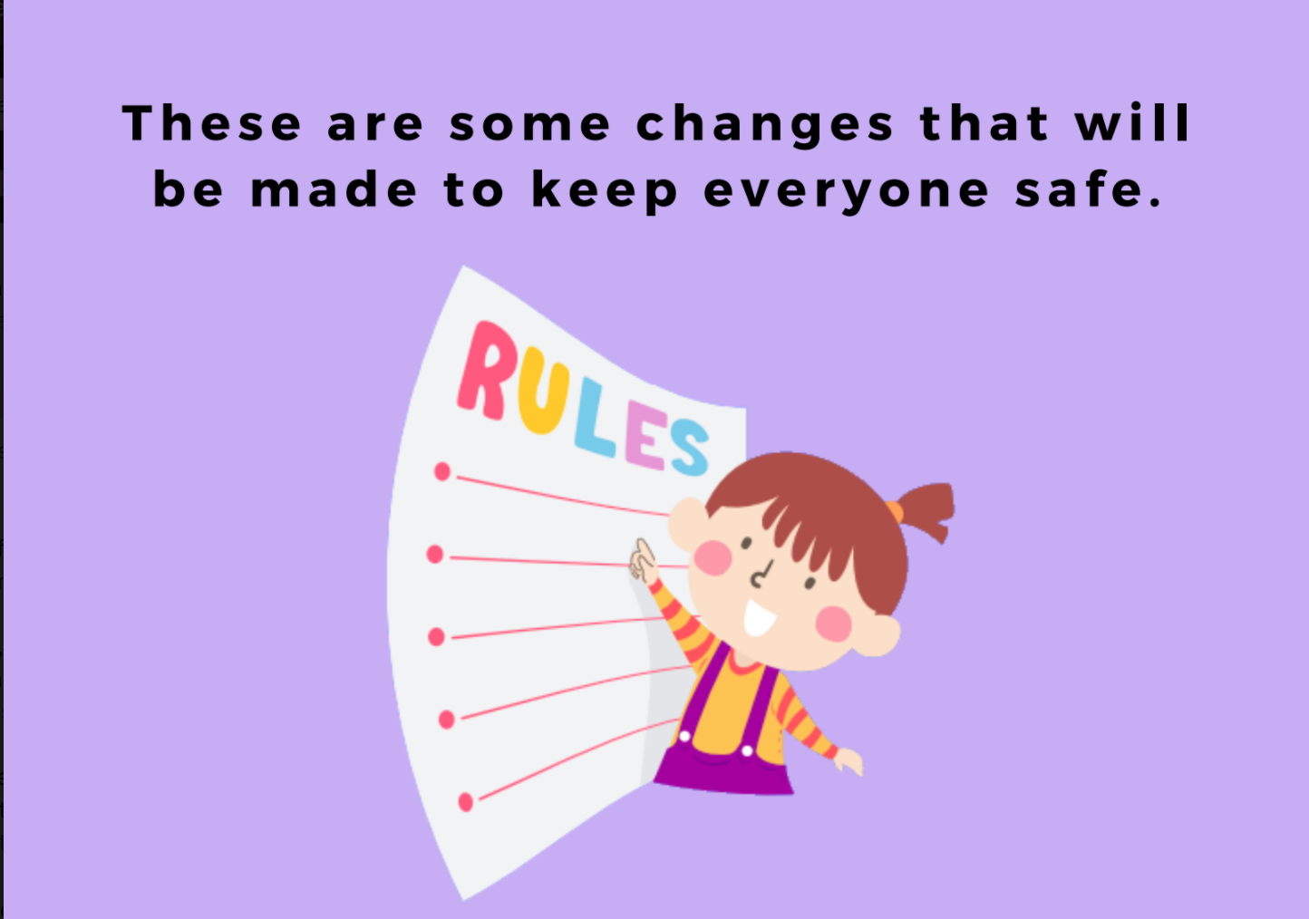

Slide 6
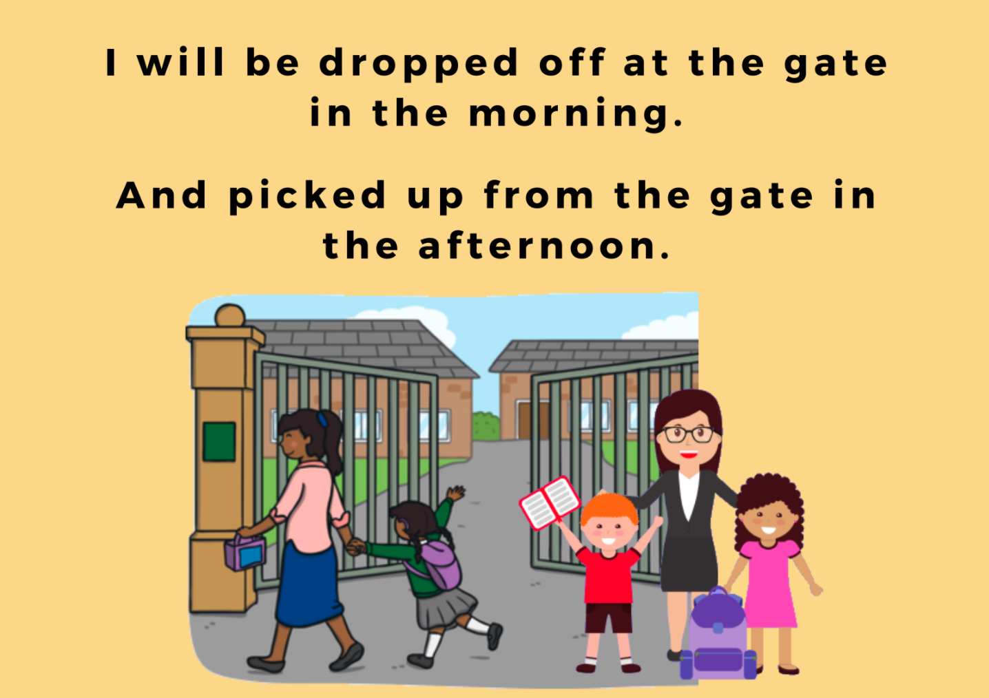
I will be picked up and dropped off at the Breen Street or Cooper Street Gate.
I will always use the same gate each day.
The times will be staggered so I may go a little earlier or little later than some of my friends.

Slide 7
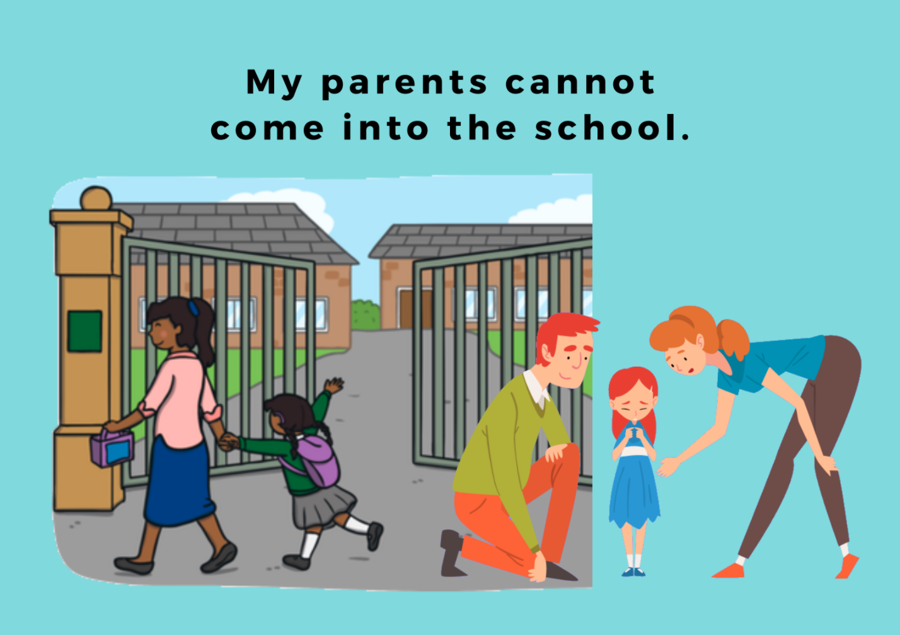

Slide 8
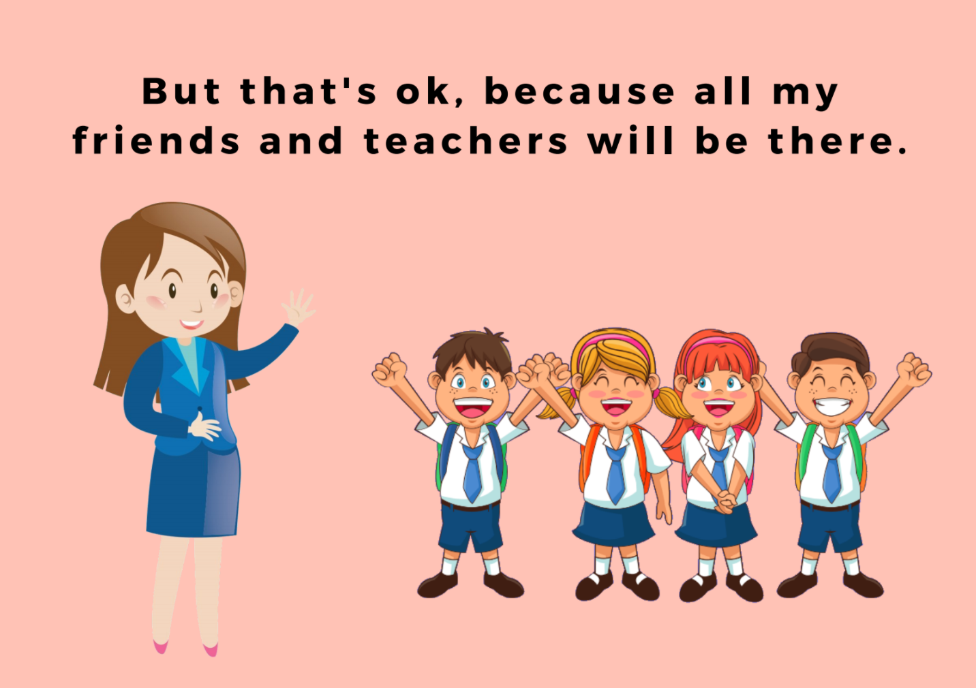

Slide 9
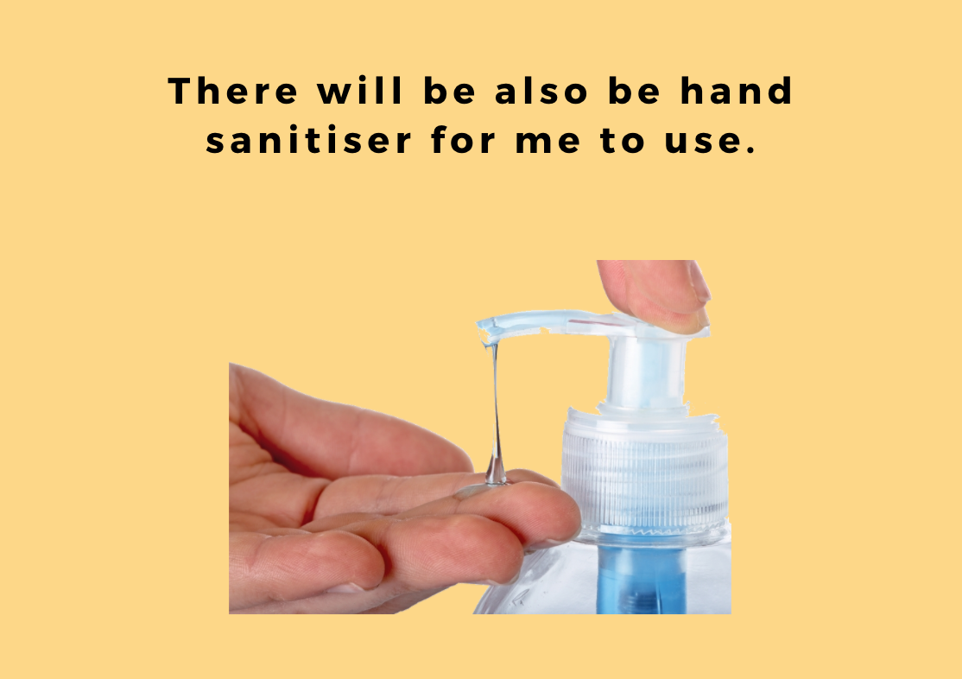

Slide 10
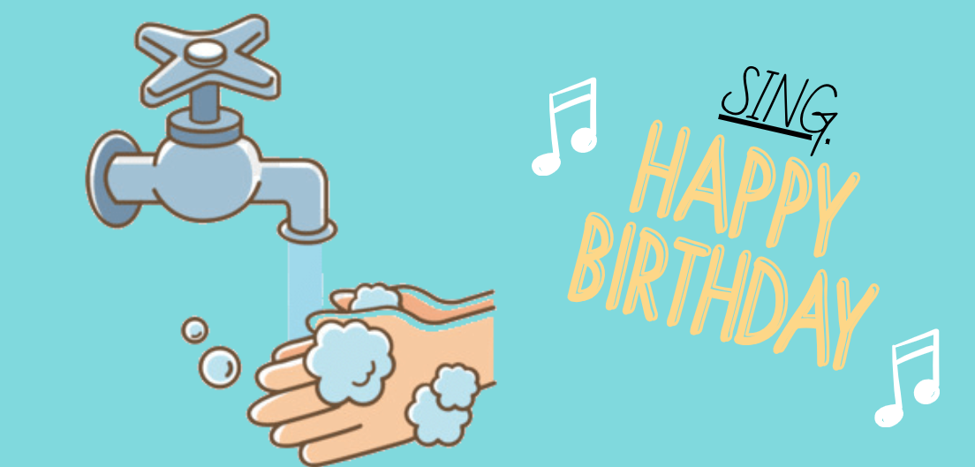
When I need to wash my hands, I can do this in the sink near our classroom or in the bathrooms. When washing my hands, I do this for 20 seconds.

Slide 11
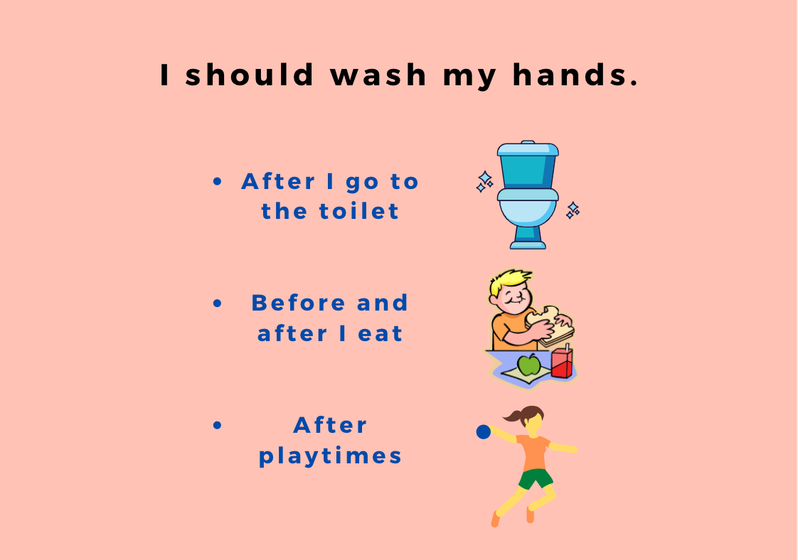

Slide 12
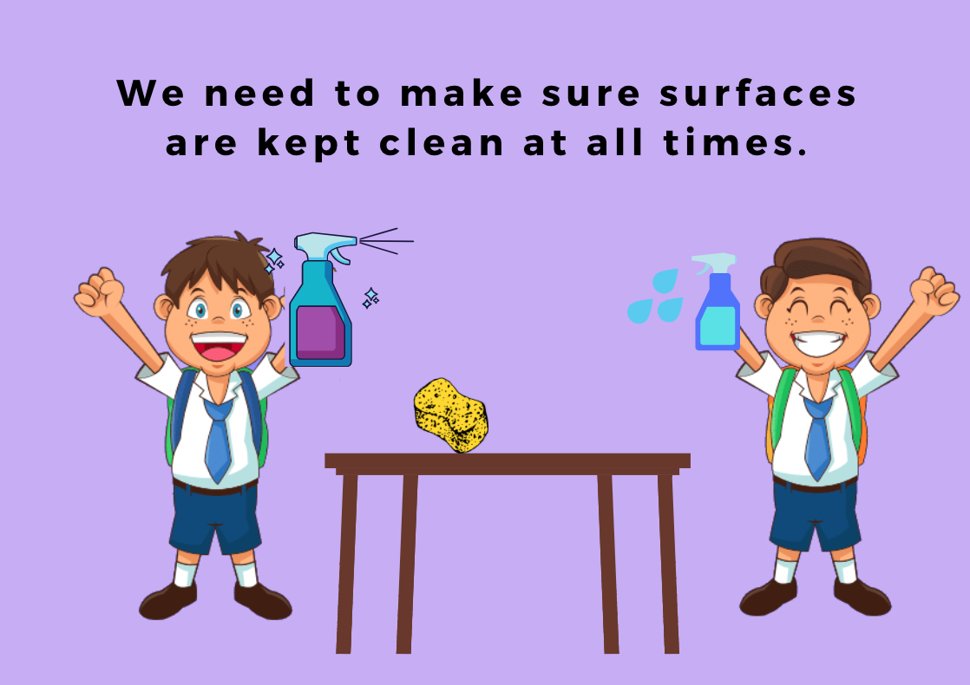

Slide 13
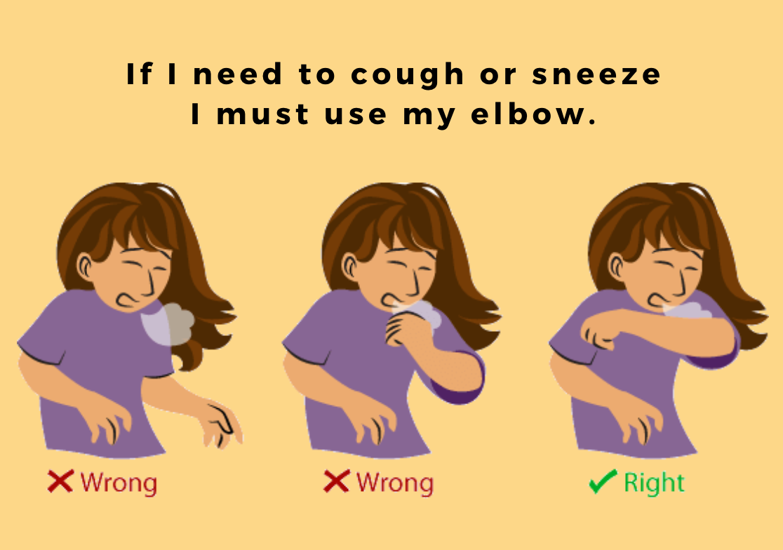

Slide 14
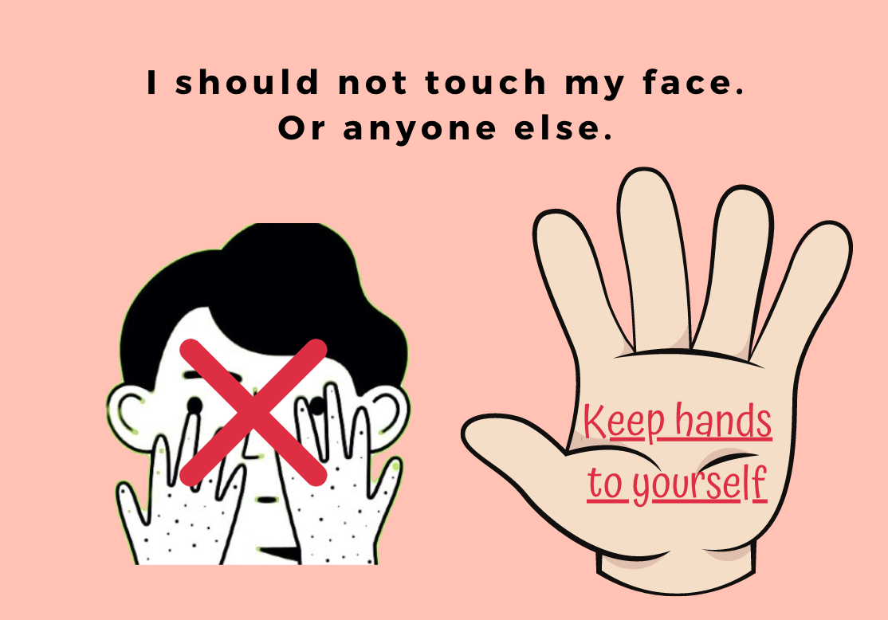

Slide 15
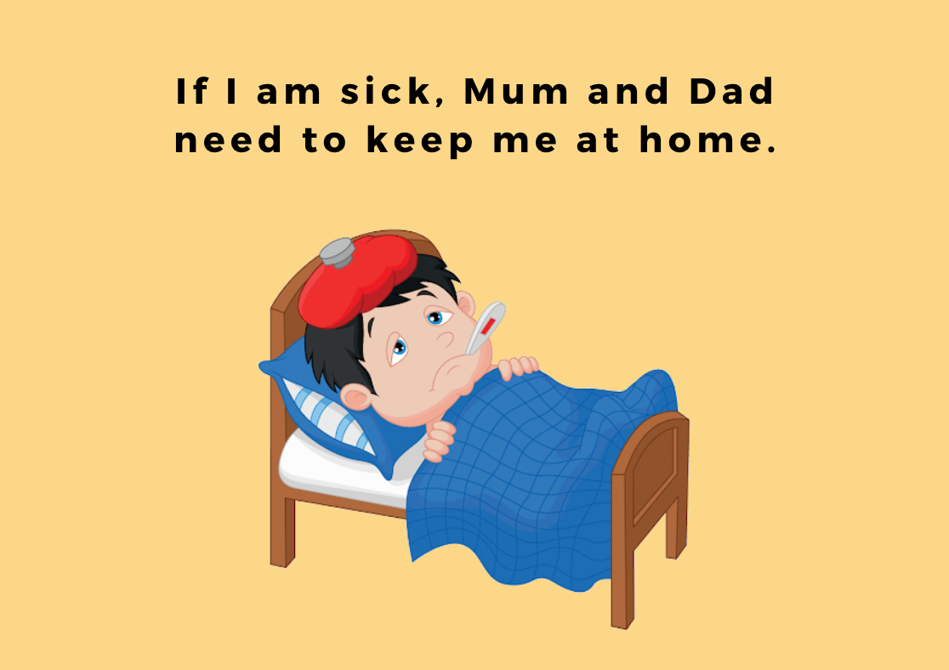

Slide 16
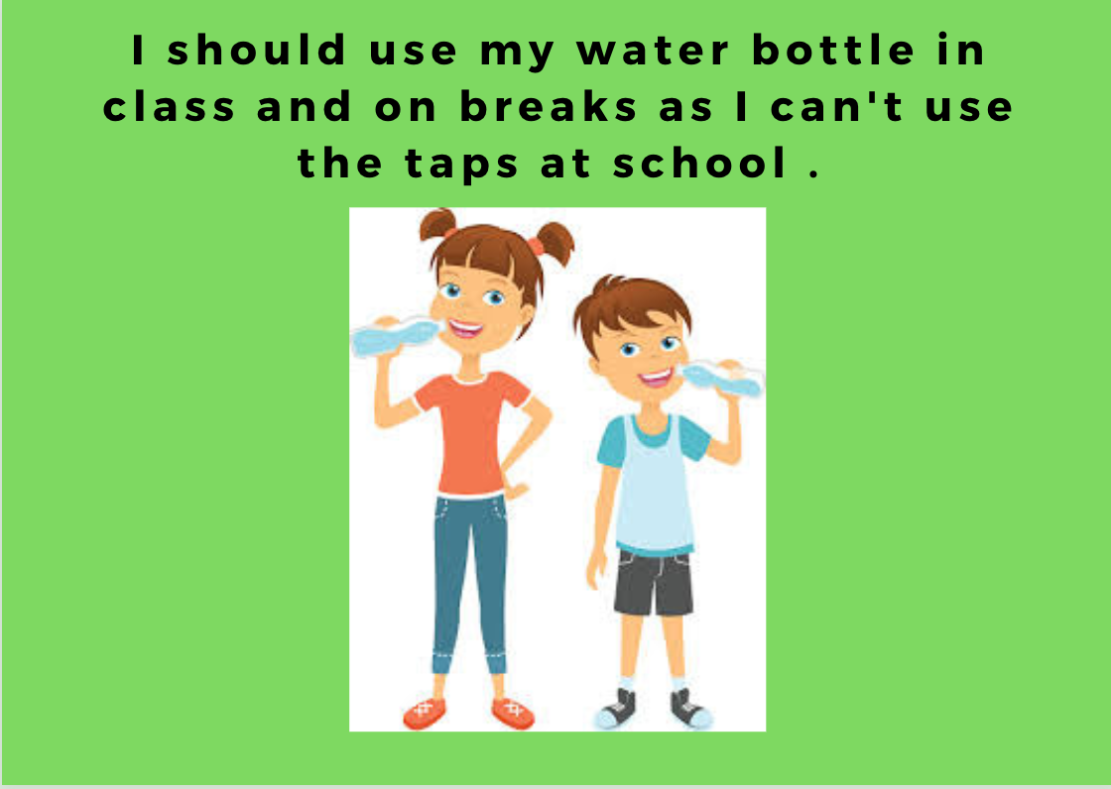

Slide 17
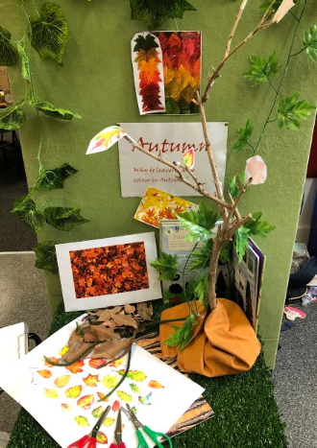
We will still be doing Investigations this Term.
We will need to make sure our hands are clean before using our spaces.
When resetting, we will need to make sure things are wiped down properly.

Slide 18
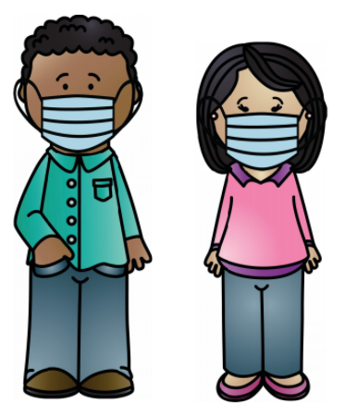
I might see adults wearing masks around the school. When people wear masks, I will only be able to see their eyes.

Slide 19

The school will be cleaned each night by a professional cleaner.

Slide 20
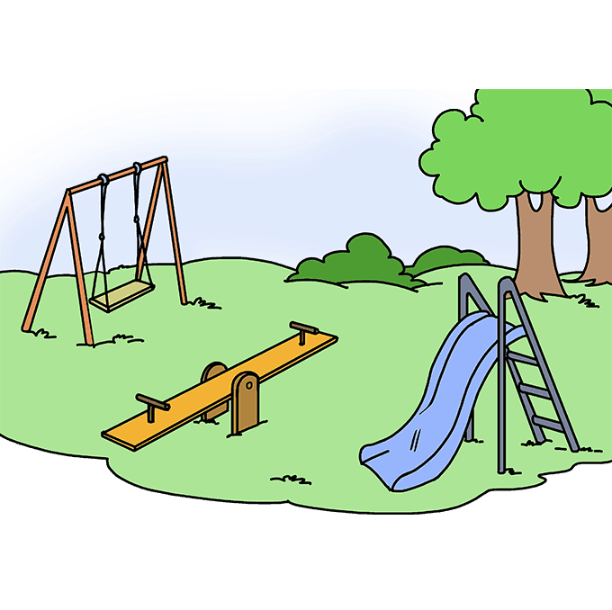
We will be playing outside at staggered times.
Foundation to Year 2 will have their lunchtimes at the same time and the Year 3 to 6 students will be together.
We will also be going outside as a class regularly to play games and complete activities.

Slide 21
