Slide 1
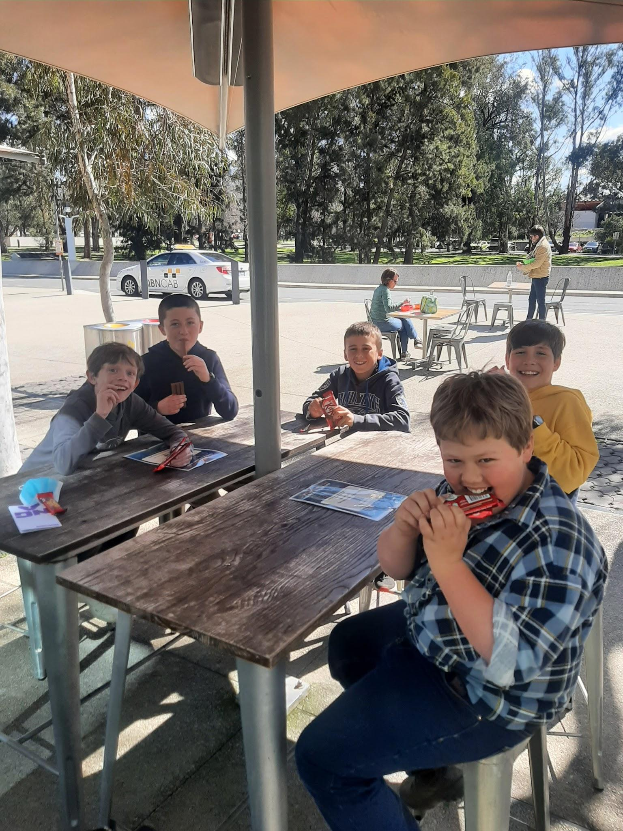
My 2022 Canberra Excursion
BY HUGO BLOMFIELD

Slide 2
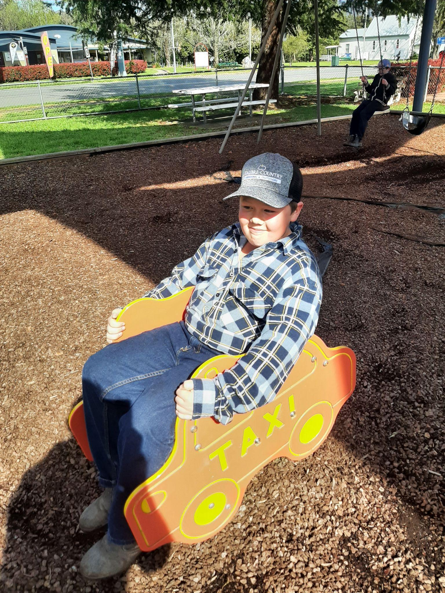
Day 1
The first day started off with us getting on the bus at 6:30am in the morning, when we got on we found the most reasonable seat near the TVs and settled in. By Tamworth there was a movie on and that meant one thing… the lollies came out. After 2hrs on the bus we stopped at Murrurundi for at quick play, Then got back on the bus to keep trekking on. After 11 hrs on the bus we made it to Canberra Park, unpacked and went for dinner.
That's me! Every dormitory is named after native animals
in Canberra Park.
FUN FACT!

Slide 3
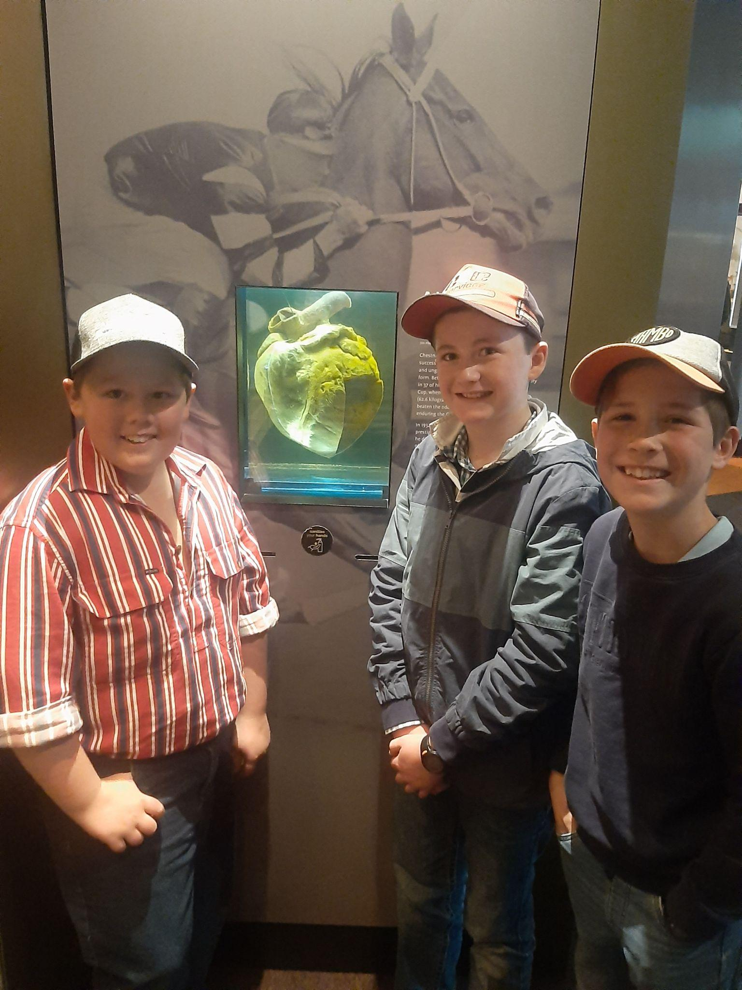
Day 2
When we woke up (The BOYS!) went for a walk to scout out the surrounding streets the first, to my farmer boy thoughts I forgot that magpies like a good old swooping. After we came back we had breakfast then got on the bus and went straight to the War Memorial, as we went in we had a quick but informal tour full of artifacts and dioramas. After we left the Memorial, Lorrie drove us to the National Museum of Australia, as our tour guide took us through Australia's history. Some of the main features of the museum was Phar Lap's heart, and Aboriginal tidal fish traps. After that we had lunch in front of the Australian Mint, when we went in we learnt how to make $40,000 spanish dollars into $80,000 spanish dollars by pressing out the middle of the coins.One of the things I most enjoyed was putting 3 dollars in a machine and getting 1 dollar change (AKA the coin press). Our next trip was to the National Museum of Democracy we had a great time learning facts about parliament and their odd clothing they wore. At the end of the day we finished off the day with some bowling, all around I thought that this day was amazing a solid 8/10 for me.

Slide 4
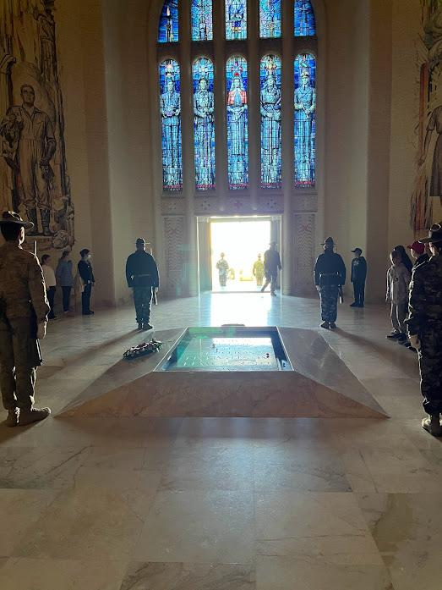
Day 2
One of the places we went on day 2 was the Australian War Memorial, this place holds all the memories and artifacts of every war Australia's has served in. Here we were taught about some famous men and women that served in WW1 and WW2. One of the people that we learnt about was a lady named Grace Margaret Wilson, Grace’s brother Graham Wilson was on Lemnos Island serving as nurse in WW1. She survived and returned to live her life, when WW2 struck out she did not flinch to volunteer as a nurse and surve once more. Another interesting thing was the some of the prisons for captured soldiers Changie, in all they had was a wood stove and a bed. When Australian heard what was going on they The Red Cross decided to send them care packages, they sent over cadbury chocolates that were raped in foil and the rest was normal solders supplies. The thing the made with the old scraps is crazy. A dentist saw that one of his friends was having to issues so used to foil from the Cadbury chocolates foil wrappers to make a new set of teeth, another man used the wooden box to make a radio that caught the radio wave in england to listen to the news once a week. After that we continued to the tomb of The Unknown Soldier ,Naphia Waller Is the Is the oldest behind this beautiful piece of art is calculated over 6 million 1by1 tiles where to put all together by hand to make this beautiful artwork. Till this day they still don't know who the soldier is but to today's technology they could find out the DNA But they believe that they should leave the person unknown for so it's not just for any soldier but for all soldiers that had fallen.

Slide 5
Day 3
At the start of the day we on a good old walk around Lake Berlie Griffin, and saw some beautiful trees and animals, sadly we only got to walk 1km of 40.2km of the amazing centerpiece of canberra. After that we hopped back on the bus and went to The National Sound and Film Archive where we saw some of the props from Australian movies, some of the props were… Crocodile Dundee’s hat and knife, some of the steering wheels from Mad Max Fury Road, and the cat and mice from Babe. To follow on to the day we went to the National Art Gallery, I have no more information apart from Mr Hyatt shoughting us boys a Kit-Kat. When we got on the bus we trekked on to the AIS (Australian Institute of Sports) this is where the national athletes of Australia train, In the AIS they had a special setup simulation training ground for children. The next place we travelled to was

