Slide 1
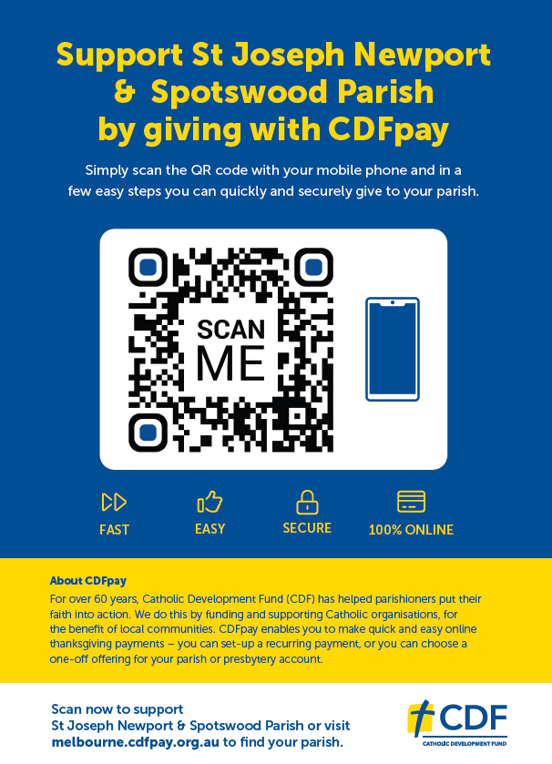
How it works?
Step 1
Parishioner uses the camera on their mobile phone to scan your unique QR Code.
A link to your CDF pay site is made available for the Parishioner to access via their phone.
Step 2
A Parishioner nominates either a once off giving or can nominate a regular frequency for a giving to occur.
The Parishioner can then choose the amount they would like to give.
Step 3
A Parishioner can select what their giving intent is for.
Step 4
A Parishioner can remain anonymous or fill out their contact details
If a Parishioner is making a regular payment, they will need to fill out their contact details in the nominated sections
All payments require an email address to be provided
Step 5
A Parishioner completes their payment details and clicks Give to authorise the transaction.

