Slide 1
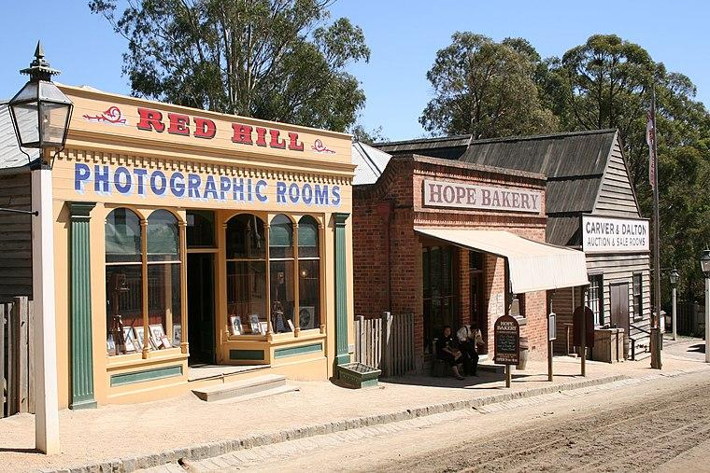
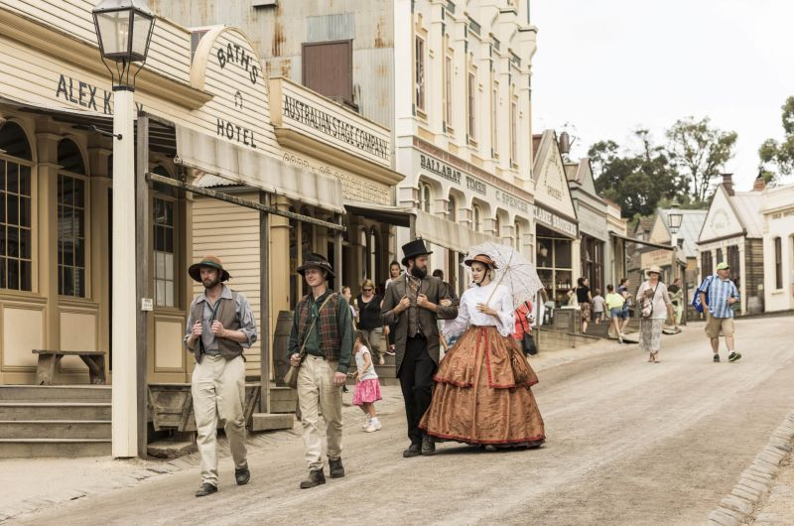
Year 5/6 CAMP SOVEREIGN HILL, Ballarat 2023

Slide 2
Attending Teachers / Adults Camp Contact information Teachers Attending Camp: Llew Humphries Melissa Woollard Stacey Bowles Justin Scicluna Meagan Tustin Adult Volunteers: Andrea Schloetzer Megan Taylor Melissa Murphy
Contact information for Camp:
Sovereign Hill Lodge:
39 Magpie st
Golden Point, 3350
03) 5337 1199
Damien Kitch:
0459 864 712

Slide 3
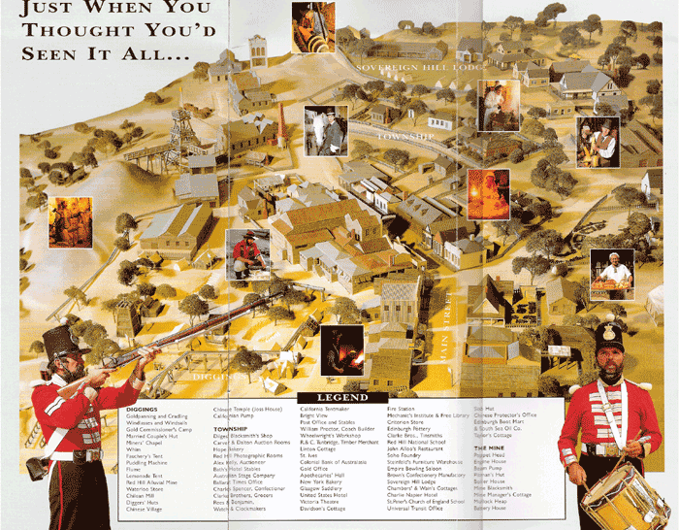
SOVEREIGN HILL MAP https://sovereignhill.com.au/uploads/resources/SH-LEARNING-Map-A4.pdf

Slide 4
ITINERARY
Wednesday 26th April
Depart school (9.00am), morning tea Melton (Hannah Watts Park)
Lunch Eureka centre. Education tour – Eureka Stockade museum.
Arrival Sovereign Hill Lodge.
Afternoon free time in Sovereign Hill. Mine Tour.
Dinner at Sovereign Hill Lodge
Evening at Sovereign Hill viewing the ‘Aura, Sound and Light show’.
Thursday 27th April
Sovereign Hill schooling experience (costume)
Free time during the afternoon to wander (supervised groups) around Sovereign Hill
Evening Of Theatre Performances at the Sovereign Hill Theatre
Trivia night at camp
Friday 28th April
Pack up camp / rooms in the morning
Sovereign Hill schooling experience, gold pouring / lolly making demonstration and free time in costume.
Depart Sovereign Hill for home (approximately 3.30pm)
Arrive at school around 6pm (arrival time TBC via Compass)

Slide 5
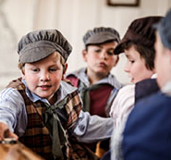
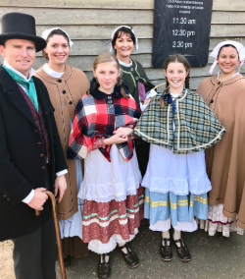
Clothing List
1 pillow / 1 pillow case
1 fitted single bed sheet
1 sleeping bag
1 track suits / jeans
1 windcheater
2 shirts or tops / tshirts
1 pair of shorts
1 Pair Pj’s
3 changes of underwear
2 pairs of socks
2 pairs of shoes / runners / boots (Costume)
1 pair thongs (for shower)
1 Water resistant jacket / parka
1 sun hat
Towel, soap in container, face washer, toothbrush/toothpaste, sun screen, deodorant, hairbrush/comb (no hair product), small packet of tissues, hair ties if needed.
Drink bottle - to be used while at Sovereign Hill and lunch on first day
1 named wallet ($20 spending money) – will be collected by Mr Scicluna on Wednesday morning
1 medium Garbage bag (dirty clothes)
Torch that works
A QUIET game or book – no digital devices
Camera - is optional and the responsibility of the student
Small backpack which can hold morning tea & lunch for Wednesday.
This will then be used for souvenirs and drink bottle while in Sovereign Hill.
CLOTHING NEEDED for COSTUME SCHOOL
1 Pair of black or brown shoes or boots, desert boots / Blundstones are acceptable
No runners for the Sovereign Hill schools - No writing on the shoes
2 Socks Girls – Long white
Boys – Long black, grey, brown or white
No Jewellery (small sleepers or studs may be worn)
Long hair must be tied up neatly (plaits or neat pony tail). No scrunchies.
No nail polish or make-up

Slide 6
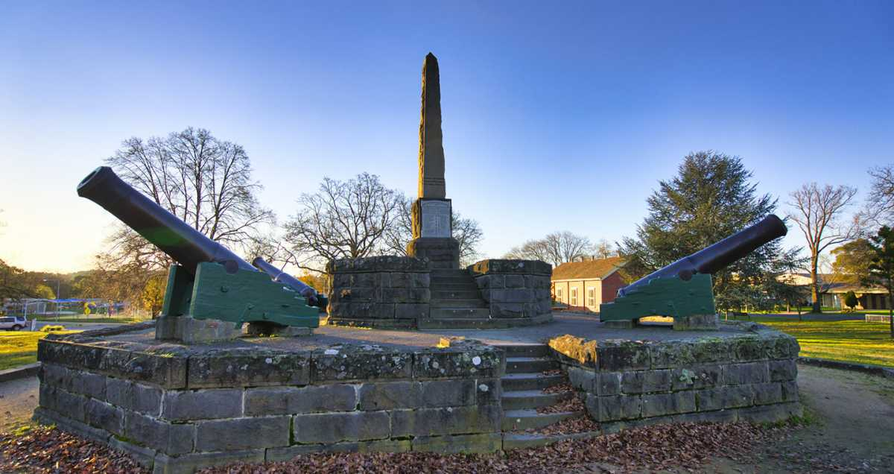
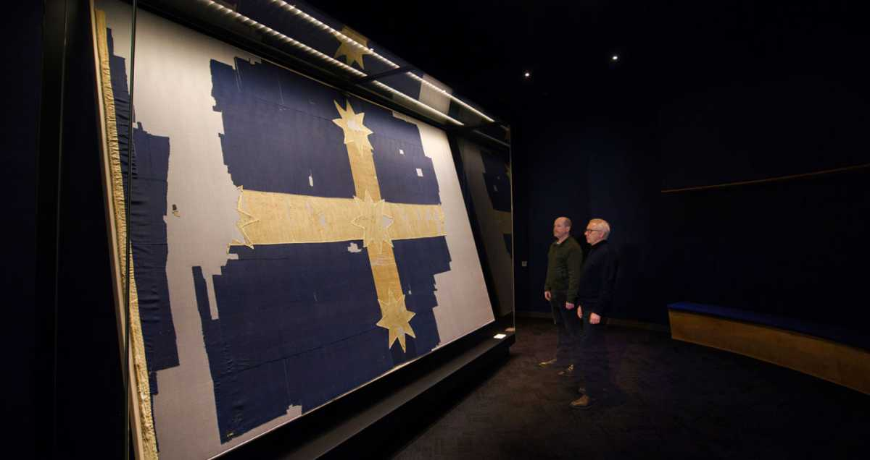
EUREKA CENTRE
Eureka Centre encourages young people to engage with Australia’s colonial history through its Eureka Education programs. We provide teachers and students with tools and experiences that explore the social history and cultural impact of the Victorian gold rush and the stories of the men and women who risked their lives in the fight for miners’ rights.
We are located on the site of the Eureka Stockade battle and in the heart of the Victorian goldfields. Our programs are developed directly from the History and Civics and Citizenship curriculum.
In this program, students explore the lives and stories of the people who had a signiﬁcant inﬂuence on shaping Australia’s colonial society. Students have an opportunity to form deeper connections with the people of the Eureka Stockade as they become absorbed in their stories.
Students will adopt the voice of key protagonists to enable them to merge these stories to their personal experience; creating a relationship with the beliefs, values and motivations of the people at Eureka and their impact on social justice and equality.

Slide 7
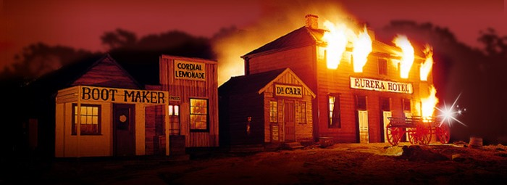
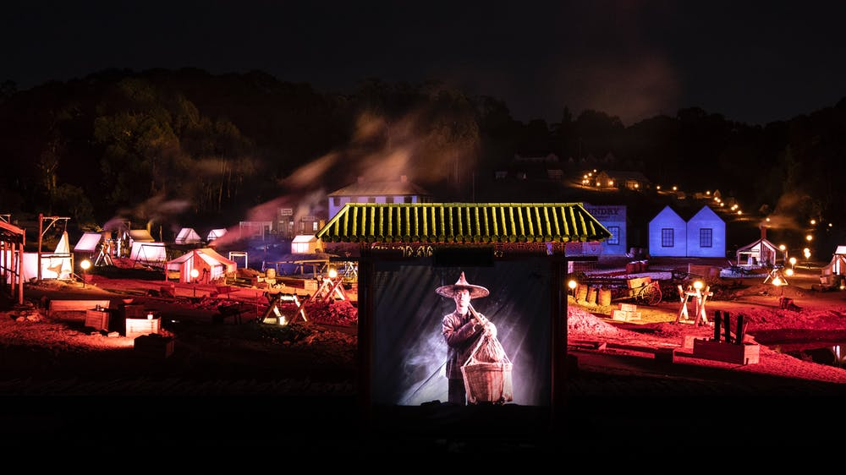
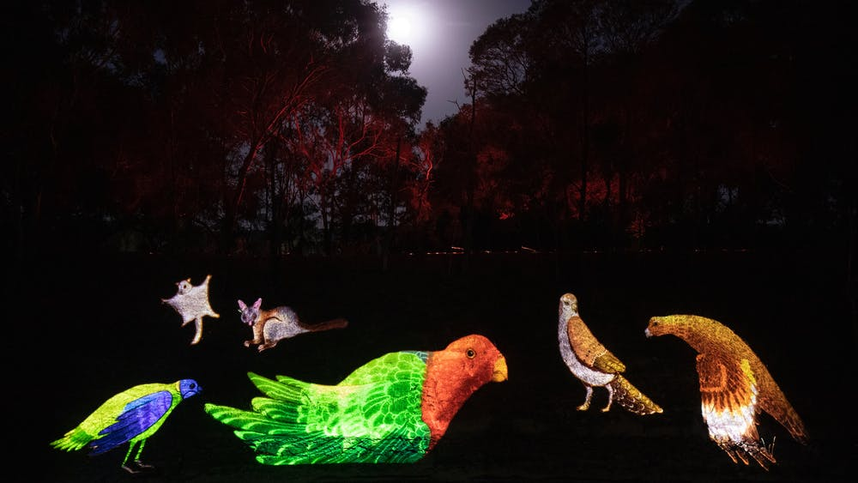
AURA – Sound and Light Show AURA is a multi-sensory sound-and-light show presenting the story of gold in all its wondrous forms. The atmospheric storytelling covers 64 acres, with hundreds of stunning projections to create an immersive storytelling experience that transports you back in time. The Wadawurrung creation story is told with projections on a magnificent lake, gunfights and protests erupt under the night sky, and the gold rush is brought to life as never before. You will feel the vibrations as stars explode in front of your eyes, watch as the land is transformed by the gold rush, and dive into the chaos of the Eureka Rebellion as you witness the creation and discovery of the world’s most precious metal. Victorian Curriculum Links • History • Media Arts • English: Reading & Viewing Sovereign Hill was grateful for the opportunity to work with Uncle Jack Charles as part of our AURA show. Uncle Jack was a proud Boon Wurrung, Dja Dja Wurrung, Woiwurrung and Yorta Yorta senior Elder. He was a storyteller, an activist and much more. You will hear and see Uncle Jack in our AURA introduction and Welcome to Country and his family have given their permission for us to continue to use his name and images. May he be greeted by his Ancestors on his return home.

Slide 8
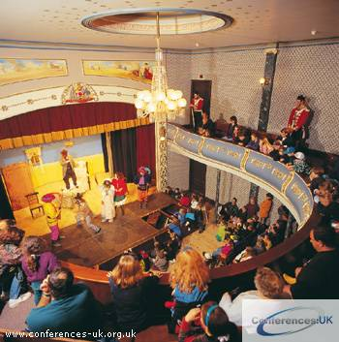
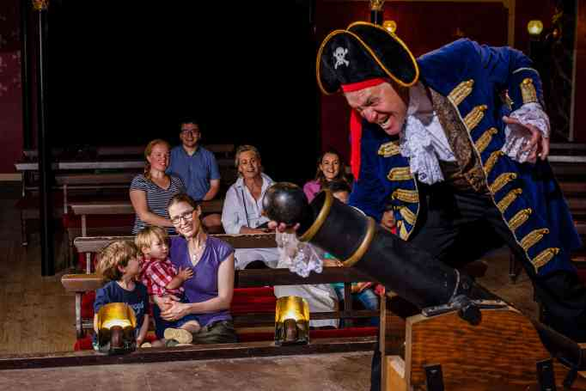
Theatre Performance
THEATRE PERFORMANCE (45 mins)
Students will enjoy participating as an audience member in an interactive theatre piece performed for entertainment. Interpretive theatre is a key element for our living museum. Students will experience the theatre and key drama skills as performers shape characters, use voice and movement in improvisation and play-build performances of devised and scripted drama for them.
Victorian Curriculum Links
• History
• Drama
Available to school groups who have booked the sound-and-light show and are staying more
than 1 night at camp, minimum numbers required
.

Slide 9
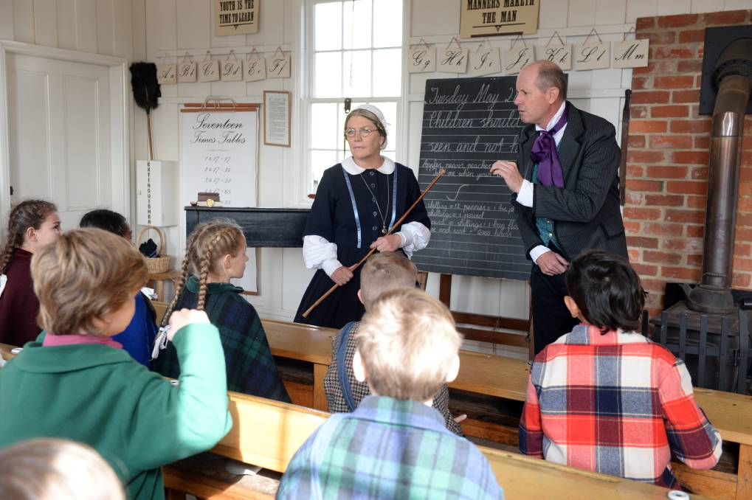
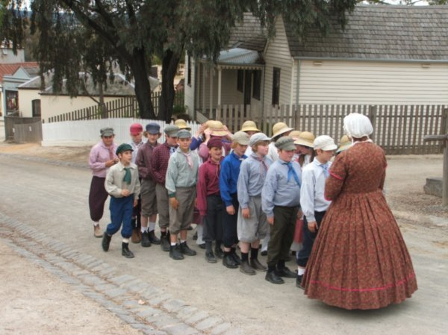
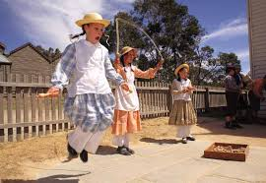
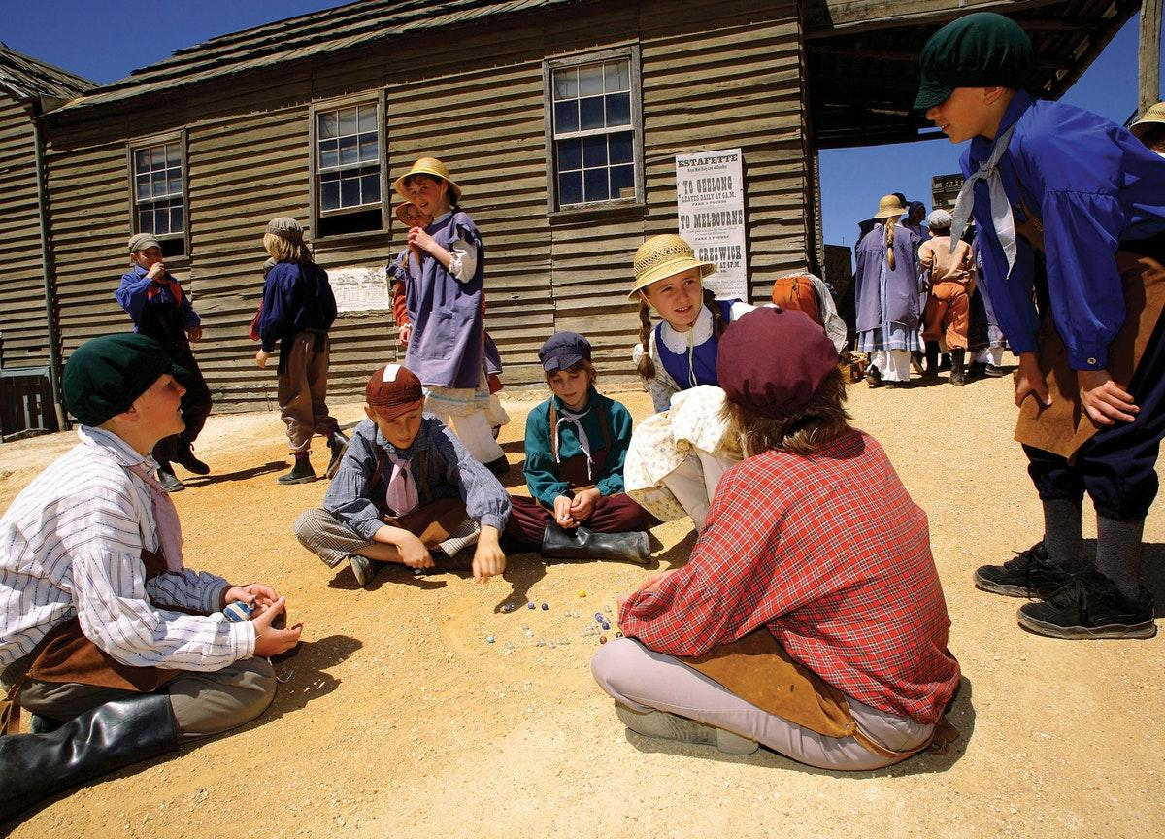
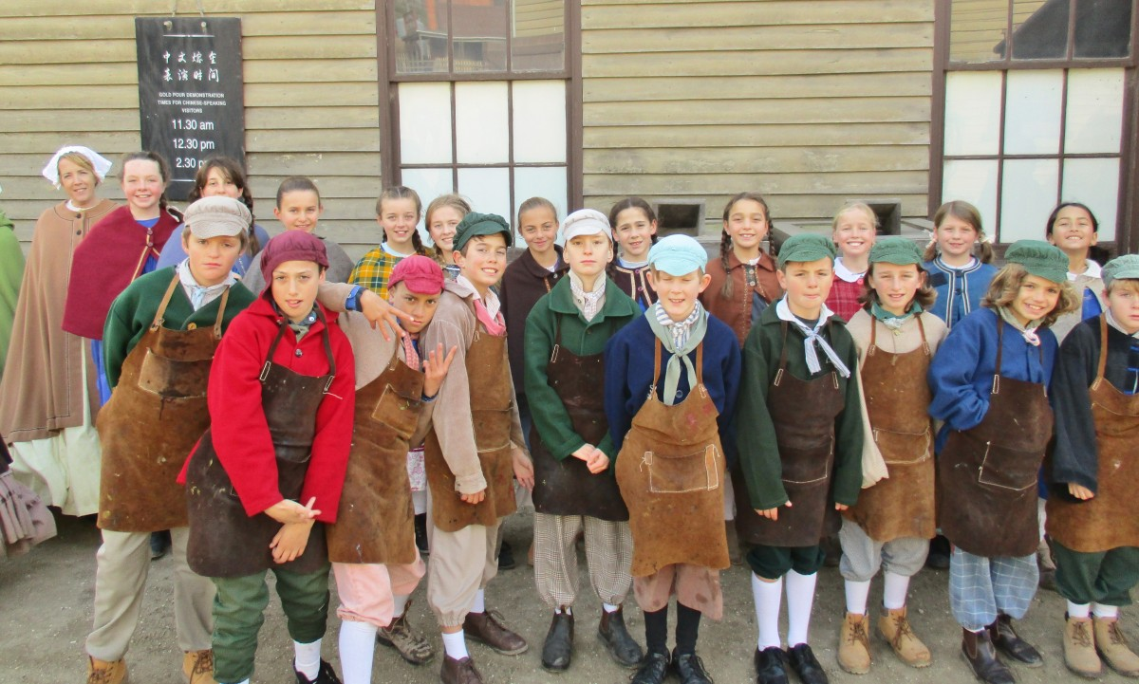
Costume Schools
Students will attend a school within Sovereign Hill on Thursday and Friday. The schools we are assigned to are the Wesleyan, Red Hill and St. Peters Denominational.
Our students will completed an 1850’s character profile building on the role playing experience. These will be sent to the Sovereign Hill school teachers who will engage with the students in these developed roles.
USPS students will become part of this 1850 settlement and part of the living museum of Sovereign Hill.

Slide 10
LEARNING OUTCOMES OF CAMP
Knowledge of a significant part of Australian History – Gold Rush and Life in the 1850’s. Focus will be on settlement, migration to Australia and significant people
We will also be covering many capabilities such as:
Resilience
Persistence
Teamwork
Communication

Slide 11
Information Session
We will be holding an Information session on Tuesday 21st of March at 7:00pm. We will be in the Senior Gallery (outside 5/6 classrooms)
The evening is aimed for our parents/carers to gain information about the camp. Students will be presented with similar information during a student-specific presentation held during school hours.
Parents/ Carers will have an opportunity to ask relevant camp questions.
Miss Humphries, Mrs Woollard, Miss Bowles and Mr Kitch will be present for this information session.
Hard copies of Sovereign Hill policies and Medical forms will be available to view / collect.

