Slide 1
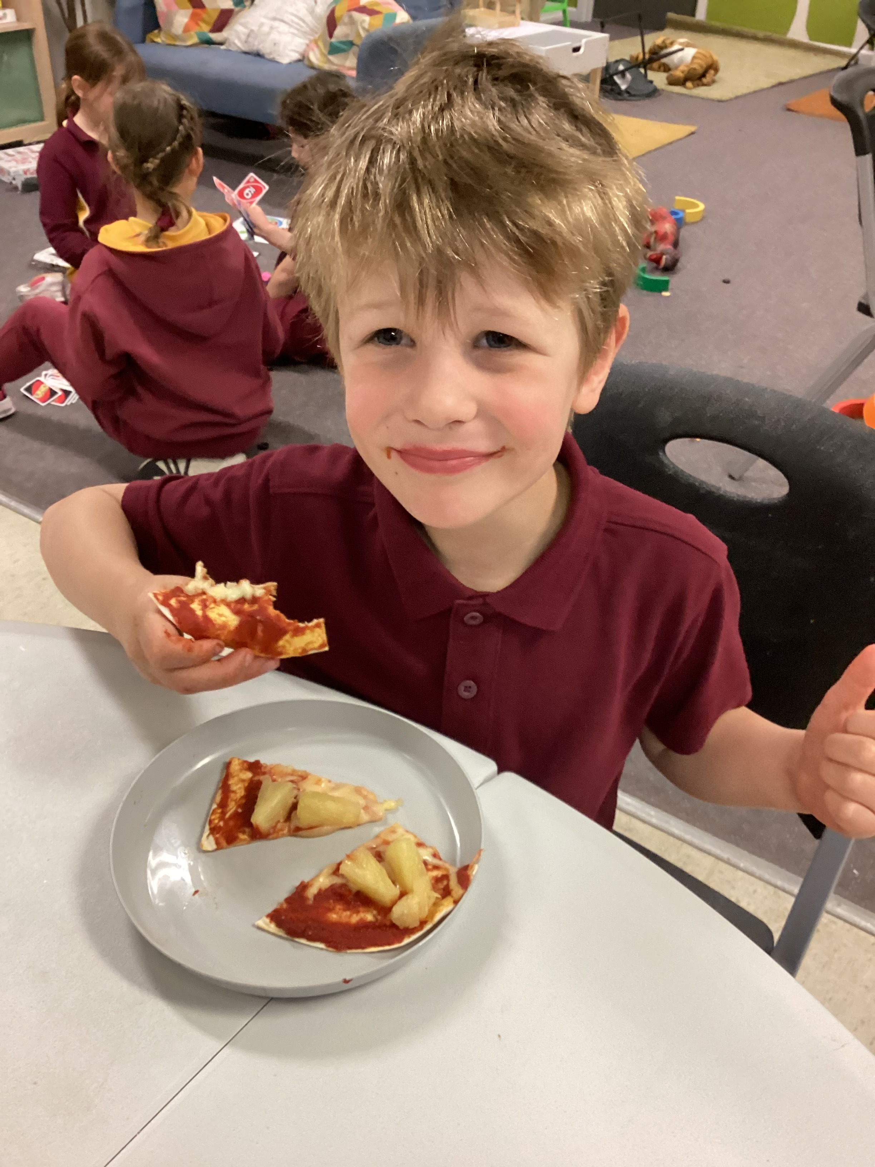
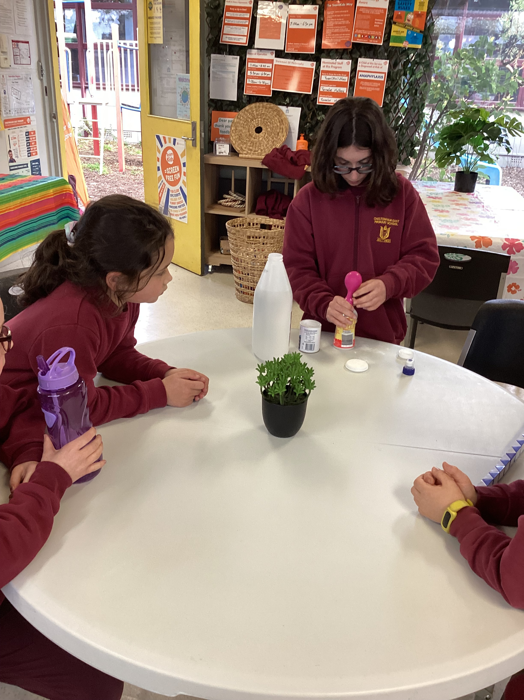
Cheltenham East Team Kids
Dear Parents and Guardians,
Get ready for an exciting month of August at TeamKids Before & After School Care! We've got a fantastic line-up of activities that will engage, inspire, and nurture our young minds. Read on to find out what's in store for our wonderful kids.
Book Week Extravaganza - Let's Dive into Stories! Next week, from 21/08 to 27/08, we're celebrating Book Week! It's a time to immerse ourselves in the magic of stories, characters, and adventures. Children are encouraged to bring their favourite book to share with us. Whether it's a well-loved classic or a new discovery, we're excited to hear about the worlds that captivate their imaginations.
Wagging Tails on Dog Appreciation Day - August 25th! Mark your calendars for August 25th - it's Dog Appreciation Day at TeamKids! We believe in nurturing love and respect for all creatures. Children are invited to send in a photo of their furry, feathered, or scaled friends to our service email address at CheltenhamEastPS@teamkids.com.au. Let's celebrate the joy that our pets bring to our lives!
Growing Young Gardeners - Let's Get Green-Thumbed! Throughout the month, we'll be diving into the world of gardening. Our young ones will have the opportunity to learn about nature, responsibility, and the magic of growth. We're thrilled to announce that we'll be building our very own mini garden right here at TeamKids!
We're thrilled to embark on this wonderful journey of reading, pet appreciation, and gardening with your amazing kids. Thank you for choosing Team Kids Before & After School Care. Together, we're nurturing young minds and cultivating a love for learning, nature, and furry friends!
Warmest regards,
Eric
7
Cooking Club
Origami Club
Game Club
Cooking Club
Origami Club
Monday 21st - Friday 25th August
Book Week
Friday 25th August
Dog Appreciation Day
Thursday 31st August
Eat Outside Day
0432 299 468
CheltenhamEastPS@teamholiday.com.au
1300 035 000
info@teamkids.com.au

