Slide 1
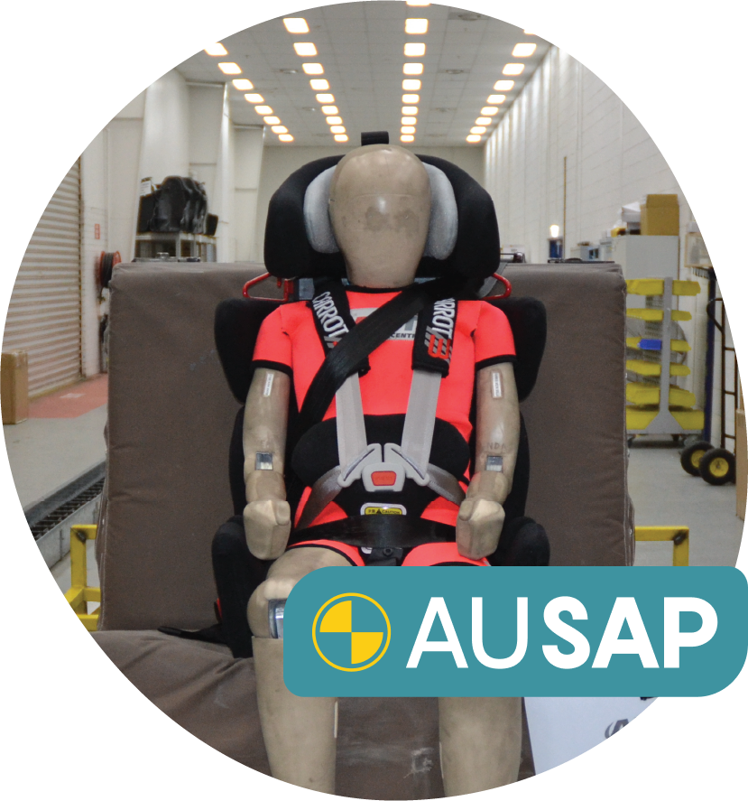
MACA is an Australian charity committed to advancing the rights of children with disabilities & medical conditions to safe & equitable transport
Vision
Every child has access to safe & equitable transport
Mission
To develop & deliver solutions for the safe & equitable transport of children with disabilities & medical conditions

Slide 2
Project: Recommendations for the development of guidance and standards for adoption and use of safety harnesses and vests
vests
September 2022 – June 2024
Notes:
EC
There is a lack of research in this area and MACA is committed to developing the evidence-base. In addition to the Australian Safety Assessment program which this presentation focuses on, we are leading a number of other research projects, which I will briefly touch on.
MACA and Curtin University’s national survey is the largest and most comprehensive survey of its kind in Australia providing the first national data about the current experiences, challenges and barriers of families, health professionals, and organisations. Approx. 500 responses were included in the analysis, and we’ll be conducting a follow up survey mid next year to evaluate the effectiveness of our work to-date. We’ll share some of the findings from the survey later in the presentation.
Our national survey revealed that the practice of modifying Australian standard child restraints – for example adding towels and padding - is common in Australia. NeuRA has a PhD student who is researching the impact of modifications to Australian standard child restraints by crash testing restraints with modifications and through survey work. Another PhD project is exploring future mobilities through the Monash University Emerging Technologies Research Lab.
MACA, together with the George Institute for Global Health, is leading an Austroads project to investigate harness and vest use in Australia and New Zealand. Harnesses are the most commonly prescribed restraint type in Australia, but we know very little about their design, construction, safety, performance and use. This project will provide recommendations for safe use and inform the selection of harnesses and vests for inclusion in AuSAP.
MACA is also working with Monash University to undertake ethnographic research.

Slide 3
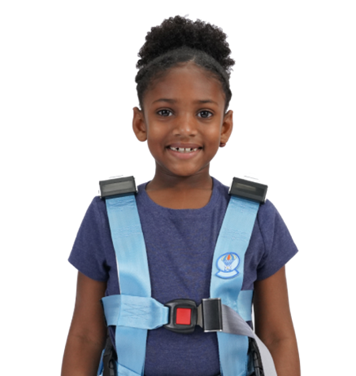
Objectives
1. Characterise current use of specialty harnesses and vests
2. Establish recommendations for safe use of specialty harnesses and vests in motor vehicles
3. Inform development of guidance and standards for the adoption and use of specialty harnesses and vests in motor vehicles

Slide 4
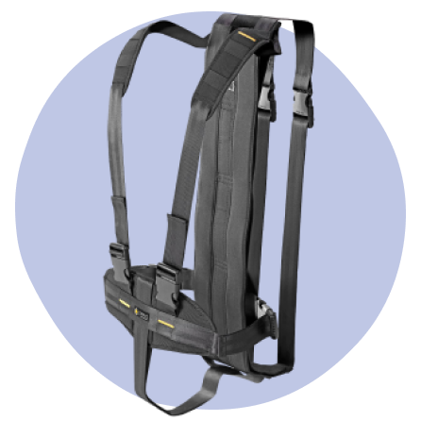
Scope
1. Online survey
Undertake a survey (Australia and New Zealand) to provide a holisitic understanding of harness/vest use and access in the community.
2. Desktop review
Desktop review of vehicle types harnesses/vests are used in and harness/vest products in Australia and New Zealand, compliance with vehicle standards, Australian/New Zealand standards, overseas standards, and road laws in Australia and New Zealand, as well as potential safety and usability issues.

Slide 5
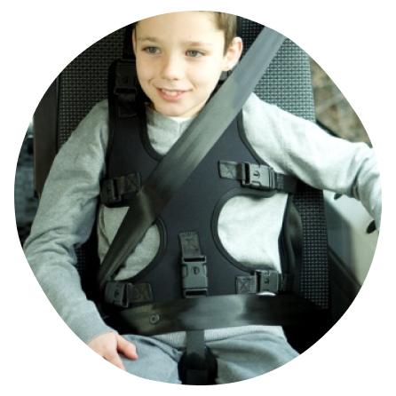
Scope
3. Expert consultation
Engagement of experts to review the range of harnesses/vests available in Australia and New Zealand and provide recommendations relating to their safe use in motor vehicles.

Slide 6
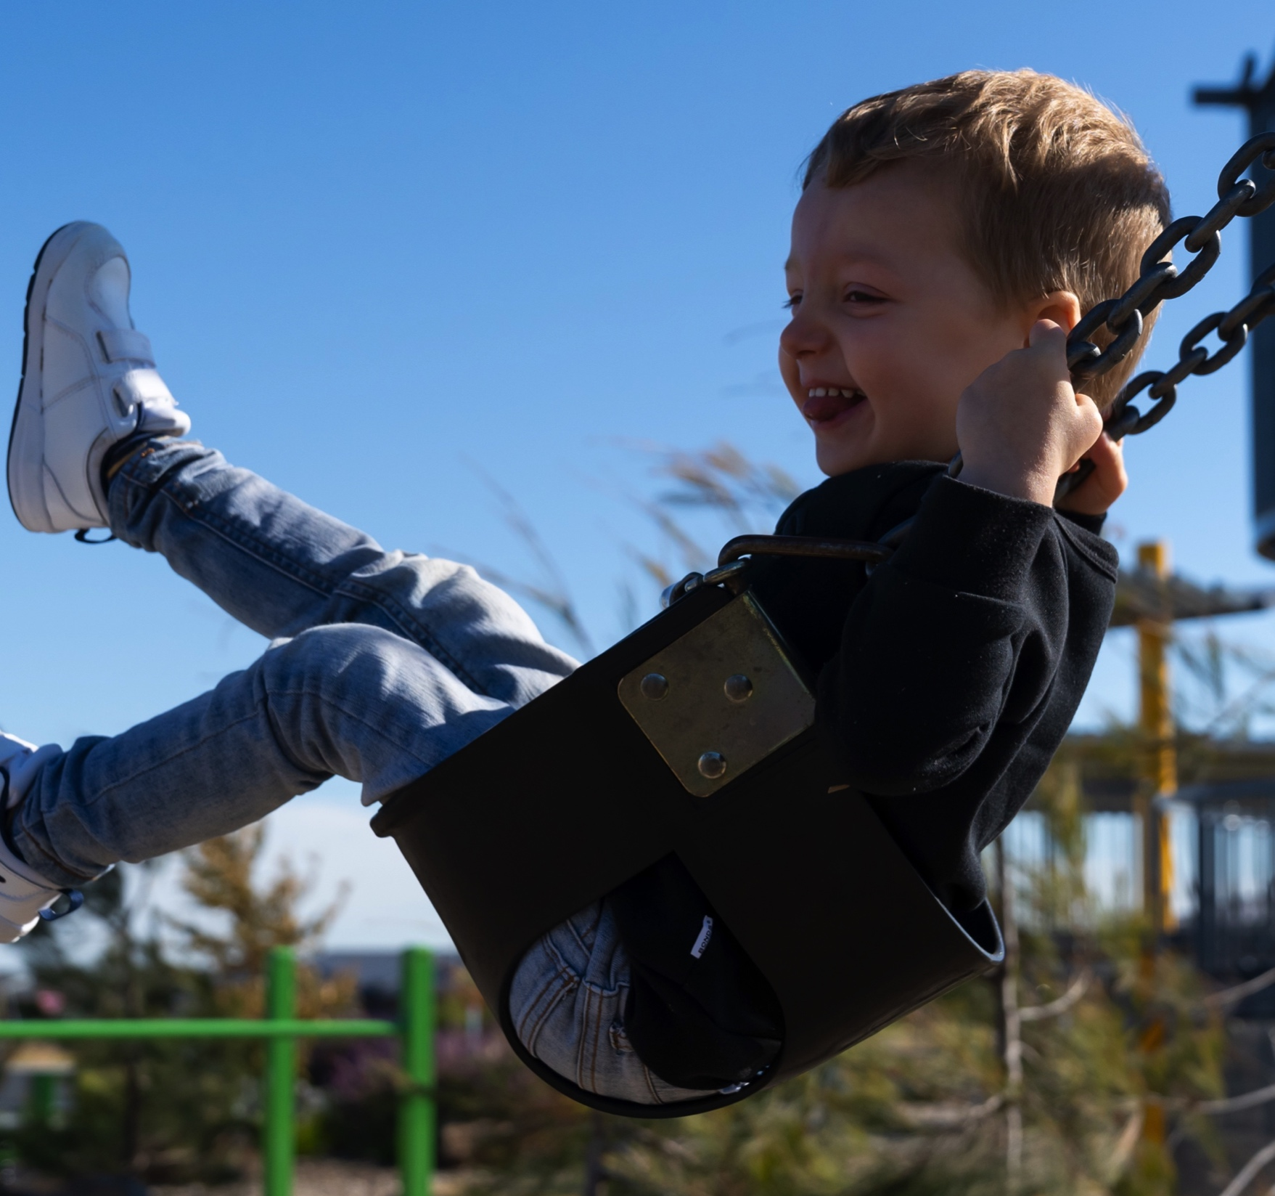
E: helen@macahub.org
Ph: +61 (03) 9134 2500
www.macahub.org

