Slide 1
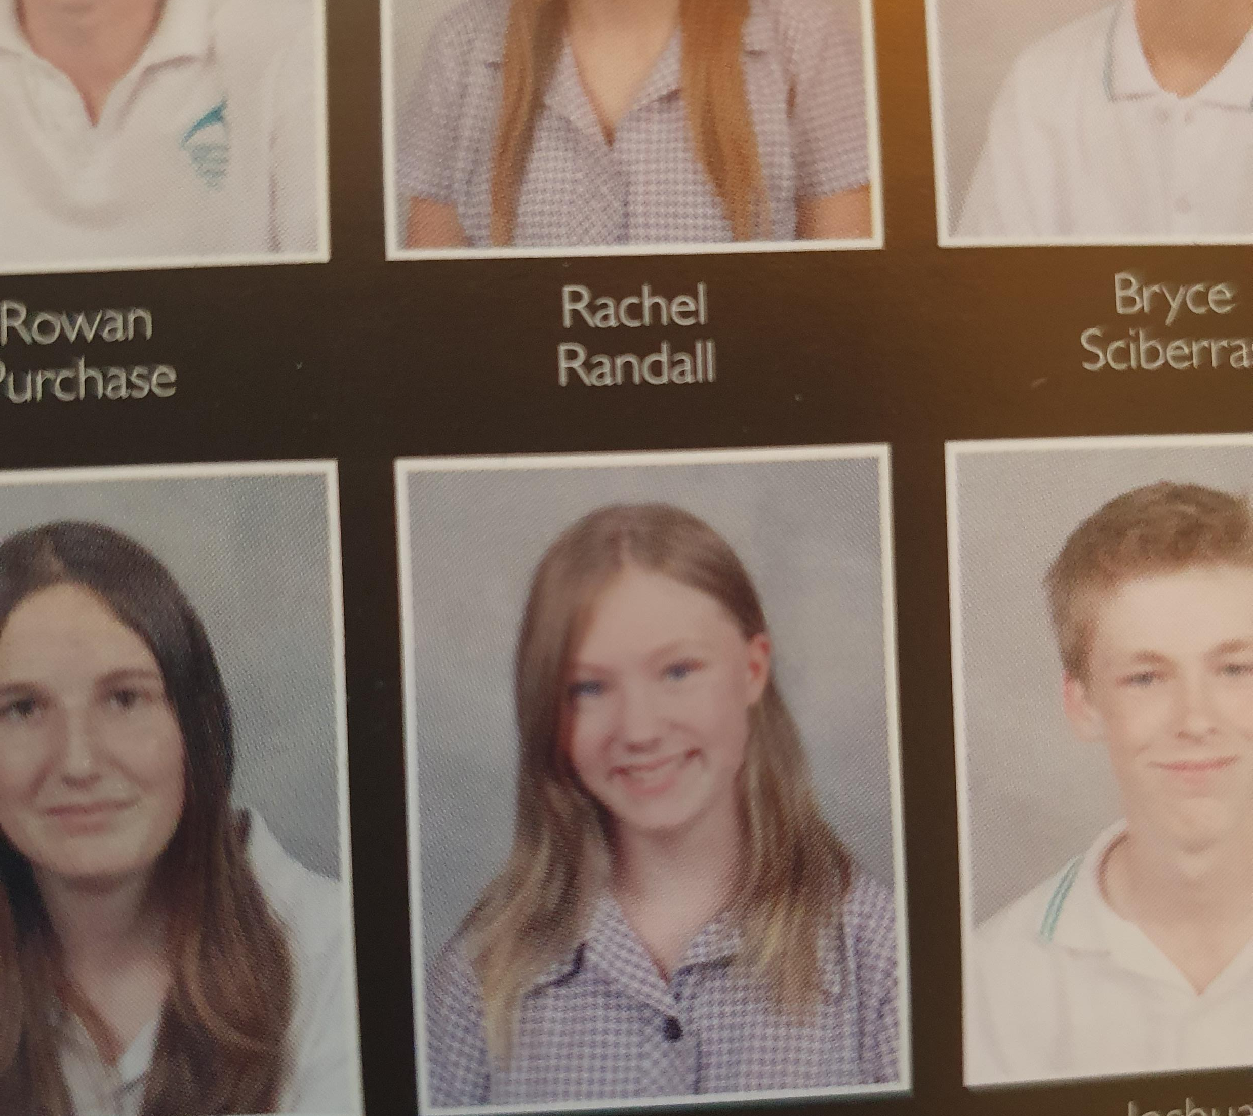
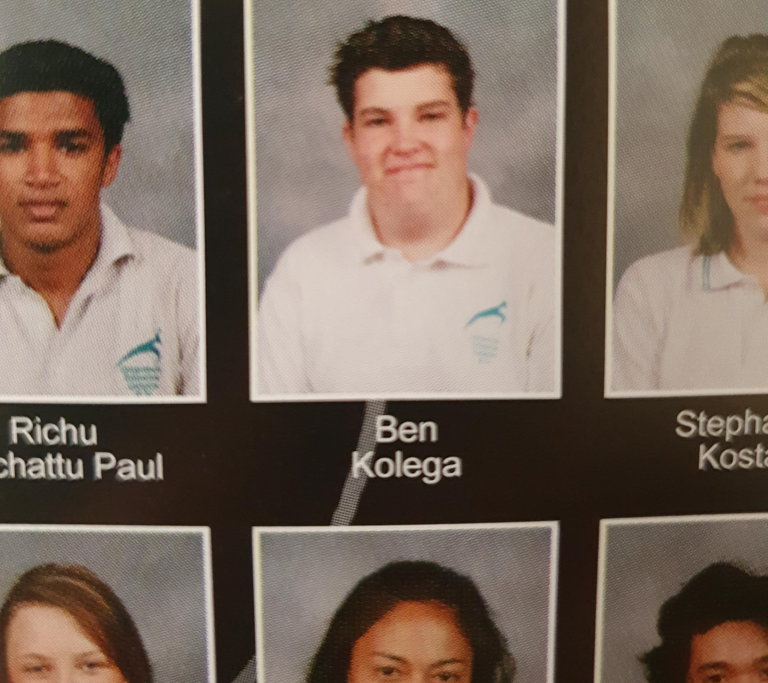
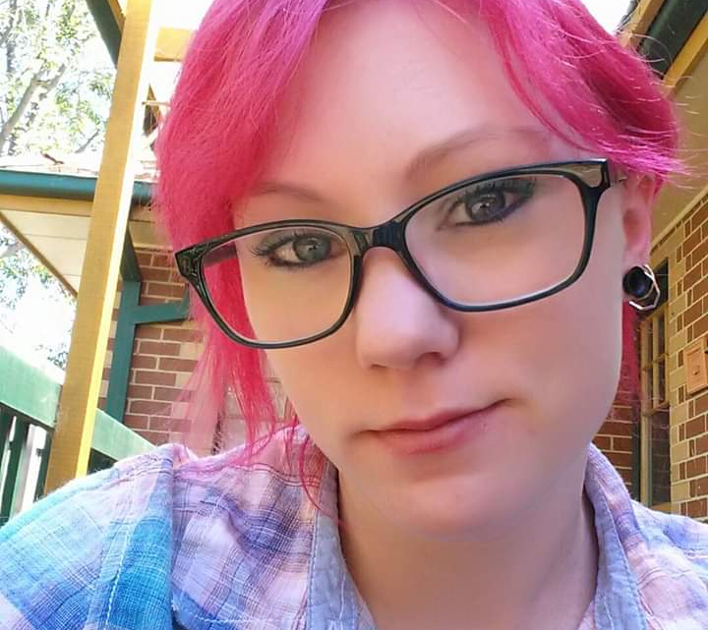
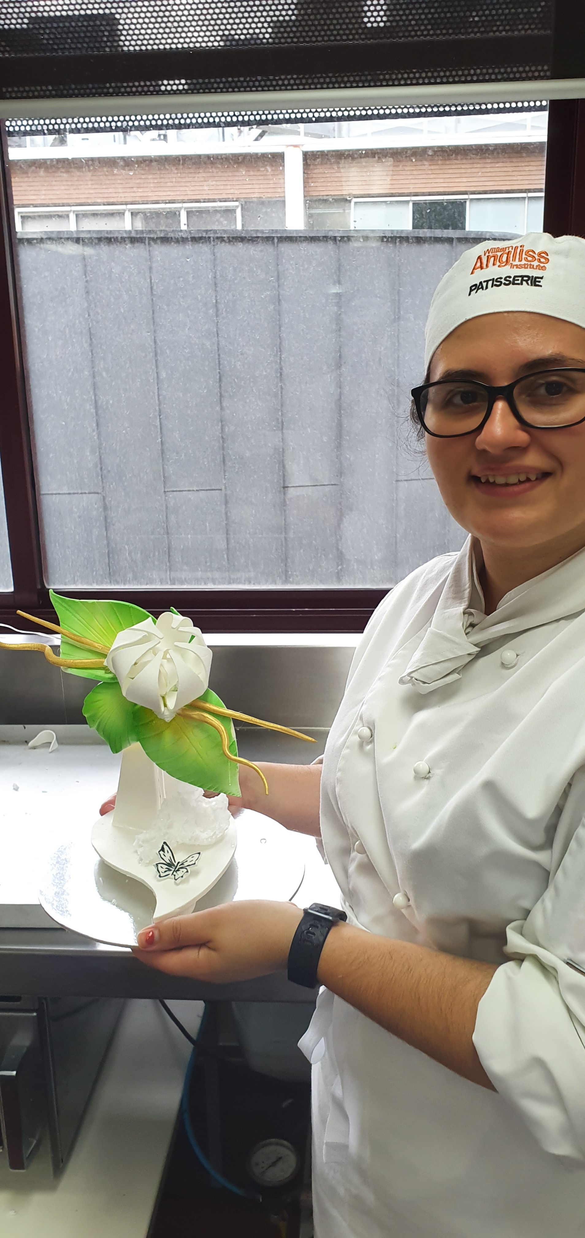
Craigieburn Secondary College Alumni Program

Slide 2
VCAL Diverse Pathways Session 12.03.20
As part of our Alumni program we invited 3 former students back to inspire our VCAL students with an in depth QandA session about their study and career pathways. And WOW, what an amazing session! Such an impressive and insightful trio!
A HUGE thank you to our wonderful alumni Anastasia Spindzos ‘12, Ben Kolega ‘08 and Kat Jeal ‘12, who returned to Craigieburn Secondary College for the VCAL Diverse Pathways Session. They each gave candid, and at times emotional, accounts of their post school journeys. Keep exploring, remain open to new opportunities, and ask more questions; just some of the gold uncovered and drawn out by the meaningful questions posed by the students. By inviting alumni back we’re offering our students relatable insight and tips from the minds of those who’ve walked their path and tread these halls before them.
I wish we could do this everyday, for every student.
Nicole Gurd, Alumni Program Coordinator
alumni@craigieburnsc.vic.edu.au

