Slide 1
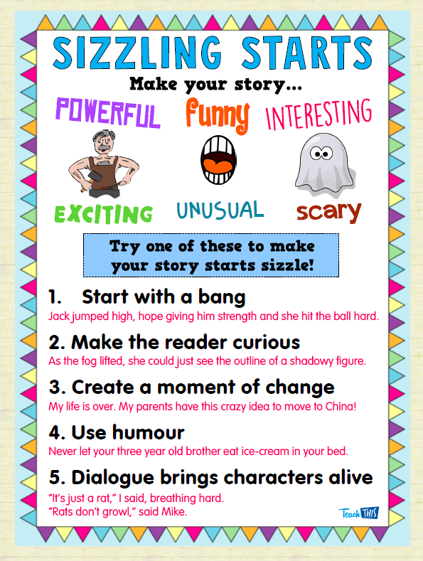


Slide 2

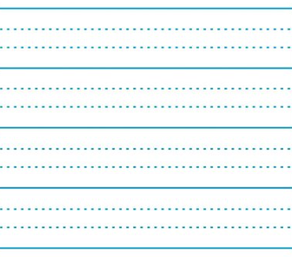
‘Wow!’ shouted the girl as she saw the rainbow-coloured cotton candy.
‘What?’ said the monster.

Slide 3

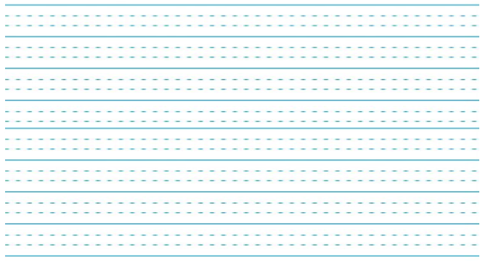
He turned on the light and suddenly an engineer smashed the switch.
As she tore the wrapping off the present she saw a puppy.

Slide 4

‘Oh no!’ I thought. ‘The train is going too fast.’
I looked in the mirror and gasped, seeing that my makeup and hair were all scribbly.

Slide 5
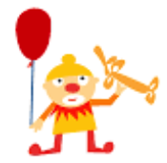
It was a stinky, farty hippo!
With my pet turtle now dressed as a ballerina we went dancing.

Slide 6

“How could you ruin my dress with spray paint?”
“But I didn’t. It was my friend.”
“The shark is in our flooded house!”

