Slide 1
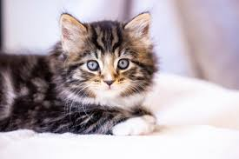
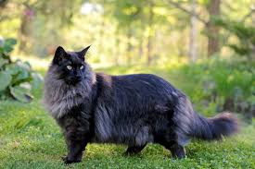
Cats
By Abbie

Slide 2
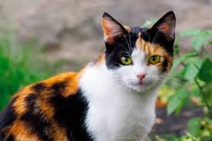
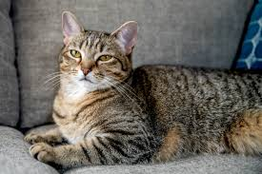
Introduction
I choose a cat because a cat is my favourite animal and a cat is a mammal and cats have soft fur a short snout and retractable claws cats can be your pet if you want a cat and cats use there claws to hunt mise

Slide 3
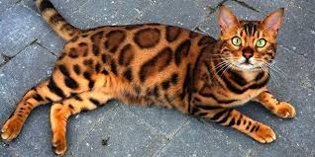
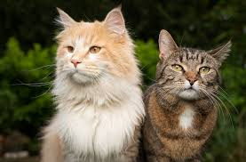
A cats appearance
A cats appearance can look many different ways because its fur colour, patterns and hair length make different cats look difference

Slide 4
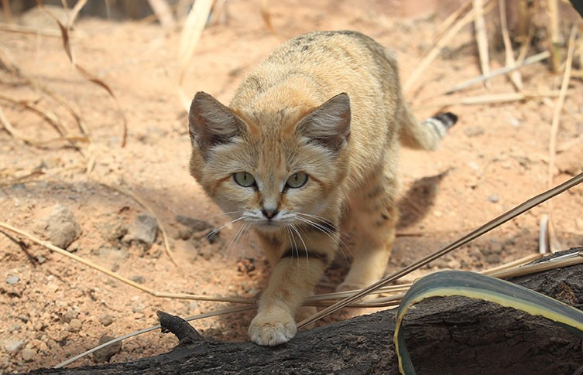
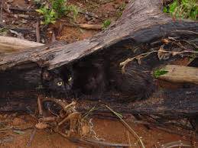
A cats habitat
A cats habitat is a human house hold to wild and there habitat is also a arid dessert

Slide 5
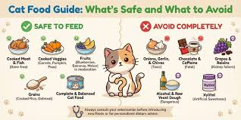
A cats diet
Wet food for cats is highly recommended for proper hydration witch prevents kidney issues and protein for cats are chicken or fish also helping muscle miniatous chicken fat and fish oils provide energy.

Slide 6
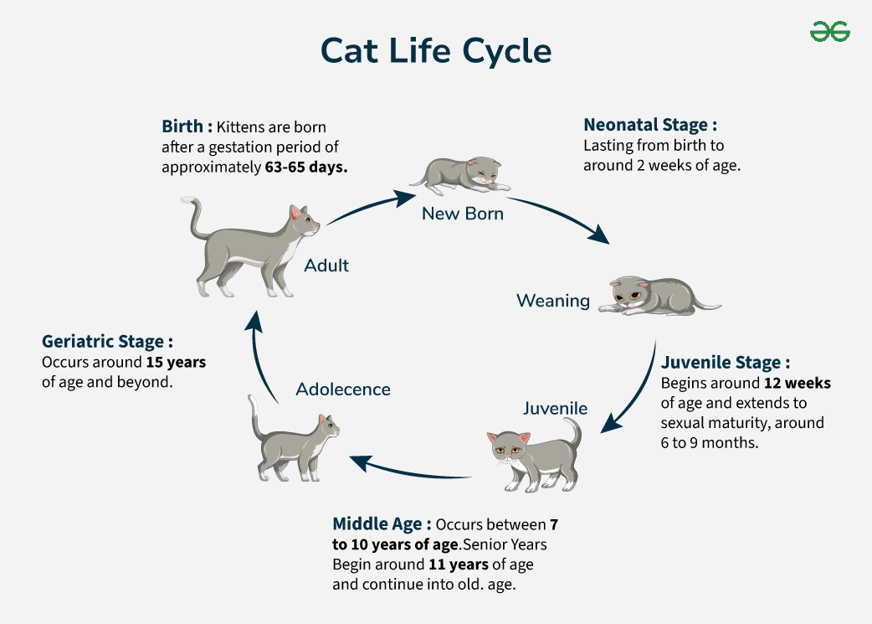
Life cycle
The first stage of a life cycle for a cat is a kitten from birth up to one year old next stage is a young adult from one year old to six years old and the third stage is a mature adult from seven to ten years old and the last stage is a senior witch is over ten years old

Slide 7
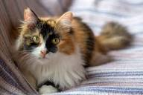


different breeds of cats
Calico cat
Main coon and this is a calico cat
Ragdoll
Birman
Persian cat
British shorthair
Siamese cat and this is a American curl
American shorthair this is a American bobtail
Abyssinian
Sphynx cat
Scottish fold
American curl
American bobtail
Bombay cat
Siberian cat

Slide 8
Interesting facts about cats
Cats can rotate their ears 180 degrees hear ultrasonic sounds and posses a third eyelid to protect there eyes when hunting
Cats collar bones don’t connect to their other bones.
People least desire black cats and black and white cats.
Cats rub there sides on you to mark you with their scent signalling ownership and social bonding.
Cats hate to walk on sticky surfaces and metal, plastic, wood, leather or fabric surfaces
And the deadliest things for cats are lilies
Cats are toxic to the smell of tea tree, peppermint, cinnamon and lavender

