Slide 1
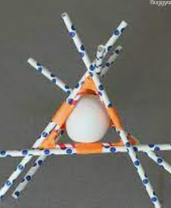
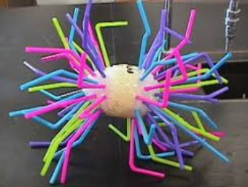
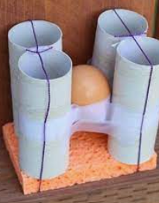
Egg drop challenge
By Sophie and Tiahana

Slide 2
Goal:
To create armour to protect the egg when it is dropped from a height

Slide 3
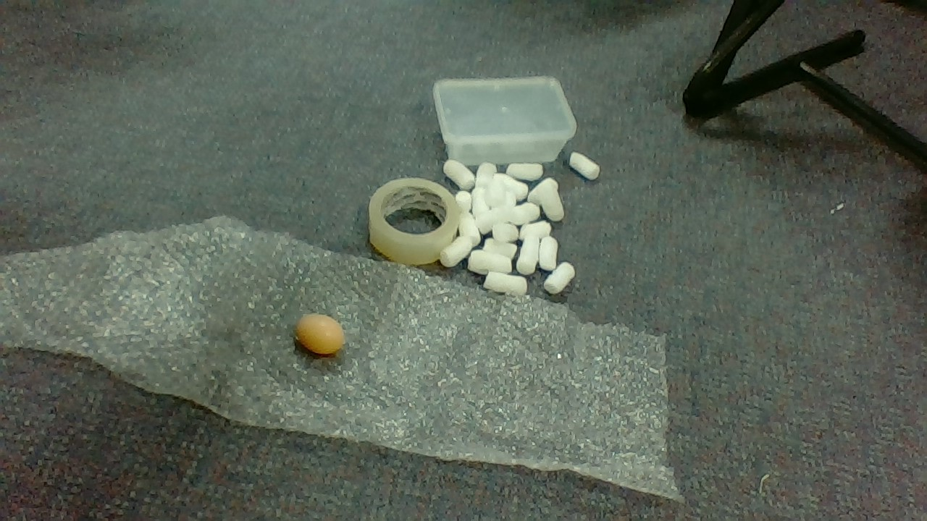
Materials:
Bubble wrap
Cotton wool balls
Packing Peanuts
2x Plastic containers
Sticky Tape

Slide 4
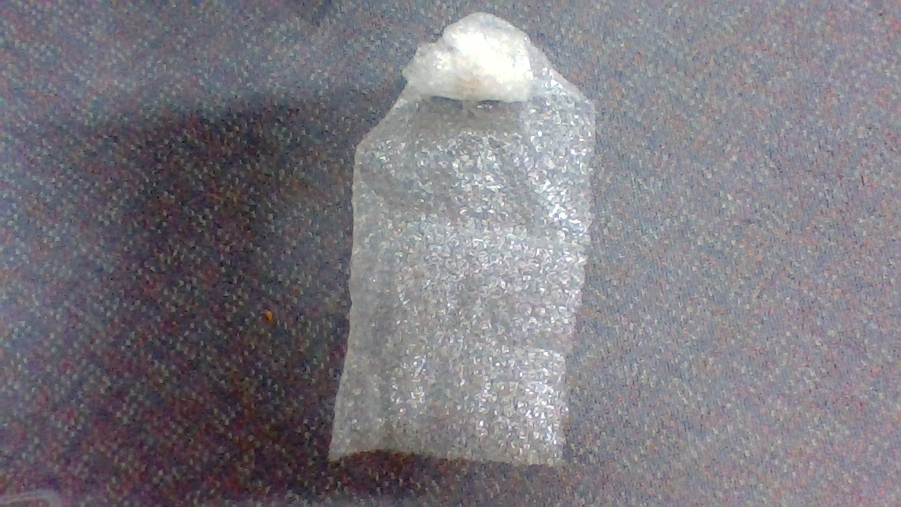
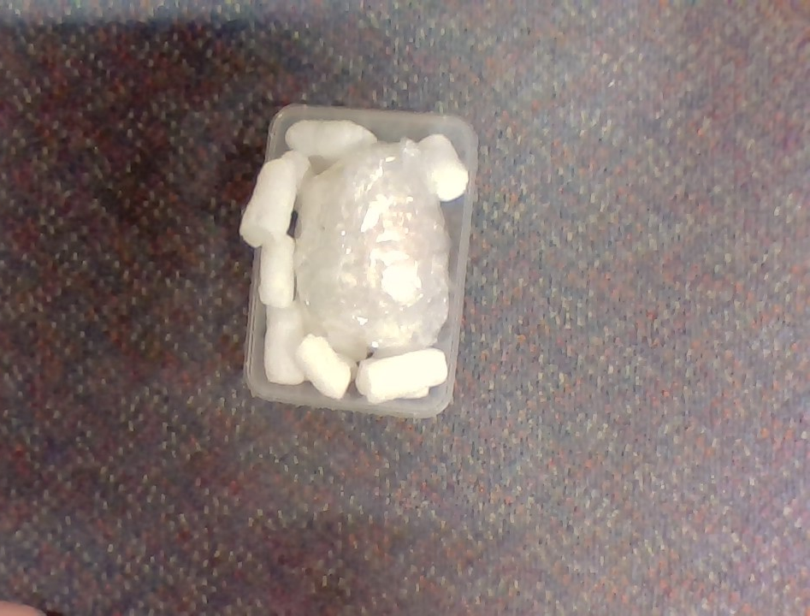
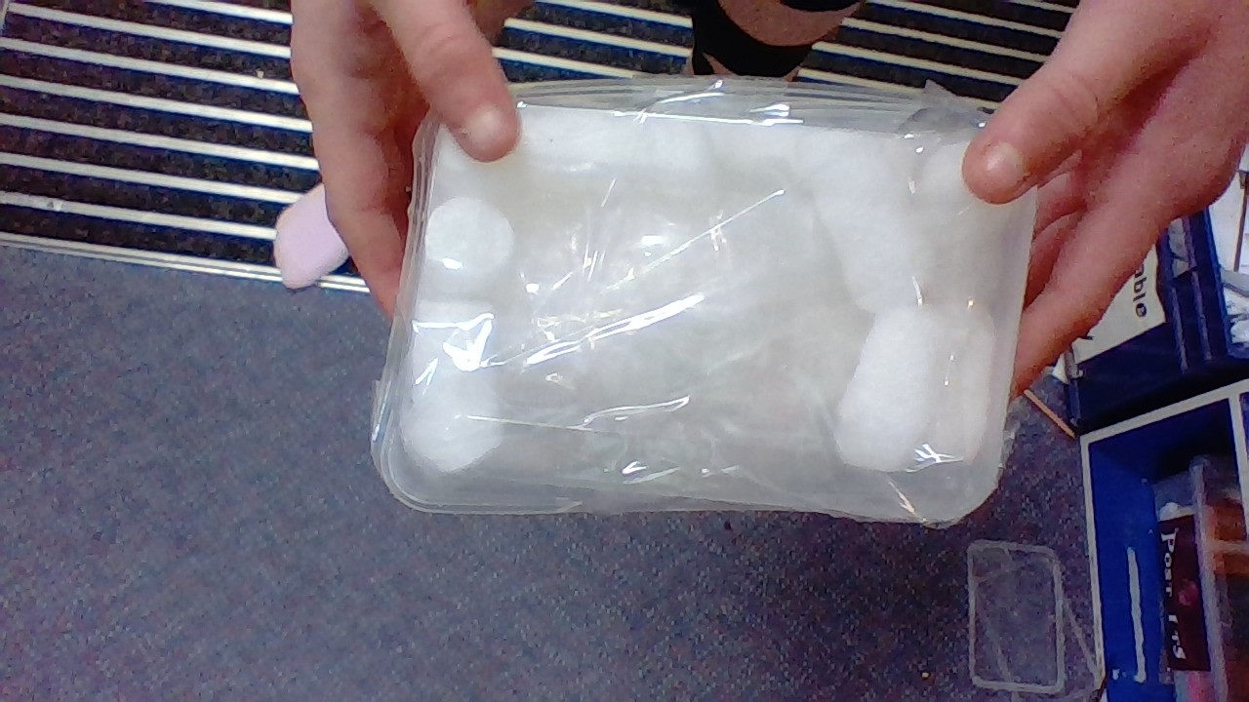
Steps:
Step 1- Wrap the egg in bubble wrap.
Step 2- Once wrapped secure with tape.
Step 3- Place packing peanuts and cotton wool balls in container.
Step 4- Place the egg in the 2 containers.
Step 5- Put both of the containers on top of each other and tape together.

Slide 5
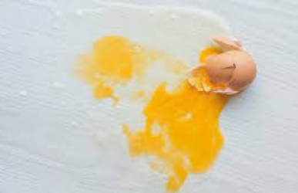
Conclusion:
Our egg drop structure worked very well and the egg survived. Lots of other structures work as well.

