Slide 1

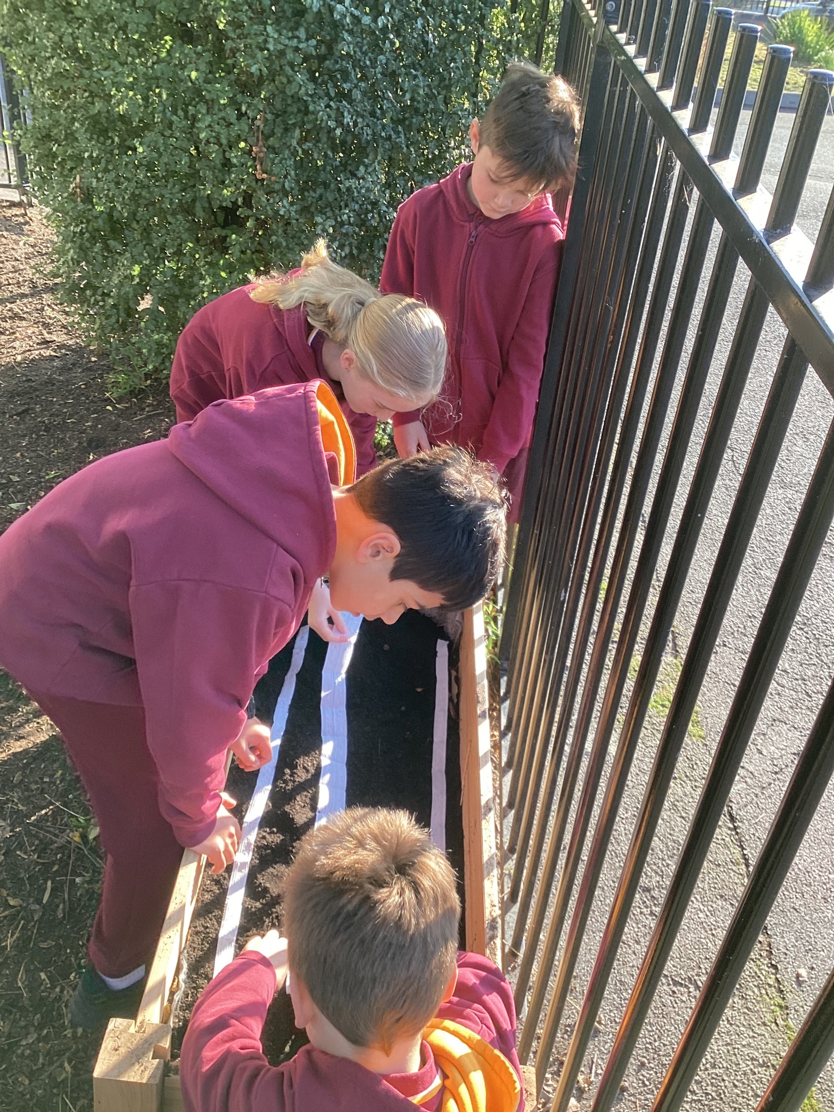


Cheltenham East Team Kids
Dear Families,
We hope this newsletter finds you well and excited for the upcoming month of September. Your feedback on our service menu has been invaluable, and we are thrilled to incorporate your suggestions into our plans. As we transition into the beautiful season of Spring, we have an array of engaging activities lined up for the children.
🍽️ Eat Outside Day - August 31st 🍽️ Join us on Wednesday, August 31st, for our delightful "Eat Outside Day." We're taking advantage of the pleasant weather and inviting the children to enjoy their snacks and meals in the fresh air. It's a wonderful opportunity for them to connect with nature while relishing their food.
🌸 Welcoming Spring - September 1st 🌸 On Thursday, September 1st, we're celebrating the first day of Spring with an exciting school walk! The children will have the chance to witness the changes that this season brings to our surroundings. But that's not all – we keep running the "Little Photographer" activity.
🎨 Crafts and free coffee for Dads - September 1st 🎨 Father's Day is around the corner, and we've prepared a heart-warming celebration for our kids and their beloved dads! On Friday, September 1st, we're hosting a special day filled with hand and art craft activities. It's a time for ki ds to express their love and appreciation while engaging in fun and creative project. ☕Dads dropping off their kids will have the chance to enjoy a freshly brewed cup of coffee from our coffee van, which will be located on the asphalt where school holds assembly every week.
*Don’t miss out on the Lunch Time Legends event! From 11:00 to 11:30 on the oval, children will dance to a up-lifting disco, unite under the giant parachute, and engaging in a thrilling game of tag called Fruit Salad. Come on and join us!
As always, feel free to reach out if you have any questions or suggestions. We're here to make your child's time at Team Kids memorable and enriching.
Warm regards,
Eric
Director of Team Kid Before and After School Care
8
Cooking Club
Origami Club
Game Club
Cooking Club
Origami Club
Thursday 31st August
Eat Outside Day
Friday 1st September
First Day of Spring
Monday–Friday 4th–8th September
Flower Power Spring Dance Party
0432 299 468
CheltenhamEastPS@teamholiday.com.au
1300 035 000
info@teamkids.com.au

